Slide 1
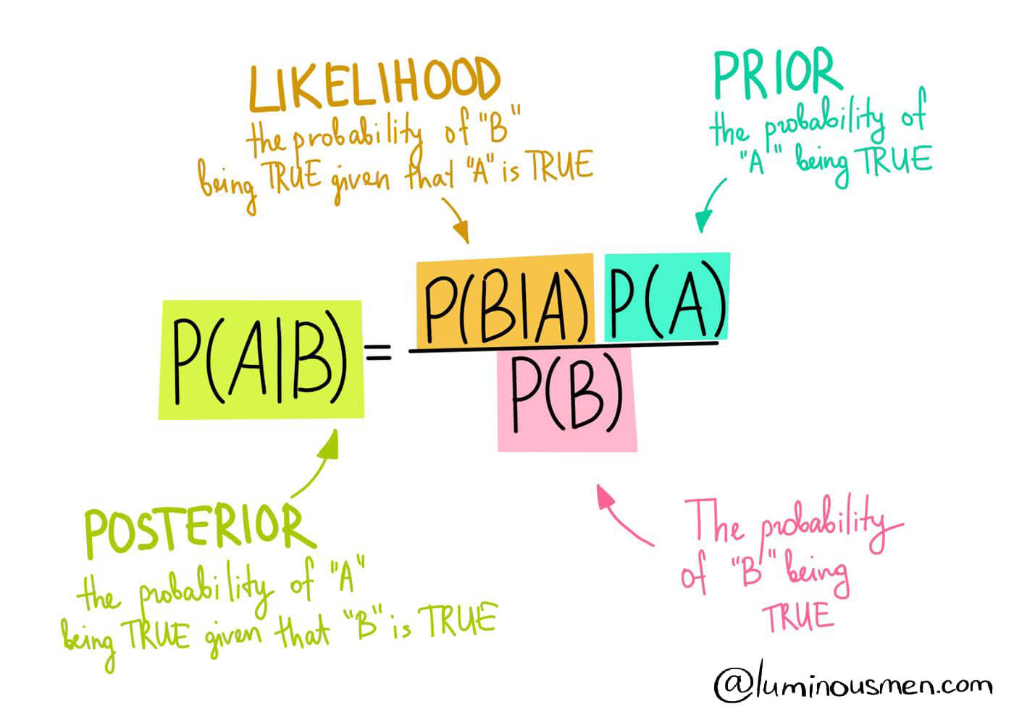
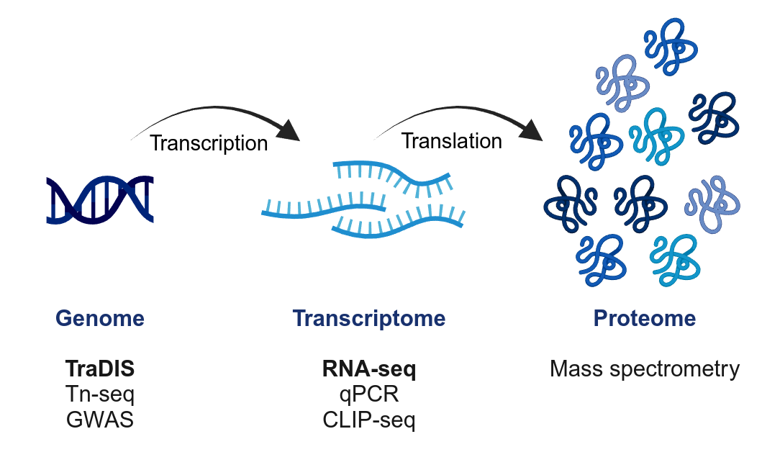
Advancing functional genomics analysis with Bayesian modeling
Case studies in RNA decay and pathogen invasion models
Laura Jenniches, PhD, Barquist Lab
June 12, 2024

Slide 2
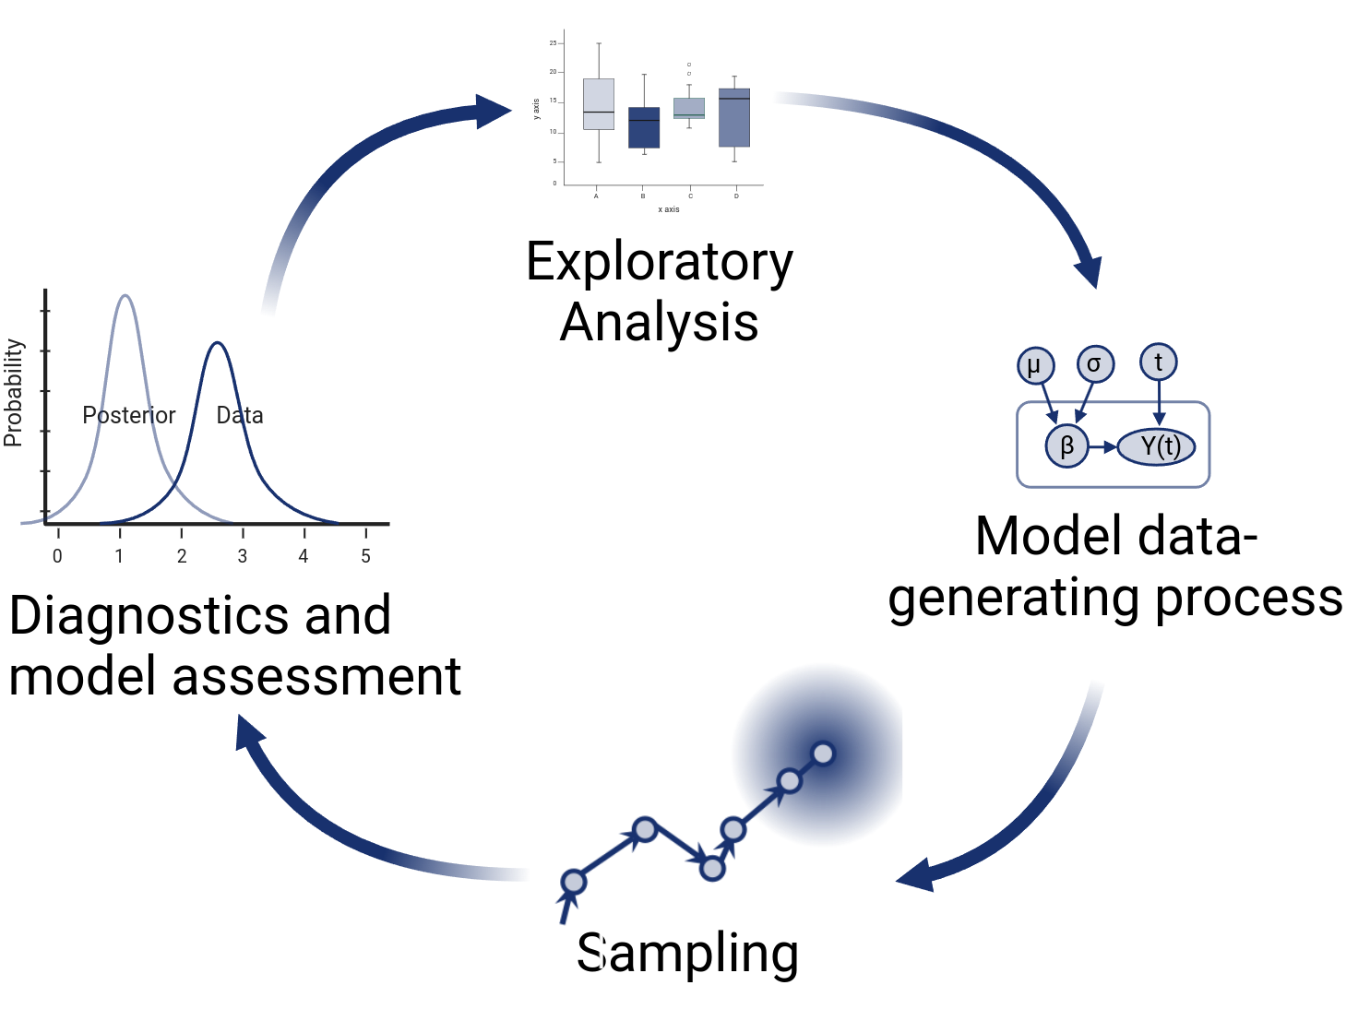
Advancing functional genomics analysis with Bayesian modeling
Functional genomics
Contribution of genes to cellular processes.
Advances in high-throughput sequencing have resulted in complicated experimental setups.
Bayesian modeling
Flexible parametric modeling of data-generating process.
Priors: encode prior knowledge, restrict parameter space, facilitate convergence during sampling.
Elegant alternative to inflexible custom workflows.

Slide 3
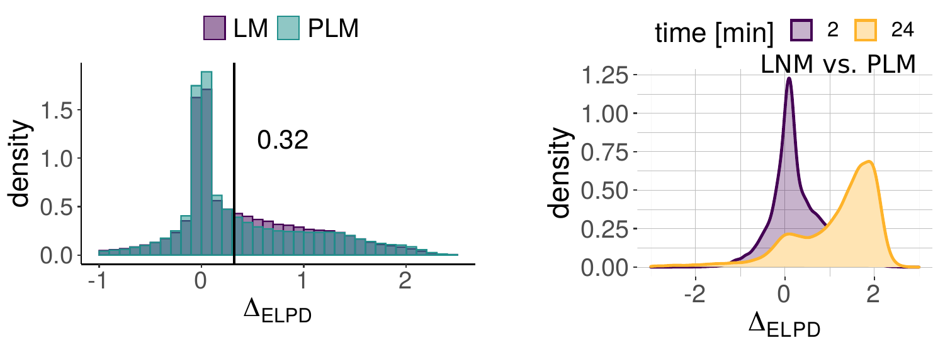
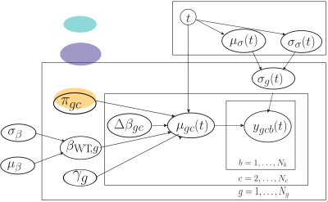
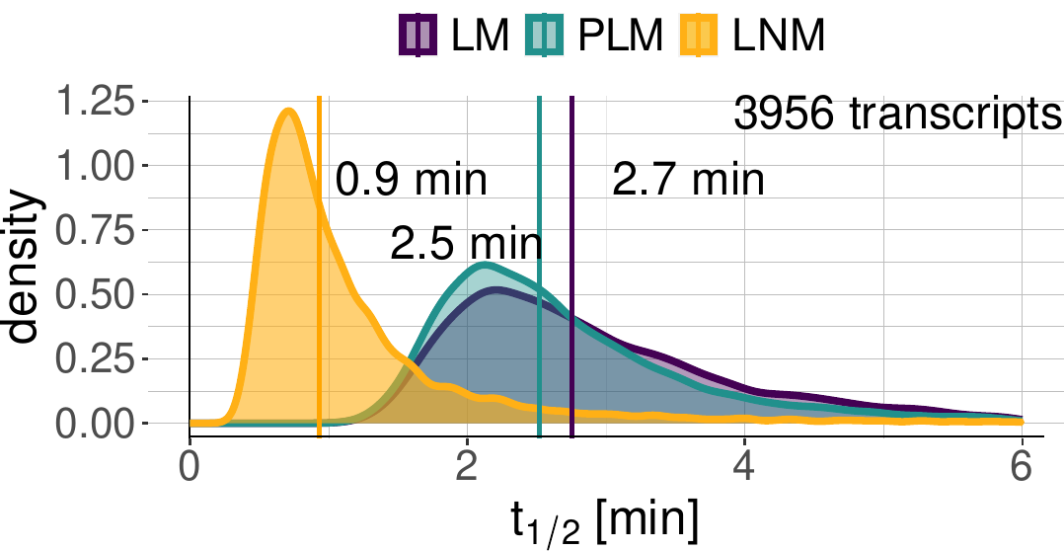
Bayesian modeling suggests that mRNA half-lives have been largely overestimated in bacteria
Model assessment: Use leave-one-out cross validation to select best model
Exploratory analysis: Non-linear confounding factors
Model data-generating process: Plate diagram
Visualization: Standard analysis with linear models overestimates mRNA half-life by a factor of 3!

Slide 4
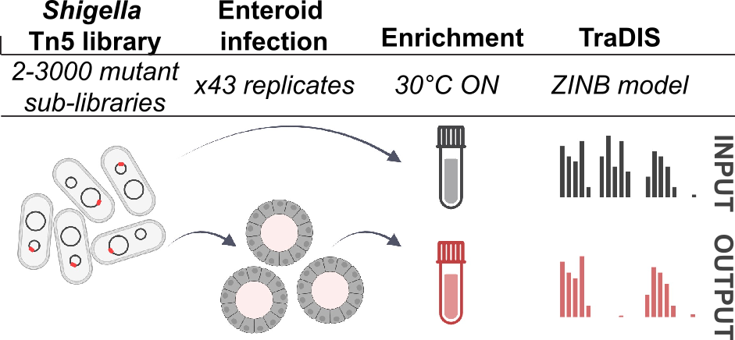
Bayesian modeling suggests that mRNA half-lives have been largely overestimated in bacteria
Model assessment: Use leave-one-out cross validation to select best model
2nd case study: large-scale organoid infection assays for human-restricted pathogens. Poster!
Model data-generating process: Plate diagram
Exploratory analysis: Non-linear confounding factors
Model data-generating process: Plate diagram
Exploratory analysis: Non-linear confounding factors
Visualization: Standard analysis with linear models overestimates mRNA half-life by a factor of 3!

