Slide 1
Masks, Signs and
Learning Rate Rewinding
Advait Gadhikar and Rebekka Burkholz
ICLR 2023
European Research Council (ERC) under the Horizon Europe Framework Programme (HORIZON) for proposal number 101116395 SPARSE-ML

Slide 2
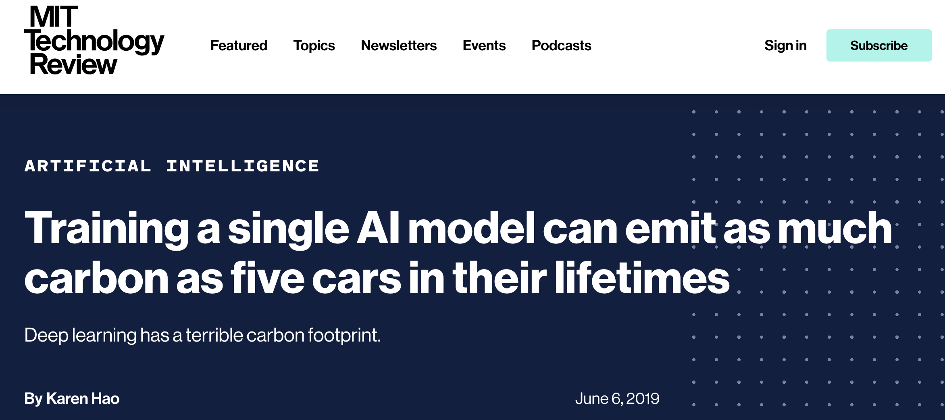
Deep learning is overparametrized
Models are heavily overparametrized with billions of parameters.
175 billion parameters in ChatGPT!!!
Training GPT3 costs 1-5 Million USD!³
Image source (left): https://vega.github.io/editor/#/
Image source (right):https://www.technologyreview.com/2019/06/06/239031
https://www.mosaicml.com/blog/gpt-3-quality-for-500k
Notes:
Deep Learning is heavily overparametrized and has achieved huge success because of that.
However, this is at the cost of computational resources that are exorbitant and have a significant impact on the environment.
Moreover, this means huge expenses to run experiments, which prevents small labs and research groups to solve problems in this area.
Running deep learning models on Mobile Phones for example, also needs small memory efficient models.
We need sparse structures simply to democratise deep learning, make it more accessible to everyone.

Slide 3
Pruning a deep neural network
Networks are heavily overparametrized, which aids generalisation, but is computationally expensive.
Pruning removes parameters in the network (ideally) without compromising performance.
Makes the network efficient as fewer parameters need to be retained.
Can give an insight into the learnt representation by identifying the most influential parameters.

Slide 4
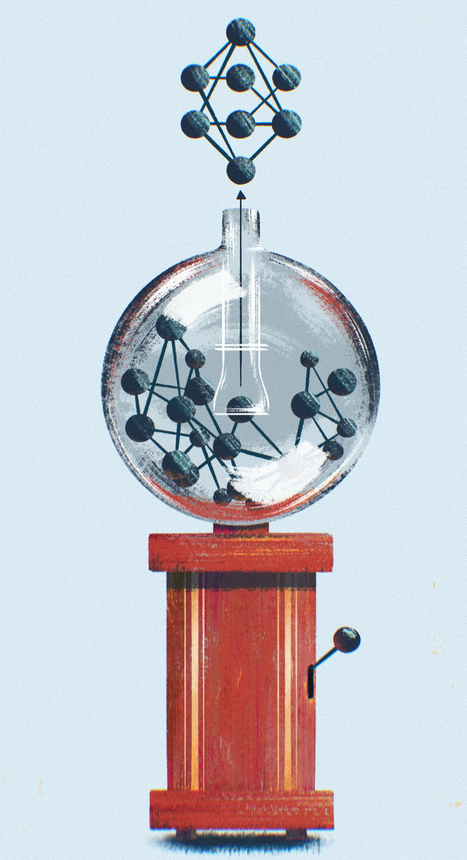
Sparse training is hard
Training a sparse network from scratch is a challenge!
SGD converges slowly.
Standard initialisations are problematic.
The Lottery Ticket Hypothesis provides provides an answer!
But finding one is expensive :(
© Valentina Galata
Kuznedelev, D., Kurtic, E., Iofinova, E., Frantar, E., Peste, A., & Alistarh, D. (2023). Accurate Neural Network Pruning Requires Rethinking Sparse Optimization. arXiv preprint arXiv:2308.02060.
Frankle, J., & Carbin, M. The Lottery Ticket Hypothesis: Finding Sparse, Trainable Neural Networks. In International Conference on Learning Representations.

Slide 5
Lottery Ticket Hypothesis
A dense network contains a sparse network which can be isolated and trained from scratch (with the same weights) to achieve the same performance (or better) as the dense network i.e. the lottery ticket.
2
Frankle, J., & Carbin, M. The Lottery Ticket Hypothesis: Finding Sparse, Trainable Neural Networks. In International Conference on Learning Representations.
Image Source: https://www.istockphoto.com/de/vektor/gl%C3%BCcksrad-objekt-isoliert-auf-wei%C3%9Fem-hintergrund-gm1458863614-493362869
Notes:
Exciting progress in this direction has happened recently.
With the Lottery Ticket Hypothesis. (Won best paper at ICLR in 2019)
LTH-define:
Finding this subnetwork has given us hope that we would be able to train this sparse subnetwork instead, very efficiently, to solve the learning task.
But finding this subnetwork is computationally expensive, needs multiple prune train iterations with IMP
Is there a simpler way?

Slide 6
Finding a lottery ticket
Iterative Magnitude Pruning (IMP)¹ finds a Lottery Ticket.
2
Sparse Trainable Subnetwork
Frankle, J., & Carbin, M. The Lottery Ticket Hypothesis: Finding Sparse, Trainable Neural Networks. In International Conference on Learning Representations.
Image Source: https://www.istockphoto.com/de/vektor/gl%C3%BCcksrad-objekt-isoliert-auf-wei%C3%9Fem-hintergrund-gm1458863614-493362869
Notes:
IMP however starts from a dense network and needs to go through multiple prune train iterations to obtain the sparse subnetwork, which can prove to be more expensive than training a dense network from scratch.

Slide 7
Rewinding methods
Iterative Magnitude Pruning:
Train, Prune, Weight Rewind repeat
How to find a sparse network?
Identify structure.
Initialize weights.
Sparse
Initialization
Learning Rate Rewinding:
Train, Prune, LR Rewind repeat
IMP finds a sparse network.
But LRR performs better!
What can we learn from LRR?
Finetuned
Weights
Frankle, J., & Carbin, M. The Lottery Ticket Hypothesis: Finding Sparse, Trainable Neural Networks. In International Conference on Learning Representations.
2. Renda, A., Frankle, J., and Carbin, M. Comparing Rewinding and Fine-tuning in Neural Network Pruning. In International Conference on Learning Representations.
Notes:
IMP however starts from a dense network and needs to go through multiple prune train iterations to obtain the sparse subnetwork, which can prove to be more expensive than training a dense network from scratch.

Slide 8
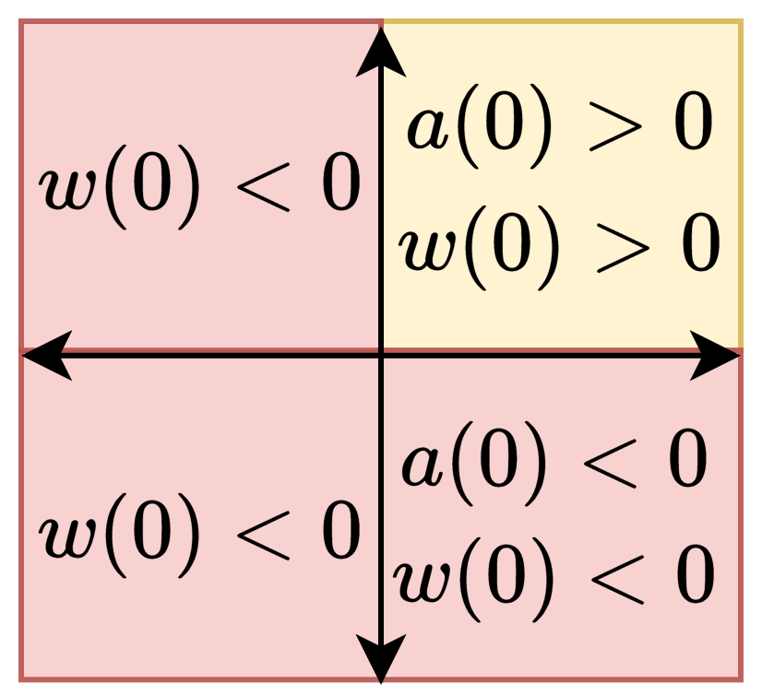
Its all about the sign
For a single hidden neuron network
Target function
Single Neuron Model
Training Data
The target values $a=1,w_{1}=1$ can only be learnt by SGD if
$a(0)>0$ and $w_{1}(0)>0$.
If $a(0)<0$ or $w_{1}(0)<0$, the target cannot be learnt under gradient flow.
SGD cannot flip the initial sign during training.
Notes:
IMP however starts from a dense network and needs to go through multiple prune train iterations to obtain the sparse subnetwork, which can prove to be more expensive than training a dense network from scratch.

Slide 9
Rewinding can fail due to bad signs
Once target mask is identified
If $a(0)<0$ or $w_{1}(0)<0$, training fails
IMP cannot find target at the last pruning level.
IMP will only succeed if initial signs are positive.
But LRR can leverage earlier pruning levels to switch initial sign for last pruning level.
IMP Success
LRR Success
IMP fails due to rewinding
LRR can correct initial signs
Notes:
IMP however starts from a dense network and needs to go through multiple prune train iterations to obtain the sparse subnetwork, which can prove to be more expensive than training a dense network from scratch.

Slide 10
Signs in practice
LRR quickly changes signs to find a better mask.
Notes:
IMP however starts from a dense network and needs to go through multiple prune train iterations to obtain the sparse subnetwork, which can prove to be more expensive than training a dense network from scratch.

Slide 11
Signs in practice
LRR finds better solutions within a fixed mask by quick sign alignment.
Notes:
IMP however starts from a dense network and needs to go through multiple prune train iterations to obtain the sparse subnetwork, which can prove to be more expensive than training a dense network from scratch.

Slide 12
Signs in practice
LRR is robust to sign perturbations.
Notes:
IMP however starts from a dense network and needs to go through multiple prune train iterations to obtain the sparse subnetwork, which can prove to be more expensive than training a dense network from scratch.

Slide 13
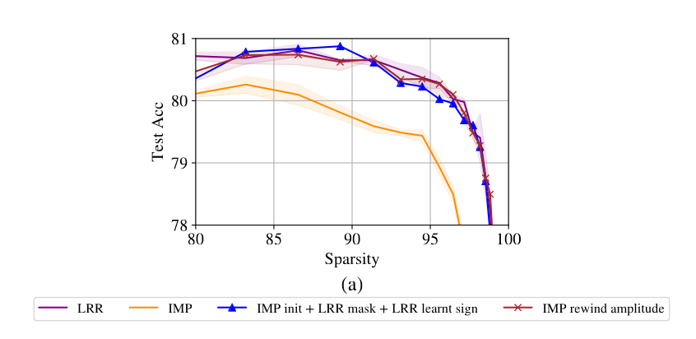
Signs influence large scale training
Learning suitable signs can bridge the gap between LRR and IMP.
ResNet50 on ImageNet
Notes:
IMP however starts from a dense network and needs to go through multiple prune train iterations to obtain the sparse subnetwork, which can prove to be more expensive than training a dense network from scratch.

Slide 14
Conclusion
LRR finds a better sparse mask and improves parameter optimization.
LRR quickly aligns initial signs to find better sparse masks at lower sparsities.
LRR improves optimisation within fixed masks.
LRR is robust to sign perturbations
Key Takeaway:
Sparse training methods must align signs early in training.

Slide 15
Random pruning is unreasonably effective
Randomly pruned networks can even outperform state of the art pruning algorithm¹.
Computationally cheap
Does not require multiple prune - train iterations
2
Liu, S., Chen, T., Chen, X., Shen, L., Mocanu, D. C., Wang, Z., & Pechenizkiy, M. The Unreasonable Effectiveness of Random Pruning: Return of the Most Naive Baseline for Sparse Training. In International Conference on Learning Representations.
Image Source: https://www.freepik.com/free-photos-vectors/slot-machine-cartoon
Notes:
Random pruning provides a simple and inexpensive method to obtain a sparse subnetwork, and recently has been shown to be empirically successful.
To shed light on the success of random pruning, our work provides an insight into the conditions under which they can succeed and identify their limitations.
In order to do so, we model a randomly pruned network as an Erdos Renyi graph, assuming that each weight in the network is nonzero with a success probability p.
And the sparsity of the network is then 1 - p.
We can such a network an ER network.

Slide 16
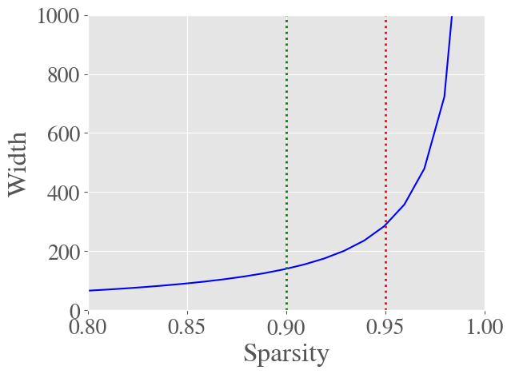
Random pruning fails at high sparsity
Required overparametrization of source ER network drastically increases as sparsity increases $1/log(1/(1-p_{l}))∼1/p_{l}$.
Explains the drop in performance of randomly pruned networks at high sparsities.
Overparametrization factor is necessary.
The figure shows the required width for an ER network to represent a single layer target network of width 128 with a confidence of 0.999.
Notes:
However, our construction requires that the source network has to be wider and contain one more layer than the target.
This width overparametrizaton factor scales with sparsity and the required width increases drastically beyond 0.9.
These insights help to explain experimental results that show random networks do not perform well at higher sparsities.
However, there is no getting around this, as we show that this overparametrization factor is actually necessary to represent arbitrary target networks by proving a lower bound.

Slide 17
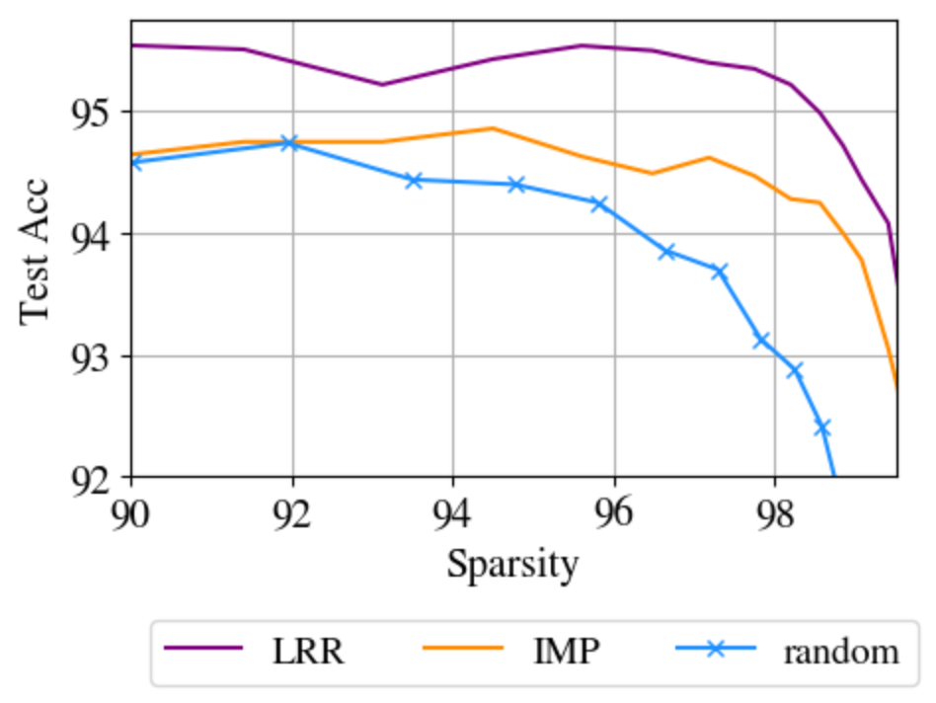
Random gradual pruning is better?
Remove few elements in each step.
Train to convergence at every step.
Can a random mask compete with IMP / LRR (baselines)?
Current work:
Neurons have low degrees at high sparsity.
Can reducing effective width help?
Notes:
IMP however starts from a dense network and needs to go through multiple prune train iterations to obtain the sparse subnetwork, which can prove to be more expensive than training a dense network from scratch.

Slide 18
Rewinding Methods
Iterative Magnitude Pruning:
Train, Prune, Weight Rewind repeat
How to find a sparse network?
Identify structure.
Initialize weights.
Sparse
Initialization
Learning Rate Rewinding:
Train, Prune, LR Rewind repeat
IMP finds a sparse network.
But LRR performs better!
What can we learn from LRR?
Finetuned
Weights
Frankle, J., & Carbin, M. The Lottery Ticket Hypothesis: Finding Sparse, Trainable Neural Networks. In International Conference on Learning Representations.
2. Renda, A., Frankle, J., and Carbin, M. Comparing Rewinding and Fine-tuning in Neural Network Pruning. In International Conference on Learning Representations.
Notes:
IMP however starts from a dense network and needs to go through multiple prune train iterations to obtain the sparse subnetwork, which can prove to be more expensive than training a dense network from scratch.

