Slide 1
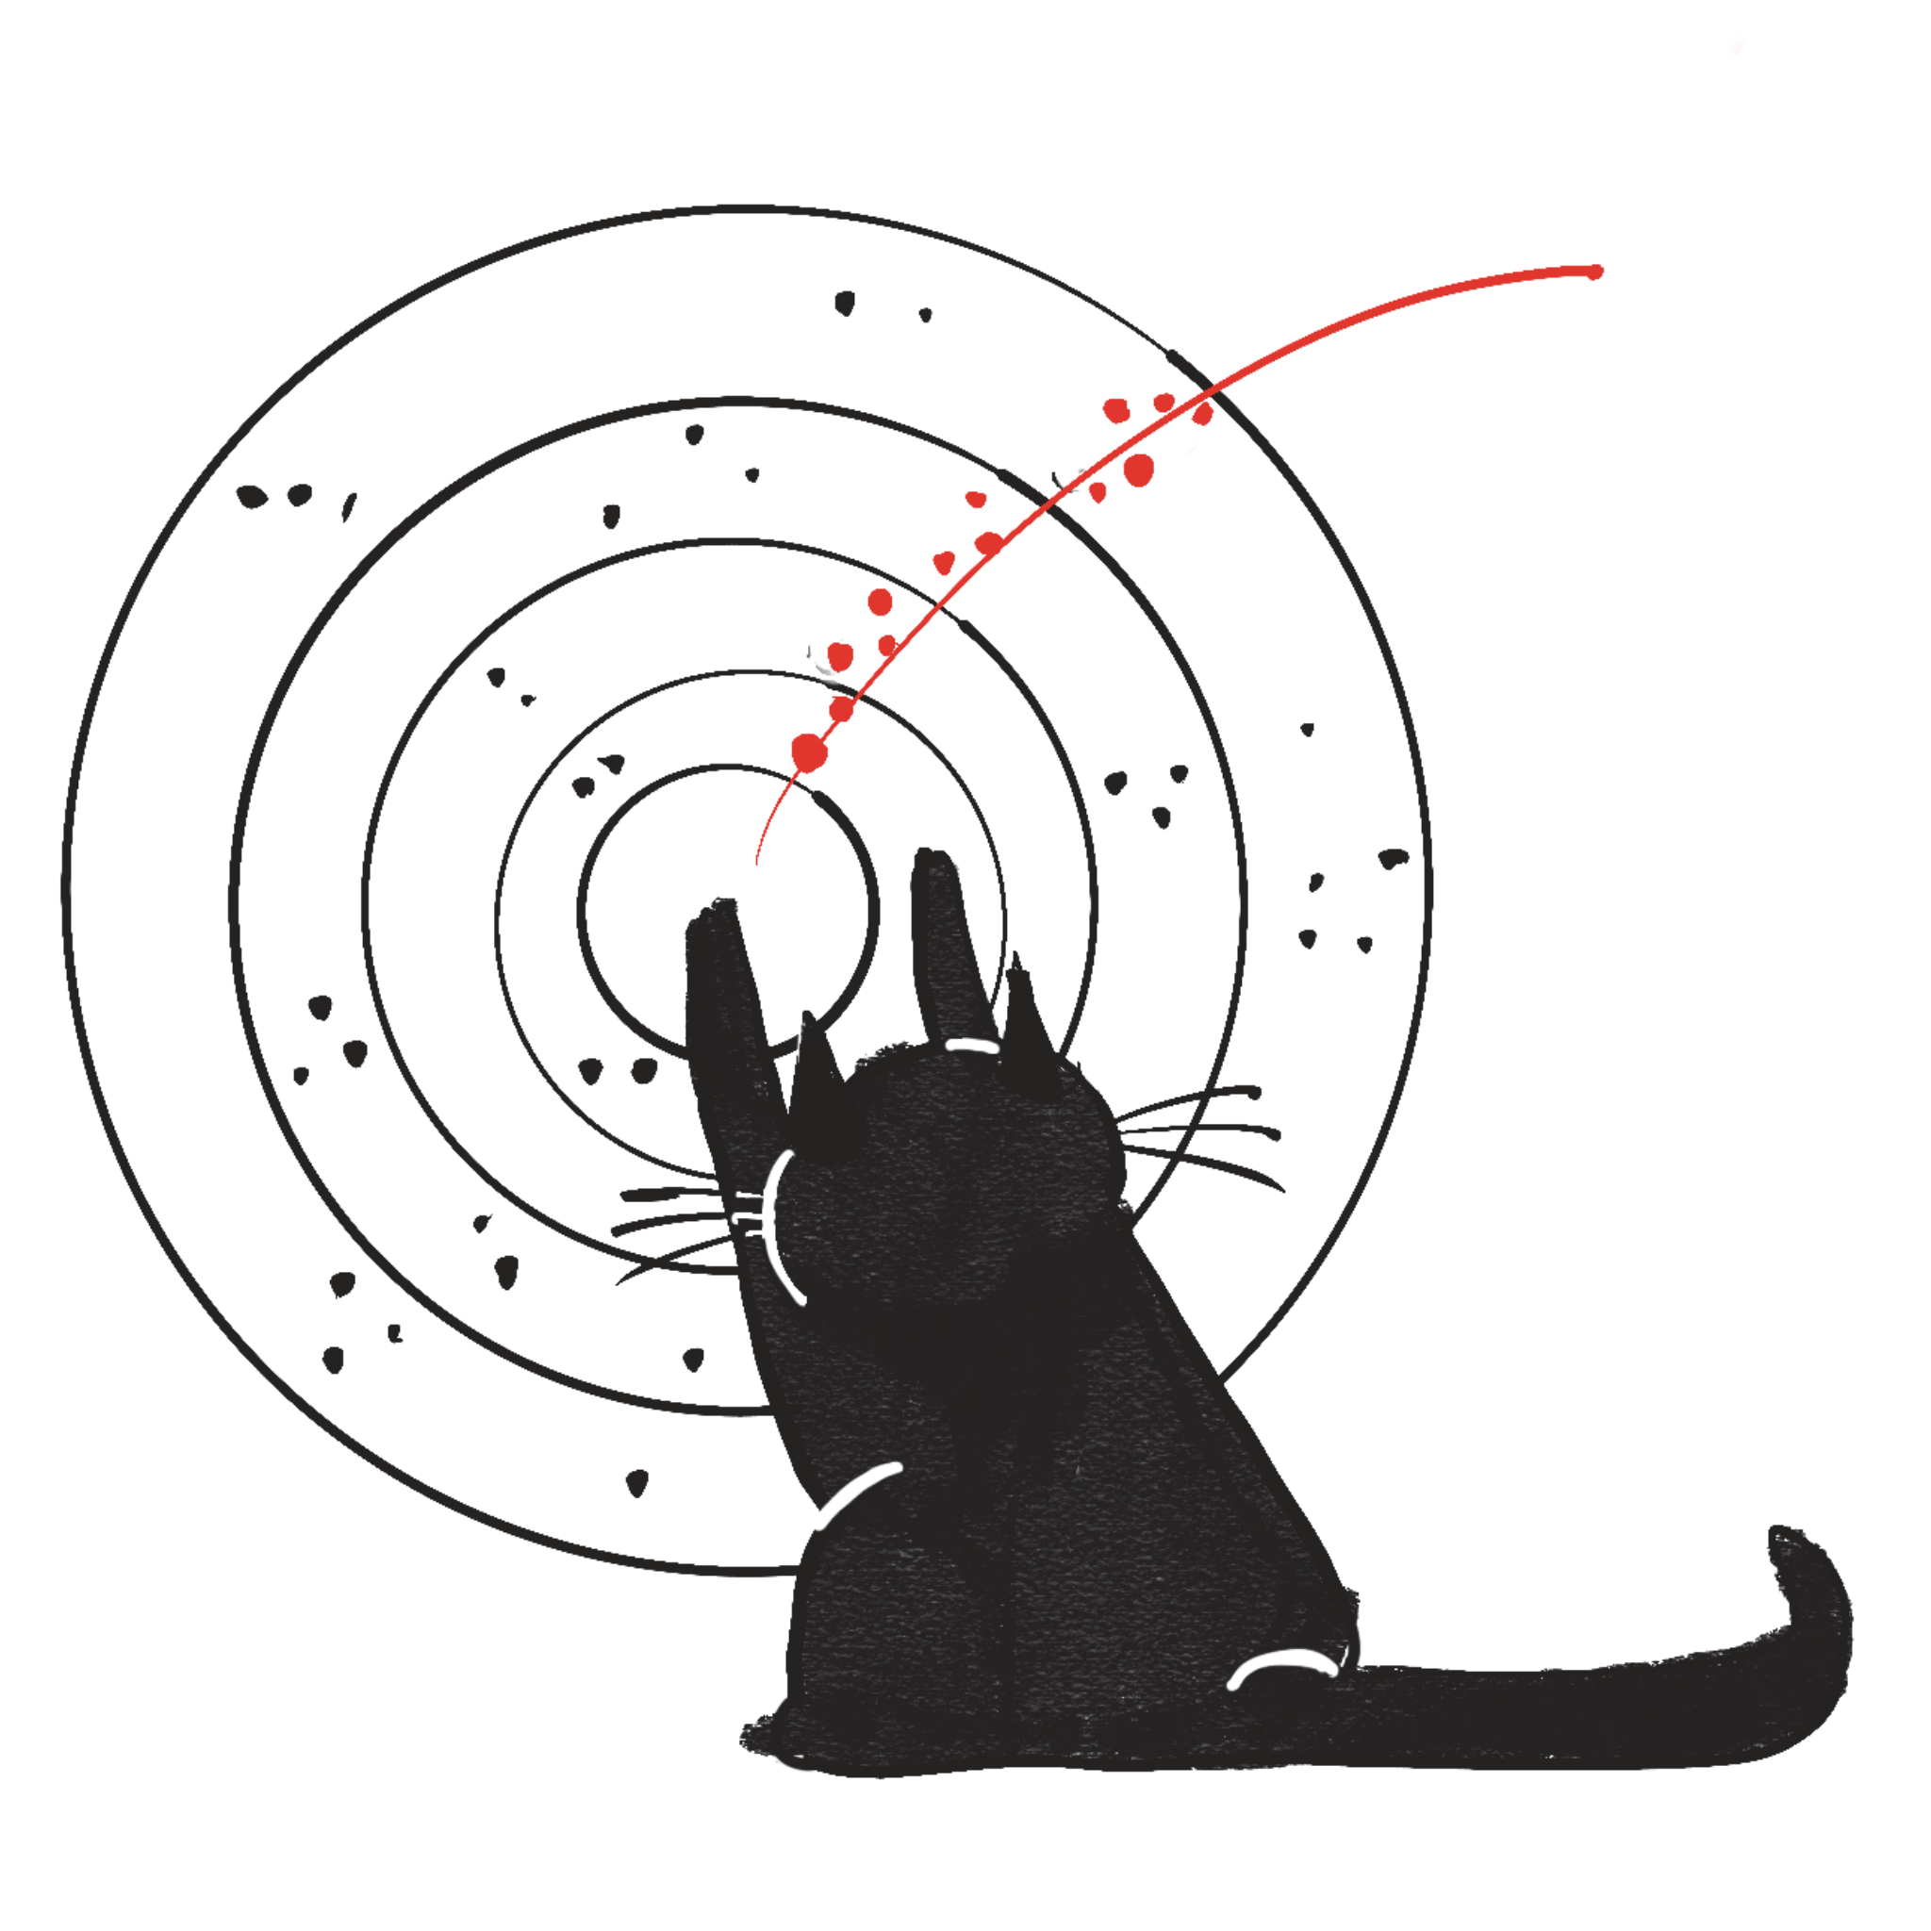
End-to-End Track Reconstruction using Graph Neural Networks at Belle II
Helmholtz AI Conference 2024
S-02a - Applications of AI: Graph Neural Networks
Lea Reuter, Giacomo De Pietro, Slavomira Stefkova, Torben Ferber, Belle II Tracking Group

Slide 2
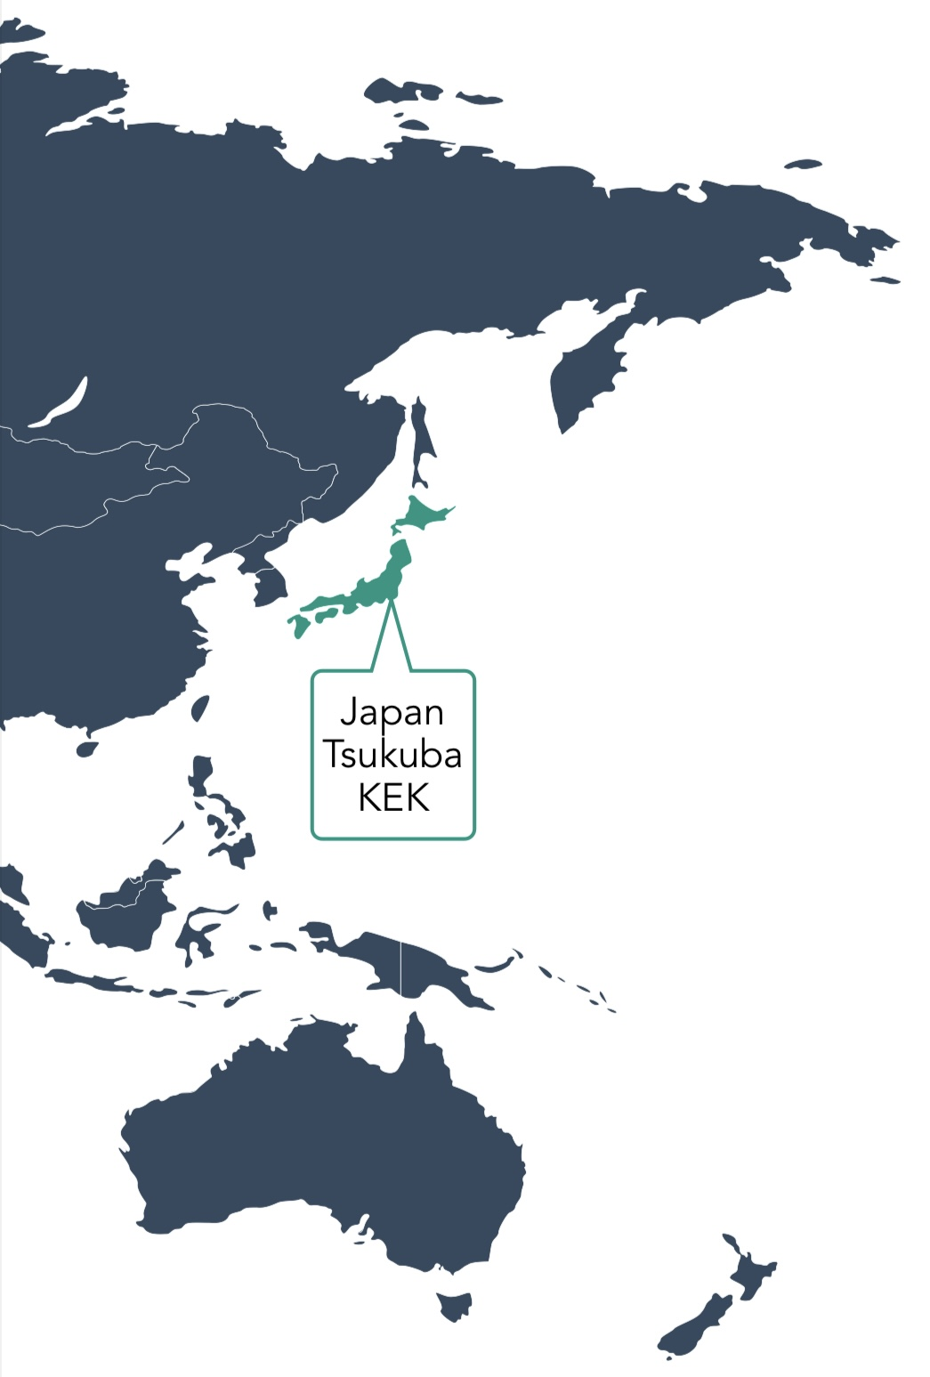
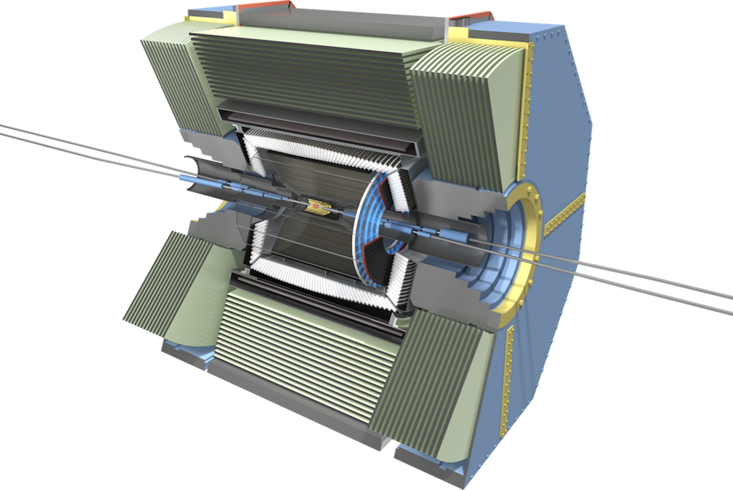
Belle II Experiment
Open Questions in particle physics
How was matter created and why is there more matter than antimatter?
What is dark matter?
How do fundamental particles acquire mass?
Why do fundamental particles come in three different copies?
…
We are answering these questions by analyzing a large number of collision events

Slide 3
Record Particles with Event Rate of 10kHz
KEK, A Search for New Physics - The Belle II Experiment

Slide 4
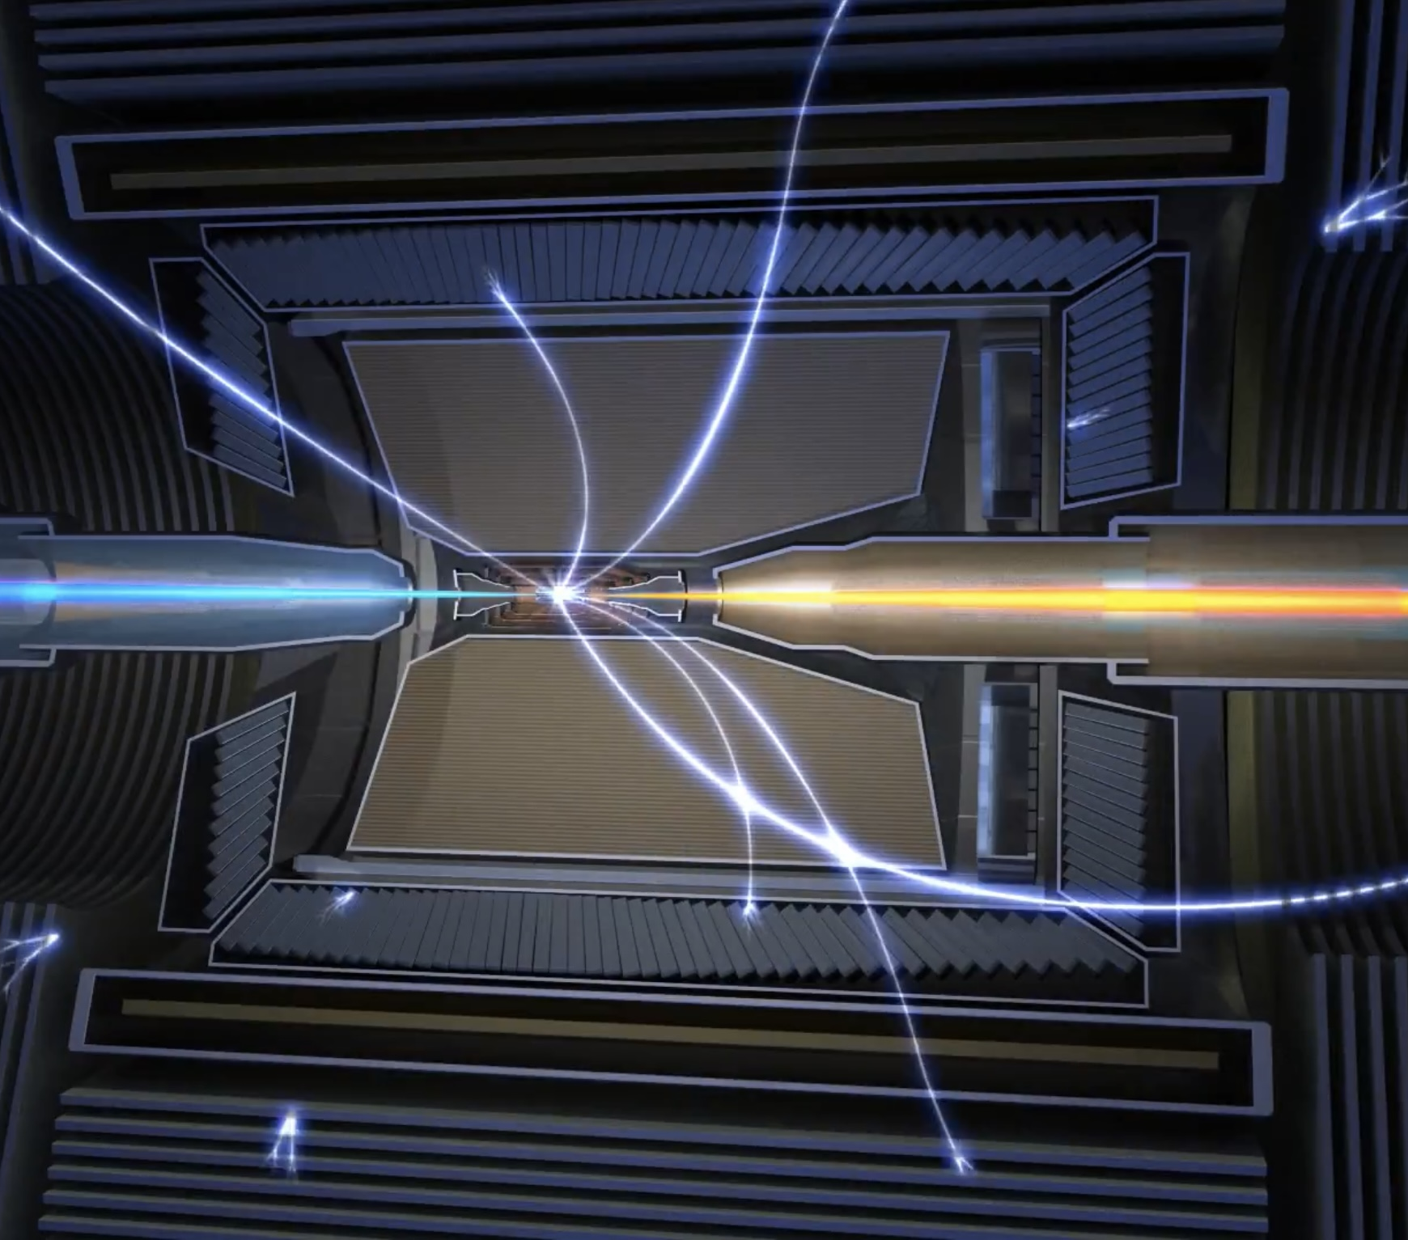
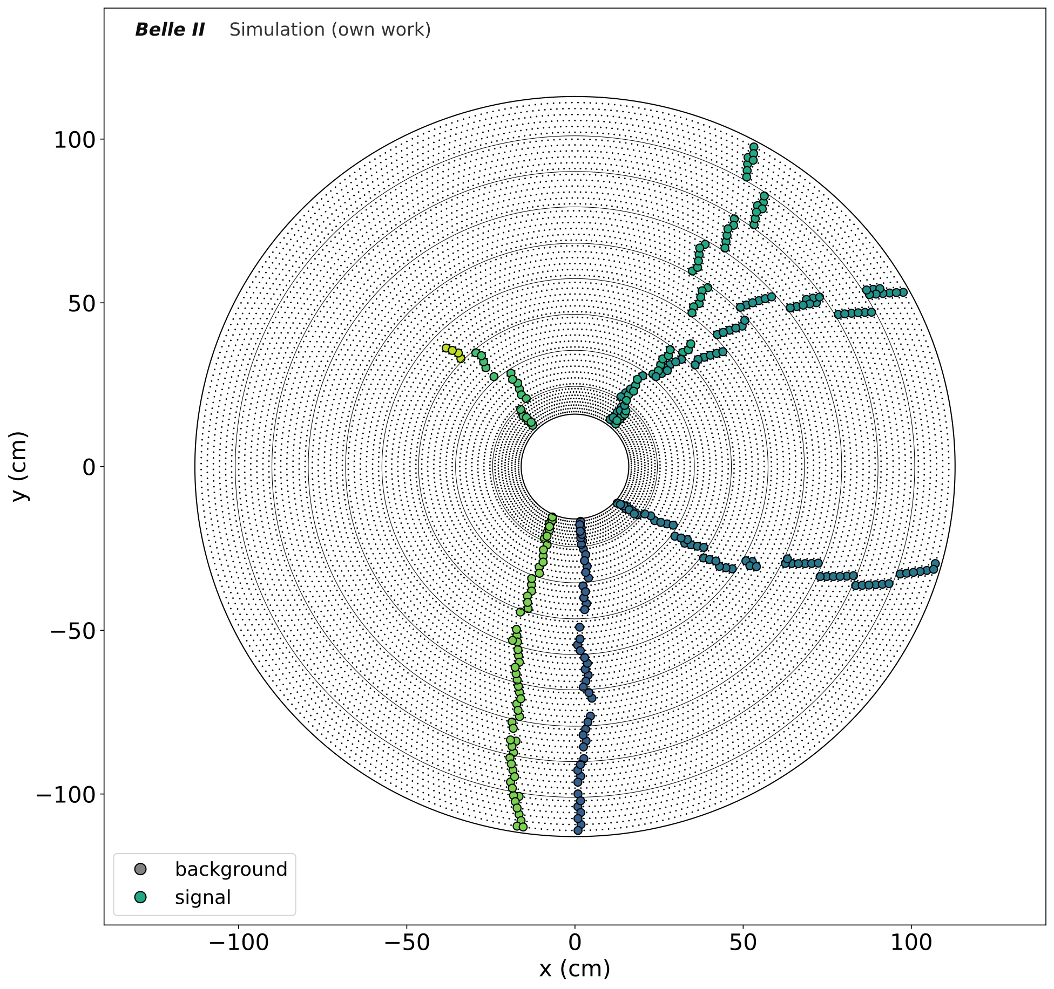
Main Tracking Detector
X-Y projection of the detector

Slide 5
Main Tracking Detector
Charged particles ionize while traveling through the detector, leaving behind trails =
Detector hits
Charged particles in magnetic field lead to circular trajectory - curvature proportional to momentum

Slide 6
Main Tracking Detector
Particle leaving this detector early
Particle traveling through the full detector

Slide 7
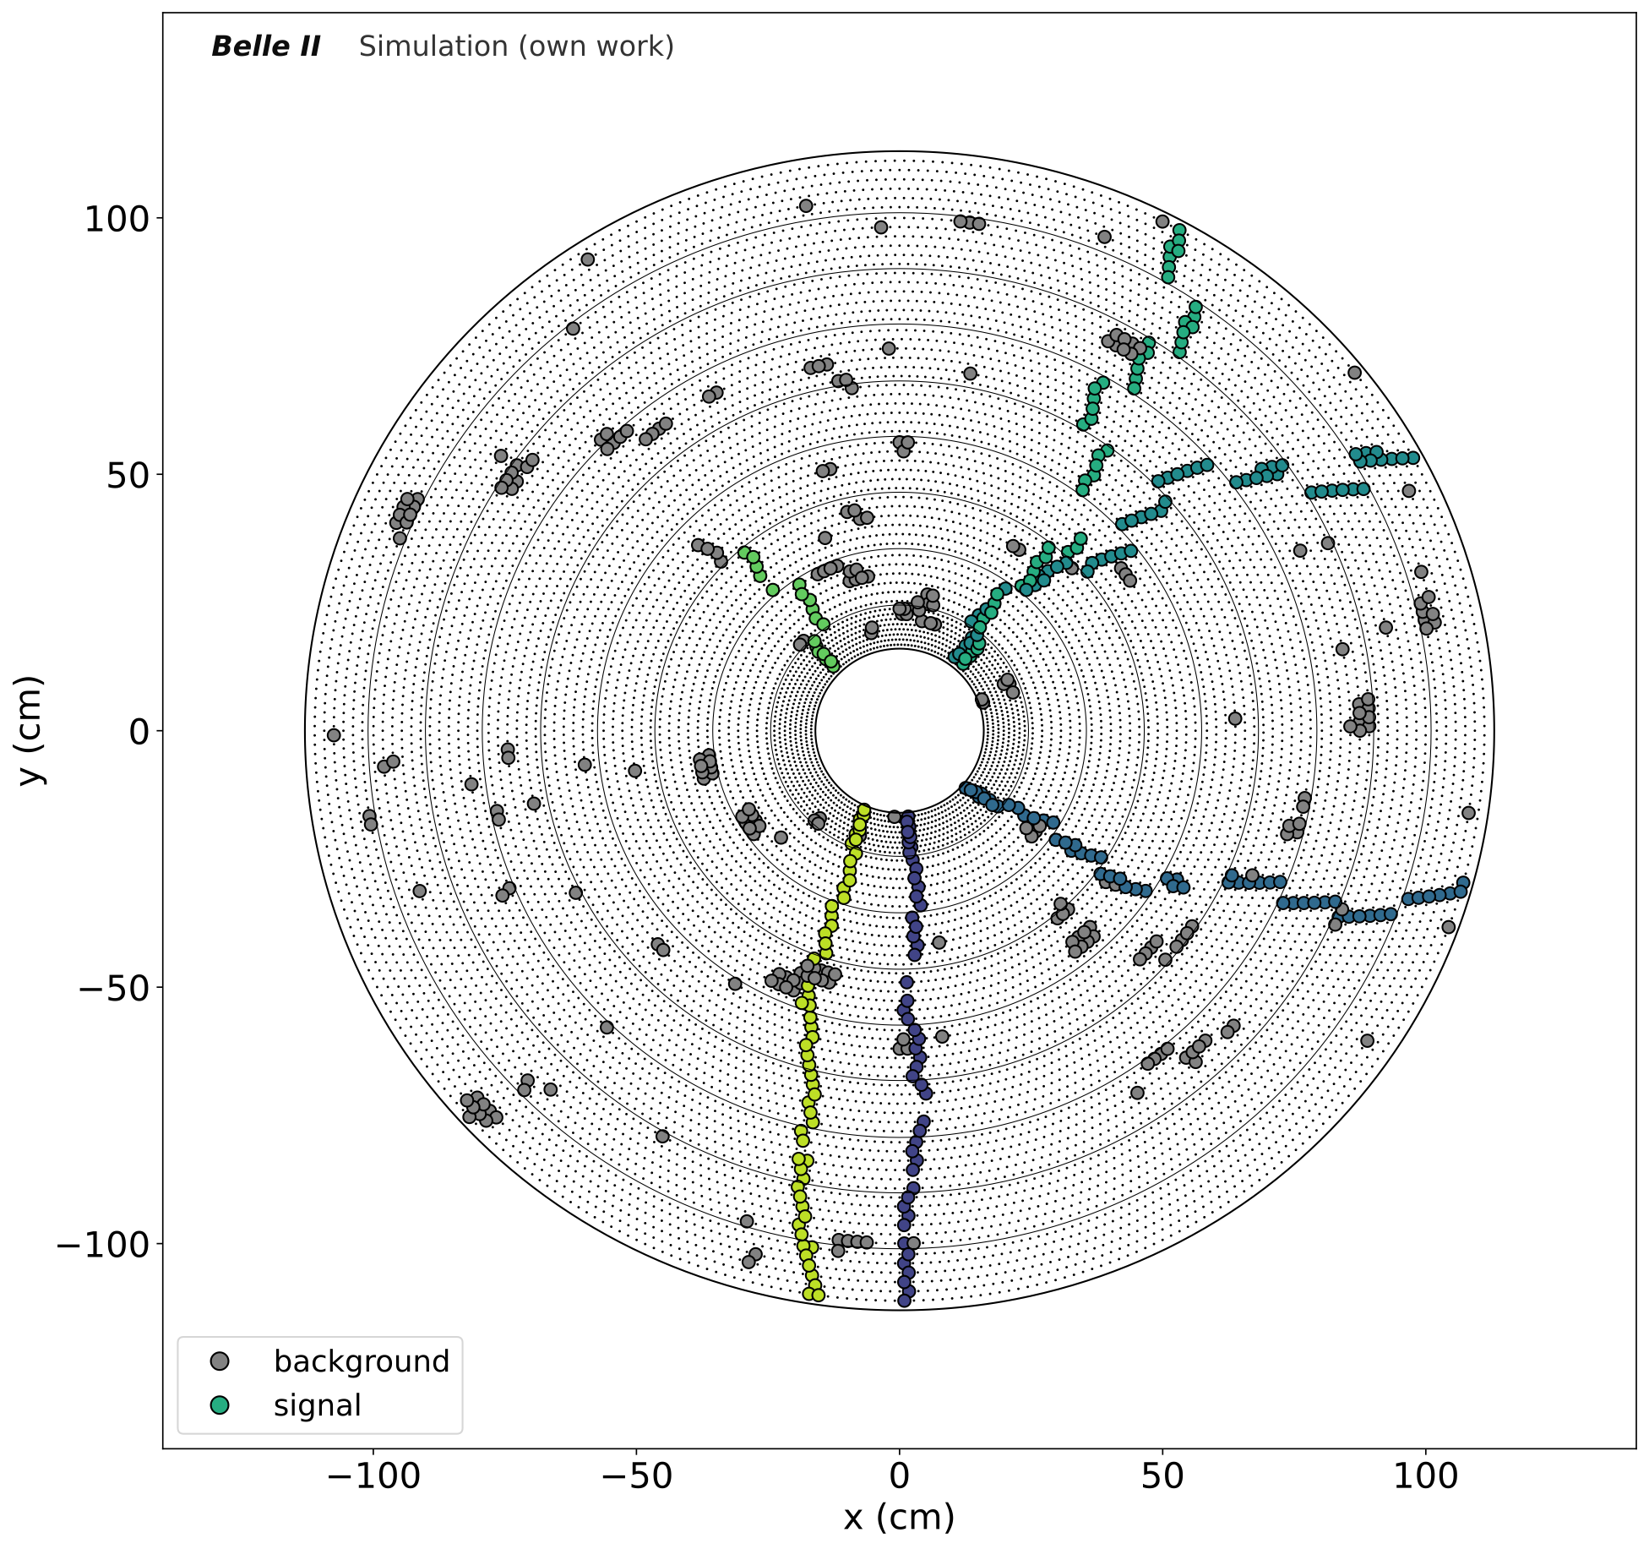
Main Tracking Detector

Slide 8
Main Tracking Detector
Circles describe trajectory of the particle
Collision point

Slide 9
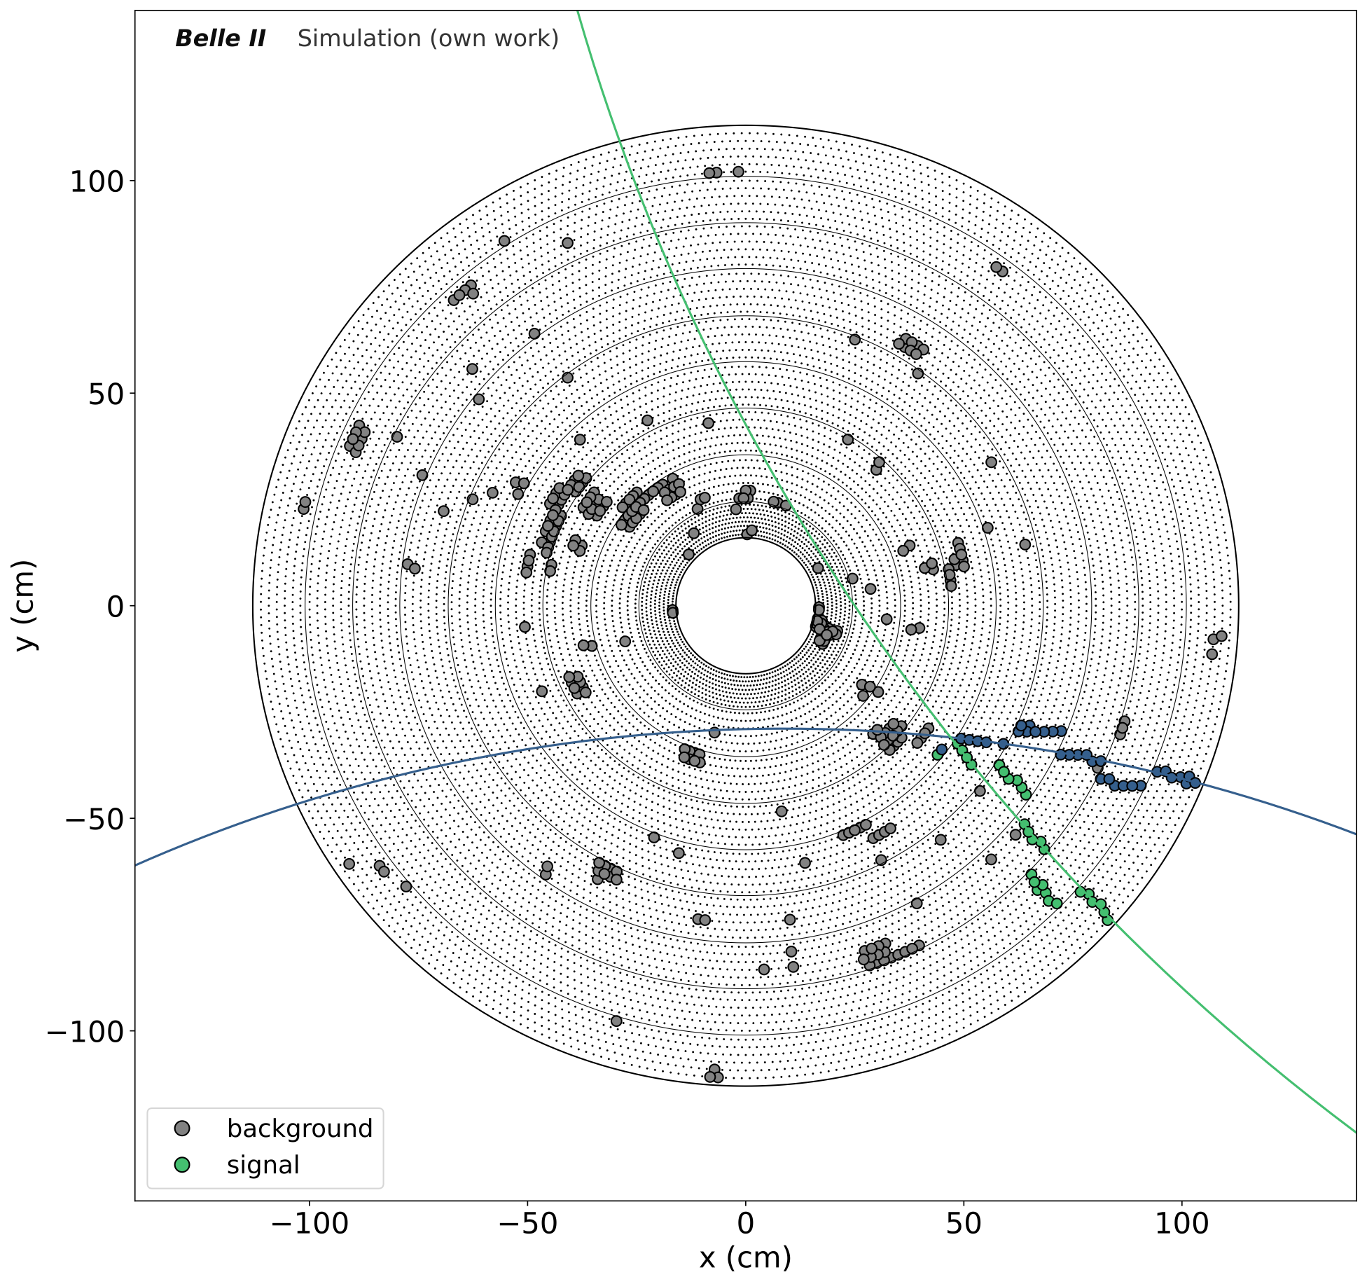
Main Tracking Detector
Starting position can be displaced

Slide 10
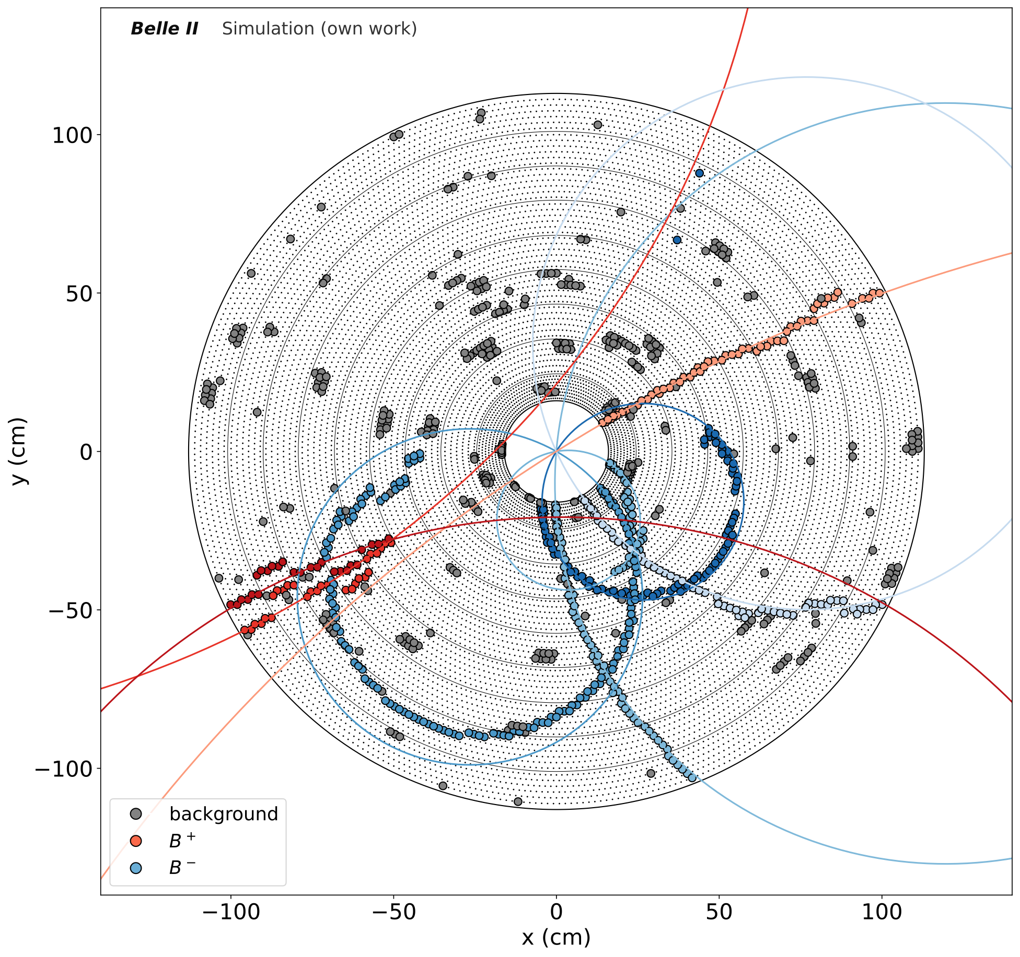
New Machine Learning Tracking Algorithm
Framing the Problem:
Challenges
Have: Hits in our tracking detector
Want: Tracks
Unknown number of tracks
Very high event efficiency and purity required (find all tracks in each event)
Very large dynamic range of momenta (curvature)
Overlapping objects
Large and varying number of sense wire inputs (15000 sense wires with up to 30% occupancy)
Varying background conditions
High event rate leads to a lot of data, computing resource and time constraint
Starting position
Momentum (starting direction and curvature)
All hits belonging to the track

Slide 11
Our Approach
Graph Neural Network based Object Condensation
Kieseler, Object Condensation: one-stage grid-free multi-object reconstruction in physics detectors, graph and image data (arXiv:2002.03605)
Applicable to overlapping objects without clear spatial boundaries
No assumption on the object size or sorting is needed
Qasim, Kieseler, Iiyama, Pierini, Learning representations of irregular particle-detector geometry with distance-weighted graph networks (arXiv:1902.07987)
Adjustable Parameters resulting in a total of 797,812 trainable parameters
General Parameters
GravNet Parameters
Output Parameters
Dimension of Linear Layers
Number of GravNet Blocks
Number of k-nearest neighbours in GravNet
GravNet space dimensions
Dimension of Cluster Coordinates
Number of output layers according to track parameter predictions

Slide 12
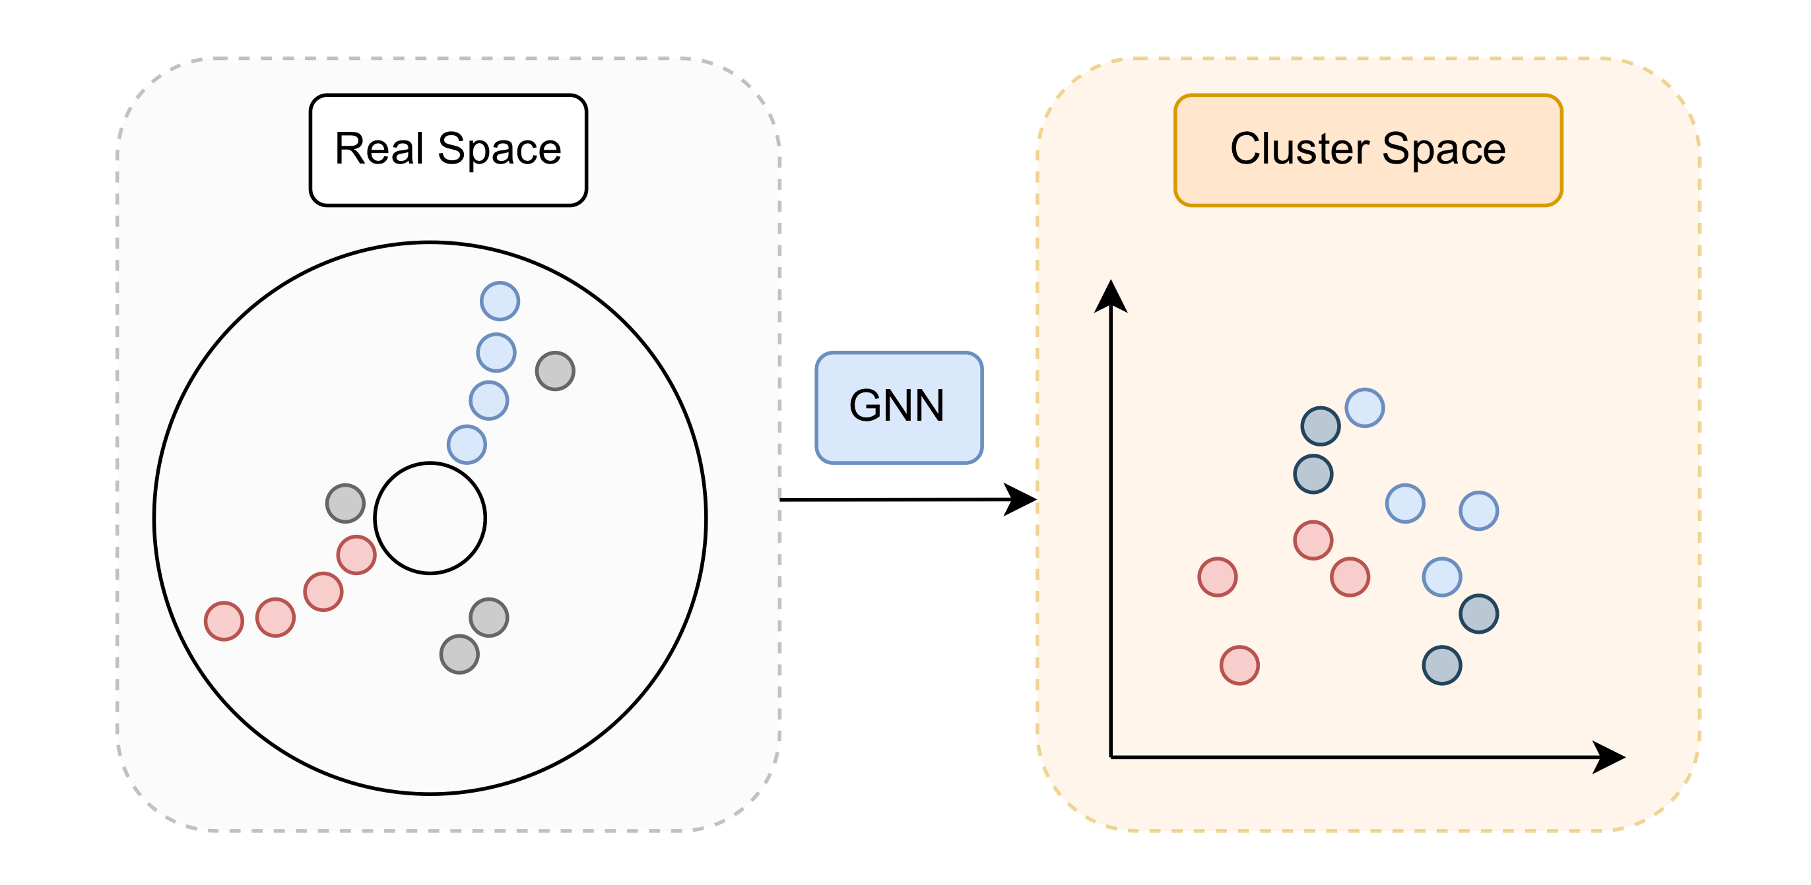
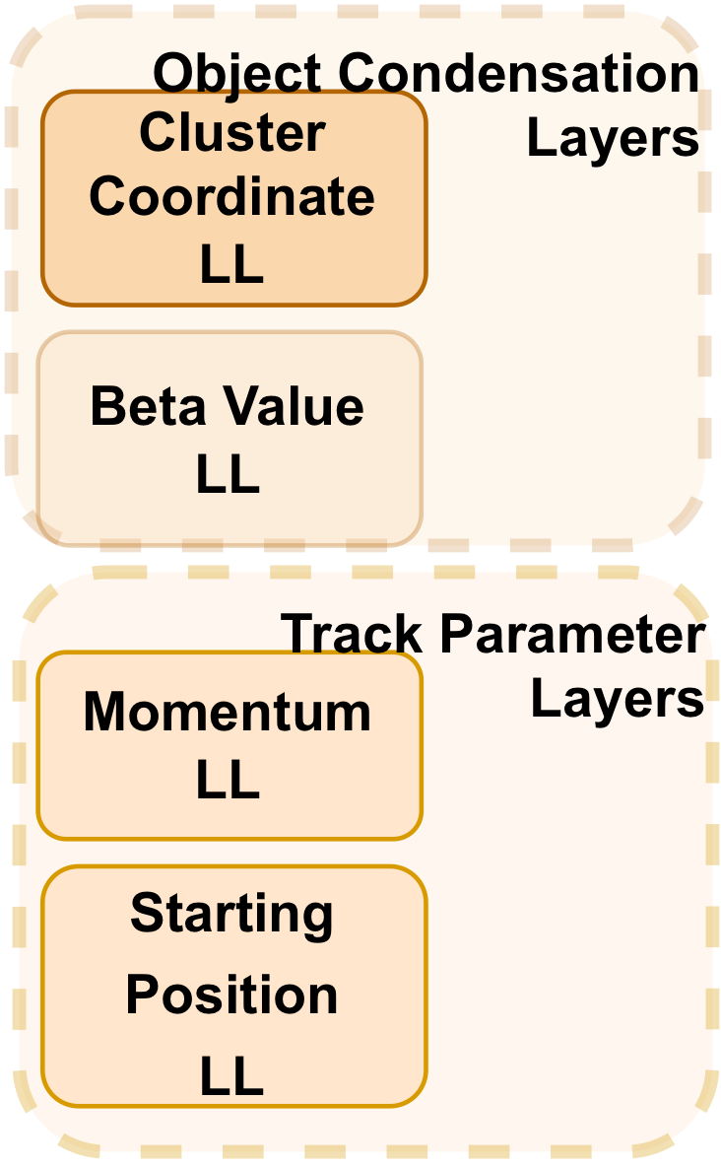
Object Condensation - Training Loss
LL - Linear Layer

Slide 13
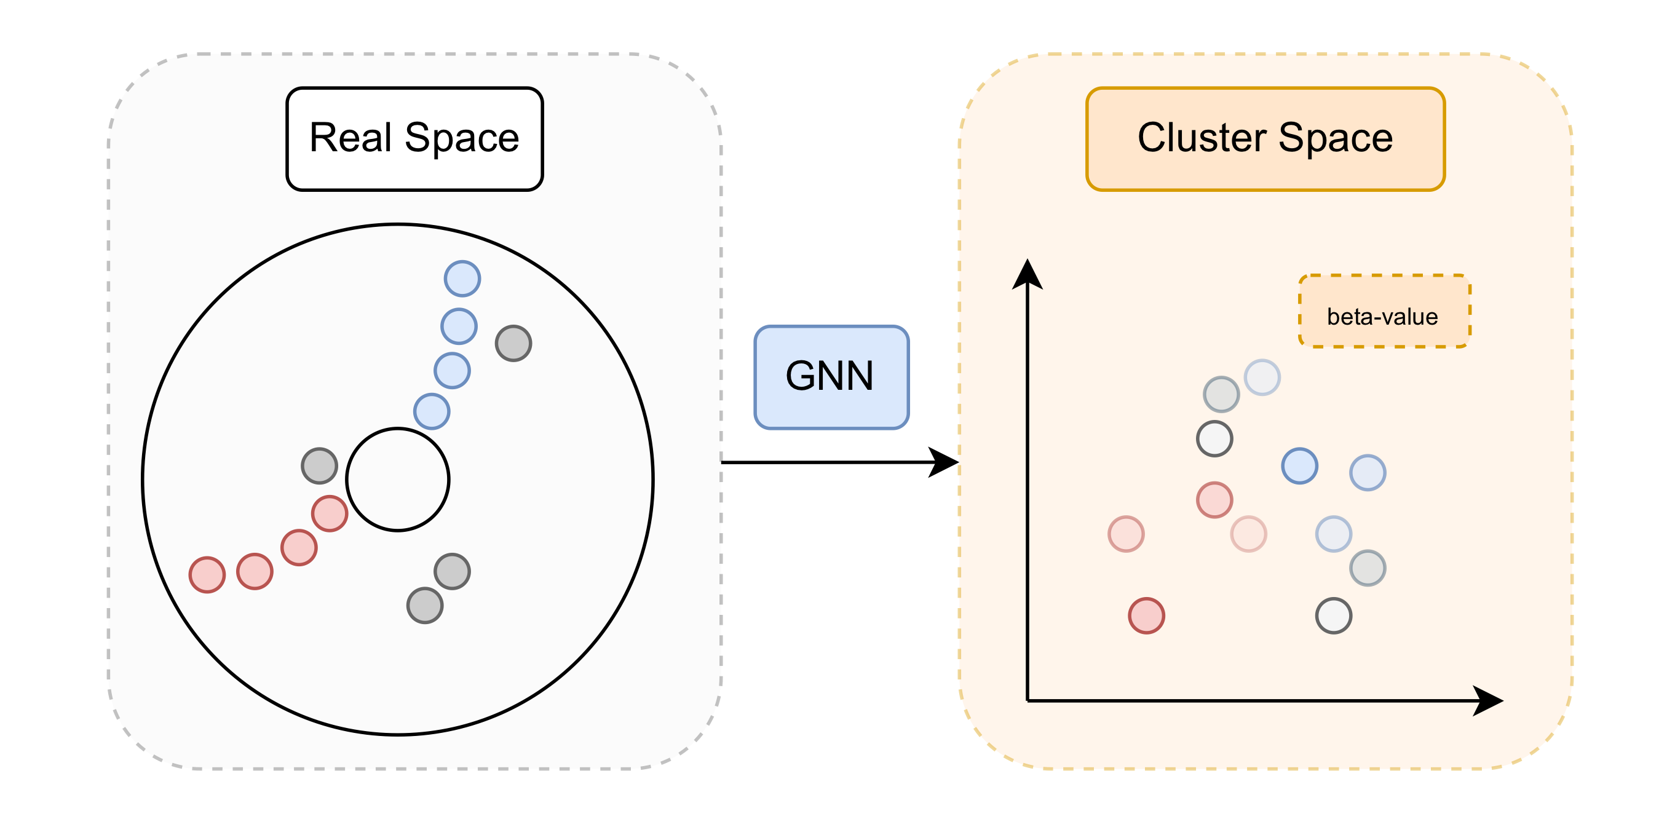
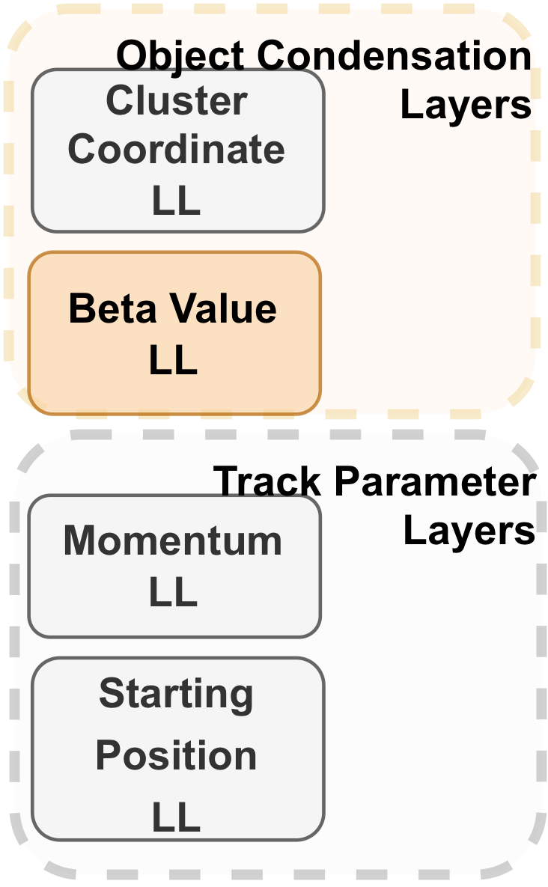
Object Condensation - Training Loss
LL - Linear Layer

Slide 14
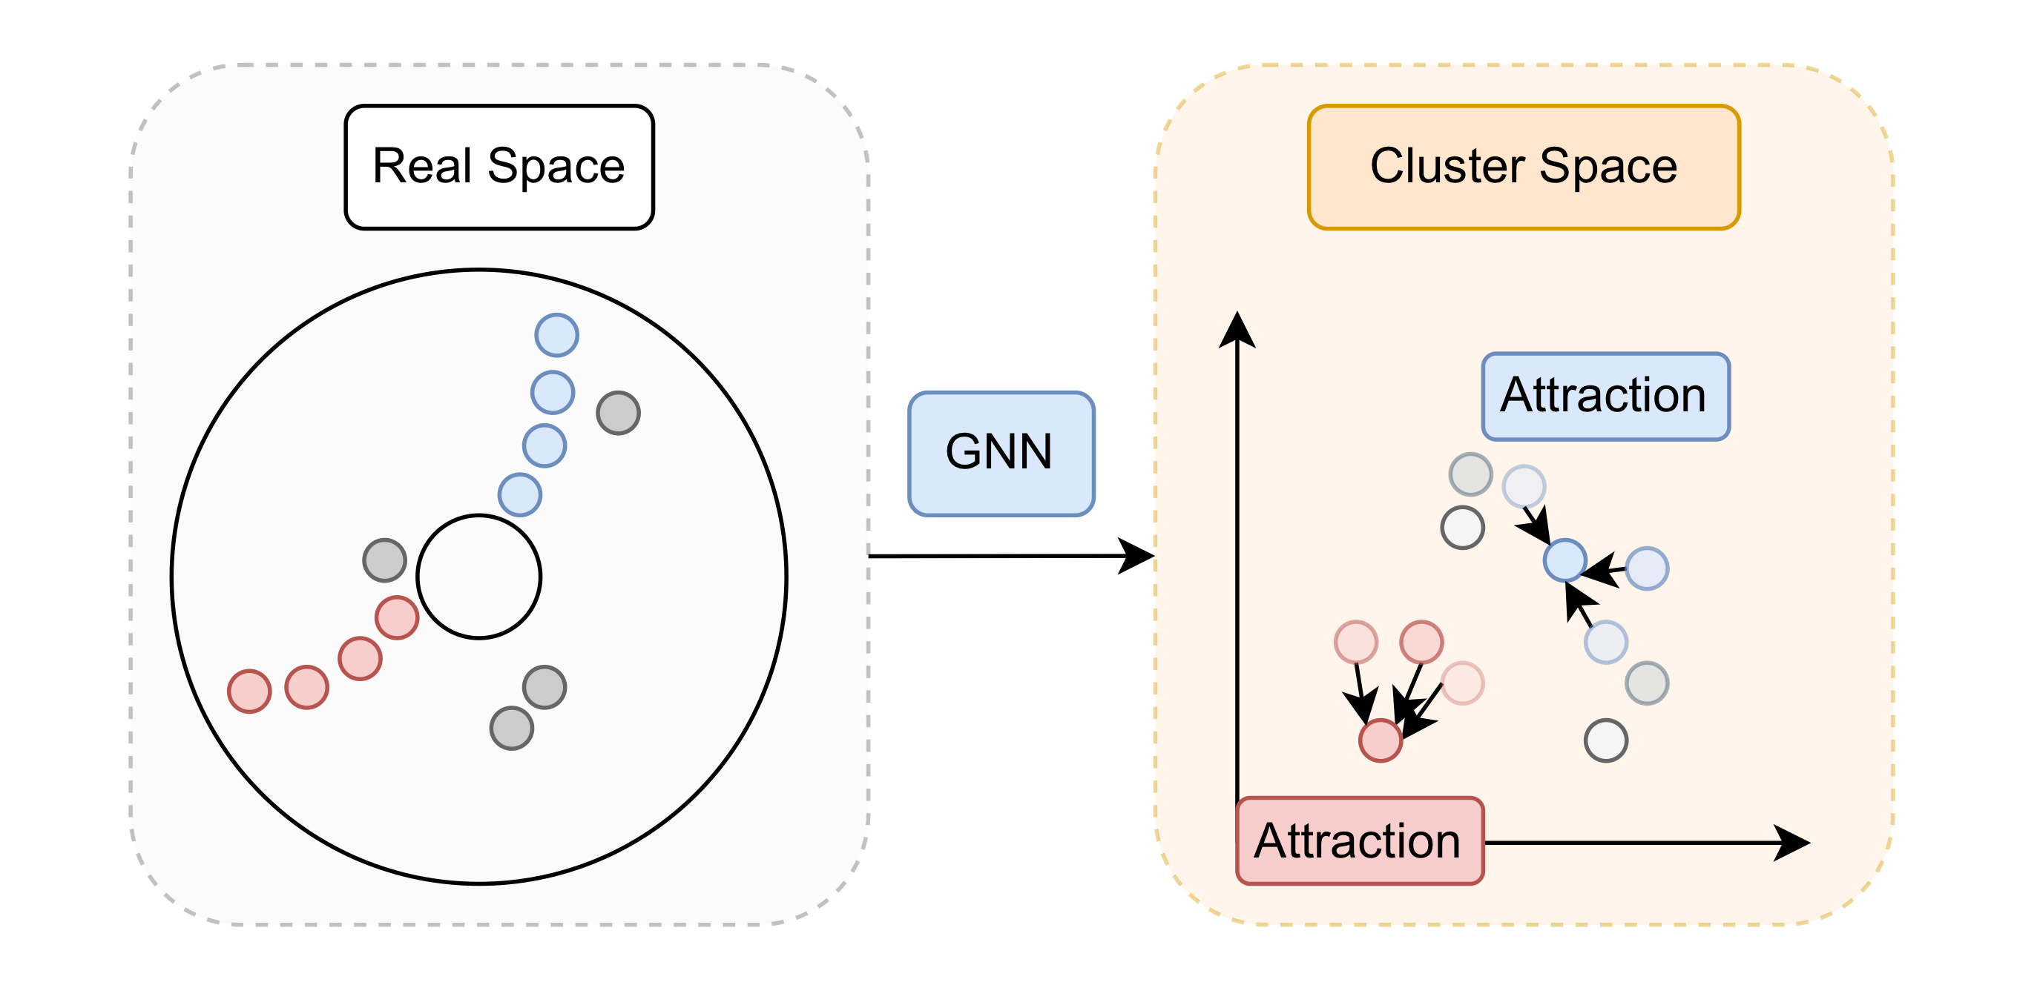
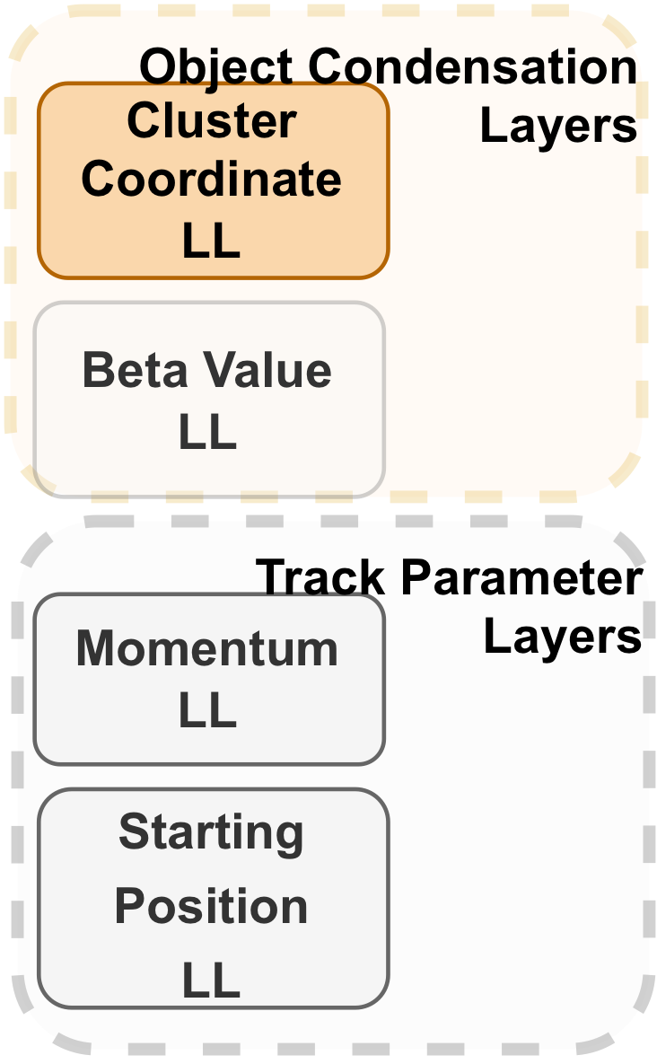
Object Condensation - Training Loss
LL - Linear Layer

Slide 15
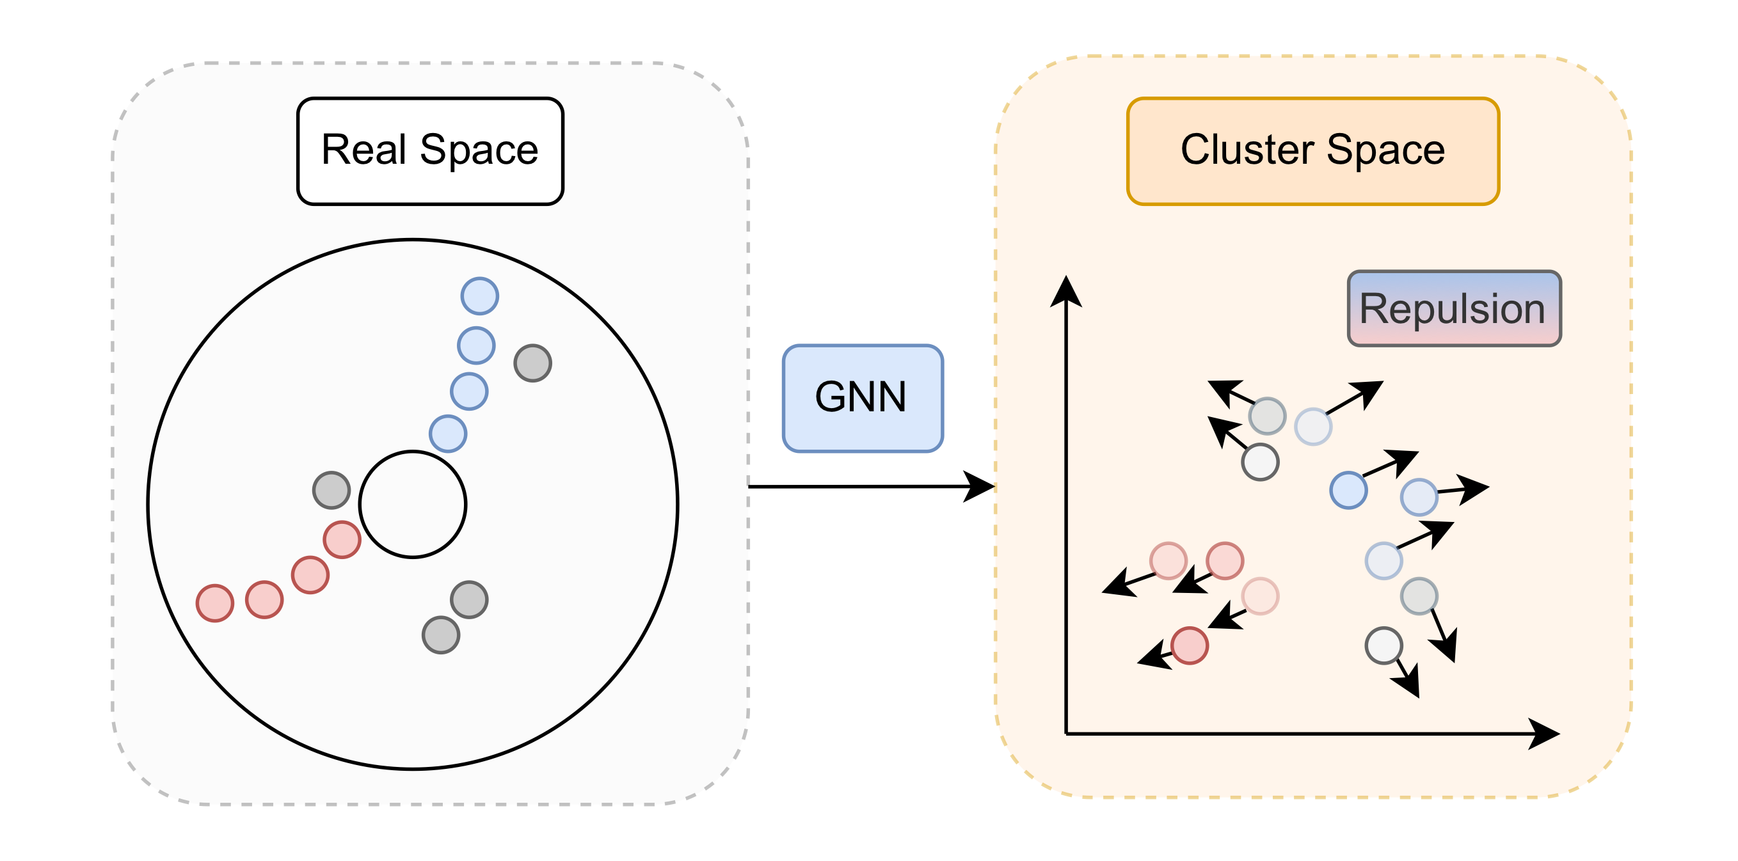
Object Condensation - Training Loss
LL - Linear Layer

Slide 16
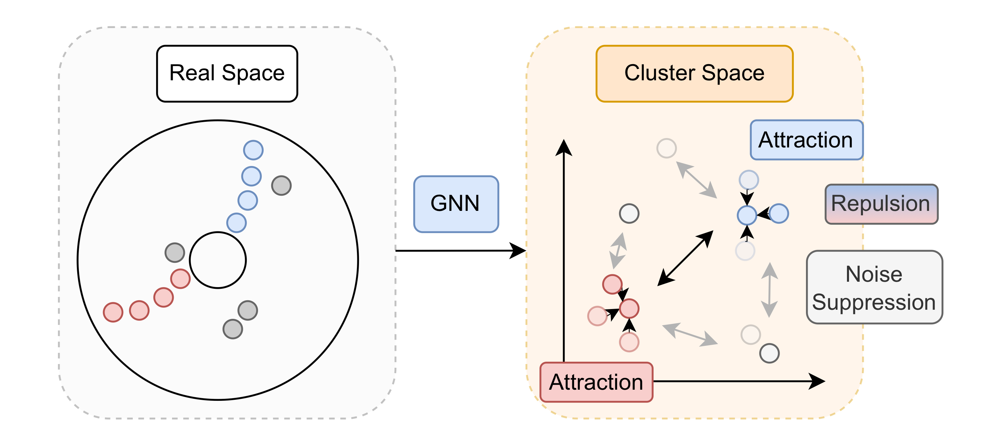
Object Condensation - Training Loss
4 loss terms for object condensation
Beta Value

Slide 17
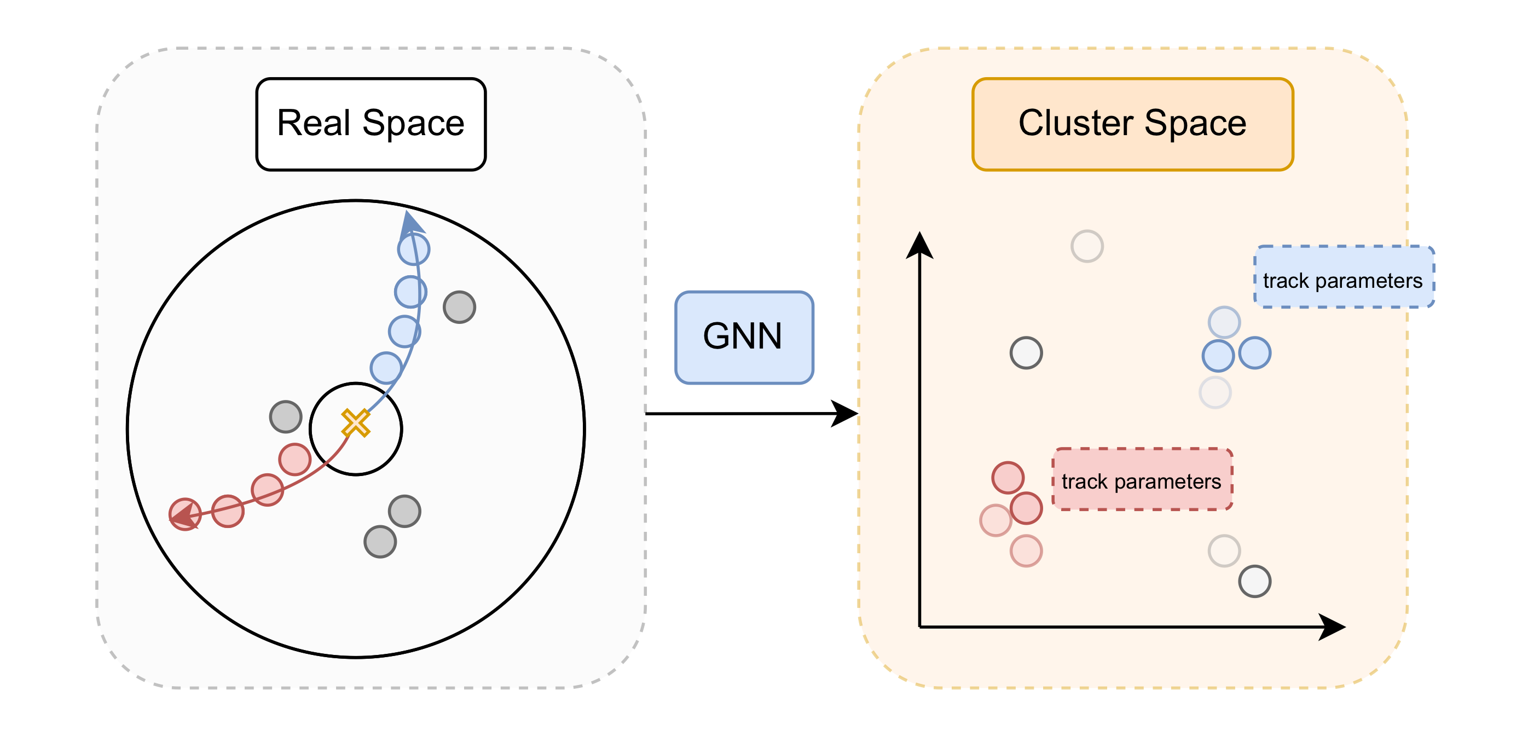
Object Condensation - Training Loss
4 loss terms for object condensation
Additional 2 loss terms according to parameter predictions

Slide 18
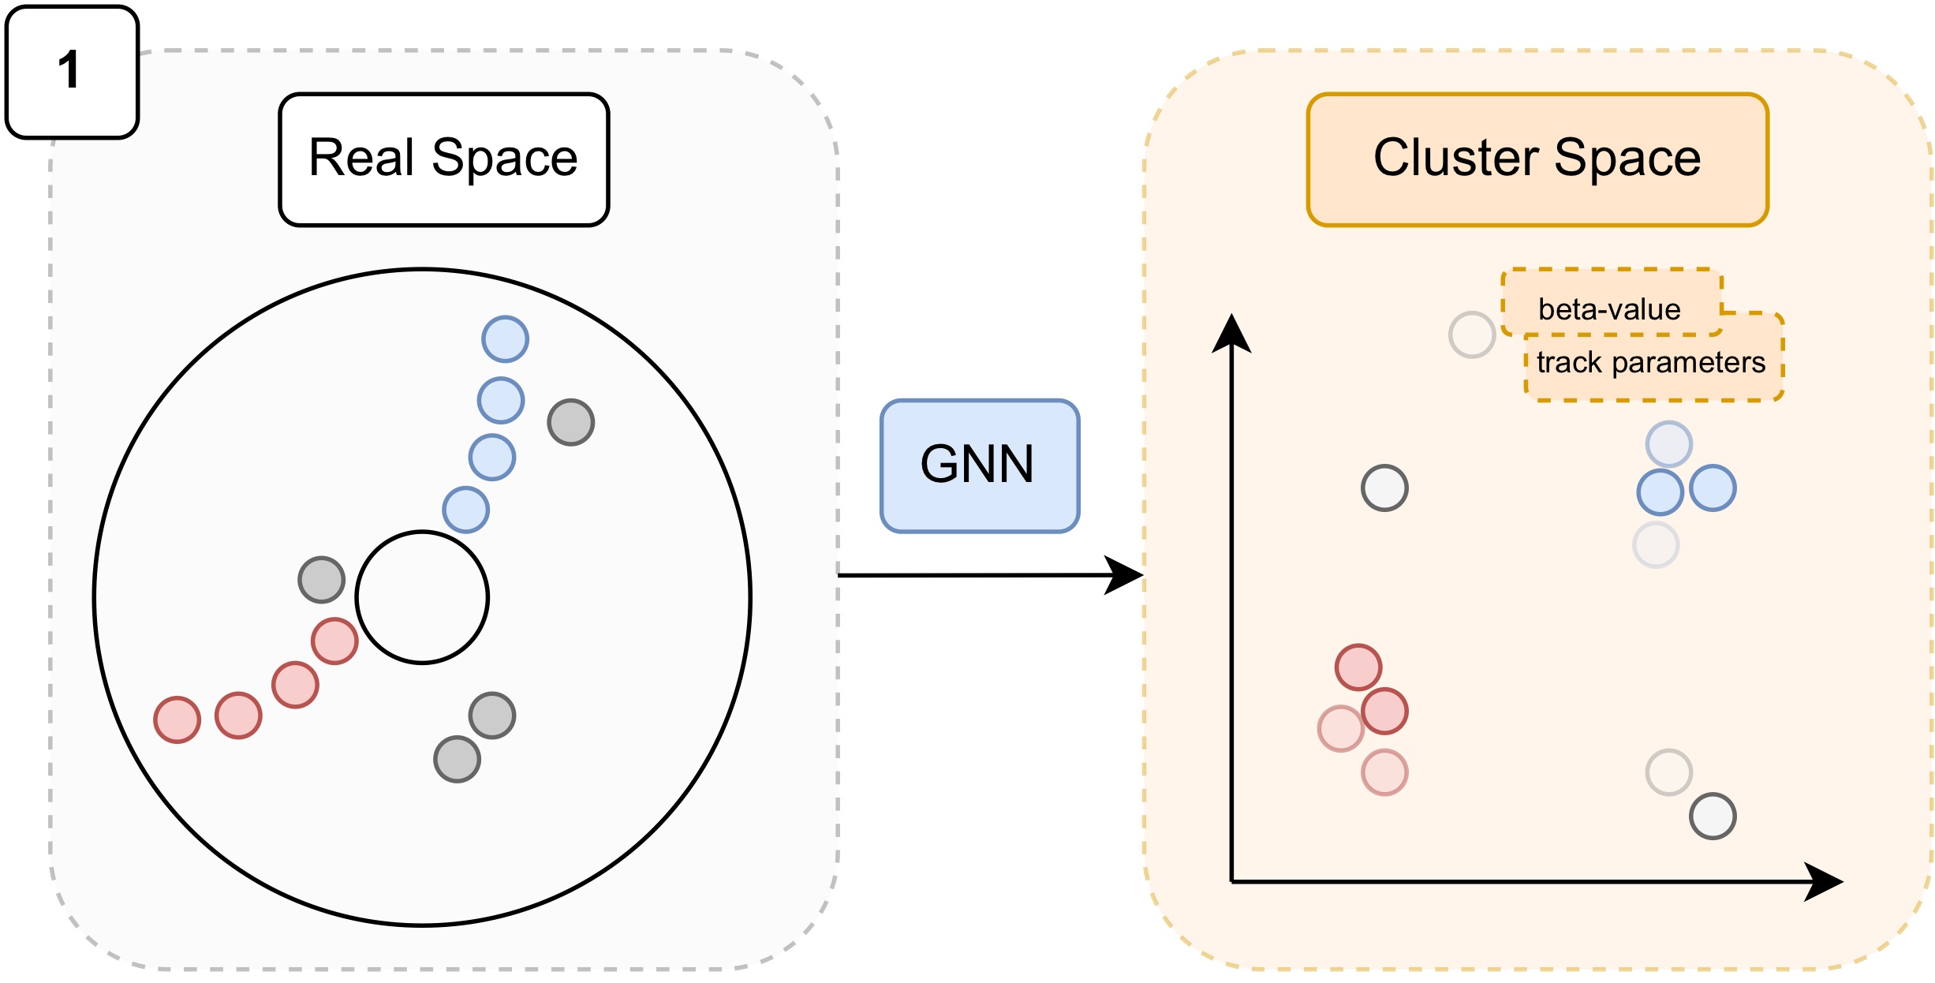
Inference

Slide 19
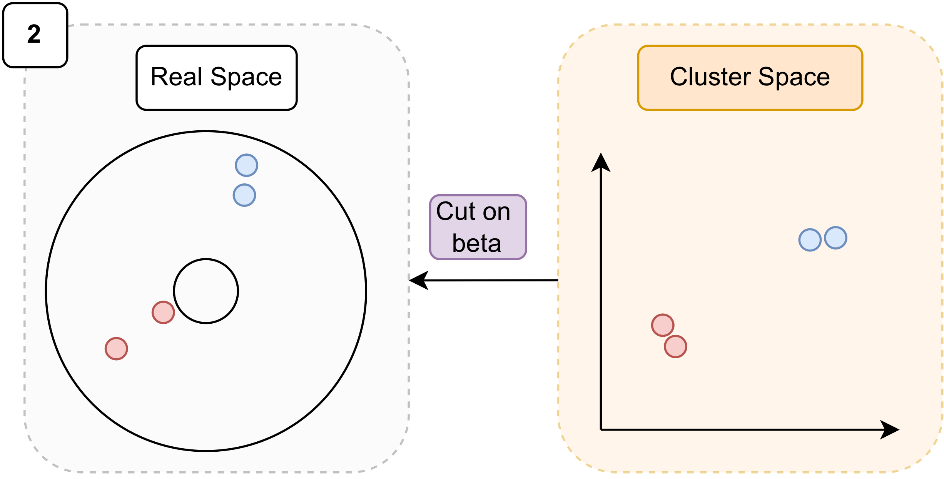
Inference

Slide 20
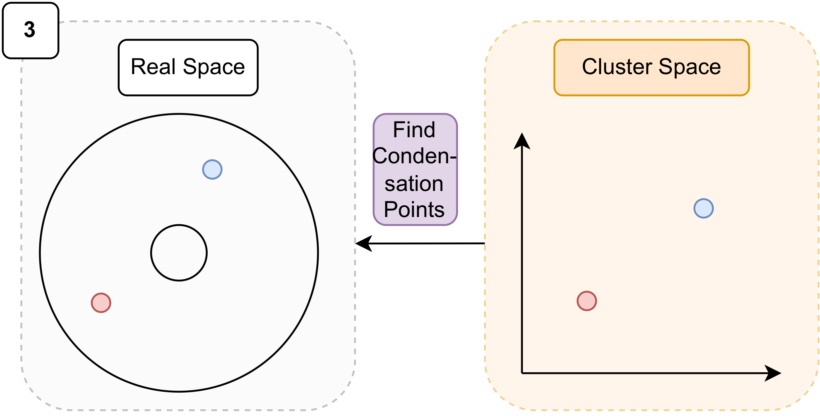
Inference

Slide 21
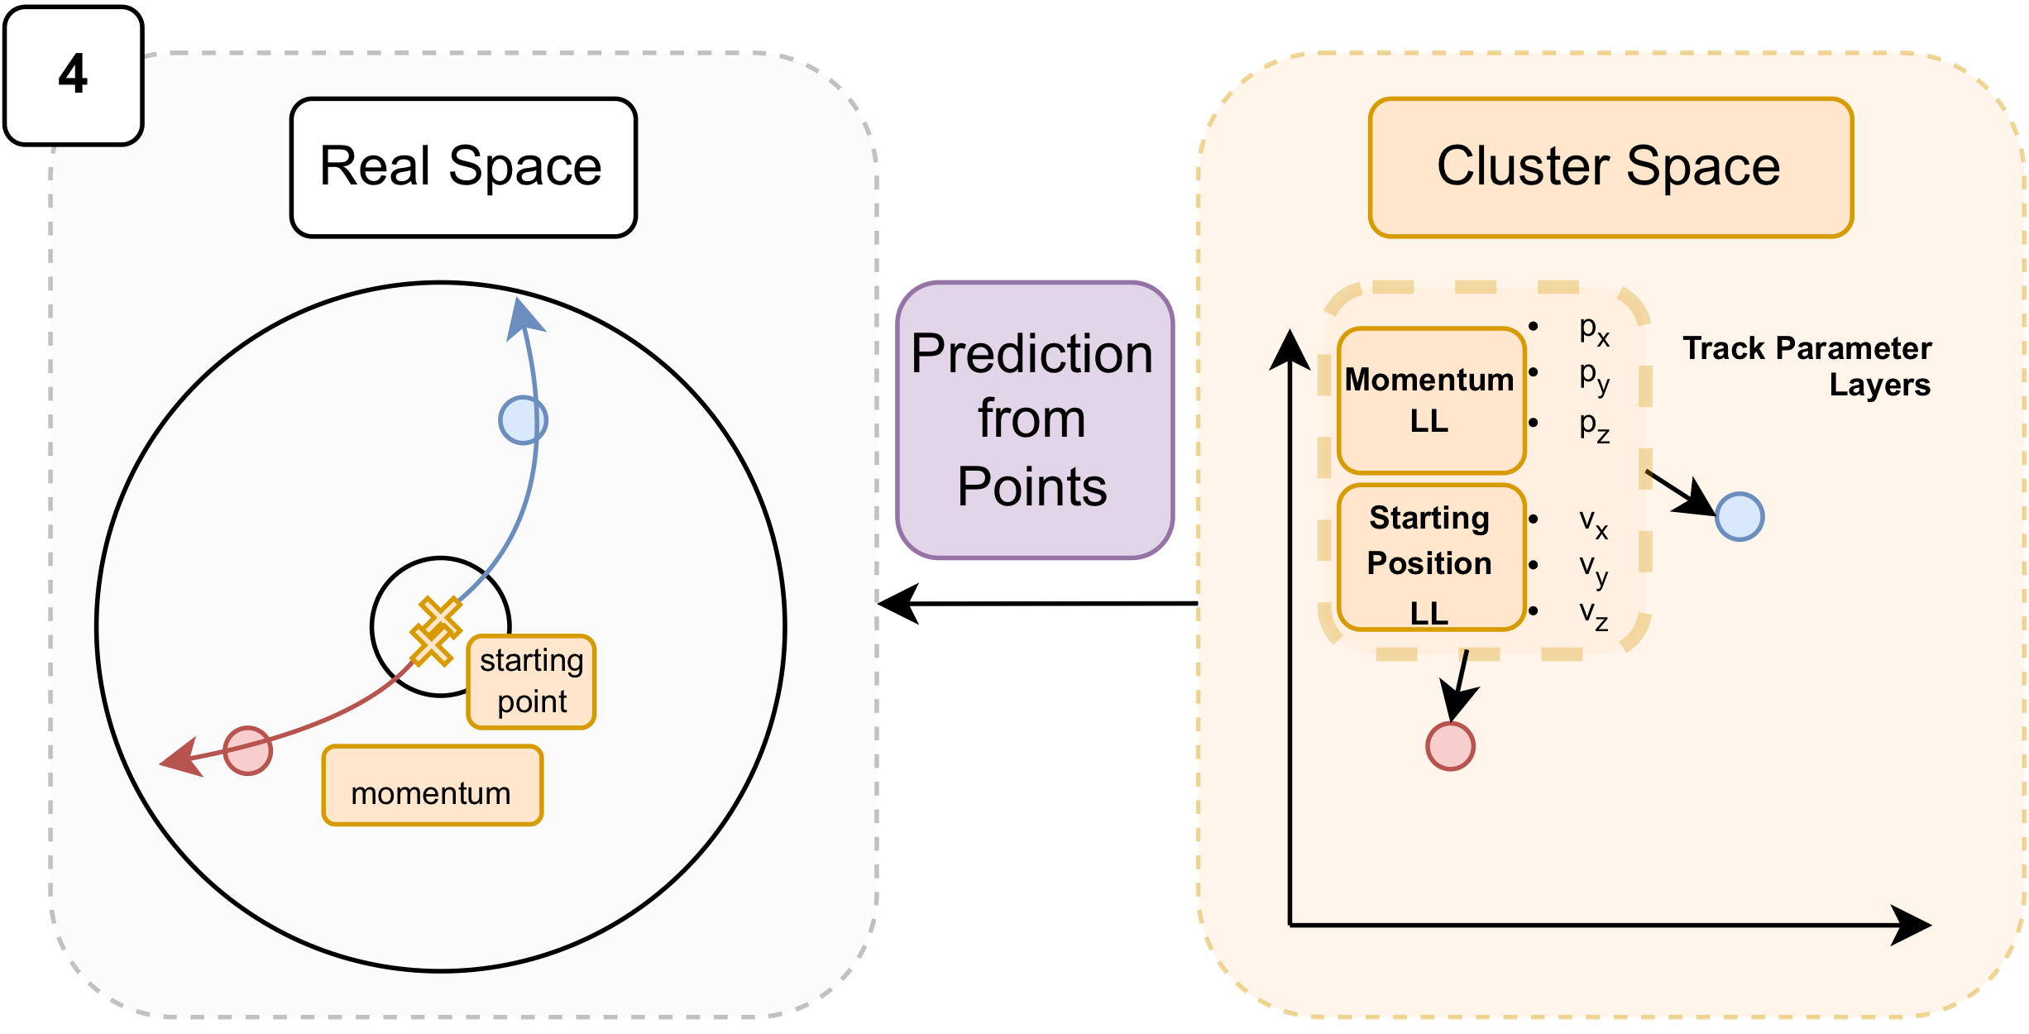
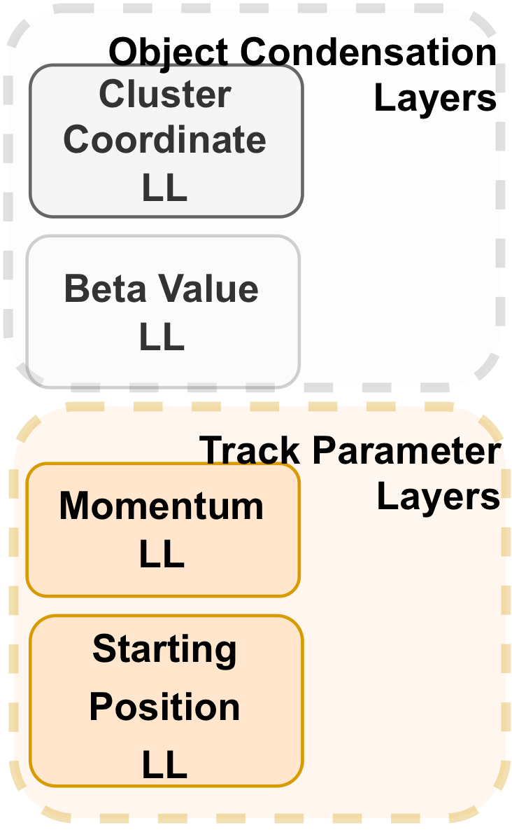
Inference

Slide 22
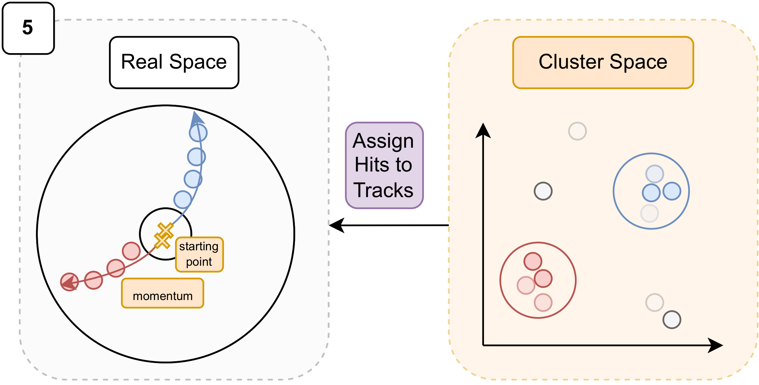
Inference
3 additional hyperparameters to tune

Slide 23
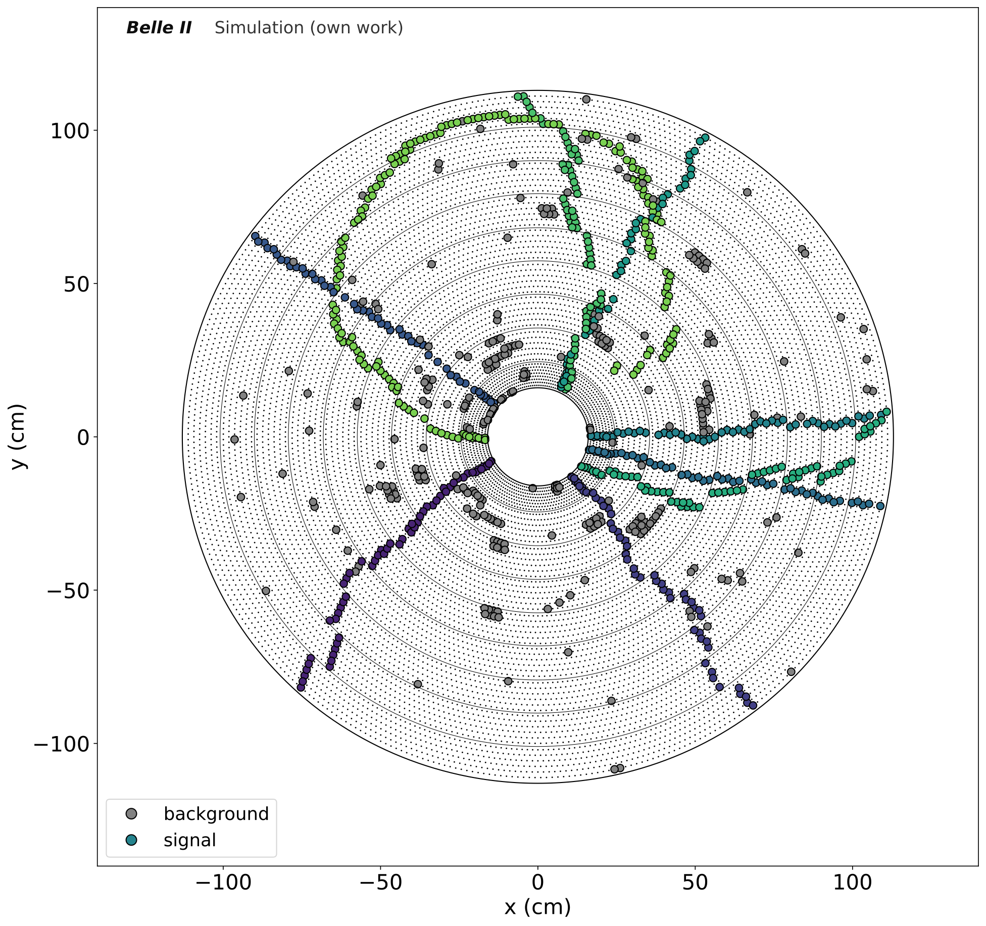
Training Samples
Excellent simulations of our detector that describe the data quite well
The Belle II Collaboration, Belle II Analysis Software Framework (basf2)
(doi:10.5281/zenodo.5574115)
Extensive background simulations, correlated over multiple detector components, also including noise from read-out chips
Natochii et al., Beam background expectations for Belle II at SuperKEKB (arXiv:2203.05731)
Liptak et al., Measurements of Beam Backgrounds in SuperKEKB Phase 2 (arXiv:2112.14537)
Simulate 600,000 events with over 2 million tracks with 80/20 split for train/validation
Train on different sample topologies that cover a large phase space, to not bias the model

Slide 24
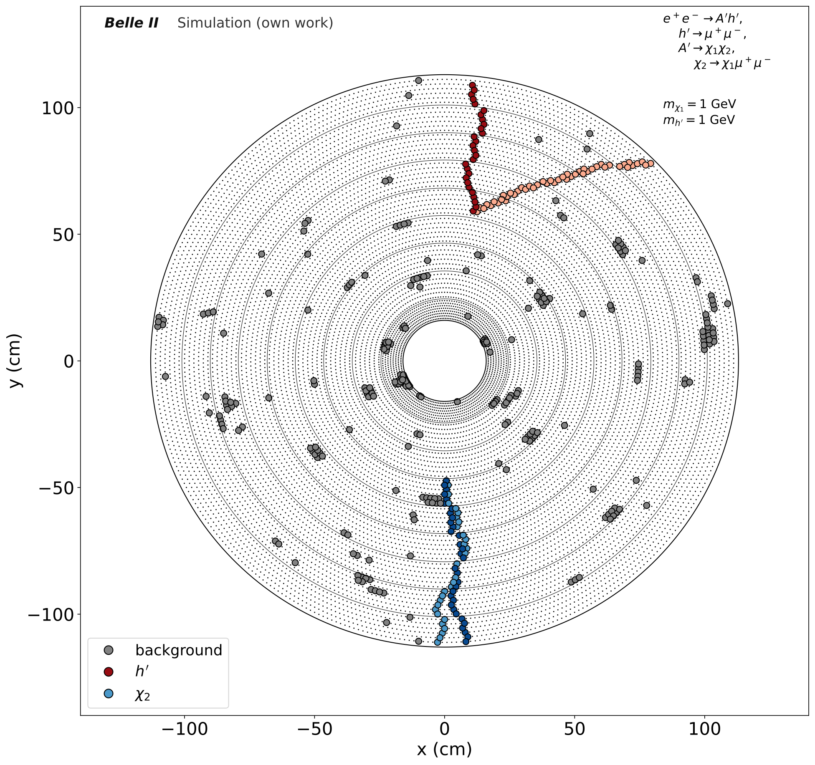
Model Learning

Slide 25
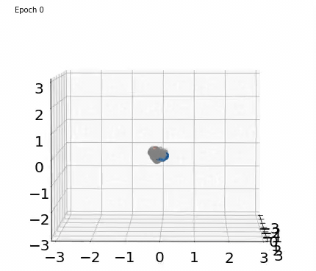
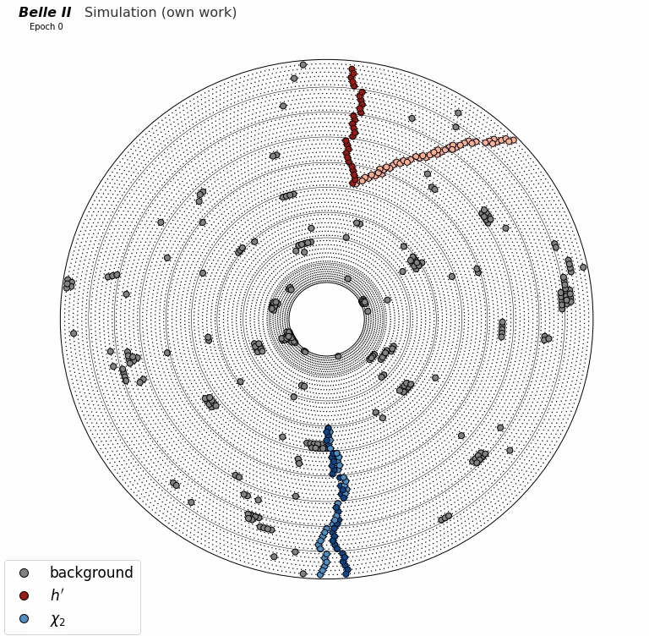
Model Learning

Slide 26
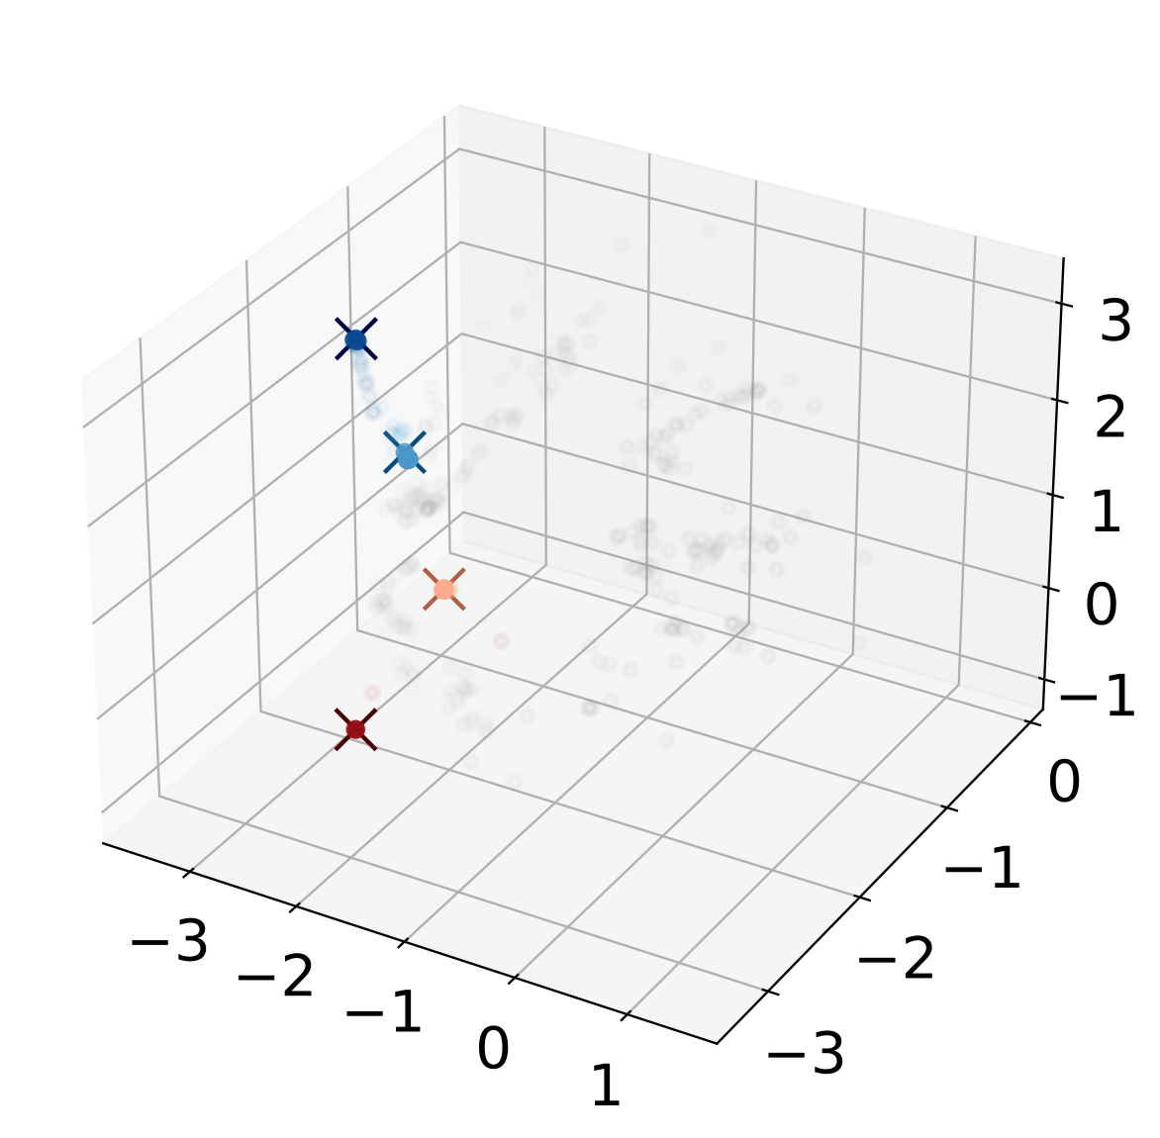
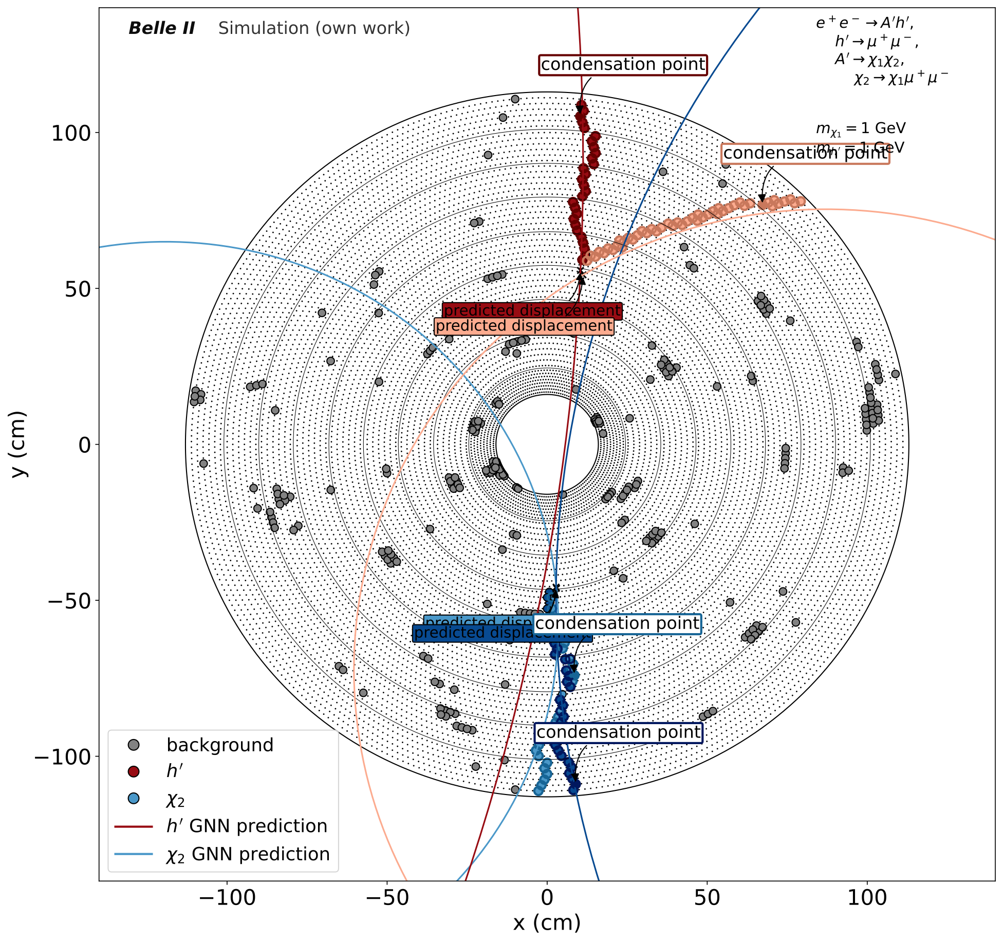
Model Prediction

Slide 27
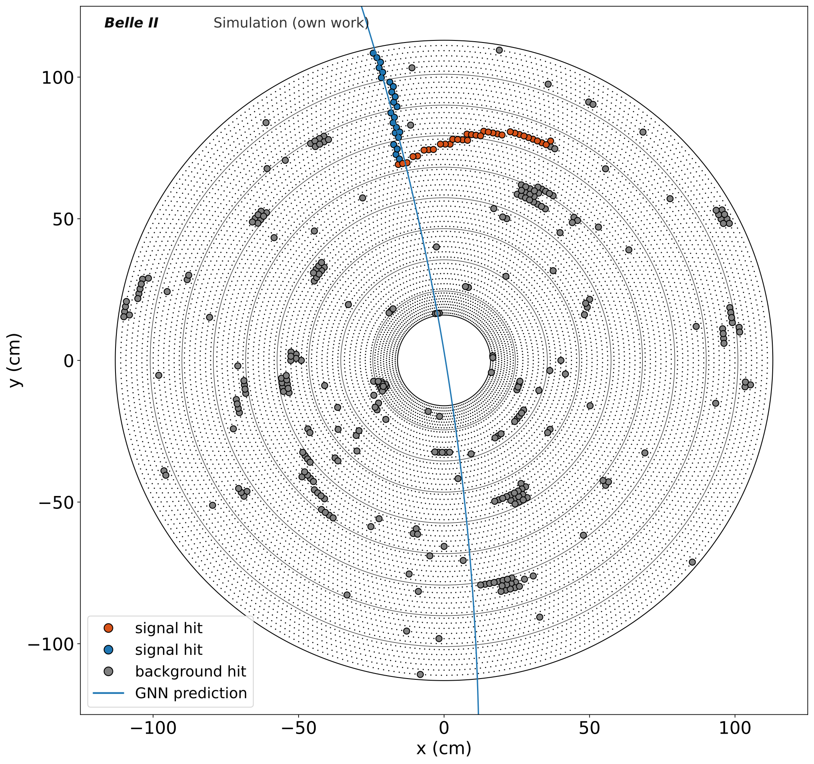
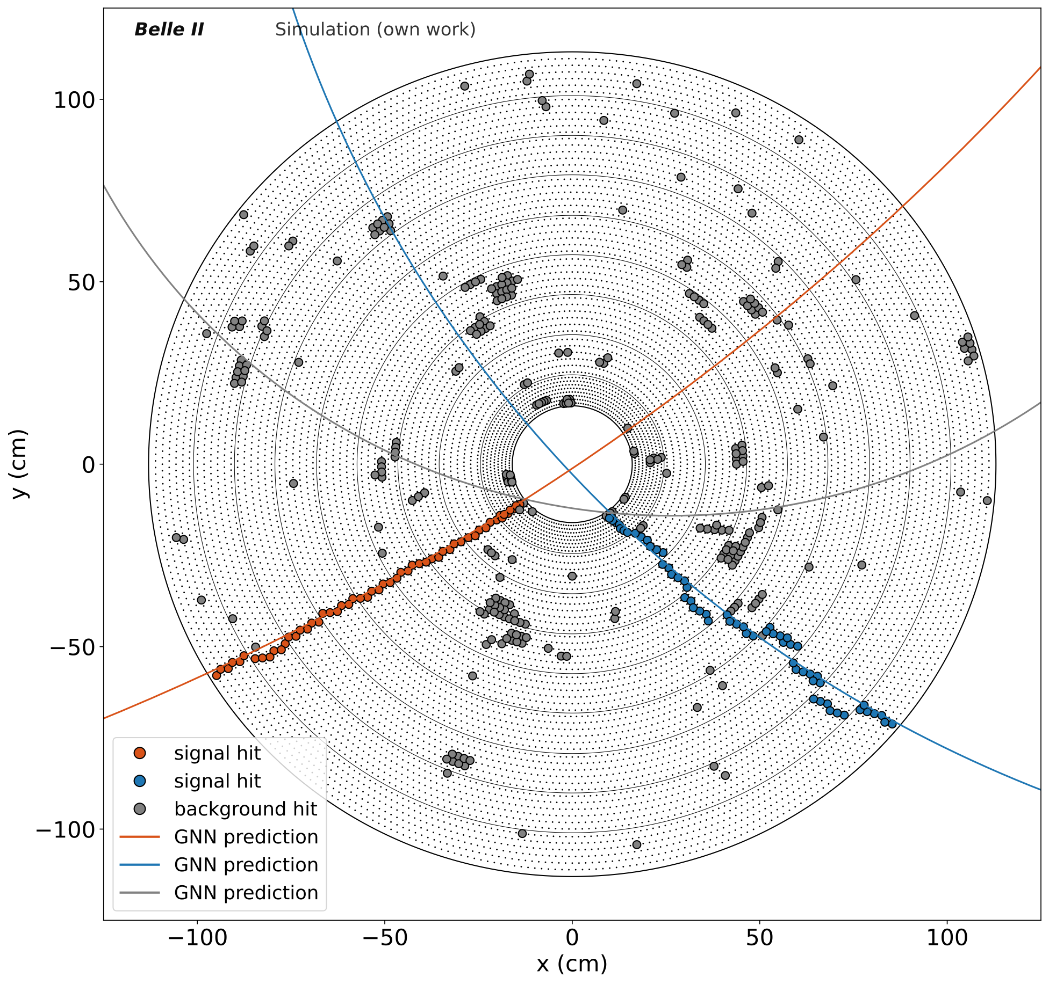
Important Metrics
Efficiency = $\frac{\text{true} \text{tracks}}{\text{all} \text{particles}}$
Purity = $\frac{\text{true} \text{tracks}}{\text{all} \text{tracks}}$
Fake Track Prediction
Missing Track Prediction

Slide 28
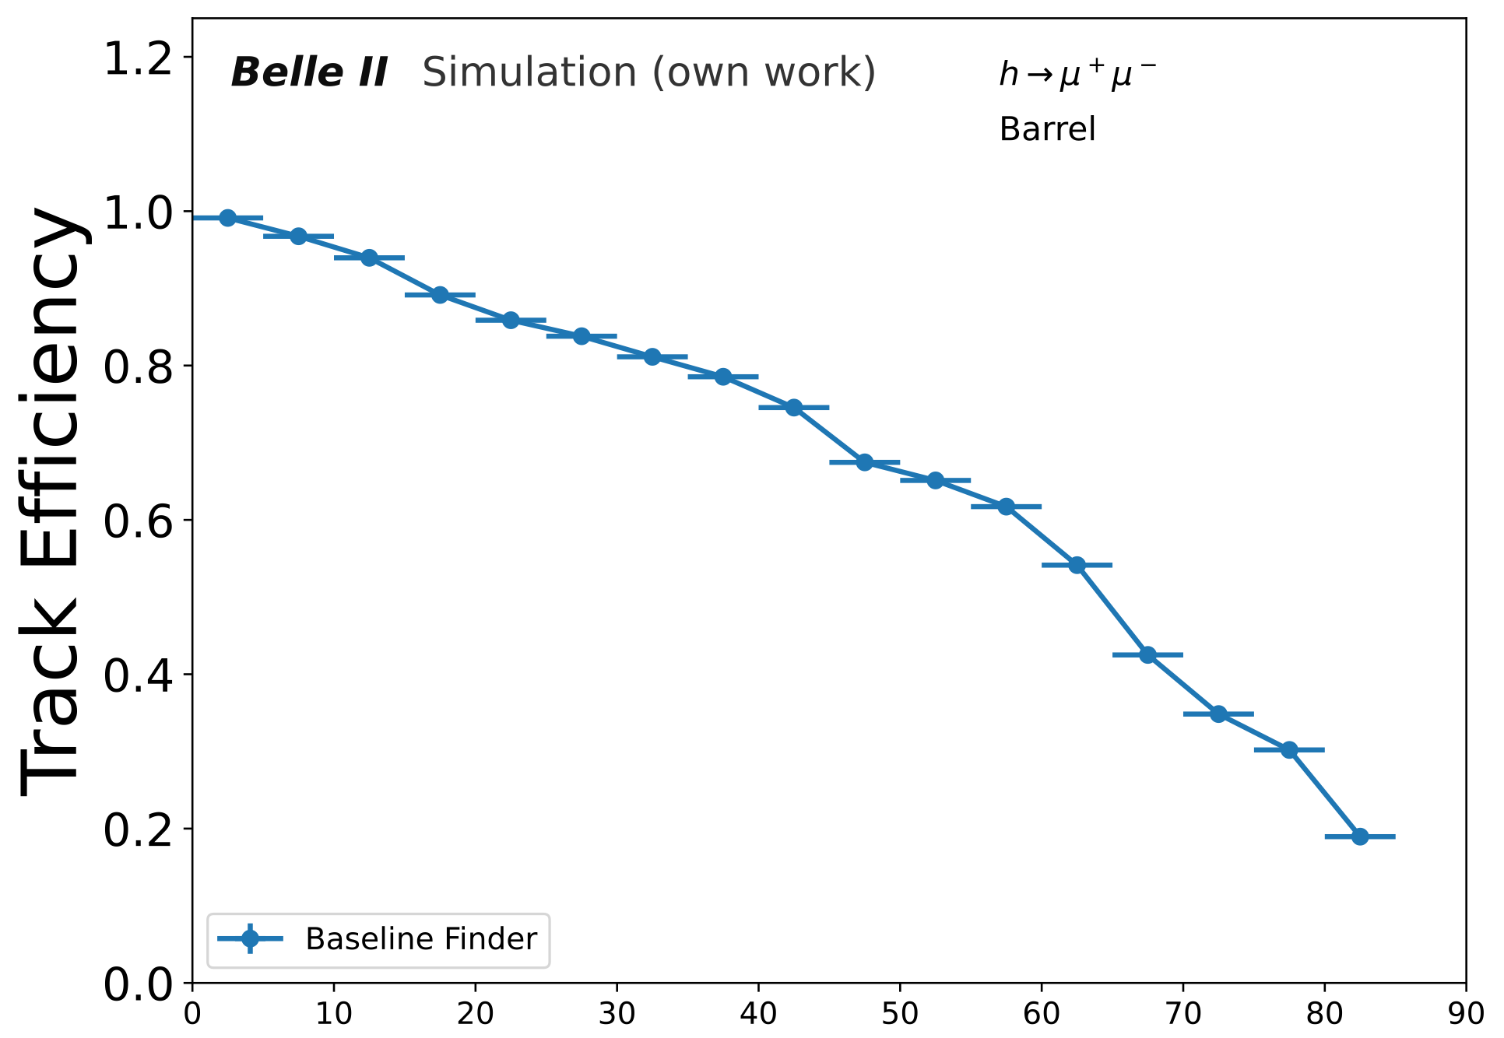
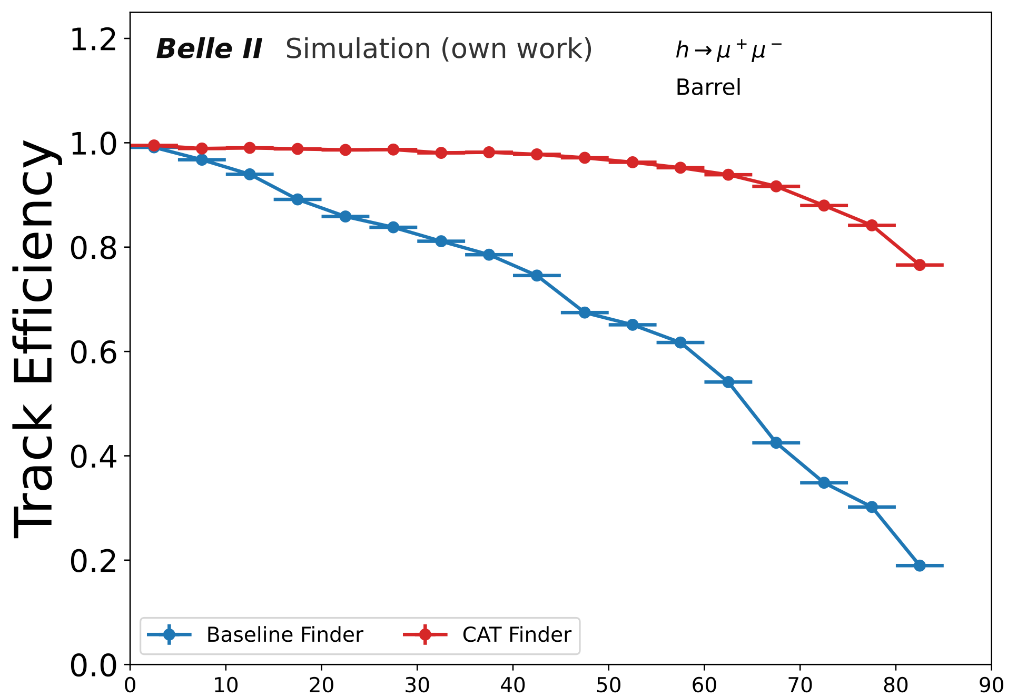
Performance
averaged | Efficiency | Purity
Baseline | 0.661^{+/-0.001} | 0.973^{+/-0.001}
Bertacchi et al., Track Finding at Belle II (arXiv:2003.12466)
CAT Finder | 0.922^{+/-0.001} | 0.998^{+/-0.001}
distance from collision point to track starting position (cm)

Slide 29
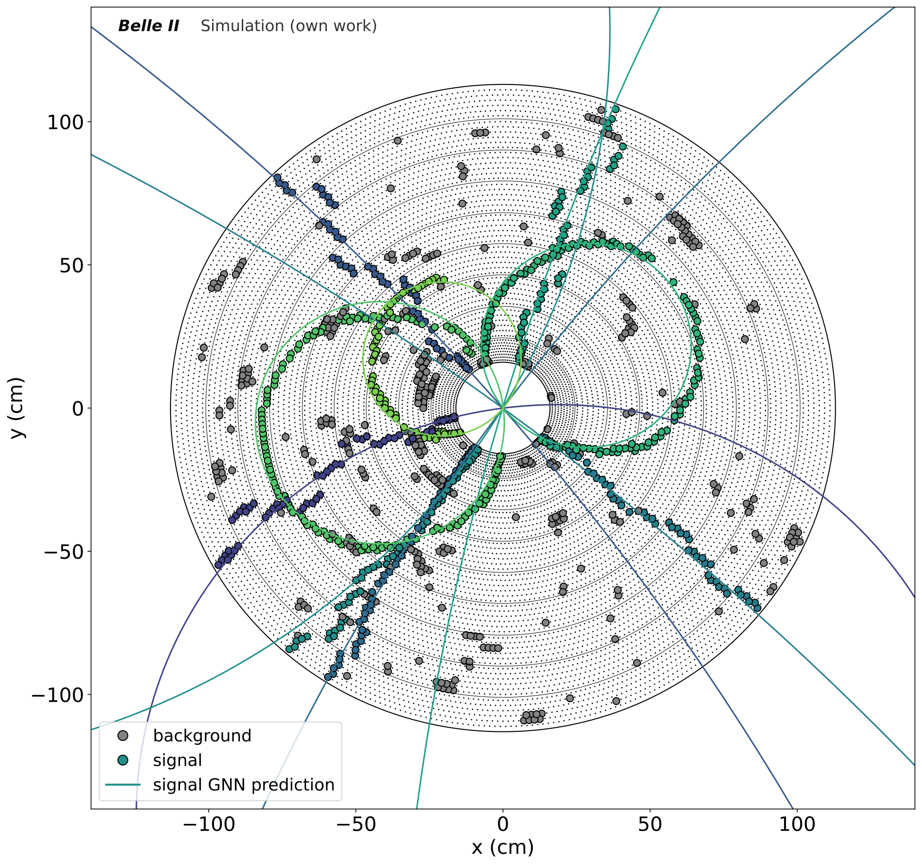
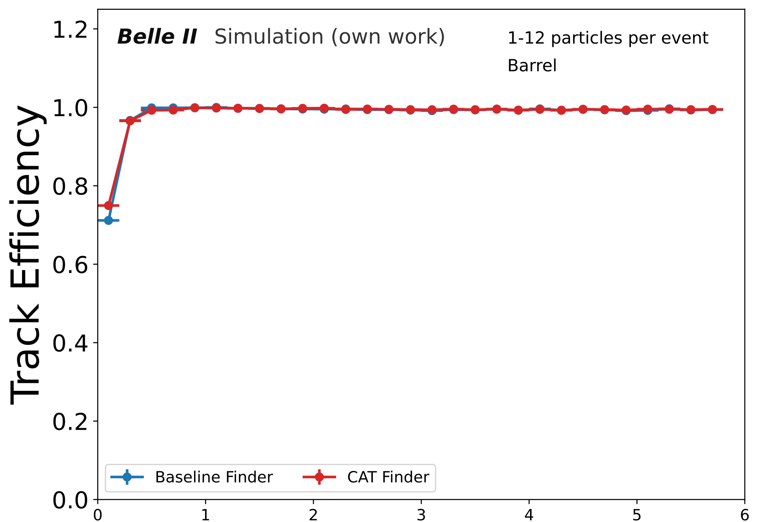
Performance
averaged | Efficiency | Purity
Baseline | 0.963^{+/-0.001} | 0.985^{+/-0.001}
(Curvature) transverse momentum (GeV)
CAT Finder | 0.966^{+/-0.001} | 0.995^{+/-0.001}

Slide 30
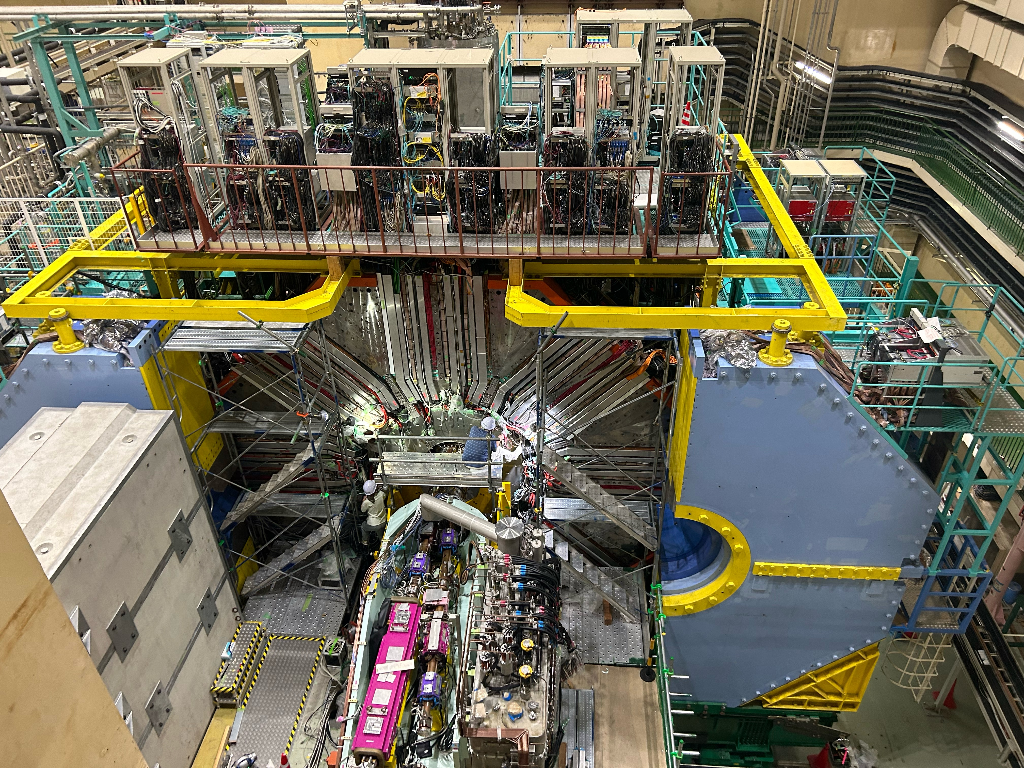
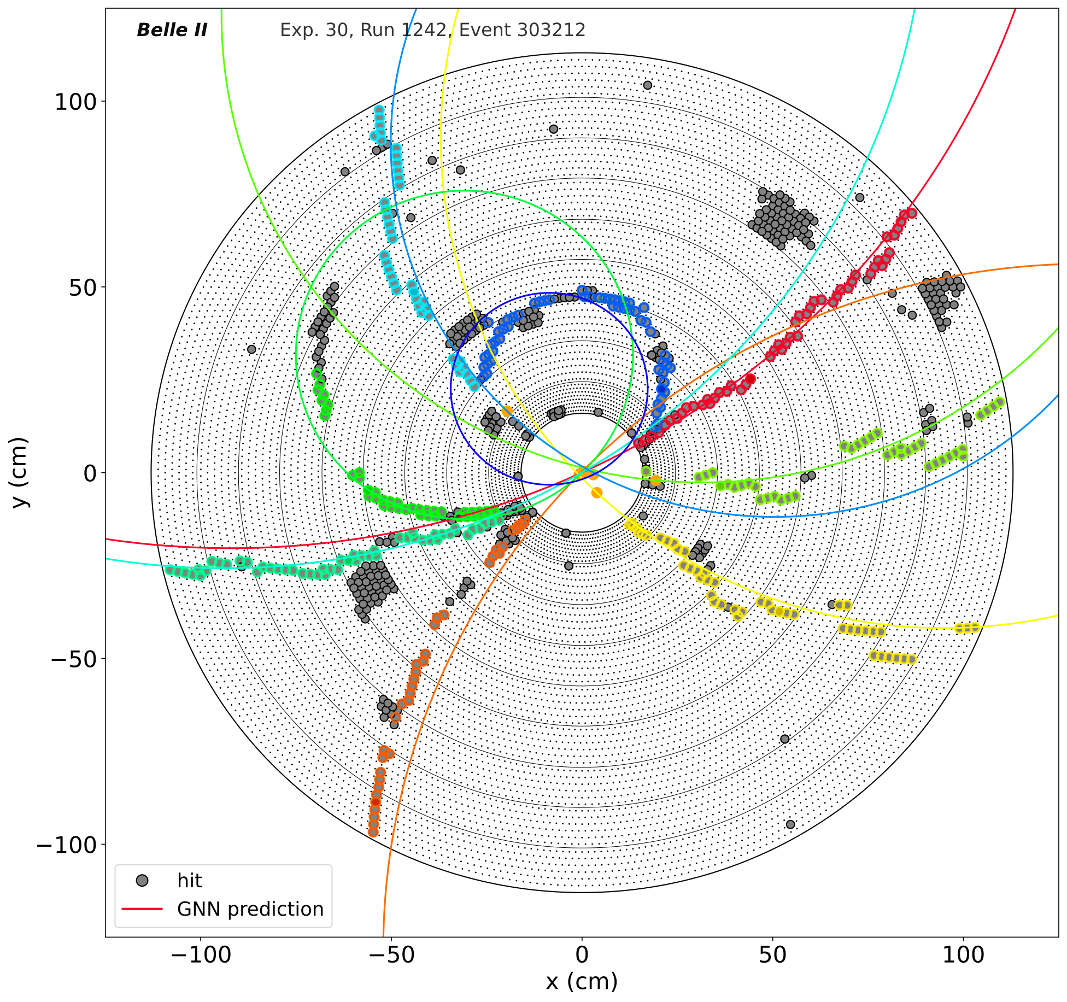
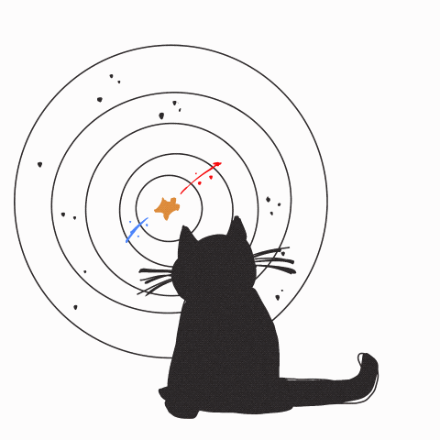
Summary
Implemented end-to-end multi-object track reconstruction algorithm using GNNs
Applicable to wide kinematic range and overlapping objects, efficiency largely independent from starting position
Suppress the varying backgrounds and achieve higher purity than baseline algorithm
Efficiency outperforms baseline algorithm for displaced tracks and has similar performance on tracks coming from the collision point
Publication in preparation

