Slide 1

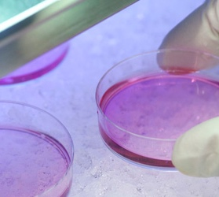

Development of a Bayesian deep-learning model to predict protein-protein interactions at proteomic scale
Manuel Seefelder, Fabrice Klein, Stefan Kochanek
Department of Gene Therapy, Ulm,
Baden-Württemberg, Germany

Slide 2
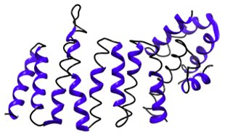
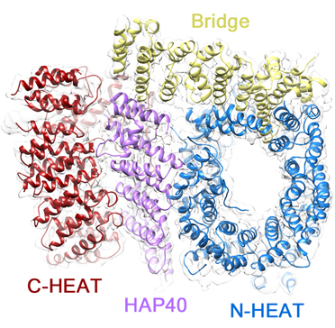
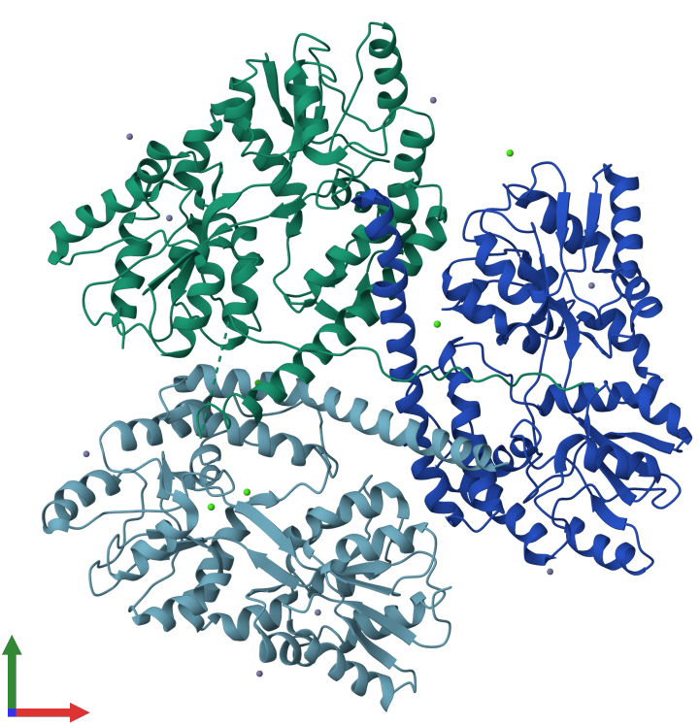
Protein-protein interactions
HAP40
HTT
P
20 proteinogenic amino acids
and PTMs
Combination of 20
proteinogenic amino acids
650,000 estimated binary protein Interactions in humans
https://www.ebi.ac.uk/pdbe/entry/pdb/3io4/portfolio/?view=entry_index#ad-image-0 (28th May 2024)
Guo et al. (2018): The cryo-electron microscopy structure of huntingtin. In: Nature 555 (7694), S. 117–120. DOI: 10.1038/nature25502.

Slide 3
Why do we need a model to infer protein-protein interactions?
High sequence diversity (630,000-6,130,000 human proteoforms)
≤ 20% of all binary protein interactions between human proteins identified
Biochemical methods are expensive, labour-intensive, and
display additional technical limitations
Potential future applications:
  Prediction of the influence of polymorphisms and mutations on the interactome
  De-novo design of new interactors
  In-silico determination of binding sites
  Studying the evolution of a protein’s interactome
G
P
20 proteinogenic amino acids
and PTMs

Slide 4
Application of convolutional networks for the prediction of PPIs
Sequence 1
Sequence 2
N = 1024
Embedding layer
Data set | Accuracy [%] | Loss
Traning set | 99.98% | 0.0082
Non redundant test set | 99.99 % | 0.0083
HIPPIE database | 91.09% | 0.0373
N = 1024
Convolutional layers with max pooling
Merging layer
N = 1024
Dense Neural Network
N = 1024
N = 2
Output layer
Total parameters: 10,761,153
Trainable parameters: 10,761,153

Slide 5
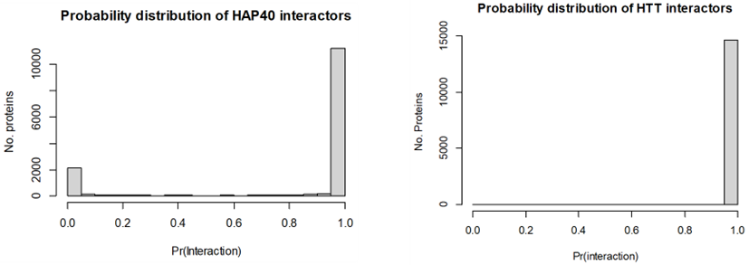
Number of predicted interactors correlate with protein localisation
Probability distribution of HAP40 interactors
N = 1024
Protein | Localisation | Number of predicted interactor (P > 0.95)
Histone 2 | Nuclear | 351
HAP40 | Cytoplasmic & Nuclear | 11,000
HTT | Cytoplasmic & Nuclear & Endosomal & Golgi | 15,000
N = 1024
N = 1024
Probability distribution of HTT interactors
N = 1024
N = 2

Slide 6
Limitations of current models
Inadequate training data and test data of current models: Current models use proteins localized to different compartments as non-interacting proteins, leading to shortcut learning.
Exclusive use of protein sequence data: Neglects important information from protein domains and other structural features.
Lack of Uncertainty Information
  Epistemic Uncertainty: Is the training data sufficient? Is the queried protein too different from other proteins in the training data?
  Aleatoric Uncertainty: PPI data is noisy due to the low sensitivity and specificity of biochemical methods.
Generation of a novel dataset using comprehensive
Yeast-two-hybrid screenings

Slide 7
Our solution: a Bayesian transformer model
Sequence 1
Sequence 2
Embedding layer
Convolutional layers with max pooling
Mulit-Head-Attention Layers
Dense Neural Network
Probability of Interaction
Epoch 31
Epoch 72

Slide 8
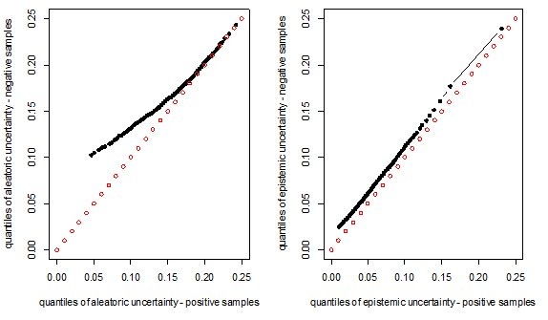
Higher aleatoric uncertainty for non-interacting protein pairs
Higher aleatoric uncertainty on
samples from the negative class
Low correlation between label and protein sequence
Limited sensitivity of biochemical approaches leads to many wrong-labelled protein pairs.

Slide 9
Summary & Outlook
Shortcut Learning: Use of proteins localized to different cellular compartments likely leads to shortcut learning.
Bayesian Neural Networks: Better differentiation between confident and unconfident predictions.
Enhanced Prediction Accuracy: Utilization of data from extensive Yeast Two-Hybrid (Y2H) screens improves prediction accuracy on a proteomic scale.
Dataset: Y2H screens alone have low sensitivity, resulting in numerous incorrectly labelled non-interacting proteins.
Further model refinement and a more stringent dataset curation

Slide 10

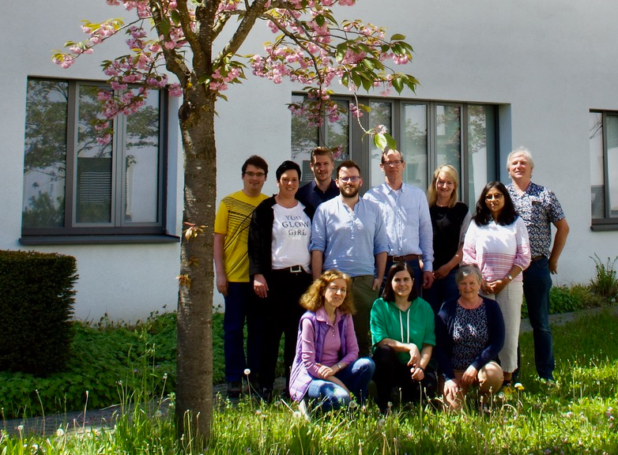

Acknowledgements
University Hospital Ulm,
Department of Gene Therapy
Thank you for your attention!
Prof. Dr. Stefan Kochanek
Dr. Fabrice Klein
and all other members of the department

Slide 11
