Slide 1
Neuromorphic sequence learning with memristive in-memory computing -- from algorithm to hardware demonstration --
Mem spiking tm
13.06.2024 | Sebastian Siegel, Tobias Ziegler, Younes Bouhadjar, Tom Tetzlaff,
Rainer Waser, Regina Dittmann and Dirk Wouters
PGI-7/10 & INM-6 Forschungszentrum Jülich gmbh
IWE2 RWTH Aachen University

Slide 2
New computing paradigms
New algorithms
New materials and devices
SRC Report 2015

Slide 3
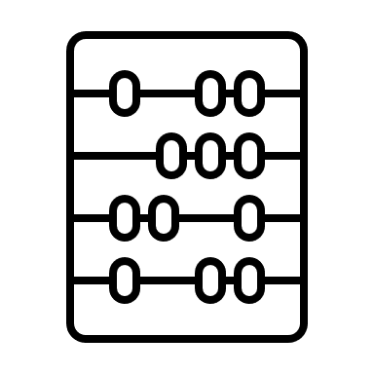
Sequence prediction
Core functionality of the human brain
Neuromorphic Hardware
- energy-efficiency
- small area
- biological time constants
before learning
after learning
3

Slide 4
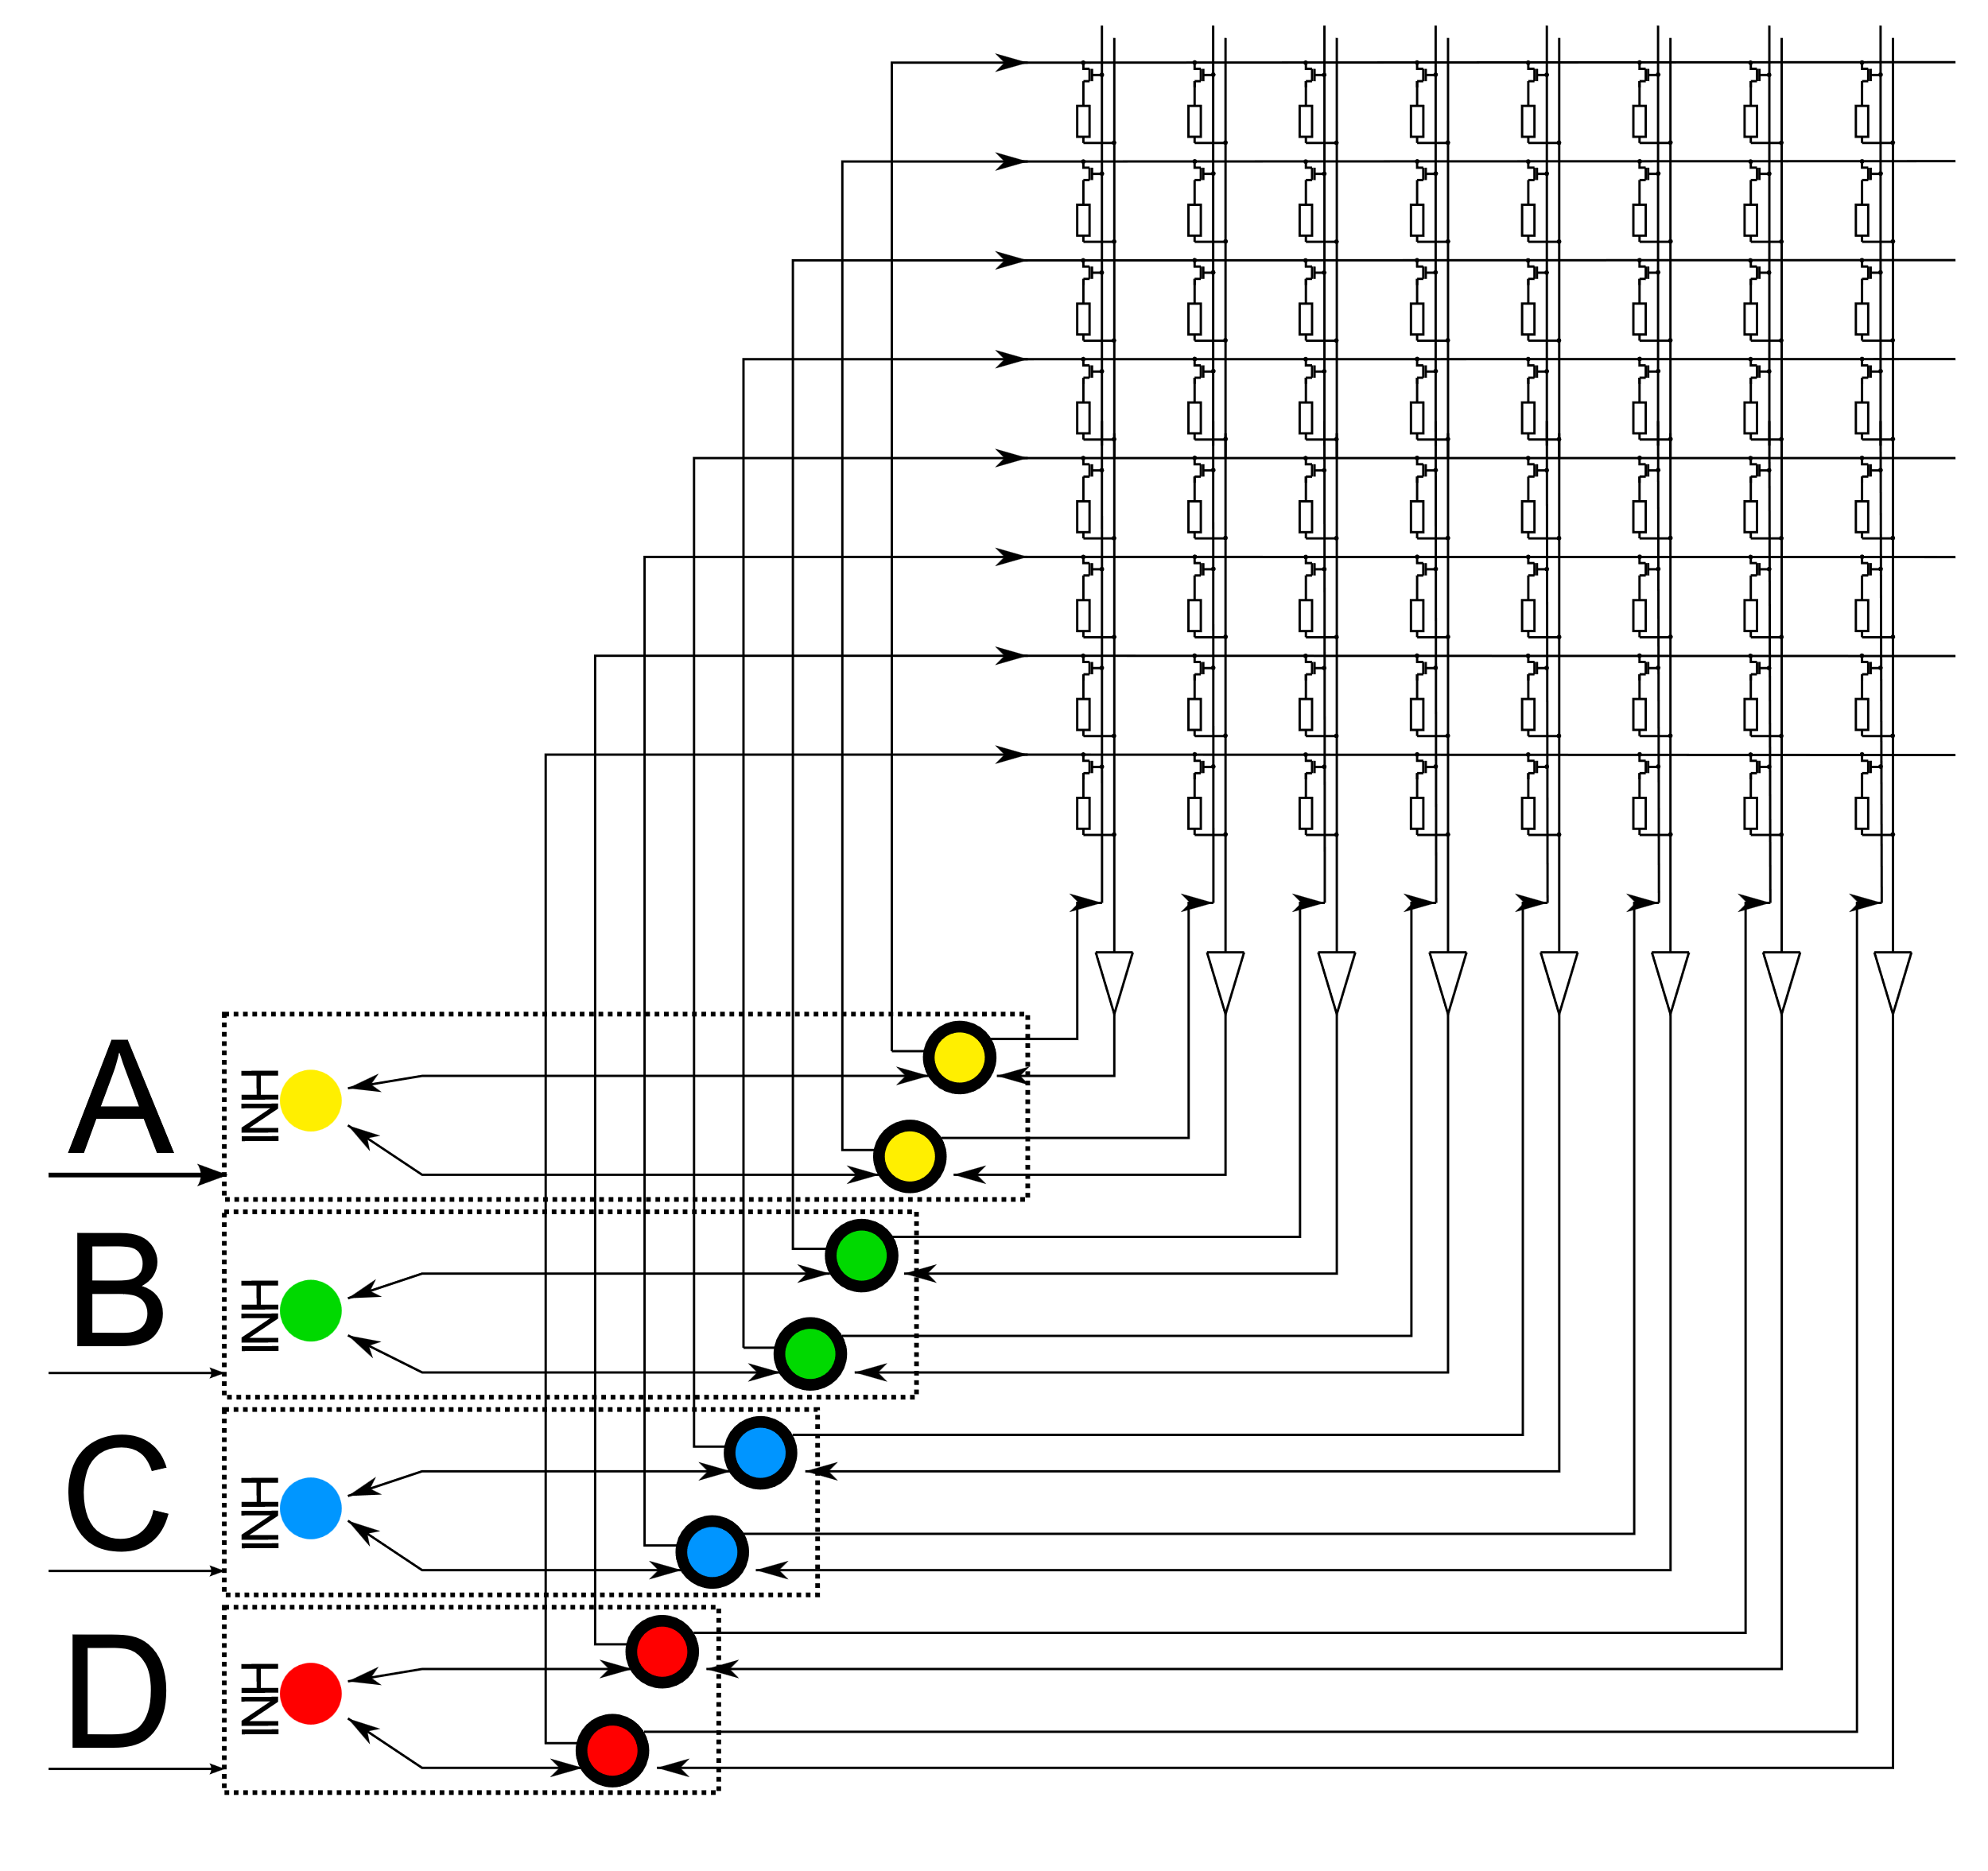
Biological inspiration to sequence learning
From biology to Spiking Temporal Memory (STM)
Brain to Algorithm
Algorithm to Hardware
Spiking Temporal Memory
Bouhadjar, Younes, et al. "Sequence learning, prediction, and replay in networks of spiking neurons."
PLOS Computational Biology 18.6 (2022): e1010233.
MemSpikingTM
Siegel et al. "System model of neuromorphic sequence learning on a memristive crossbar array."
IOP Neuromorphic Computing and Engineering (accepted)
4

Slide 5
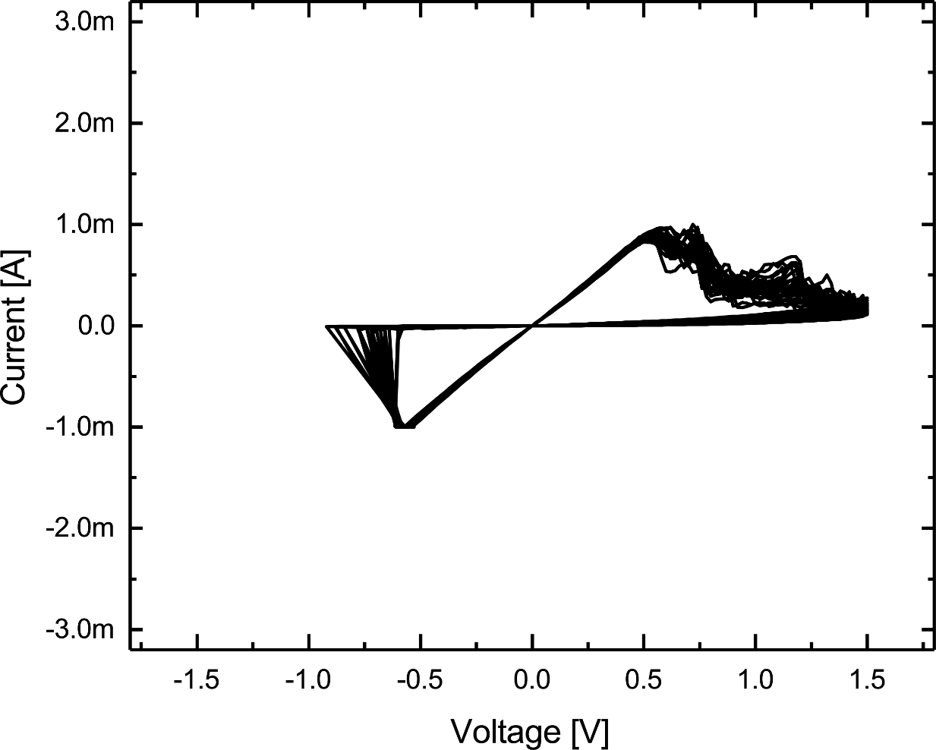
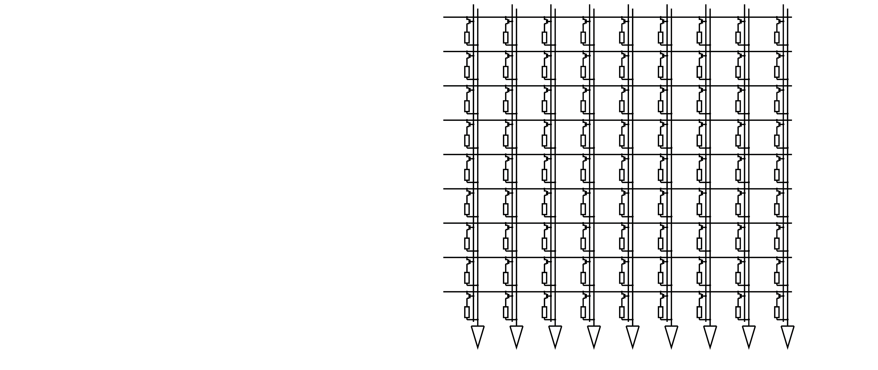
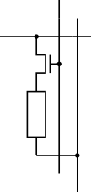
Memristive devices
Principles
F. Cüppers et al., APL Materials 7, 091105 (2019)
Adapted from Nanoelectronic for Information technology, R. Waser (2013)
5

Slide 6
Mem spiking tm
Benchmark tasks (simulation)
$$\left(A … 10xB…C\right),$$
$$(D…10xE …F)$$
$$\left(ABCDEFGH\right),$$
$$\left(HGFEDCBA\right),$$
$$\left(AXXXXXXH\right),$$
$$\left(HXXXXXXA\right)$$
Tasks proposed in: Lazar, Andreea, Gordon Pipa, and Jochen Triesch.
"SORN: a self-organizing recurrent neural network."
Frontiers in computational neuroscience (2009): 23.

Slide 7
Mem spiking tm system
Hebbian learning rule
w/ inhibition & homeostasis
Memristive crossbar array
Generation of external stimuli
$$2.25 mm$$
Inhibitory
neurons
Excitatory neurons

Slide 8
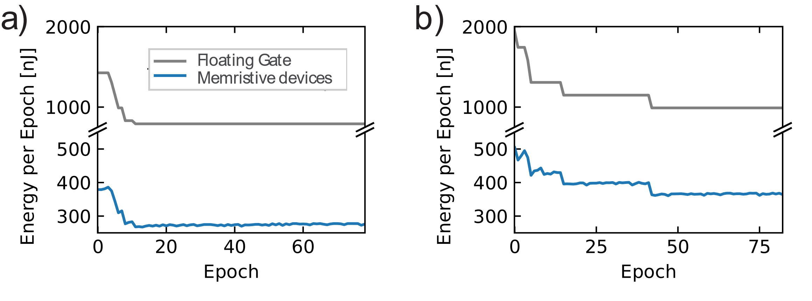
Mem spiking tm
Energy efficiency (simulation)
$$\left(ABC\right), (DBE)$$
$$\left(ABCD\right), (EBCF)$$
60% energy savings
66% energy savings

Slide 9
Mem spiking tm system
Hebbian learning rule
w/ inhibition & homeostasis
Generation of external stimuli
$$2.25 mm$$
32kbit 1T1R arrays
- 130nm CMOS
- HfO ReRAM devices
-> MAD200 process
(STM + LETI)
Inhibitory
neurons
Excitatory neurons

Slide 10
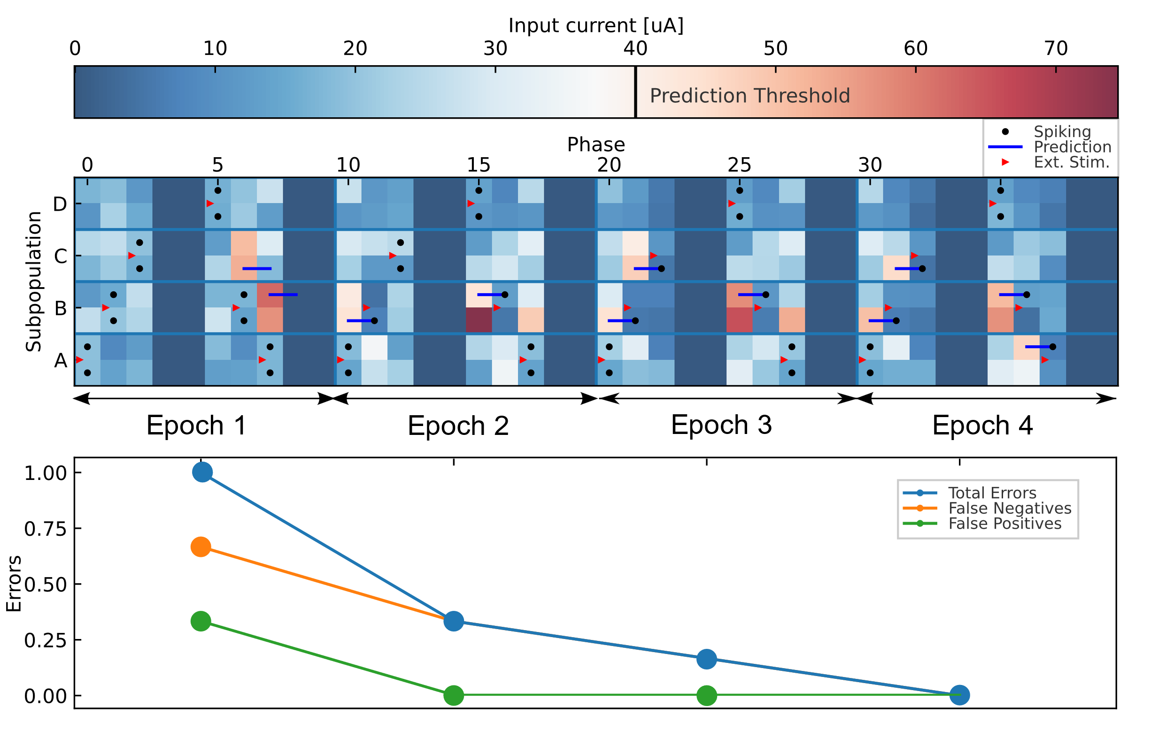
High order sequence learning
Sequence: ABC__DBA__
ABC
DBA

Slide 11
conclusion
Neuromorphic computing - From algorithm to system to hardware
66% energy savings
MemSpikingTM for Sequence Learning
Energy-efficiency with memristive NC solutions
Deployment on fabricated 1T1R arrays
Thank you for your attention!

Slide 12
Backup slides
Mem spiking tm

Slide 13
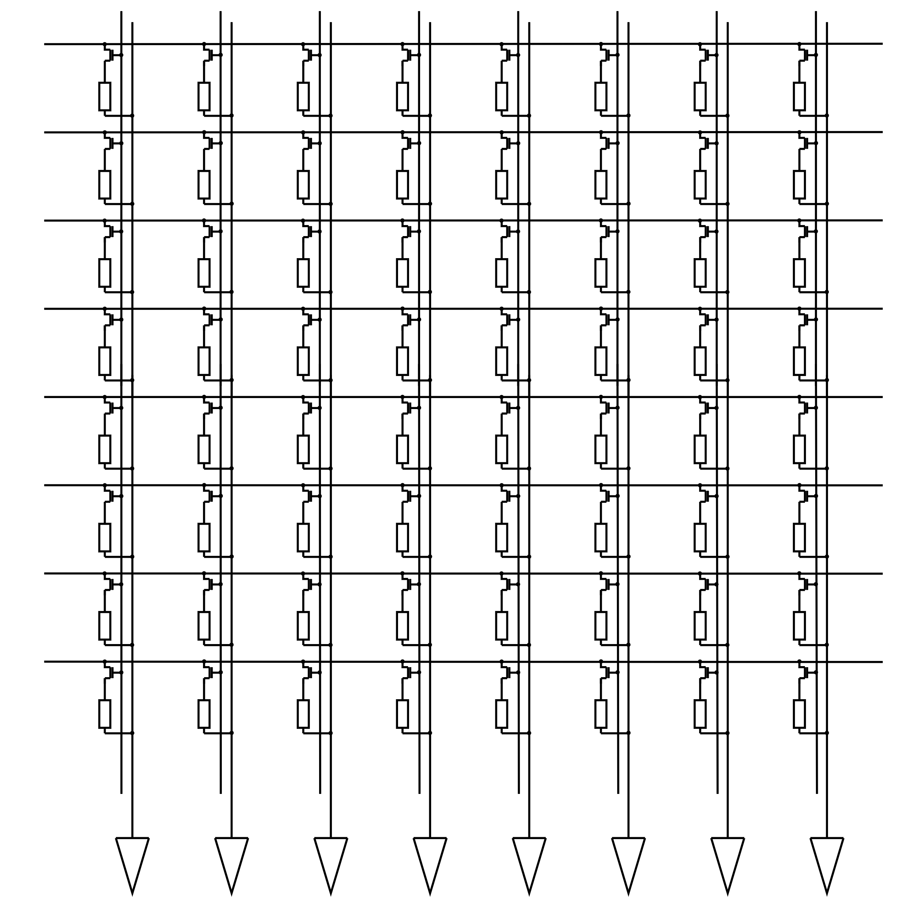
Memristive crossbar array
Compute-in-memory operations
Read-out: Vector-matrix multiplication
Update: Outer product
$$\left(\begin{matrix}1 & 1 & 1\end{matrix} \begin{matrix}1 & 1 & 1 \end{matrix}\begin{matrix}1 & 1\end{matrix}\right)∗V_{gate}$$
$$\left(\begin{matrix}0 & 1 & 1\end{matrix} \begin{matrix}0 & 0 & 0 \end{matrix}\begin{matrix}1 & 0\end{matrix}\right)∗V_{gate}$$
$$V_{read}\left(\begin{aligned}1 \\ 0 \\ 1 \\ 1 \\ 0 \\ 0 \\ 0 \\ 0\end{aligned}\right)$$
$$V_{pulse}\left(\begin{aligned}0 \\ 0 \\ 0 \\ 0 \\ 1 \\ 1 \\ 0 \\ 0\end{aligned}\right)$$
$$\left(\begin{matrix}I_{1} & I_{2} & I_{3}\end{matrix} \begin{matrix}I_{4} & I_{5} & I_{6} \end{matrix}\begin{matrix}I_{7} & I_{8}\end{matrix}\right)$$
$$G←G+f(V_{in}⊗V_{gate}, G)$$
$$I=G∗V$$

Slide 14
Mem spiking TM algorithm
A B C _ _
“A”
“B”
“C”
READ
Update
READ
Update
READ
Update
A
B
C
D
$$\left(\begin{matrix}1 & 1 & 1\end{matrix} \begin{matrix}1 & 1 & 1 \end{matrix}1 1\right)∗V_{gate}$$
$$\left(\begin{matrix}0 & 0 & 1\end{matrix} \begin{matrix}1 & 0 & 0 \end{matrix}\begin{matrix}0 & 0\end{matrix}\right)∗V_{gate}$$
A
$$\left(\begin{aligned}0 \\ 0 \\ 1 \\ 1 \\ 0 \\ 0 \\ 0 \\ 0\end{aligned}\right)V_{read}$$
A
$$\left(\begin{aligned}1 \\ 1 \\ 0 \\ 0 \\ 0 \\ 0 \\ 0 \\ 0\end{aligned}\right)V_{pot}$$
B
B
C
C
D
D
$$\left(\begin{matrix}I_{1} & I_{2} & I_{3}\end{matrix} \begin{matrix}I_{4} & I_{5} & I_{6} \end{matrix}\begin{matrix}I_{7} & I_{8}\end{matrix}\right)$$
$$\left(\begin{matrix}I_{1} & I_{2} & I_{3}\end{matrix} \begin{matrix}I_{4} & I_{5} & I_{6} \end{matrix}\begin{matrix}I_{7} & I_{8}\end{matrix}\right)$$

Slide 15
Mem spiking TM algorithm
A B C
“A”
“B”
“C”
READ
Update
READ
Update
READ
Update
A
B
C
D
A
B
C
D

Slide 16
Mem spiking TM algorithm
A B C
“A”
“B”
“C”
READ
Update
READ
Update
READ
Update
A
B
C
D
A
B
C
D

Slide 17
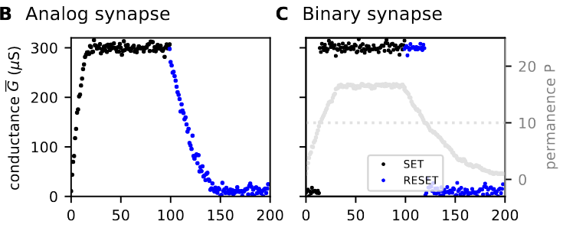
Step 1: memristive synapse dynamics
Analog and binary switching modes
Bouhadjar, Y., et al., “Sequence learning in a spiking neuronal network with memristive synapses”, under review (2023)

Slide 18
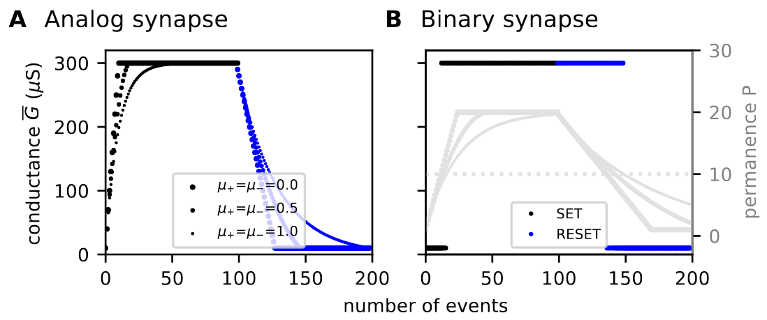
Step 1: memristive synapse dynamics
Non-linearity
$$μ_{−}$$
$$μ_{−}$$
Bouhadjar, Y., et al., “Sequence learning in a spiking neuronal network with memristive synapses”, under review (2023)

Slide 19
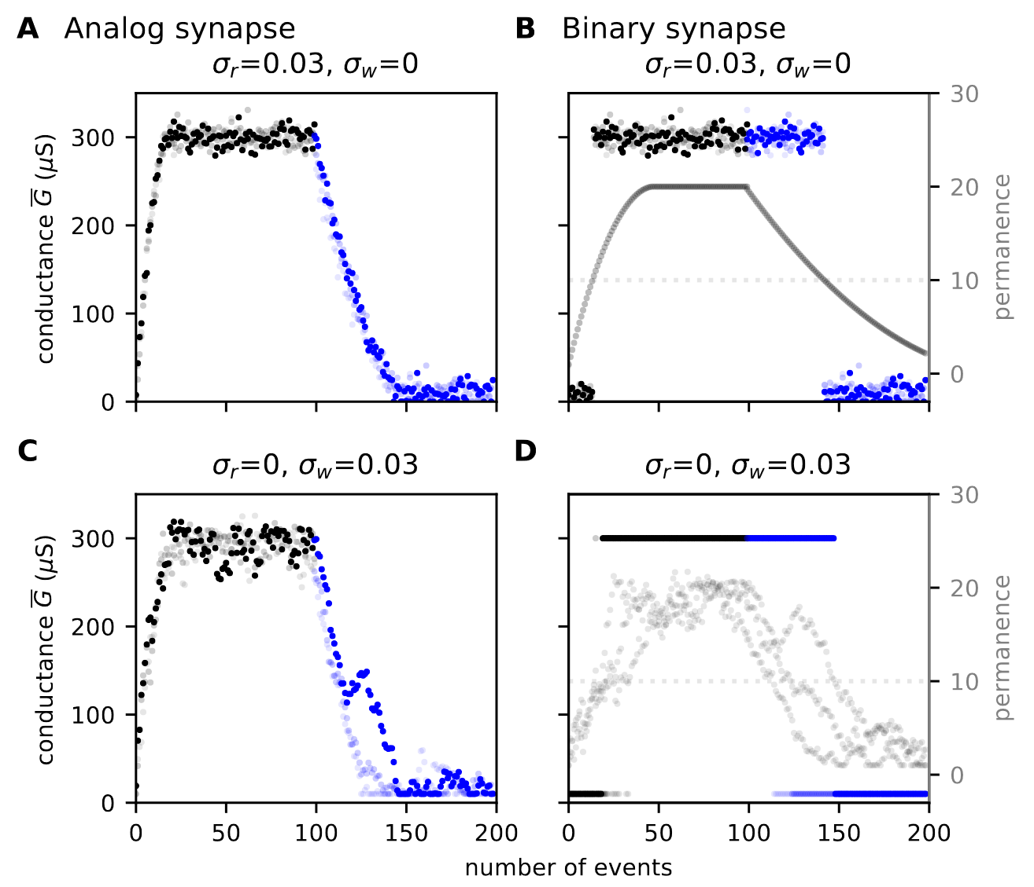
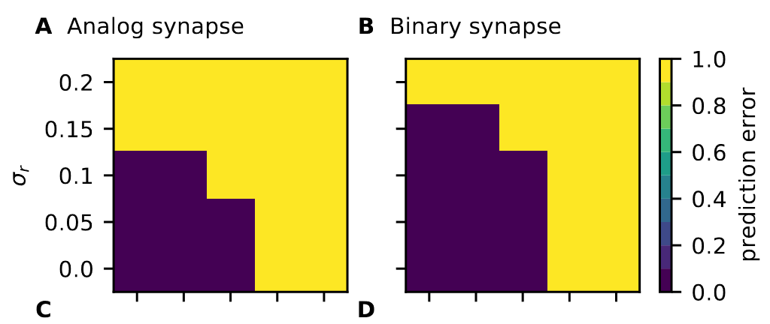
Step 1: memristive synapse dynamics
Noise
$$σ_{w}$$
$$σ_{w}$$

Slide 20
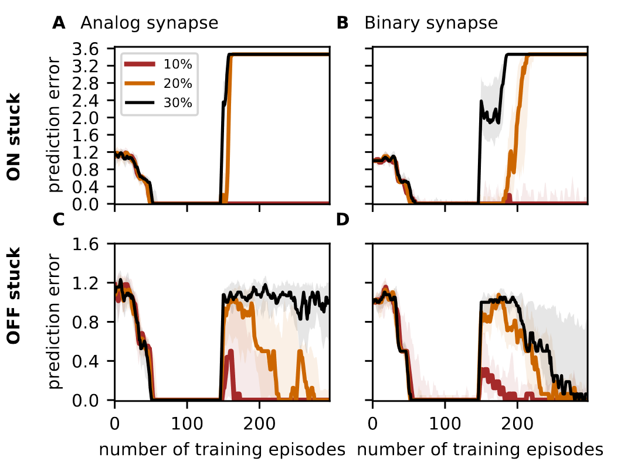
Step 1: memristive synapse dynamics
Stuck-at faults
STEP 1:
Memristive synapse dynamics
Bouhadjar, Y., et al., “Sequence learning in a spiking neuronal network with memristive synapses”, under review (2023)

