Slide 1
Marvels uncertain Universe
Tobias Schanz
Training Neural Network Ensembles

Slide 2
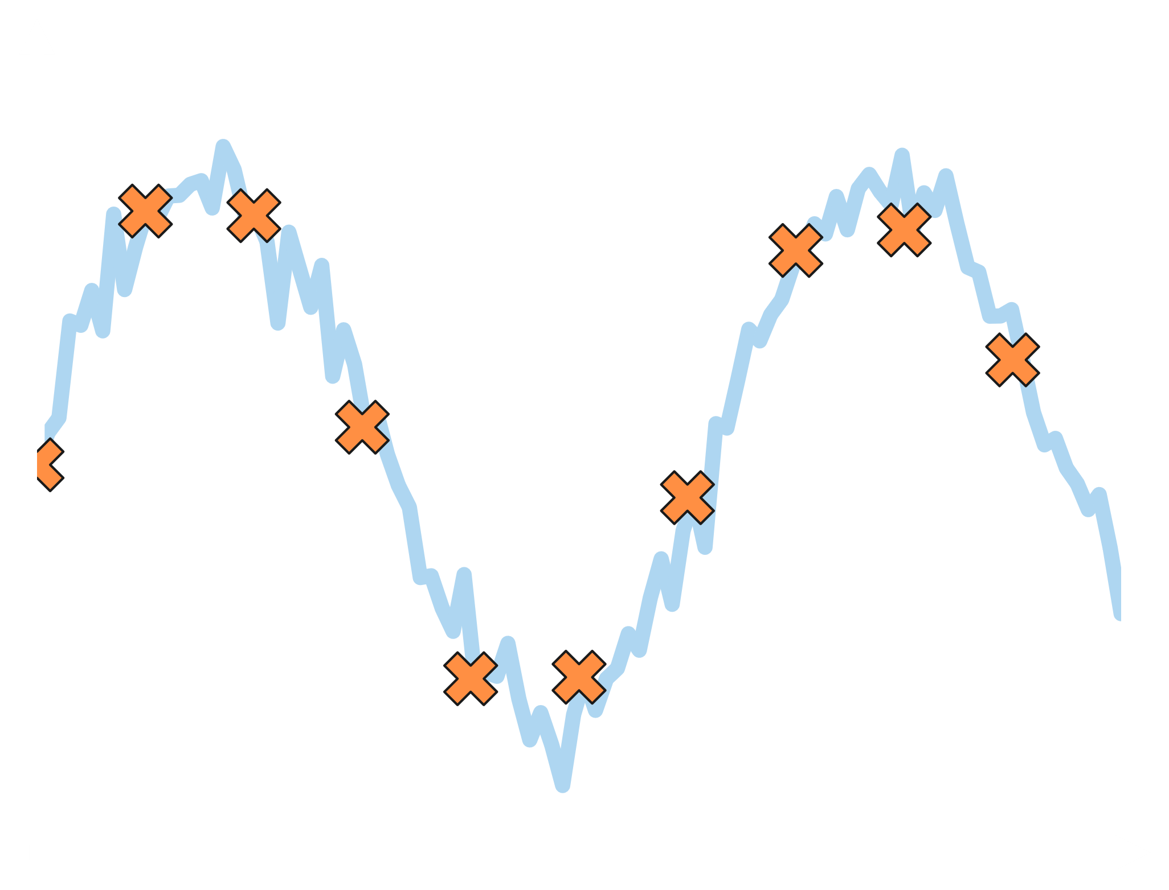
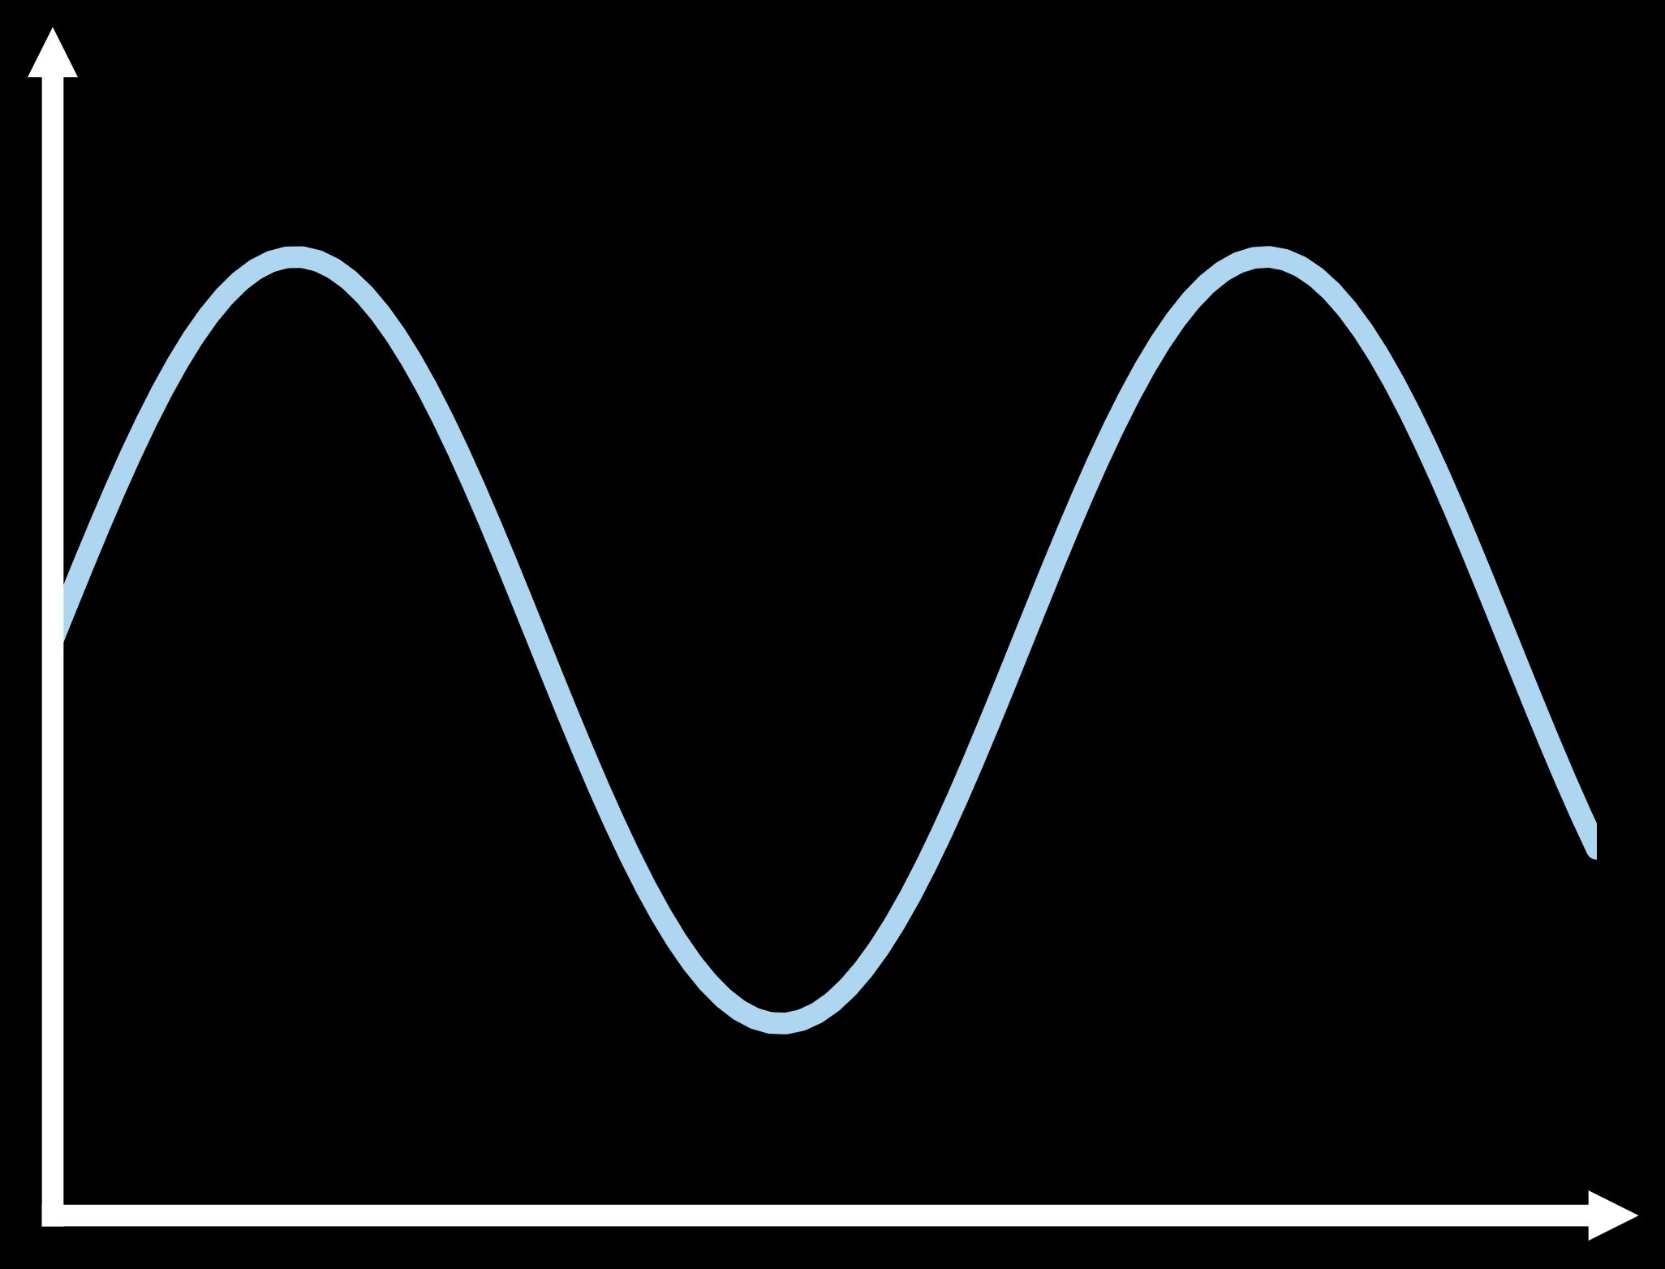
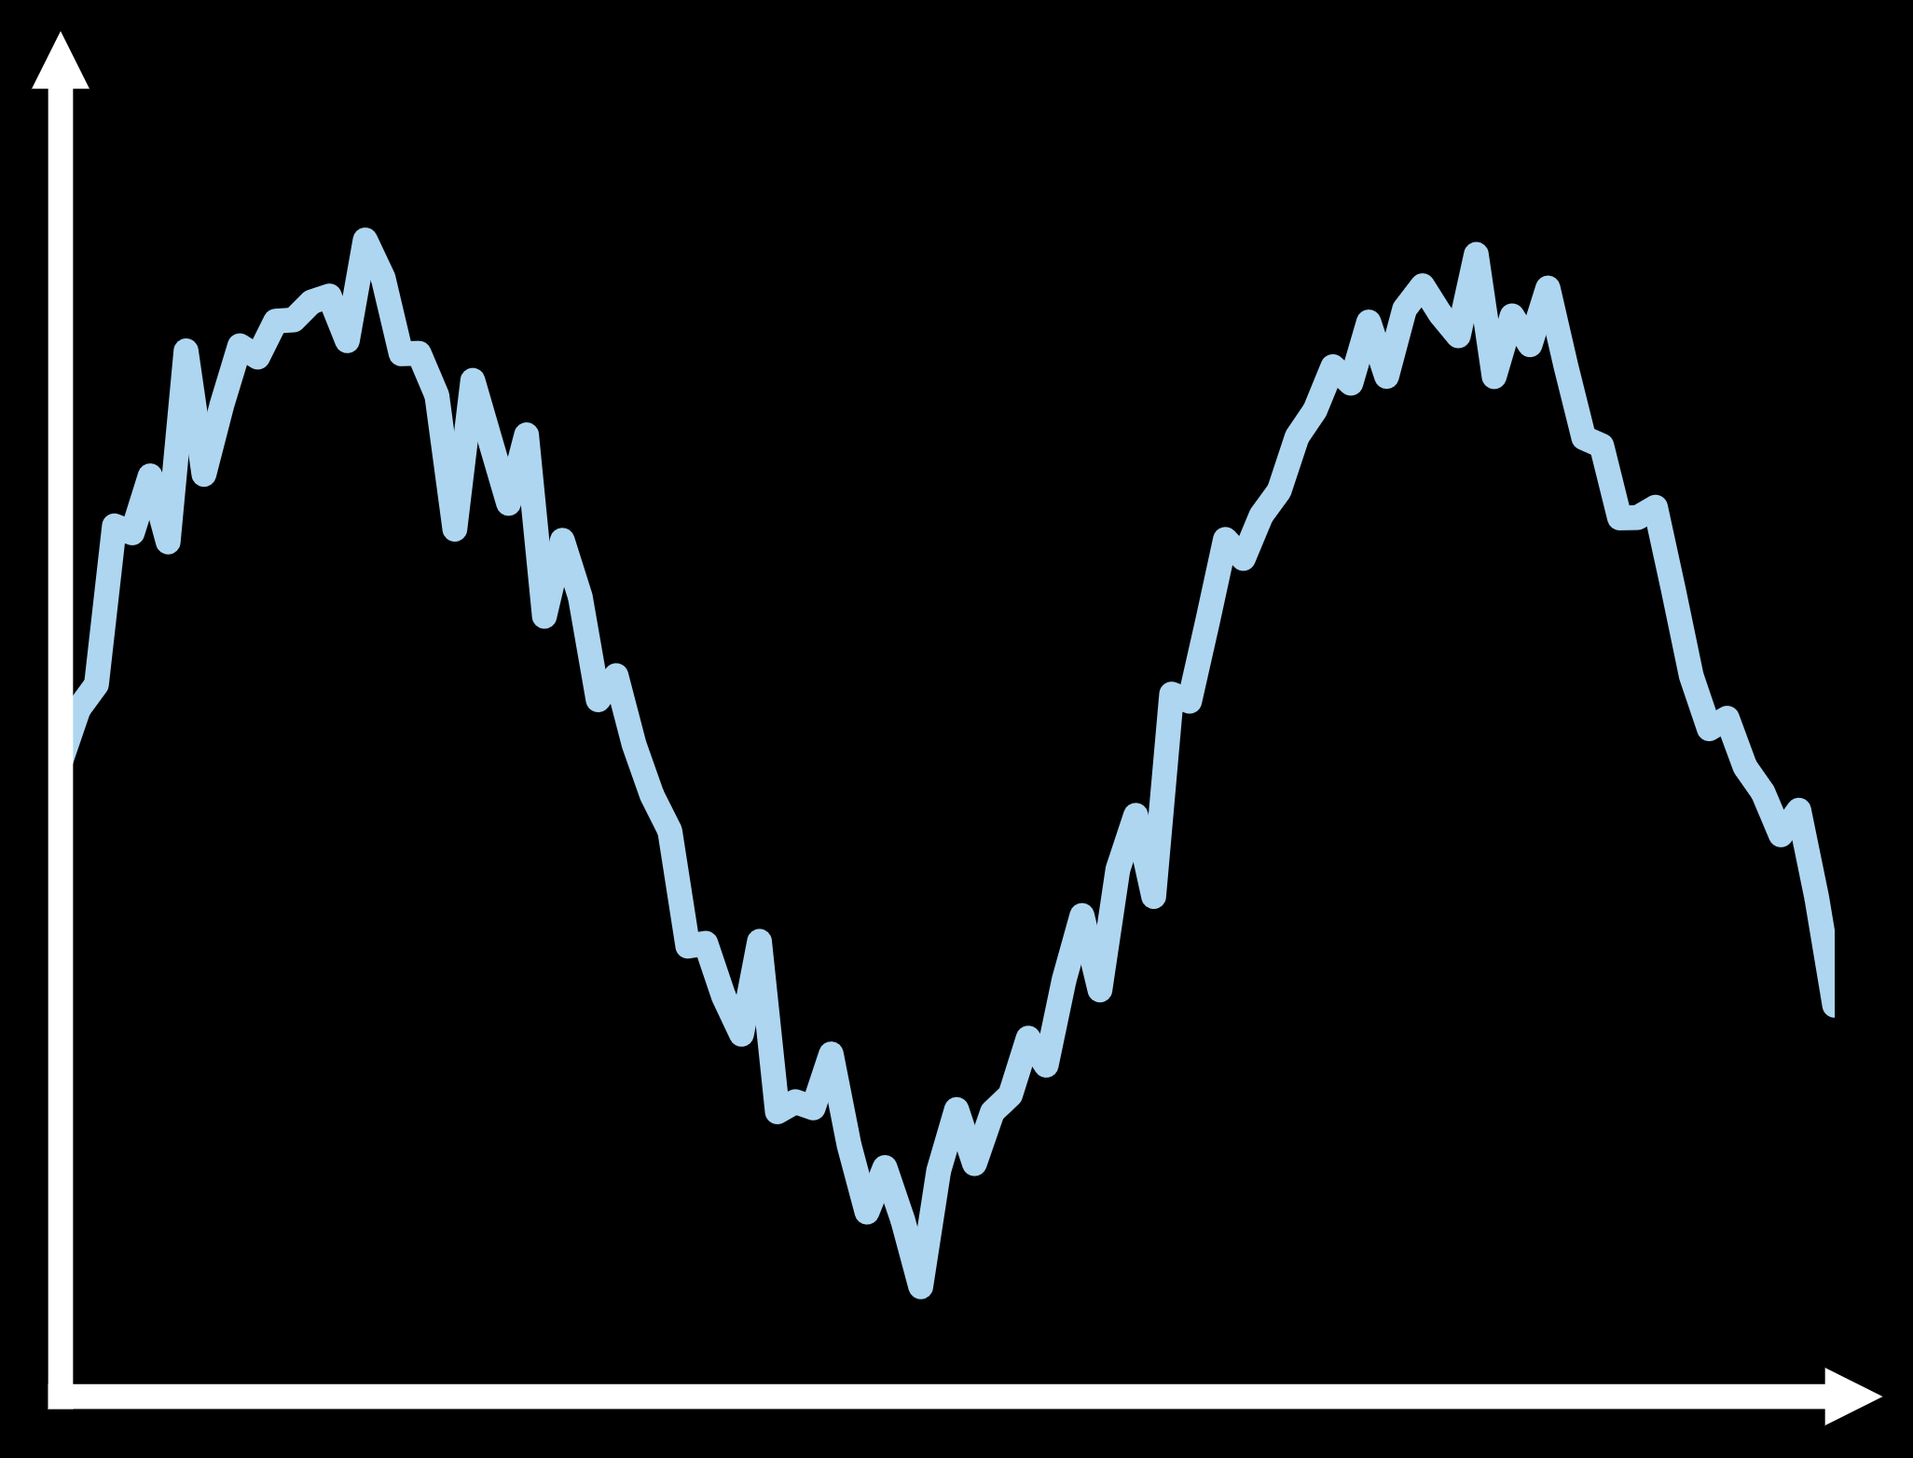
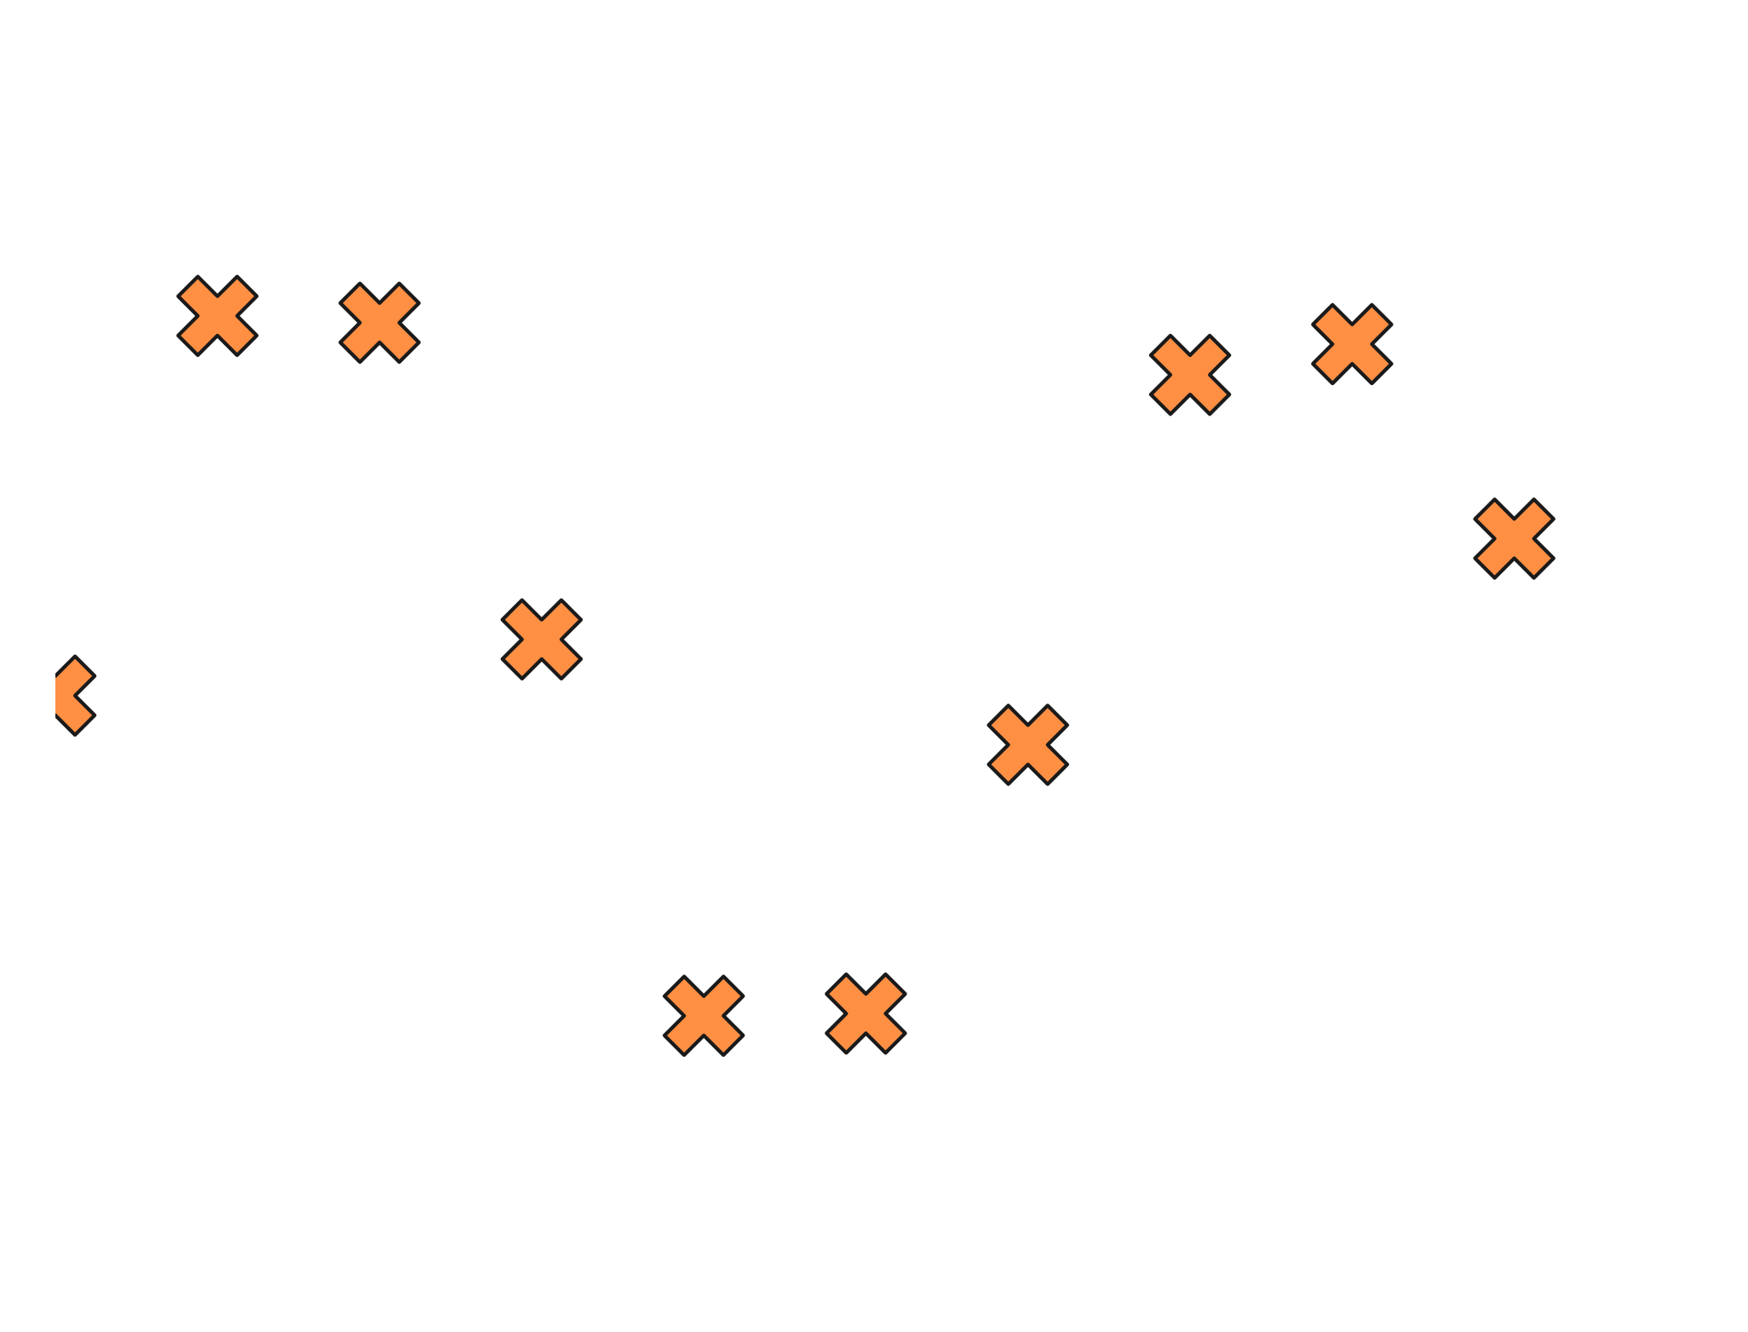
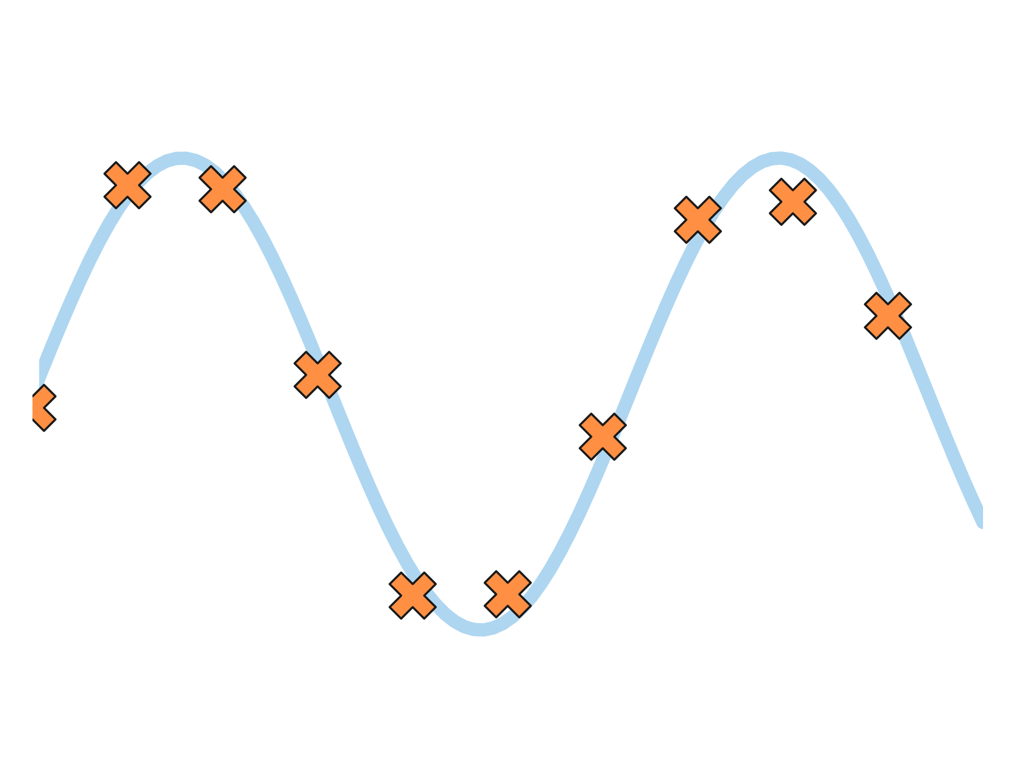
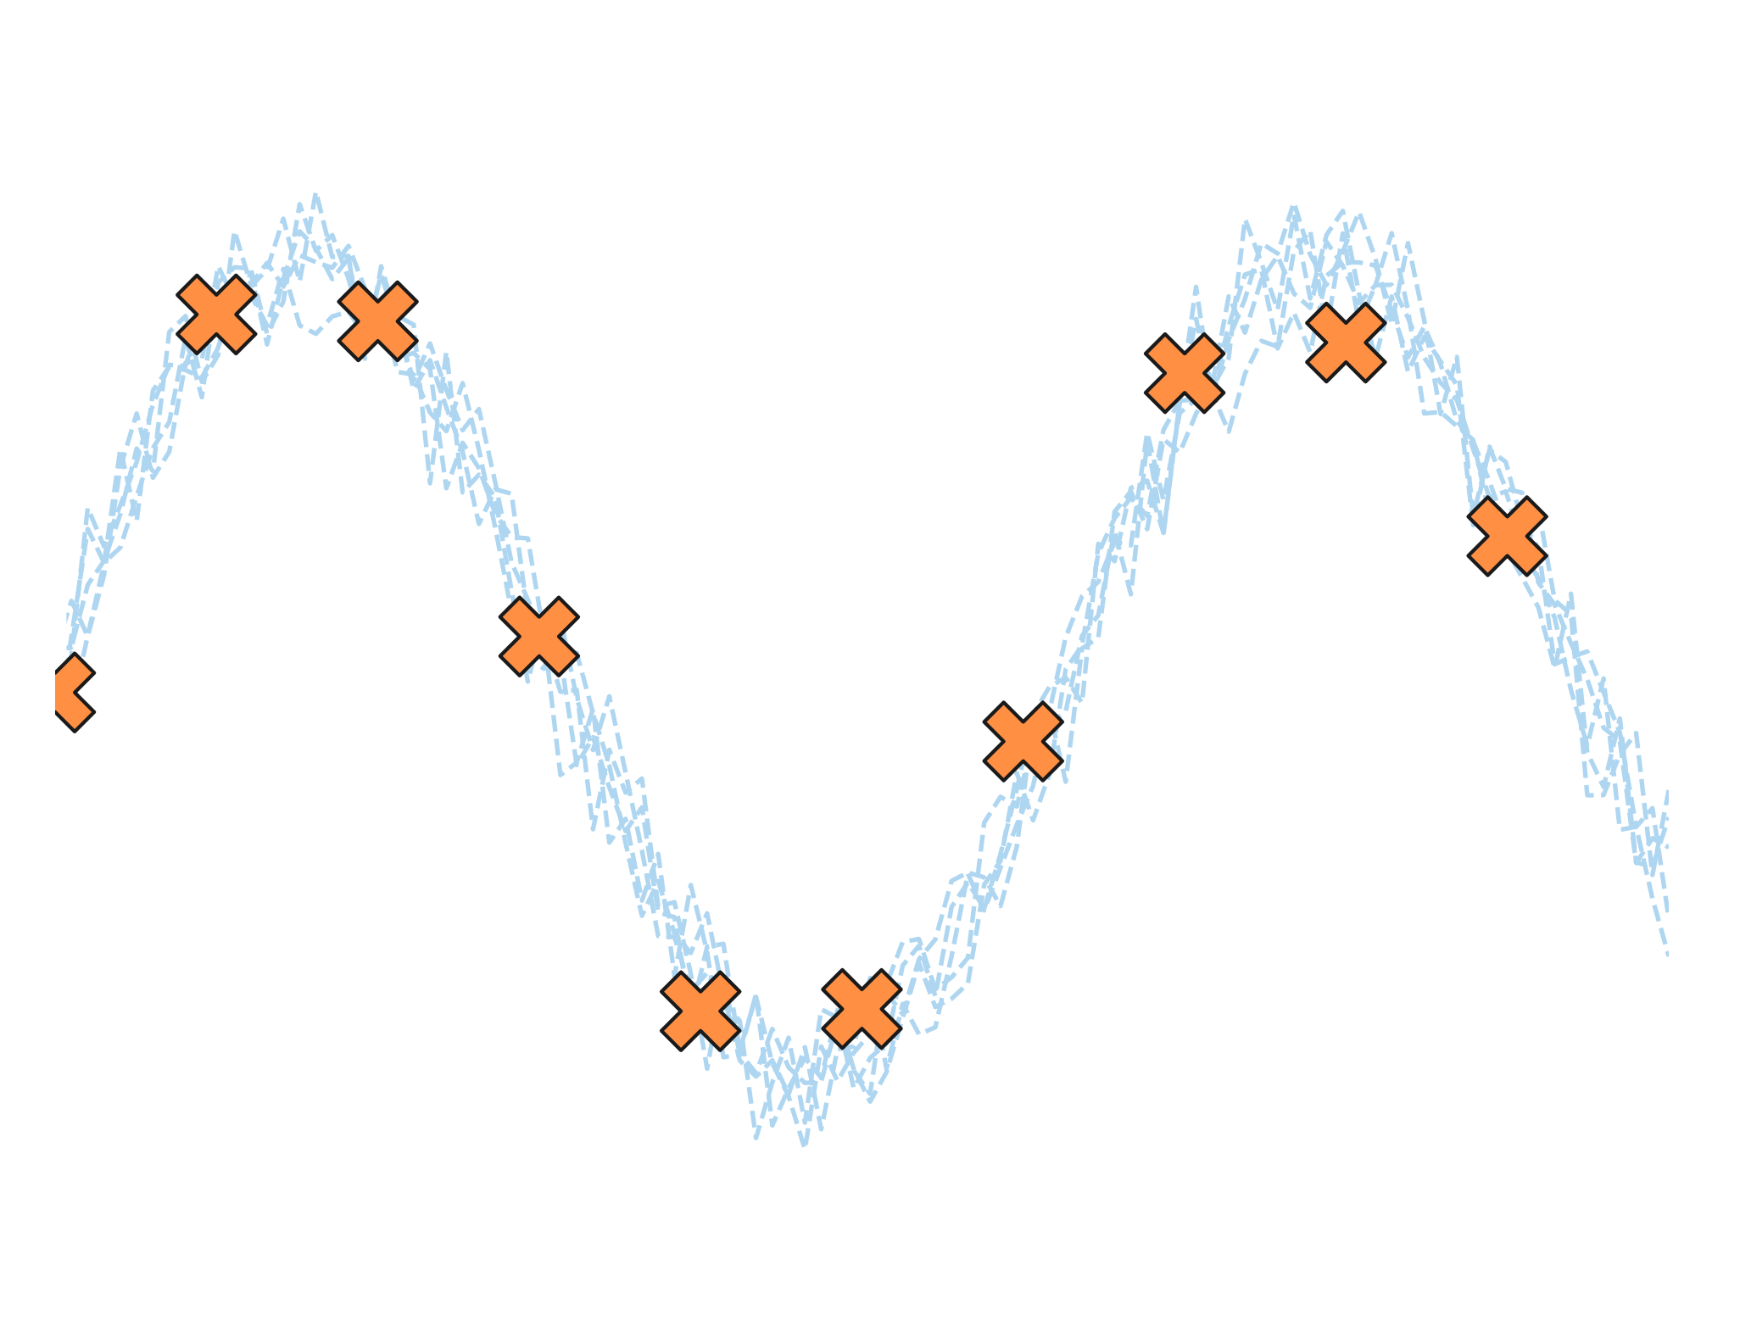
What is The Task we are trying to solve?
Tobias Schanz
Notes:
How could a neural network express this randomness?
We could learn an ensemble for this task. Each member should have the sinusoid learned as underlying data, but each member should have a different noise.
If the size and shape of the noise is learned correctly, the ensemble can represent the data fully.
Say Bias towards the mean or Loss function induced bias

Slide 3
What Problem Are we Trying to Solve?
Existing Methods do not Train the Ensemble as a Whole
Existing Methods Do not Allow fine Control over which statistical aspects to learn
Tobias Schanz
Notes:
We are able to control if we want to have right mean, variance, extreme values. No existing method gives this control.
We want to be able to say e.g. focus more on extreme events, or focus more on getting the mean correct.

Slide 4
Moment Approximation Using Randomness In a vectorized ensemble Loss
MARVEL
Notes:
To overcome these challenges we came up with an approach using Moment Approx….
In short: MARVEL

Slide 5
MARVEL
Tobias Schanz
Conditional Input
Predictions
Neural Network
Latent Input
Predictions
$$f_{p}$$
Target
$$p_{2}$$
$$p_{1}$$
Target
$$p_{3}$$
$$p_{4}$$
$ℒ$ = ( - )²
$$p_{1}$$
$$p_{3}$$
$$p_{4}$$
Notes:
What are those polar plots doing here? We will come back to that in 2 slides. For

Slide 6
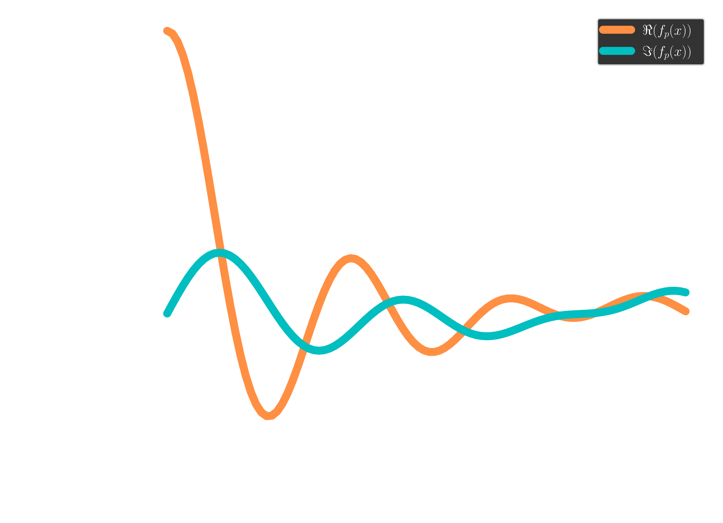
The mysterious transformation
Tobias Schanz
$$f_{p}\left(x\right)=𝔼_{x}[ⅇ^{ⅈxp}]$$
p = 1.84
$$f_{p}\left(x\right)$$
Notes:
We chose this transformation function because it is bounded and …
The function is continuous in p, but we only can compare it at discrete values
We choose these values randomly for each training update step
This way, we guarantee to learn all aspects

Slide 7
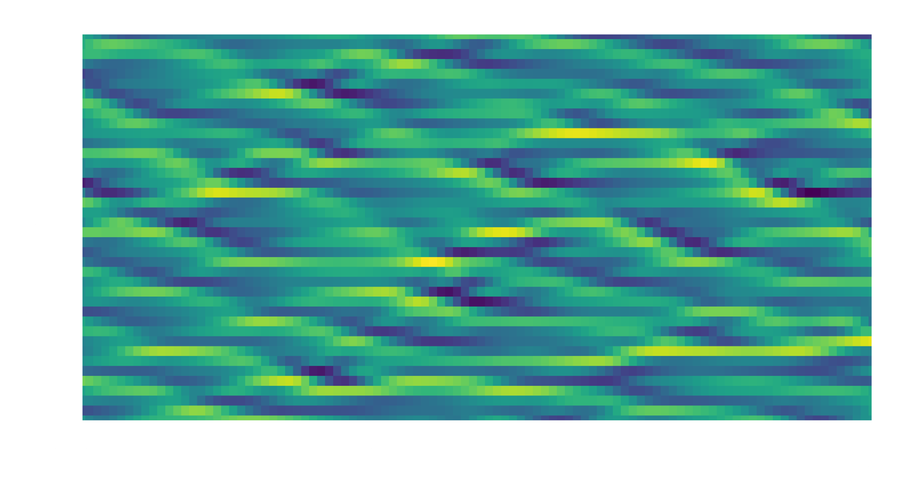
What was the Lorenz 96 Model again?
Tobias Schanz
$$\frac{ⅆx_{k}}{ⅆt}=−x_{k−1}\left(x_{k−2}−x_{k+1}\right)−x_{k}+F$$
Chaotic for certain
values of $F$
Periodic in space
Grid Points
Stable for any length of simulation
Model time units
Notes:
Chaotic means tiny changes in the initialization can have huge effects on later system states. This also means the predictability is limited.
To give an idea about the choadissity: 1 MTU = 5 days of weather simulation.

Slide 8
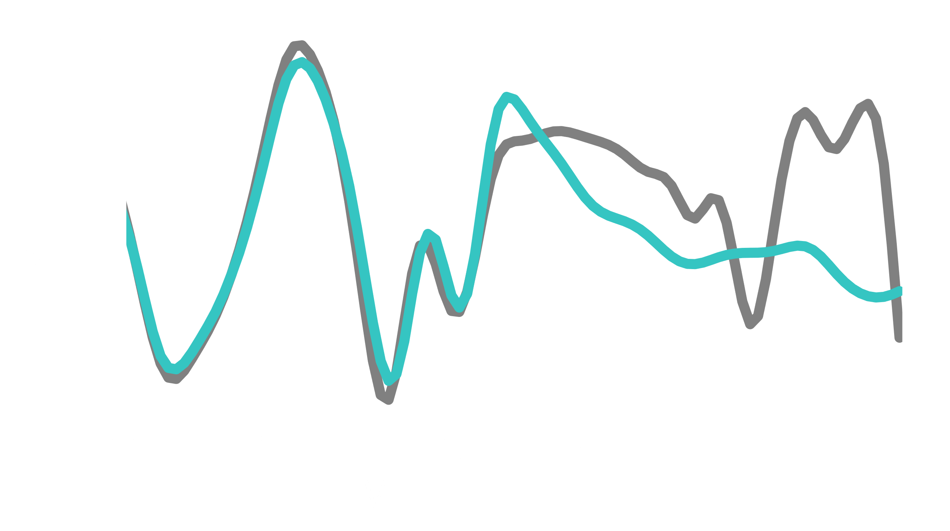
Comparing A Single Gridpoint
Tobias Schanz
MMD Ensemble Mean
MMD Ensemble Member
MARVEL Ensemble Mean
MARVEL Ensemble Member
True Simulation
Notes:
MMD is the best performing contrahend we were able to find. So all other methods performed even worse.
MMD = Maximum Mean Descrepancy

Slide 9
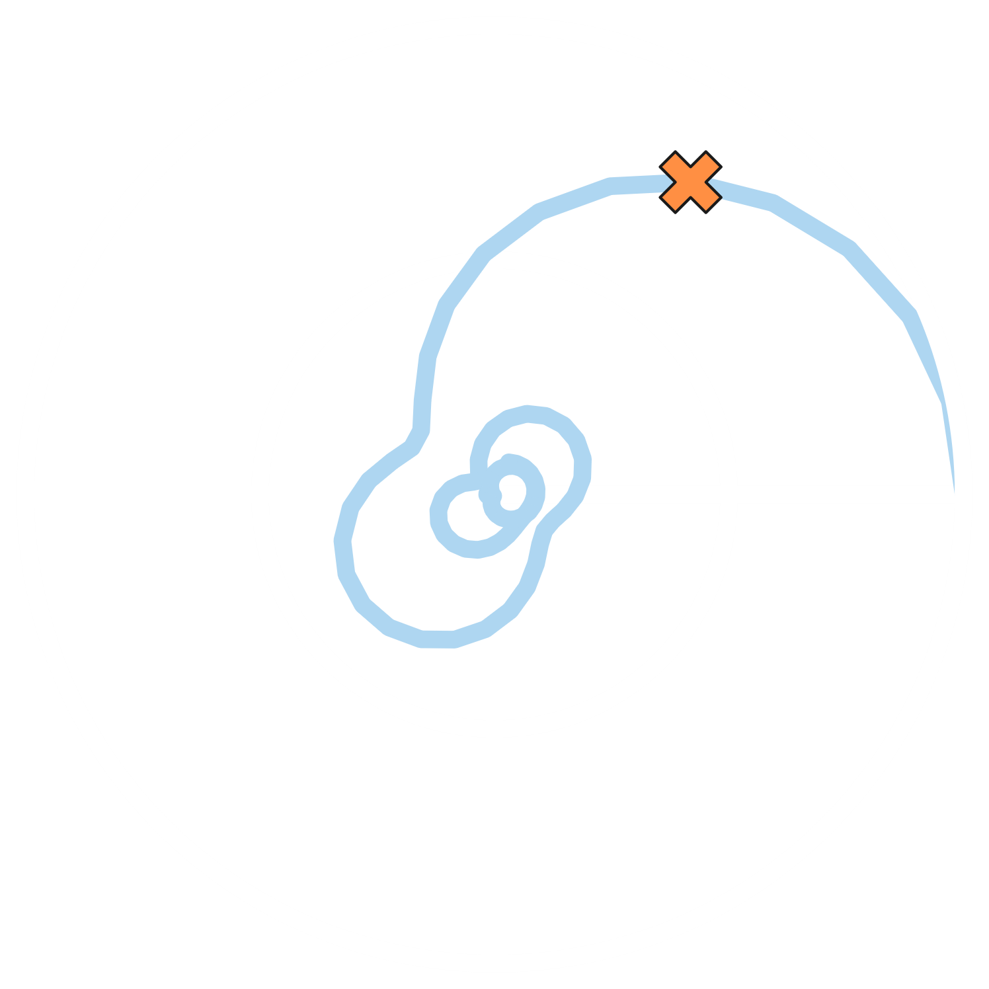
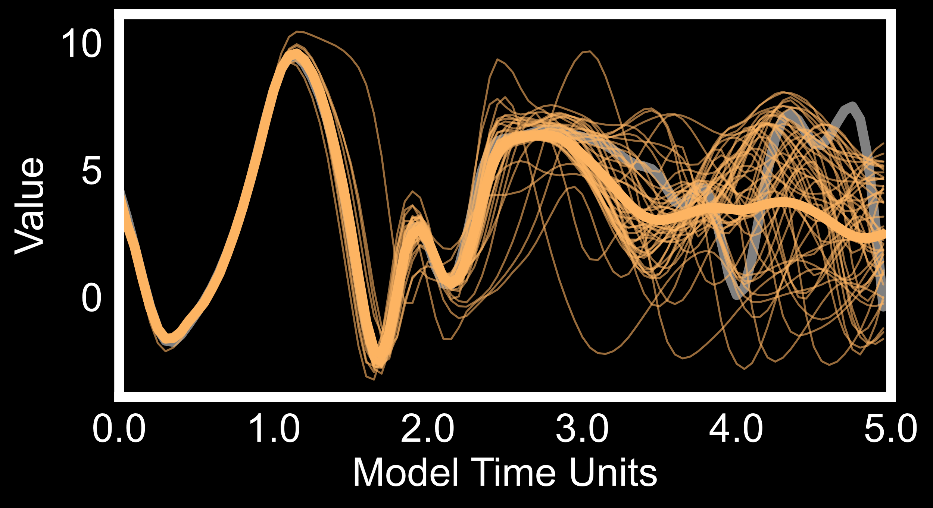
Summarizing Marvel
Tobias Schanz
$$f_{p}$$
Training the ensemble as a whole.
Utilizing randomness can ensure convergence for all data frequencies.
Neural Networks trained with MARVEL can recover even intrinsic uncertainties in the data.
$$p_{3}$$
$$p_{2}$$
$$p_{1}$$
$$p_{4}$$

