Slide 1
COMPASS 🧭 : Enhancing Deep Learning Based Molecular Docking Insights for Comprehensive Analysis
Ahmet Sarıgün, Vedran Franke, Altuna Akalin
Max Delbrück Center,
Bioinformatics and Omics Data Science Platform,
Berlin, Germany

Slide 2
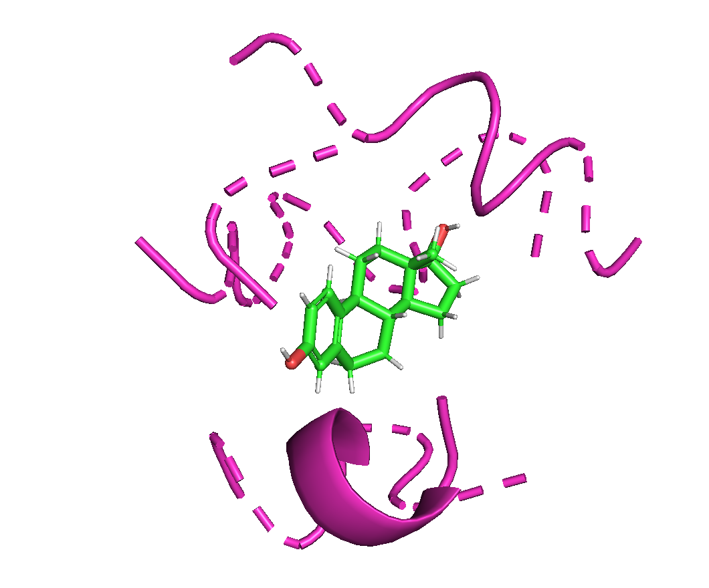
Background
01

Slide 3
BACKGROUND
🧭
What’s Molecular Docking?
Evaluate the viability of potential drug candidates through protein interactions.

Slide 4
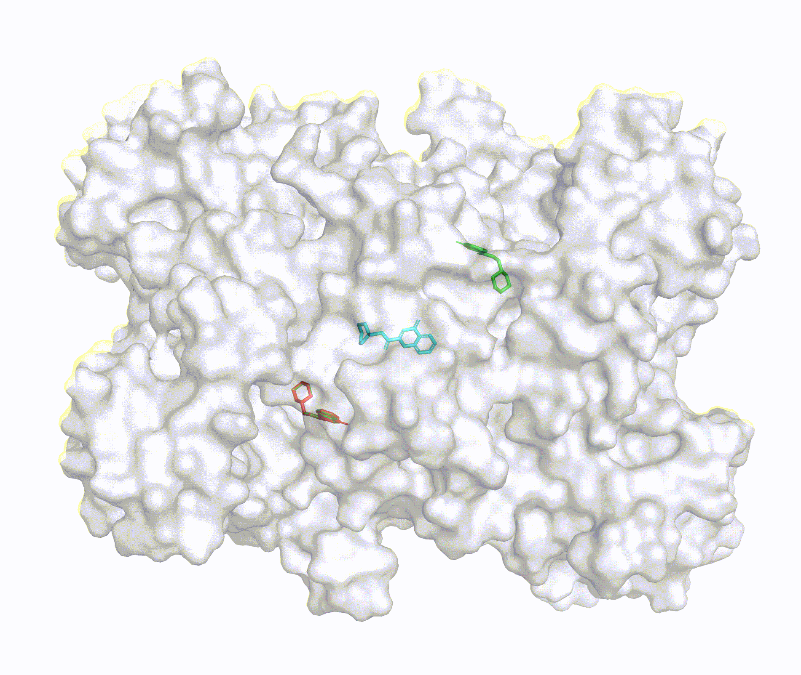
BACKGROUND
🧭
What’s Molecular Docking?
Evaluate the viability of potential drug candidates through protein interactions.
Pocket
Region
Protein
Ligand
Figure from Corso G., et. al, 2023

Slide 5
BACKGROUND
🧭
Search Based Docking Methods
consist of a parameterized physics-based scoring function
a search algorithm
Autodock vina (Trott & Olson, 2010)
Glide (Halgren et al., 2004)
Moldock (Thomsen & Christensen, 2006)
Gnina 1.0 (McNutt et al., 2021)
computationally expensive
inaccurate in blind docking

Slide 6
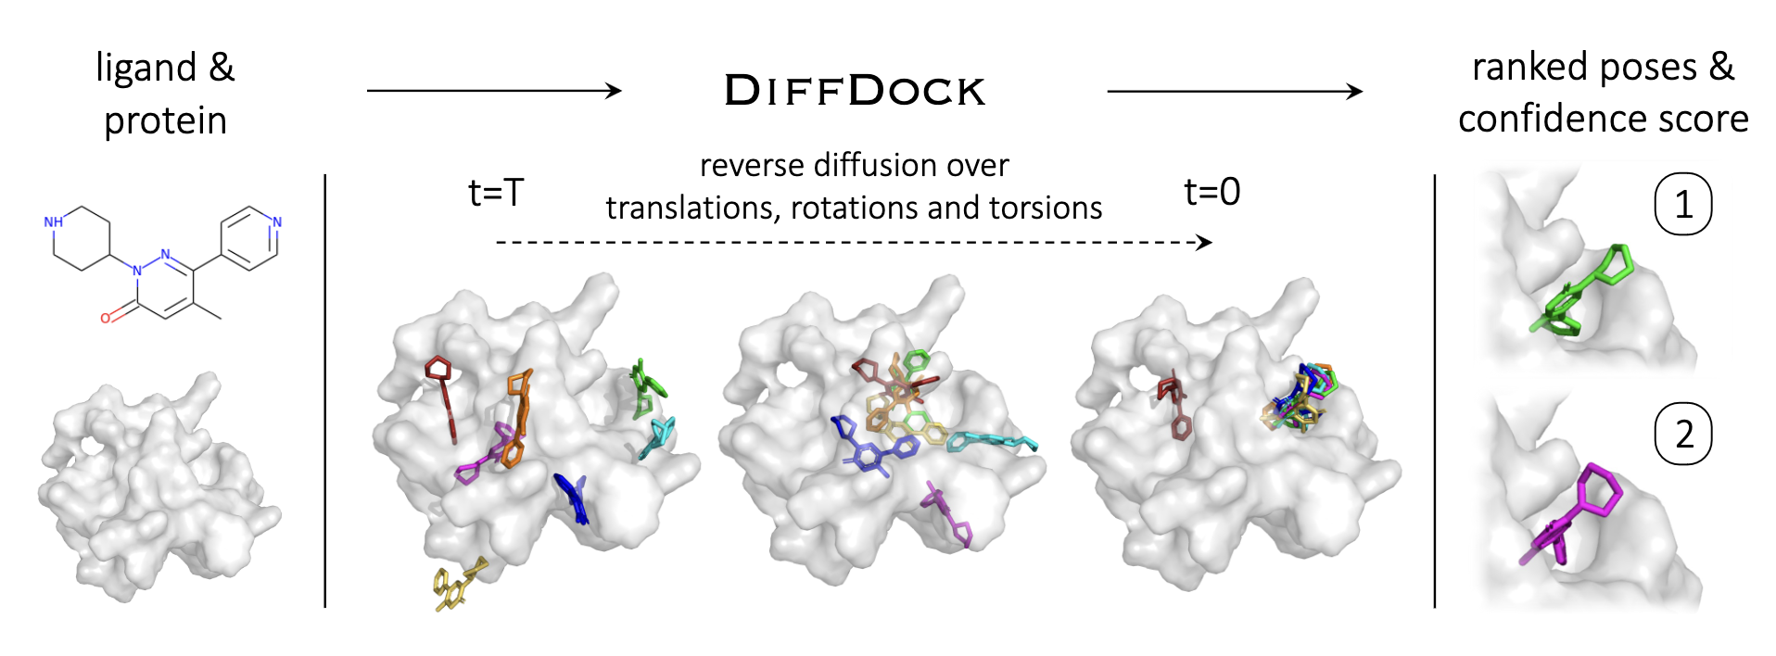
BACKGROUND
🧭
ML for Molecular Docking
EquiBind ($St\ddot{a}rk$ et al., 2022)
blind docking on both ligand and protein
Regression-Based
Faster
Not enough Accurate
DiffDock (Corso et al., 2023)
blind docking on both ligand and protein
Generative Model
Faster
SoTA Results

Slide 7
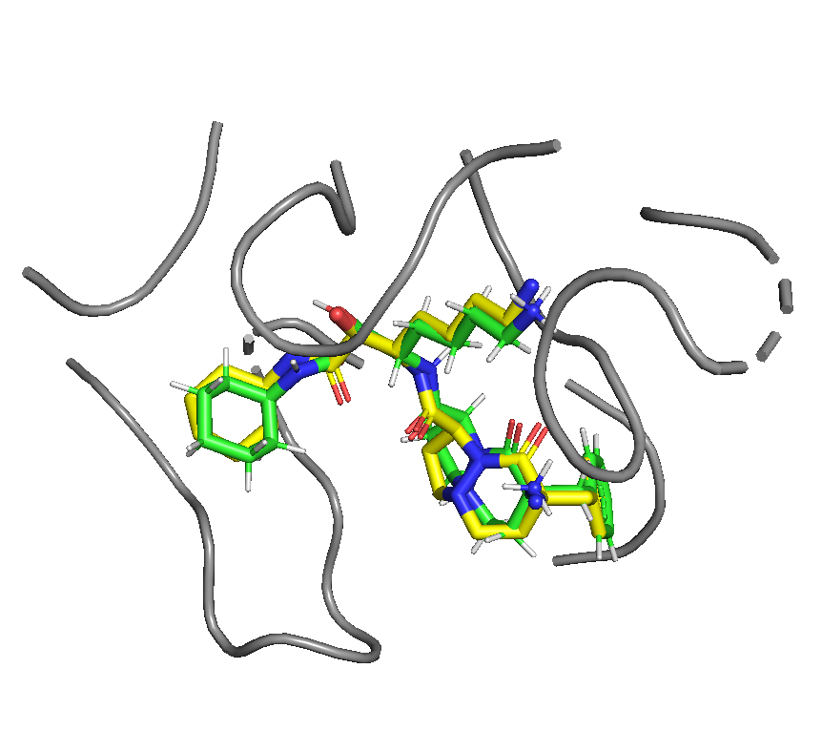
Seems EVERYTHING WORKS FINE FOR MOLECULAR DOCKING? NOT YET!
02

Slide 8
CHALLENGES
🧭
Common metric in Molecular Docking: RMSD
Root Mean Square Distance
$RMSD=\sqrt{\frac{1}{N} \sum_{i=1}^{N}{{\left\|r_{i}−r_{i}^{′}\right\|}^{2} }}$
$r_{i}$ = Ground Truth Conformation (Green)
$r_{i}^{′}$ = Predicted Conformation (Yellow)
Easy to Measure
RMSD < 2 $\dot{A}$ or RMSD < 5 $\dot{A}$
Nearly accurate?
Don’t always have Ground Truth
PDB ID: 1a46, RMSD: 1.23

Slide 9
CHALLENGES
🧭
RMSD doesn’t provide any Physical-Chemical &Bioactivity (PCB)
information of:
Number of clashes between Protein & Ligand (Physical)
Molecule’s Strain Energy (Chemical)
Binding Affinity Energy (Bioactivity)
Interactions between Protein & Ligand (Bioactivity)
RMSD: 1.23

Slide 10
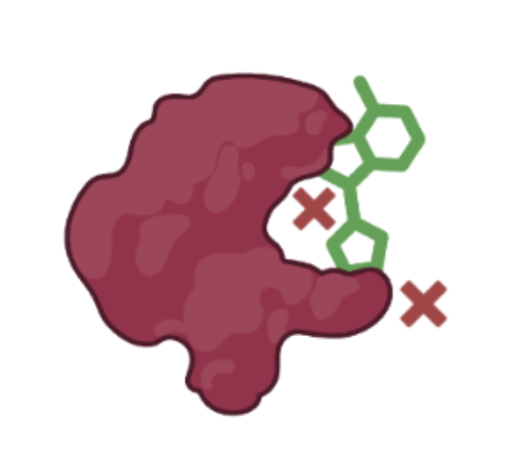
🧭
CHALLENGES: Protein-LIGAND DOCKING EVALUATION Number of clashes
Steric Clashes
`when two atoms are brought closer together than their
van der Waals radii allow without charge interaction.`
(Ramachandran S., et. al, 2011)
PoseCheck (Harris C., et. al, 2023)
Extensive analysis of SOTA methods and finds physical
violence
RMSD: 1.23
Figure from PoseCheck

Slide 11
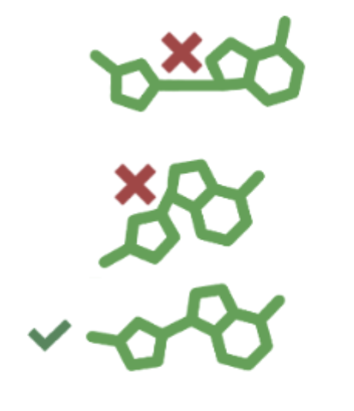
🧭
CHALLENGES: Protein-LIGAND DOCKING EVALUATION STRAIN ENERGY OF LIGAND
Strain Energy
`energy accumulated in a ligand due to structural changes
when binding to a protein, influencing binding affinity and the
effectiveness of potential therapeutics`
(Emanuele Perola & Paul S Charifson, 2004)
PoseCheck (Harris C., et. al, 2023)
Extensive analysis of SOTA methods and finds physical
violence
RMSD: 1.23
Figure from PoseCheck

Slide 12
🧭
CHALLENGES: Protein-LIGAND DOCKING EVALUATION Binding Affinity energy
Binding Affinity Energy
AA-Score Tool (Pan X., et. al, AA-Score, 2022)
a new empirical protein–ligand scoring function with amino
acid-specific interaction components for hydrogen bond,
van der Waals, and electrostatic interactions.
RMSD: 1.23
$∆G_{bind}$ =
-
-
$$∆G_{complex}$$
$$∆G_{protein}$$
$$∆G_{ligand}$$

Slide 13
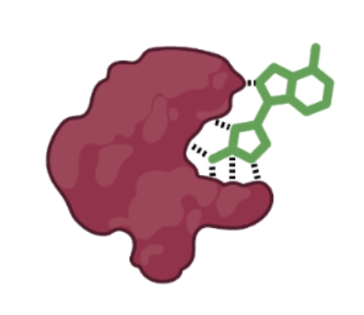
🧭
CHALLENGES: Protein-LIGAND DOCKING EVALUATION Interactions
Interactions between Protein & Ligand
`Interaction fingerprinting condenses the complex interactions
between a ligand and protein into a bit vector, facilitating quick
comparisons of binding interactions through Tanimoto similarity.`
(Marcou G. et. al., 2007; Bouysset C. et. al, 2021)
PoseCheck (Harris C., et. al, 2023)
Extensive analysis of SOTA methods and finds physical
violence
RMSD: 1.23
Figure from PoseCheck

Slide 14
METHODS: COMPASS OVERVIEW
🧭

Slide 15
METHODS: COMPASS OVERVIEW
🧭

Slide 16
METHODS: COMPASS OVERVIEW
🧭

Slide 17
METHODS: COMPASS OVERVIEW
🧭

Slide 18
METHODS: COMPASS OVERVIEW
🧭

Slide 19
METHODS: COMPASS OVERVIEW
🧭

Slide 20
METHODS: COMPASS OVERVIEW
🧭

Slide 21
METHODS: COMPASS OVERVIEW
🧭

Slide 22
METHODS: COMPASS OVERVIEW
🧭

Slide 23
METHODS: COMPASS OVERVIEW
🧭

Slide 24
METHODS: INFERENCE MODE
🧭

Slide 25
METHODS: INFERENCE MODE
🧭

Slide 26
METHODS: INFERENCE MODE
🧭

Slide 27
METHODS: INFERENCE MODE
🧭

Slide 28
METHODS: INFERENCE MODE
🧭

Slide 29
METHODS: INFERENCE MODE
🧭

Slide 30
METHODS: Fine-Tuning MODE
🧭
$$LAN−MSE\left(\hat{y,}y\right)=\frac{1}{N}\sum_{i=1}^{N}{{\left(\frac{\log\left(\left|y_{i}\right|+{buffer}_{true,i}\right)−\log\left(\left|{\hat{y}}_{i}\right|+{buffer}_{pred,i}\right)}{2\log\left(\left|y_{i}\right|+{buffer}_{true,i}\right)+ε}\right)}^{2}}$$

Slide 31
METHODS: Fine-Tuning MODE
🧭
$$LAN−MSE\left(\hat{y,}y\right)=\frac{1}{N}\sum_{i=1}^{N}{{\left(\frac{\log\left(\left|y_{i}\right|+{buffer}_{true,i}\right)−\log\left(\left|{\hat{y}}_{i}\right|+{buffer}_{pred,i}\right)}{2\log\left(\left|y_{i}\right|+{buffer}_{true,i}\right)+ε}\right)}^{2}}$$

Slide 32
METHODS: Fine-Tuning MODE
🧭
$$LAN−MSE\left(\hat{y,}y\right)=\frac{1}{N}\sum_{i=1}^{N}{{\left(\frac{\log\left(\left|y_{i}\right|+{buffer}_{true,i}\right)−\log\left(\left|{\hat{y}}_{i}\right|+{buffer}_{pred,i}\right)}{2\log\left(\left|y_{i}\right|+{buffer}_{true,i}\right)+ε}\right)}^{2}}$$

Slide 33
METHODS: Fine-Tuning MODE
🧭
$$LAN−MSE\left(\hat{y,}y\right)=\frac{1}{N}\sum_{i=1}^{N}{{\left(\frac{\log\left(\left|y_{i}\right|+{buffer}_{true,i}\right)−\log\left(\left|{\hat{y}}_{i}\right|+{buffer}_{pred,i}\right)}{2\log\left(\left|y_{i}\right|+{buffer}_{true,i}\right)+ε}\right)}^{2}}$$

Slide 34
METHODS: Fine-Tuning MODE
🧭
$$LAN−MSE\left(\hat{y,}y\right)=\frac{1}{N}\sum_{i=1}^{N}{{\left(\frac{\log\left(\left|y_{i}\right|+{buffer}_{true,i}\right)−\log\left(\left|{\hat{y}}_{i}\right|+{buffer}_{pred,i}\right)}{2\log\left(\left|y_{i}\right|+{buffer}_{true,i}\right)+ε}\right)}^{2}}$$

Slide 35
METHODS: Fine-Tuning MODE
🧭
$$LAN−MSE\left(\hat{y,}y\right)=\frac{1}{N}\sum_{i=1}^{N}{{\left(\frac{\log\left(\left|y_{i}\right|+{buffer}_{true,i}\right)−\log\left(\left|{\hat{y}}_{i}\right|+{buffer}_{pred,i}\right)}{2\log\left(\left|y_{i}\right|+{buffer}_{true,i}\right)+ε}\right)}^{2}}$$

Slide 36
RESULTS: DATASET noisiness
🧭
Mean: -8.44 kcal/mol; std: 3.76 kcal/mol
✓ Distribution looks good
✘ still, we have positive values

Slide 37
RESULTS: DATASET noisiness
🧭
Mean: 5.85; std: 4.43
✓ ~ 5% of dataset has no clashes
✘ ~ 95% of them has physical violations with
clashes

Slide 38
RESULTS: DATASET noisiness
🧭
Mean: 3.11 kcal/mol; std: 6.15 kcal/mol
✓ has stable molecules
✘ most of them are unstable

Slide 39
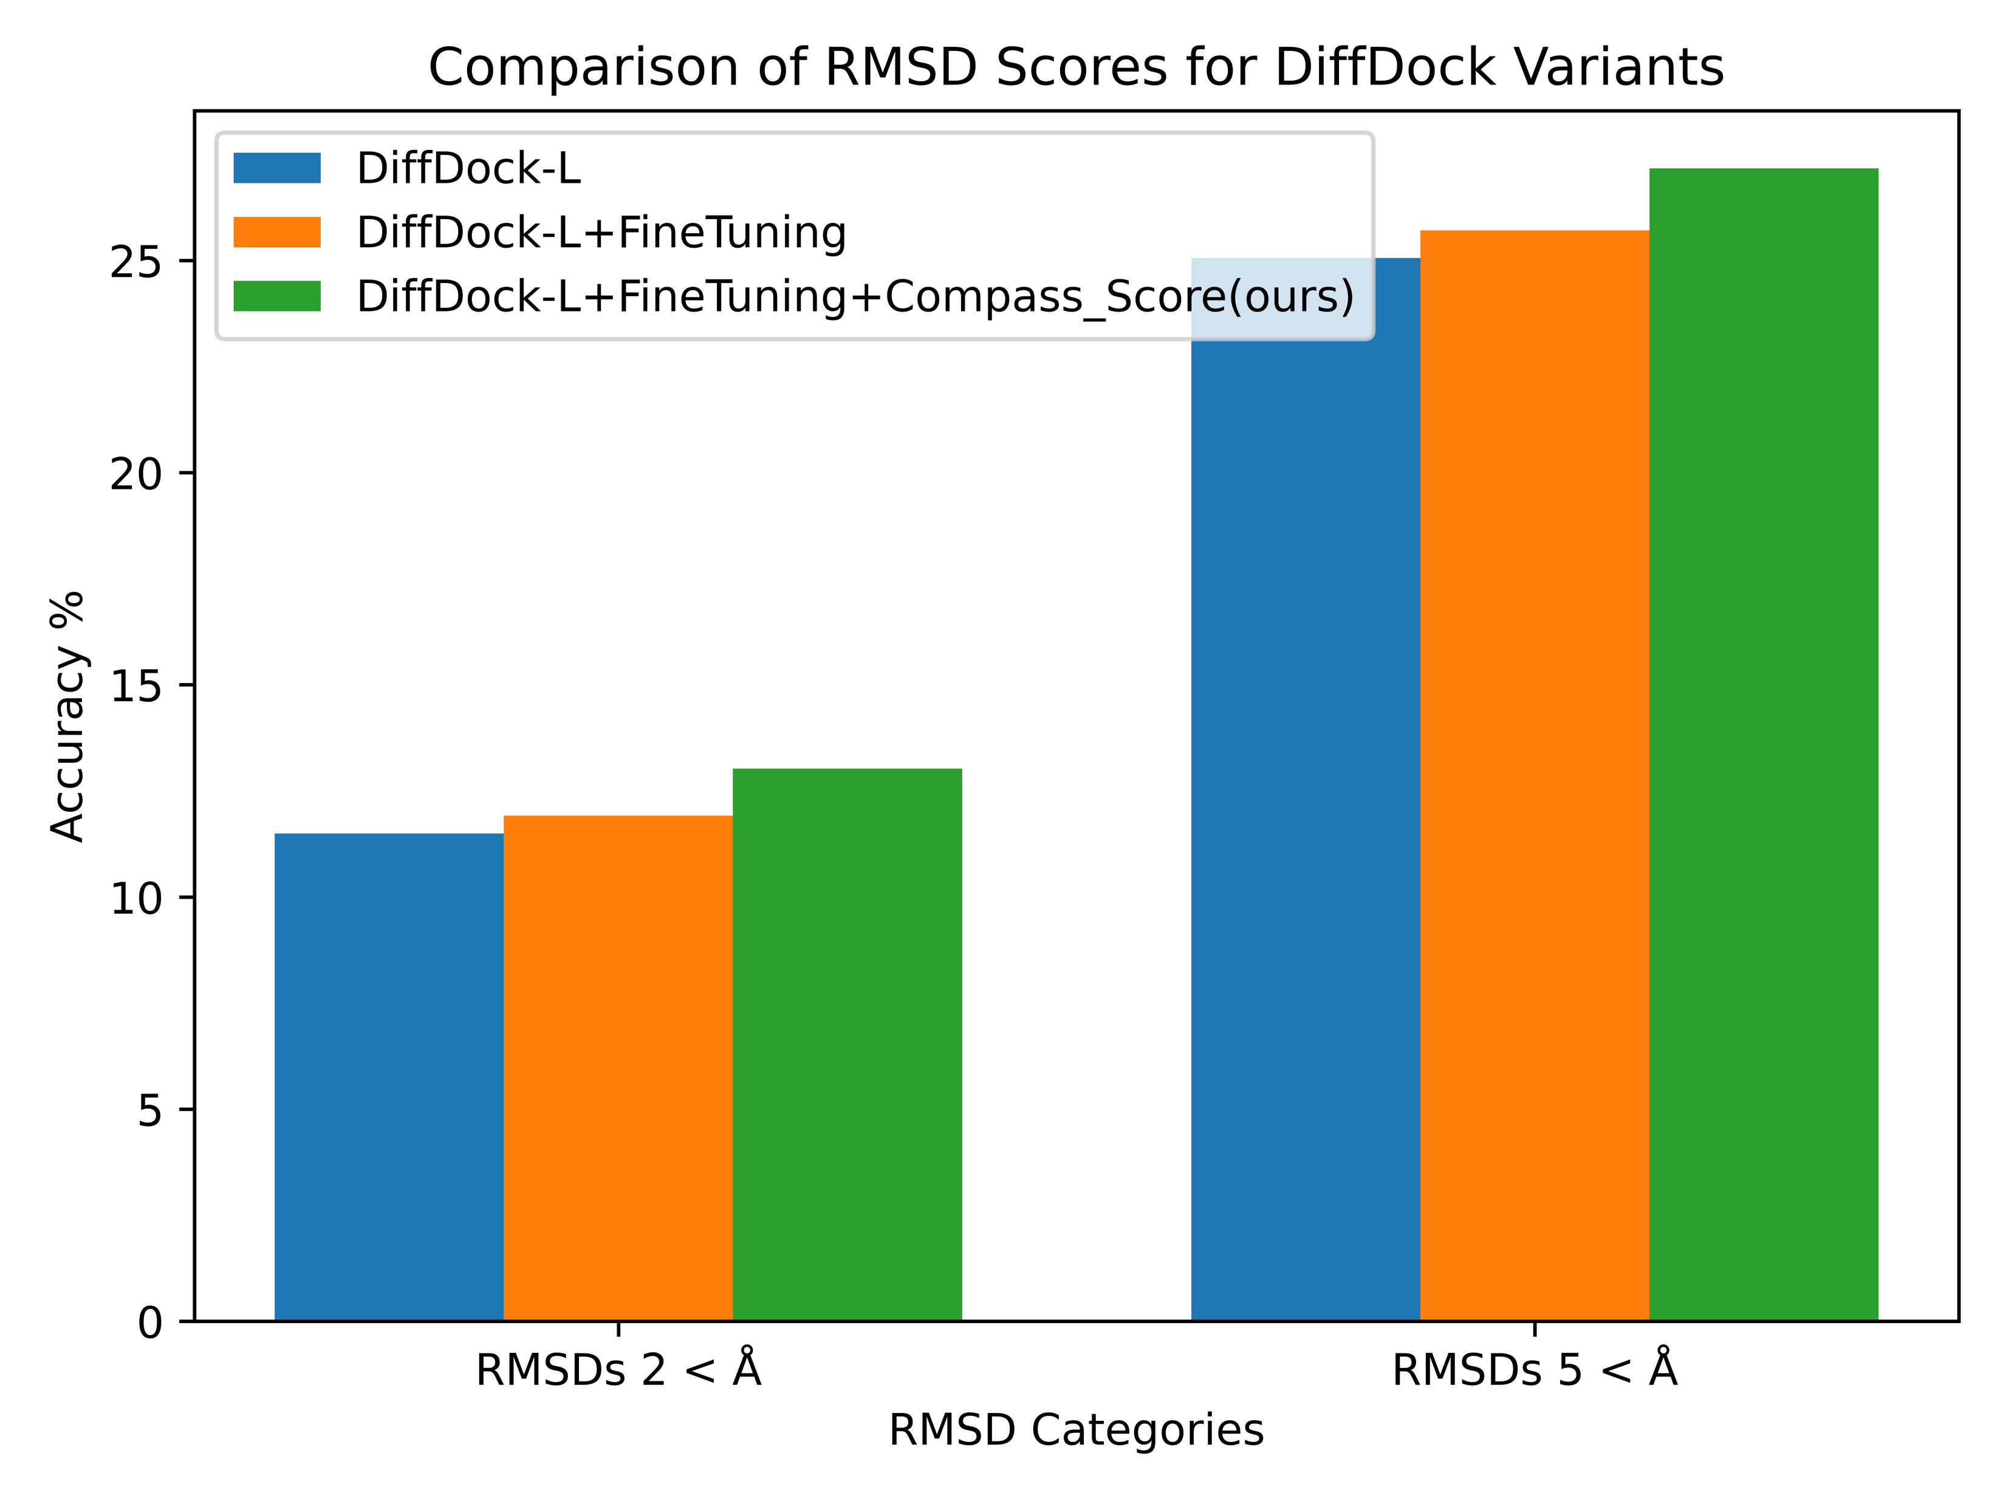
RESULTS: Fine-tuning with compass score
🧭
Samples selected randomly
from best PCB values
FineTuned with:
80 samples as Train
20 samples as Val
261 samples as Test

Slide 40
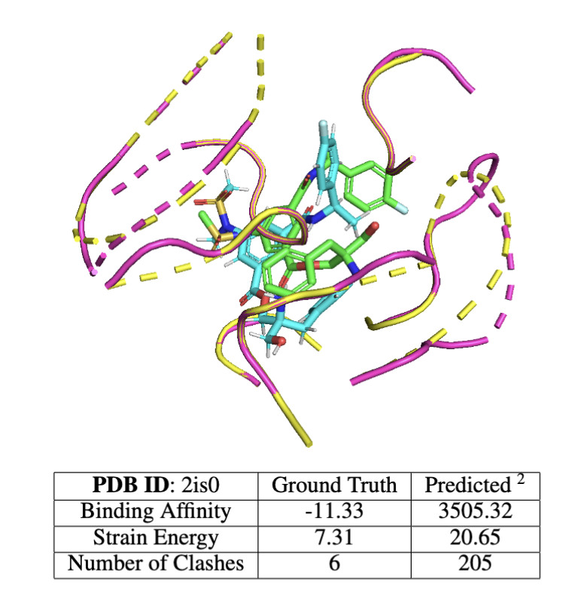
dISCUSSION: RMSD FAILS!
🧭
RMSD = 4.75
RMSD cannot always give the desired PCB features!
Less than 5 Angstrom, but fails almost every
Physical
Chemical
Bioactivity feature

Slide 41
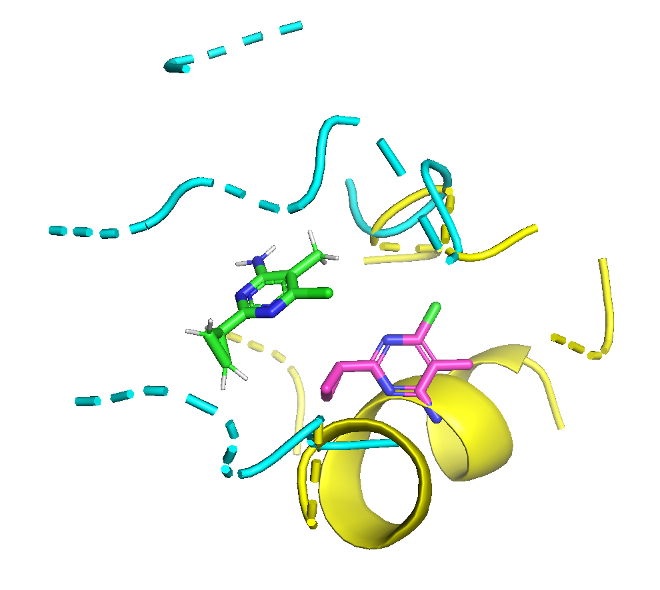
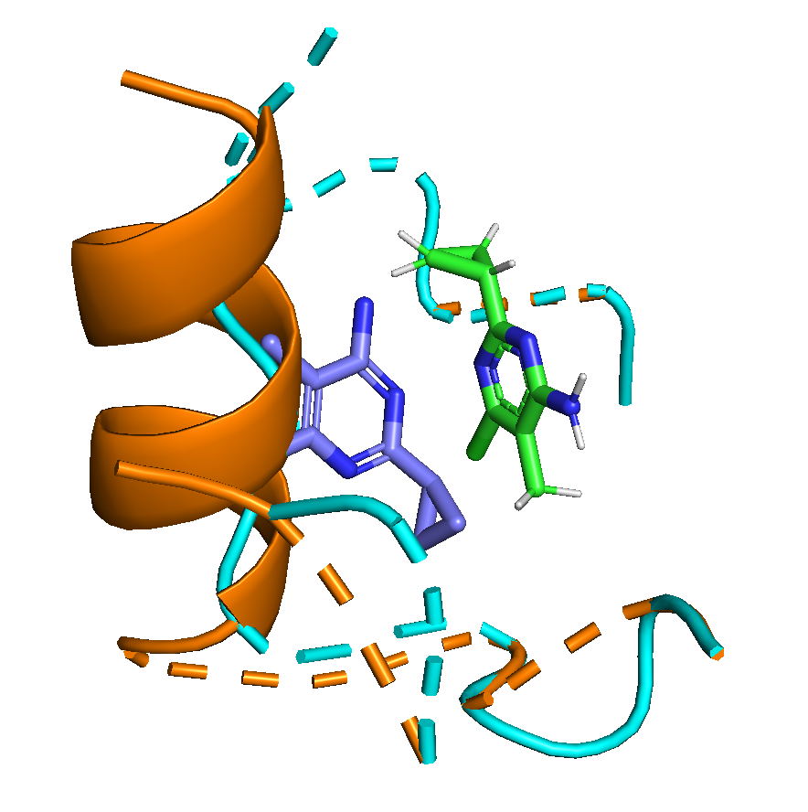
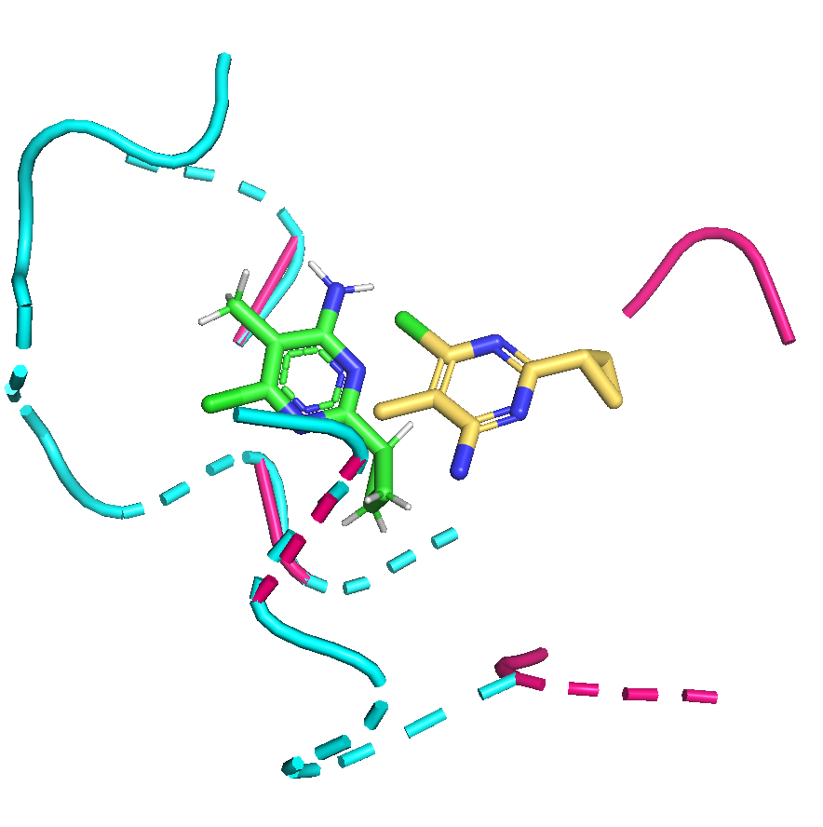
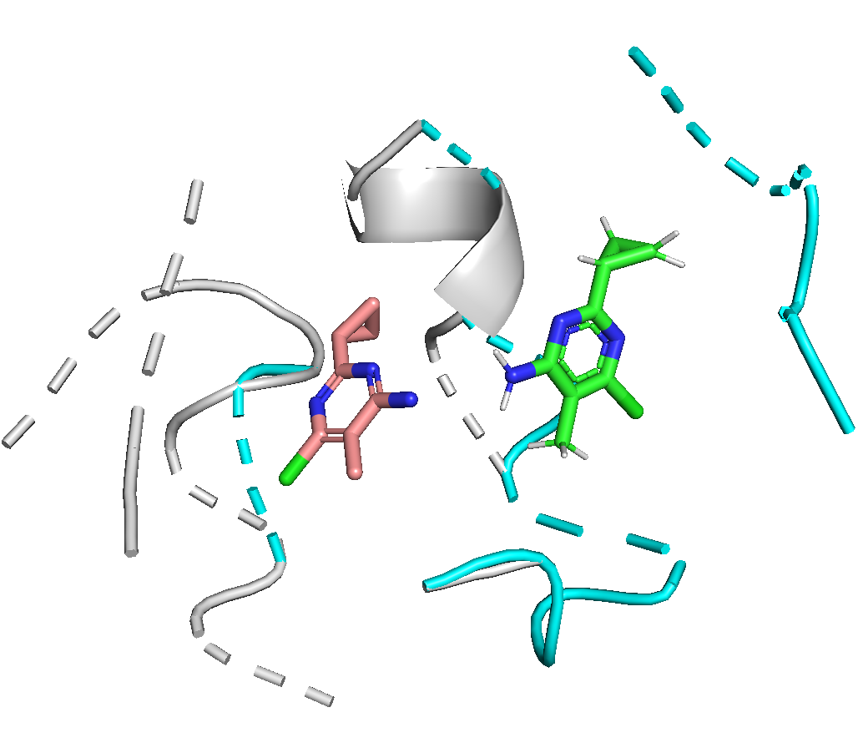
dISCUSSION: RMSD FAILS!
🧭
PDB ID: 5c28
Binding Affinity (-9.59) | 2139.99 | 625.09 | 14.68 | -5.08
Strain Energy (3.92) | 1.93 | 0.12 | 1.91 | 1.94
# of Clash (14) | 145 | 150 | 22 | 5
RMSD | 7.77 | 8.25 | 6.17 | 5.92
$1^{st}$ epoch
${33}^{rd}$ epoch
${53}^{rd}$ epoch
${55}^{th}$ epoch

Slide 42
Conclusion
🧭
With Compass 🧭;
Dataset Overview: The PDBBind dataset, commonly utilized for DL-based molecular docking, exhibits significant noise in terms of:
Physical attributes
Chemical properties
Bioactivity features
Enhanced Assessment: Implementing PCB feature analysis leads to a more accurate assessment in DL-based molecular docking. (Best option comparing to AlphaFold3 for docking)
Improved Fine-Tuning Performance: Utilizing the Compass Score results in a performance enhancement more than three times greater than that achieved with standard fine-tuning methods.

Slide 43
FUTURE WORKS
🧭
Easy Access: Use your preferred protein and ligand without installation or GPU.
API for Users (Coming Soon)
Enhanced Compatibility: Extends seamlessly to other existing methods.
Advanced Fine-Tuning: Leveraging extensive datasets for improved results.
Quality Data: Utilizing curated datasets with viable PCB (Physical, Chemical, Bioactivity) features for optimal protein-ligand docking outcomes.

Slide 44
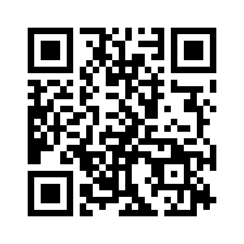
REACH US
🧭
https://github.com/BIMSBbioinfo/Compass
{Ahmet.Sariguen, Vedran.Franke, Altuna.Akalin}@mdc-berlin.de}

Slide 45
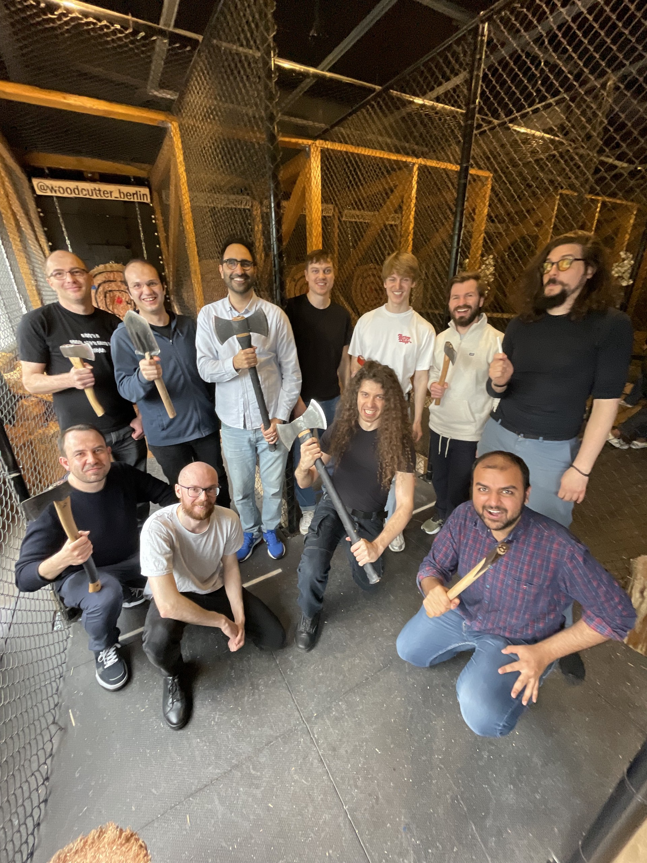
Acknowledgements
🧭
Thanks to all Akalin Lab Members, specially:
Dr. Altuna Akalin (Co-author)
Dr. Vedran Franke (Co-author)
Dr. Bora Uyar
Ricardo Wurmus
Dan Munteanu
Madalin Ionel Patrascu
Mohammed Maqsood Shaik
Fabian Janosch Krüger
Aaron Kollotzek
Taras Savchyn
Thank You!
Questions/Comments
-/+/?

