Slide 1
Spectral Pruning Can Mitigate Over-squashing and Over-smoothing in Graph Neural Networks
Adarsh Jamadandi, Celia Rubio-Madrigal, and Rebekka Burkholz.
CISPA, Saarland University.
Pre-print - https://arxiv.org/abs/2404.04612
European Research Council (ERC) under the Horizon Europe Framework Programme (HORIZON) for proposal number 101116395 SPARSE-ML

Slide 2
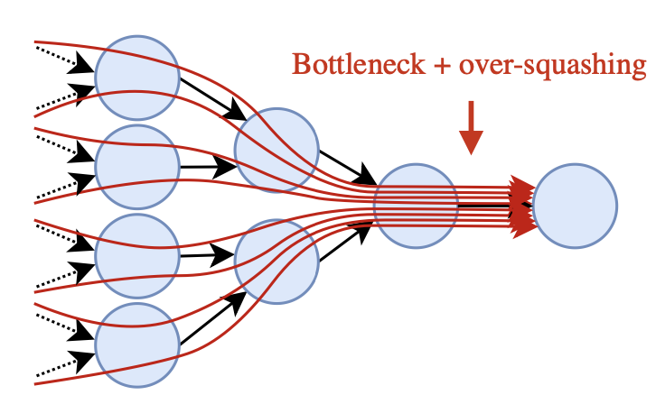
TL;DR
GLTs
Over-smoothing
Over-squashing
Spectral Graph Pruning

Slide 3
Graph Neural Networks
Graph Neural Networks aggregate vector based information on the graph, aka message-passing.
What are the factors that could affect the efficiency of message passing?

Slide 4
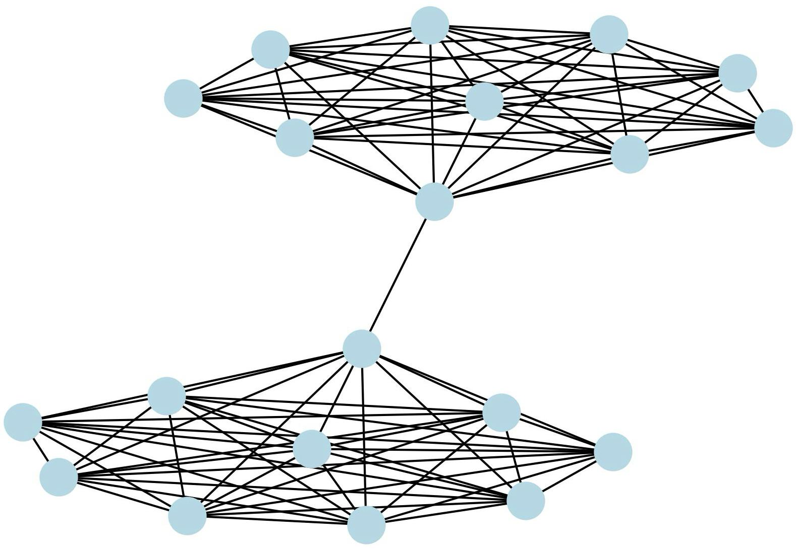
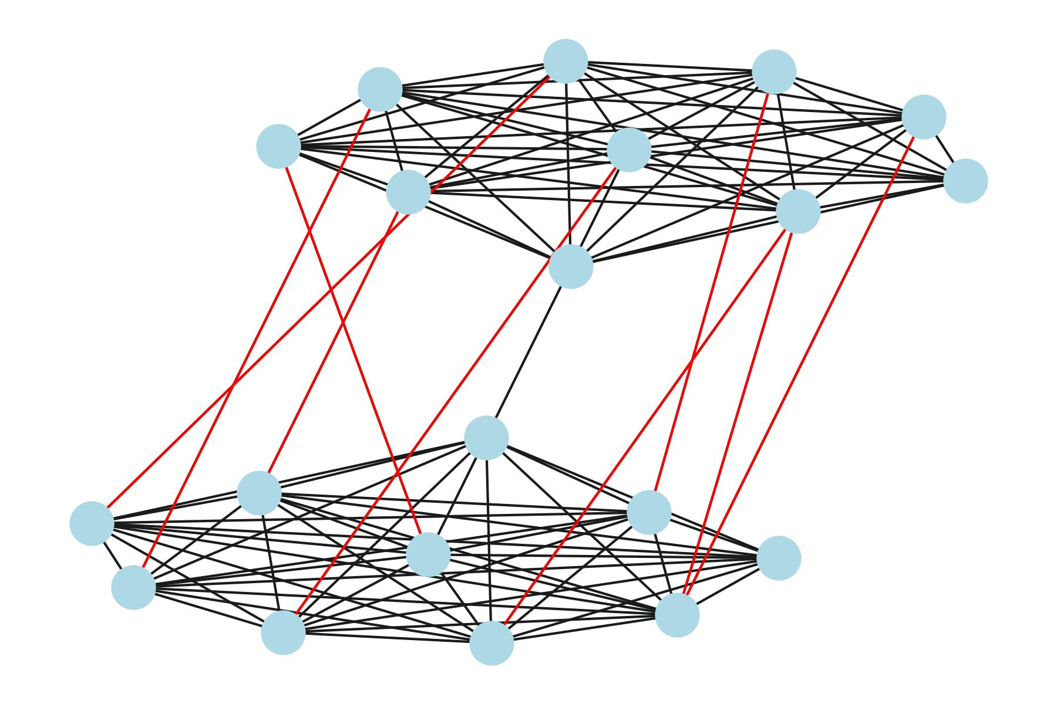
Over-squashing and Over-smoothing
How to balance over-squashing and over-smoothing?
Over-squashing
Over-smoothing
Bottleneck
Small spectral gap
No bottleneck!

Slide 5
Braess Paradox to the Rescue!
Adding an extra road causes delays!

Slide 6
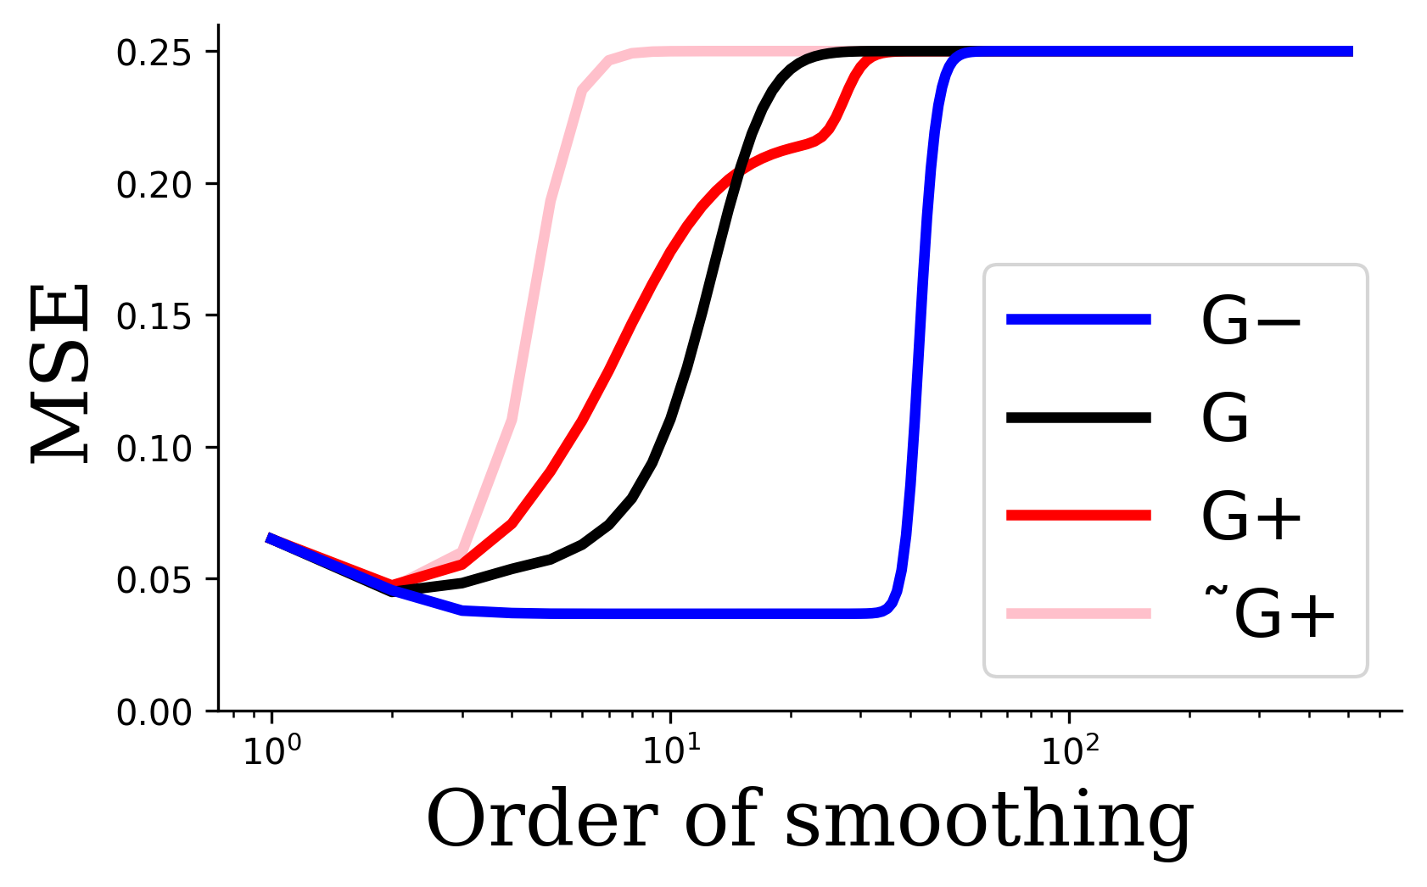
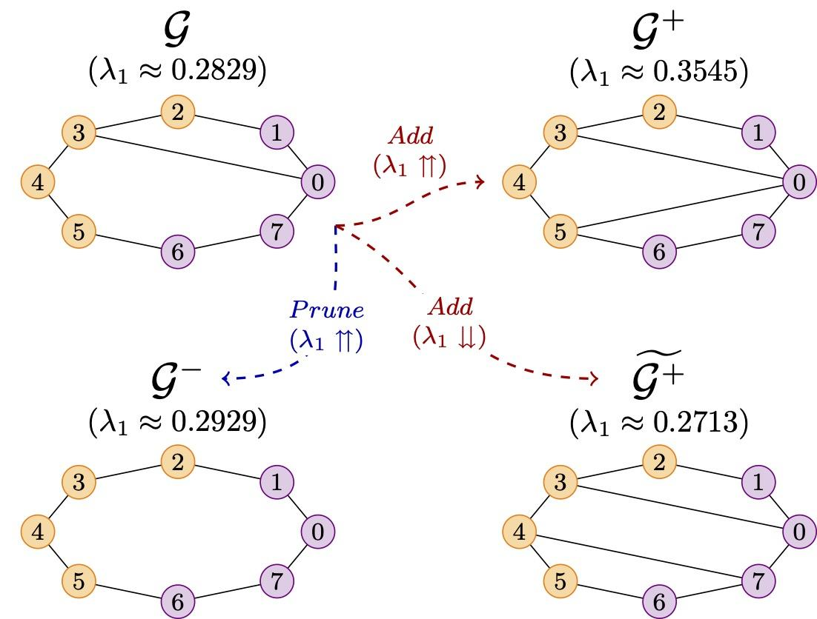
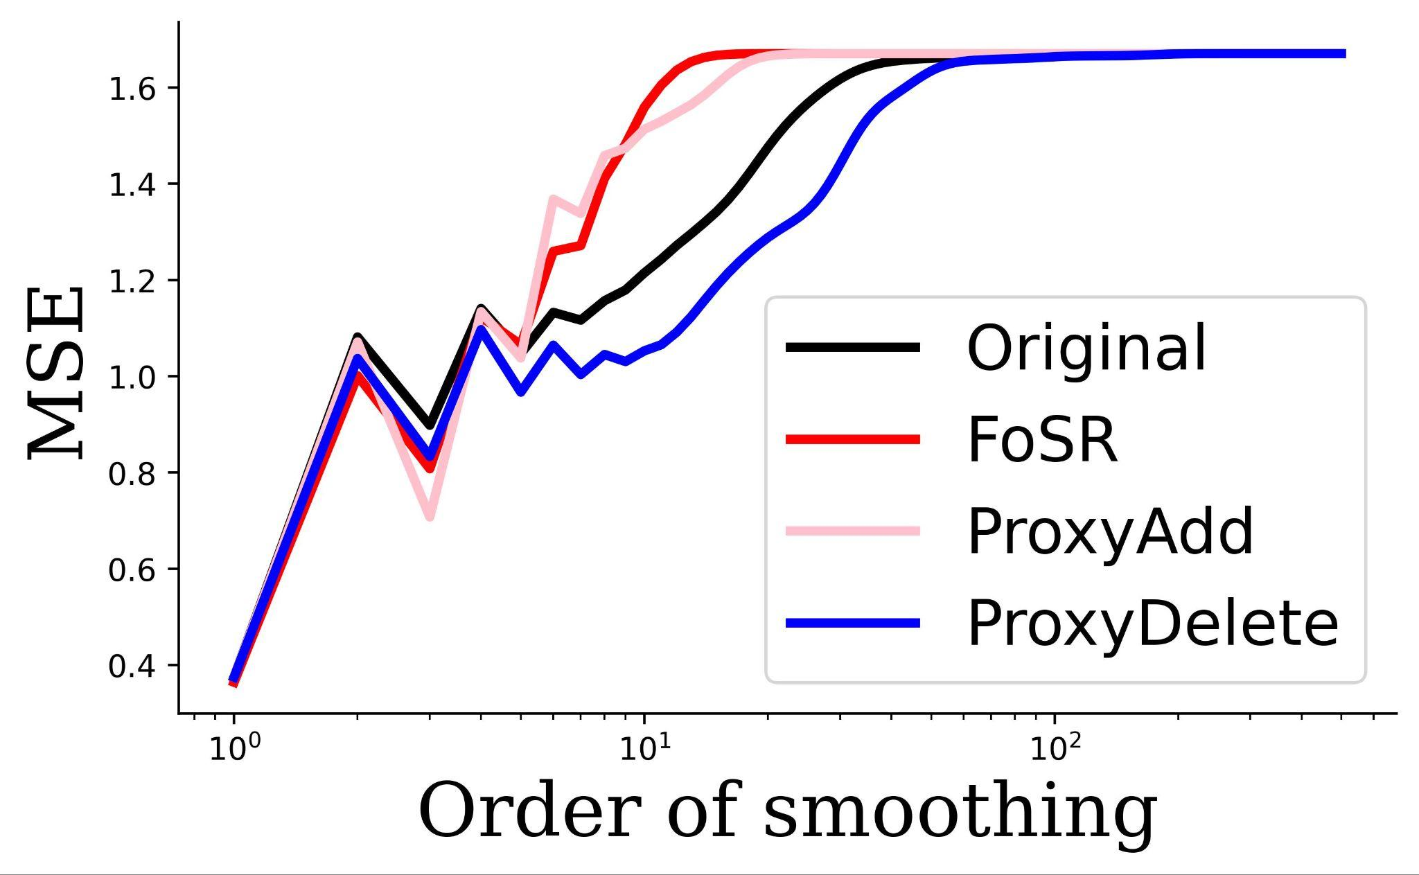
Braess Paradox and Spectral Pruning

Slide 7
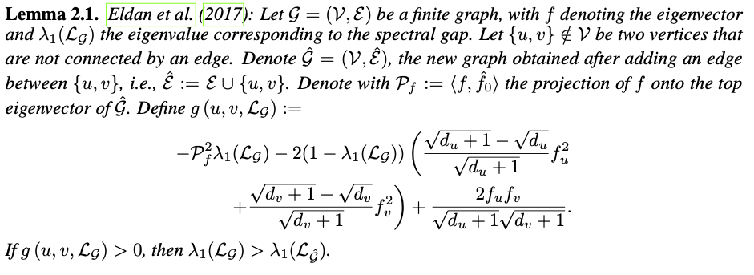
Braess criterion and Proxy spectral gap
Proxy Spectral Gap

Slide 8
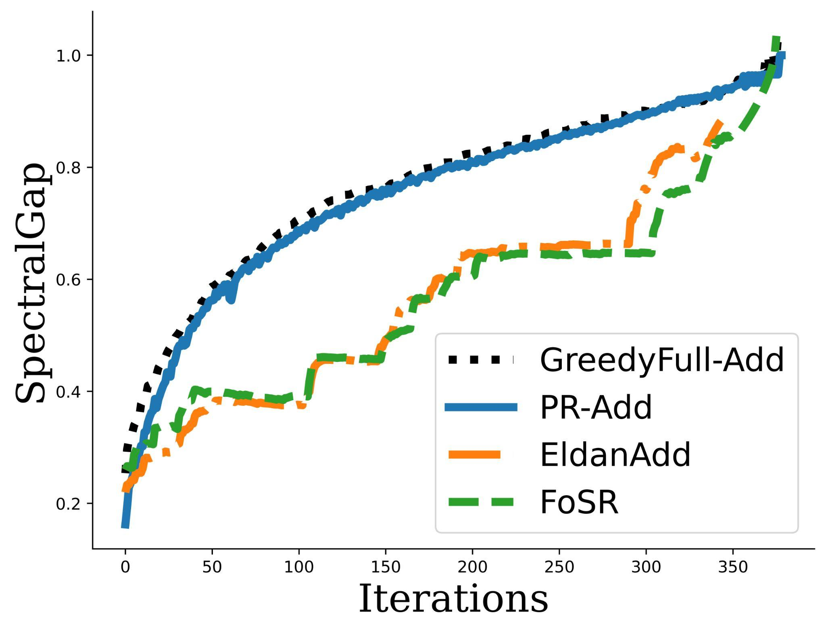
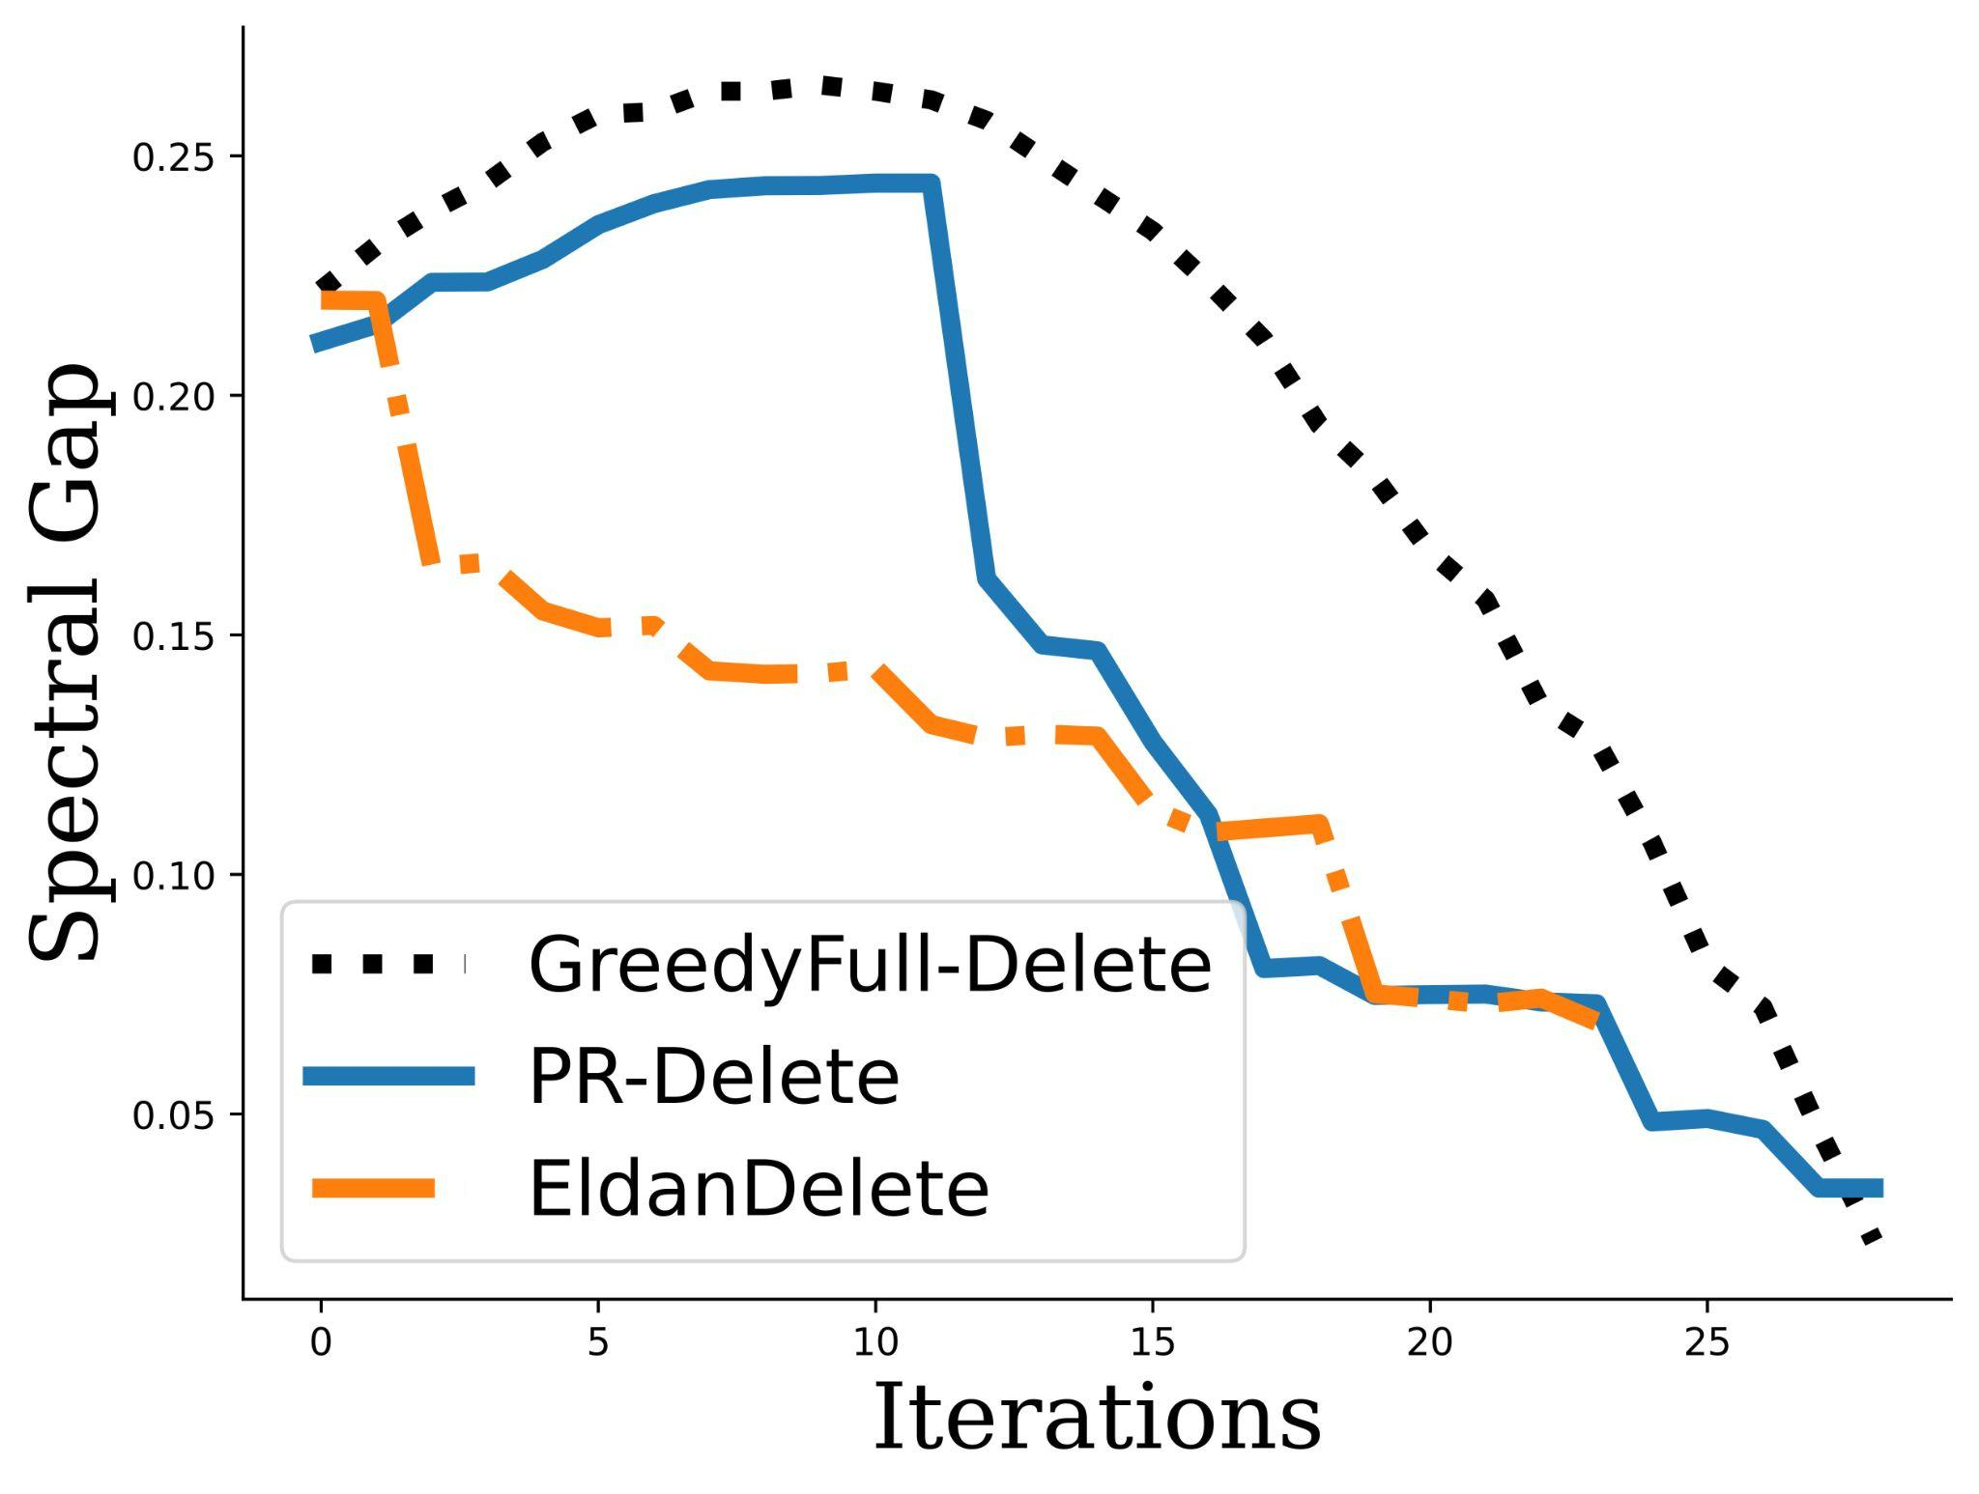
How good is this proxy?

Slide 9
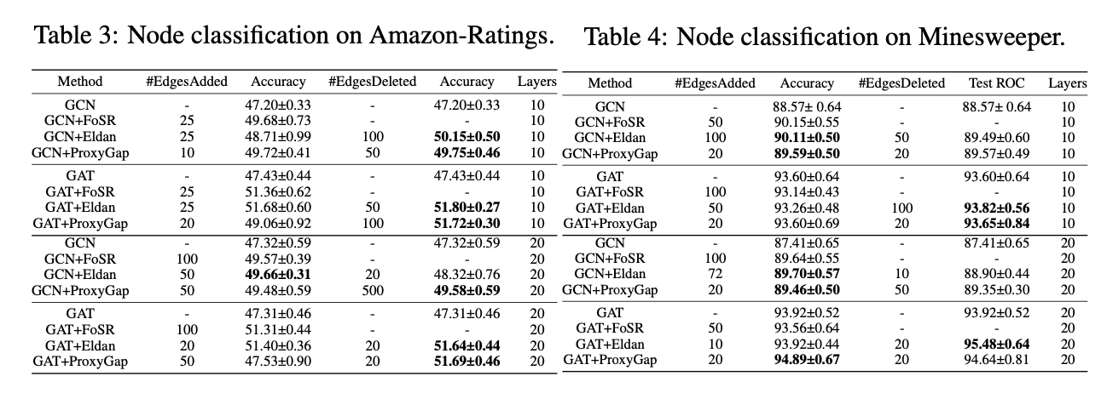
Results

Slide 10
Results

Slide 11
Summary
Over-squashing and Over-smoothing not a trade-off.
Spectral graph pruning can simultaneously mitigate both!
Interesting application also find Graph Lottery Tickets!
We propose a computationally friendly proxy method for spectral gap approximation.
A A
Acknowledgements - European Research Council (ERC) under the Horizon Europe Framework Programme (HORIZON) for proposal number 101116395 SPARSE-ML.

Slide 12
References
Aggregation steps visualization - https://disco.ethz.ch/courses/fs21/seminar/talks/GNN_Oversmoothing.pdf
Bottleneck visualization - https://urialon.cswp.cs.technion.ac.il/wp-content/uploads/sites/83/2020/07/bottleneck_slides.pdf
Braess paradox city visualization - https://unsplash.com/@dnevozhai

