Slide 1
APPLICATION AND EVALUATION OF GENERATIVE ADVERSARIAL NETWORKS TO ELECTROENCEPHALOGRAPHY DATA
F. Abdellatif, N. J. Shah, A. Morrison, A. Hasasneh, J. Dammers
13.06.2024 I fARAH aBDELLATIF

Slide 2
introduction
As for data sharing, many restriction apply to protect the patients' privacy. Sometimes, the data is withheld for keeping a competitive advantage in research.
Data augmentation comes in handy to make up for low sample sizes. Furthermore, Generative AI allows for generating an unlimited number of samples that may be indistinguishable from real data.
The availability of big data plays a crucial part in facilitating the application of AI models across domains.
Acquiring such big datasets of neuroimaging is an expensive process, both in time and resources.

Slide 3
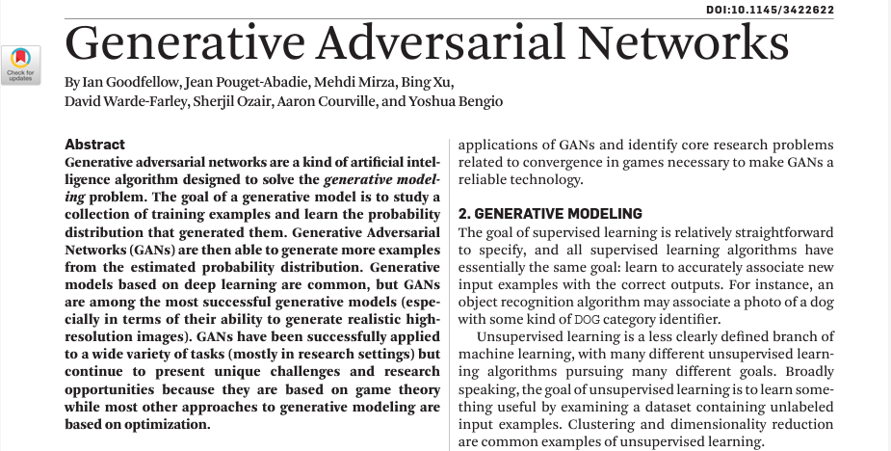
generative adversarial networks¹
¹ Goodfellow, Ian, et al. "Generative adversarial nets." Advances in neural information processing systems 27 (2014).
“… D and G play the following two-player minimax game with value function”
Generator Network, G
Discriminator Network, D
Random Input Noise, z
Fake data, G(z)
Real or Fake
D(G(z)) , D(x)
Real data, x

Slide 4
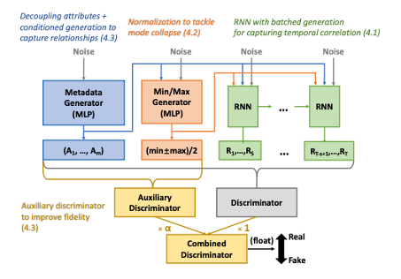
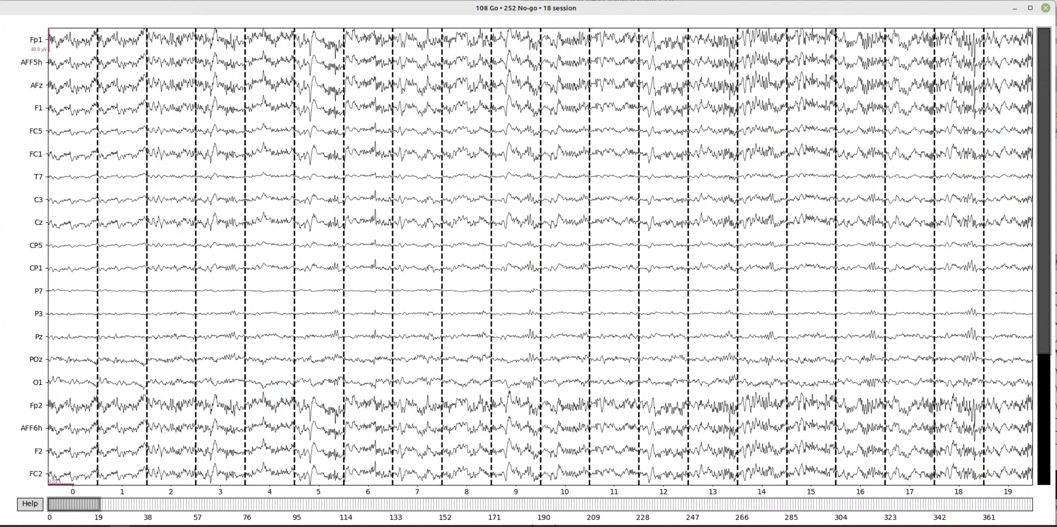
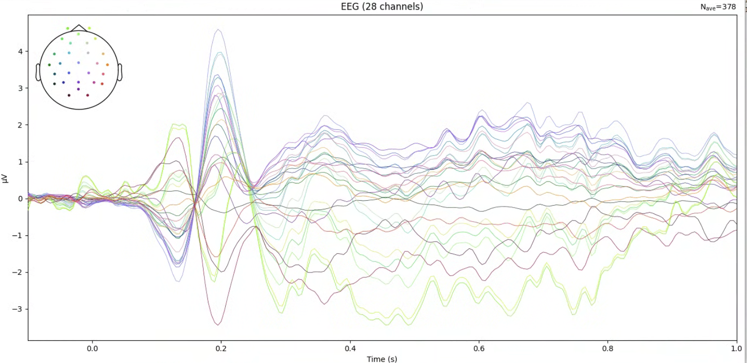
Proof of Concept with a small EEG dataset
² Shin, J., Von Lühmann, A., Kim, D. W., Mehnert, J., Hwang, H. J., & Müller, K. R. (2018). Simultaneous acquisition of EEG and NIRS during cognitive tasks for an open access dataset. Scientific data, 5(1), 1-16.01
³ Lin, Zinan, et al. "Using gans for sharing networked time series data: Challenges, initial promise, and open questions." Proceedings of the ACM Internet Measurement Conference. 2020.
Characteristics of the dataset²: Model for testing³:
Low sample size (N = 26)
Cognitive task performed for a very short duration (< 1 minute)
High dimensionality (down-sampled to 200 Hz)
EEG has Low Signal to Noise Ratio
Example an EEG recording
(background image generated with Adobe Firefly)

Slide 5
Project workflow
(I) Preprocessing EEG data
(I.I) Epochs
(I.II) Evoked Response Potentials
(II) Training the GAN
(III)
Evaluating the fake data
(III.I) Visual inspection
(III.II) Functional Connectivity
(III.III) Post-hoc RNN classifier and regressor
Integrity
Fidelity
Utility
N samples=26 (subjects) * 180 (trials)/ response
N samples=26 (subjects)* 1 (ERP)/ response

Slide 6
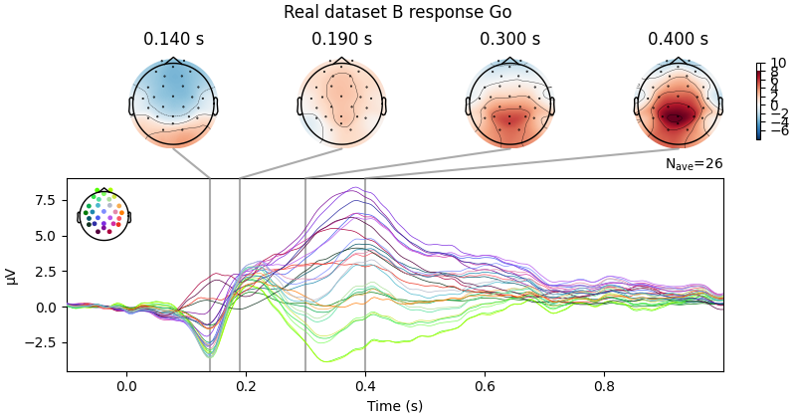
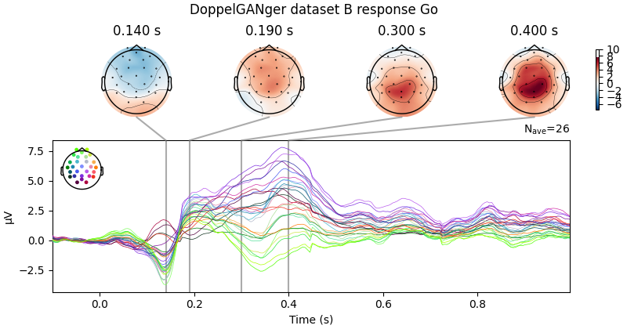
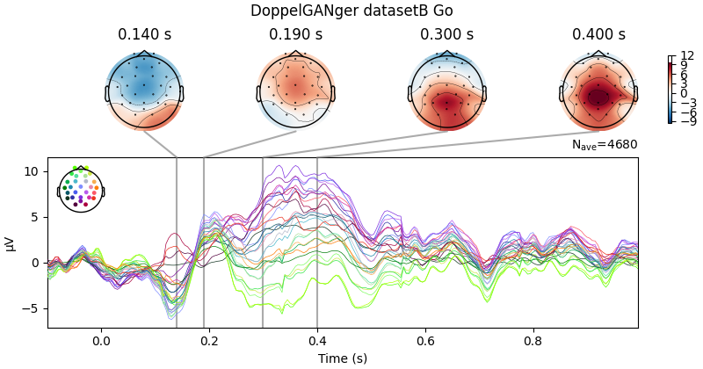
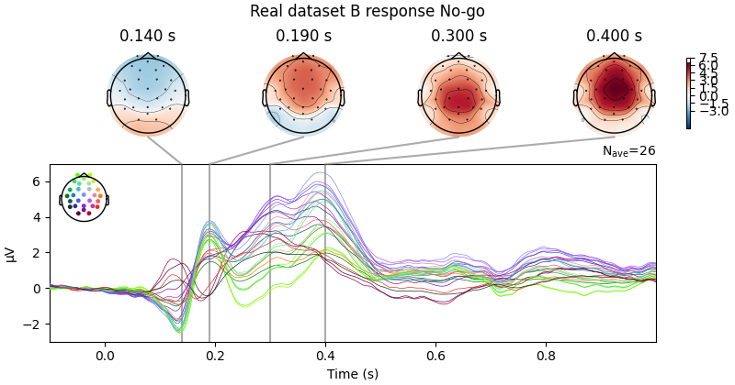
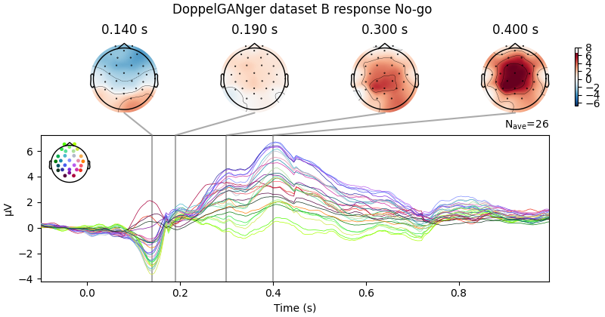
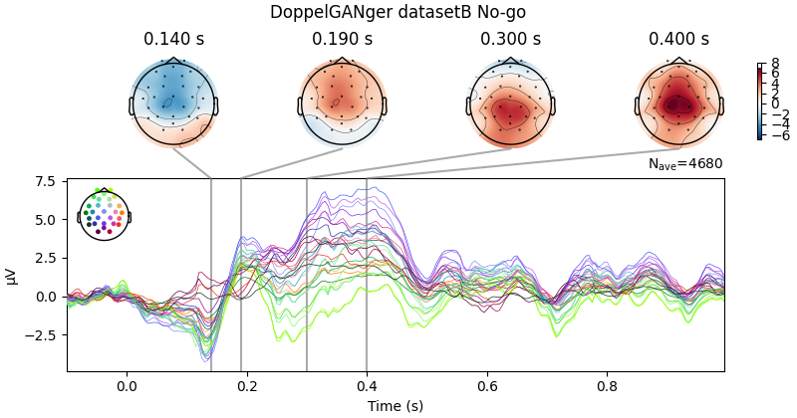
PoC results – visual inspection
Grand Averages of data
Real data
Synthetic data from ERPs
Synthetic data from Epochs
Response Go
Response No-Go

Slide 7
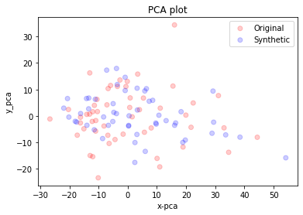
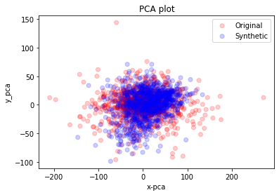
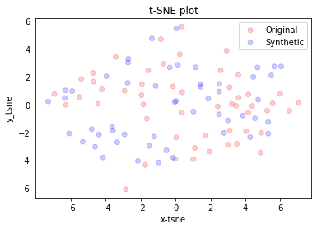
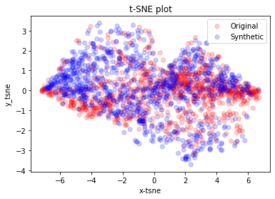
PoC results – visual inspection
Grand Averages of data
Synthetic data from ERPs
Synthetic data from Epochs
PCA and tSNE are unsupervised dimensionality reduction methods.
One should look for a high overlap between red (original) and blue (synthetic) data points as an indication of reasonable fidelity.
PCA
tSNE

Slide 8
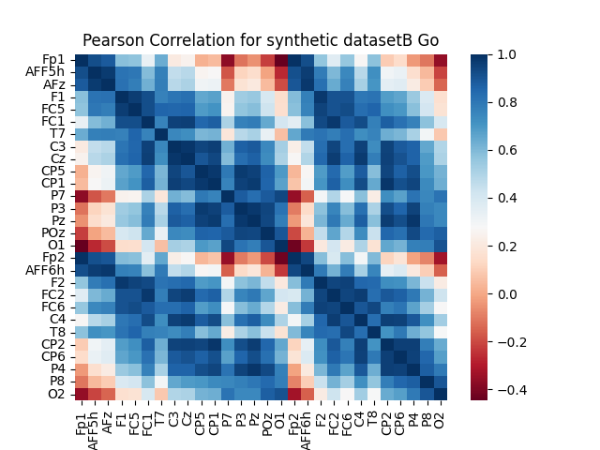
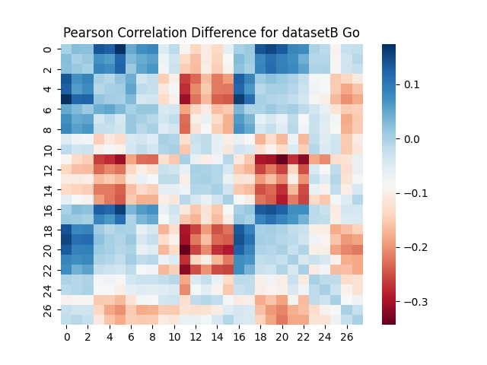
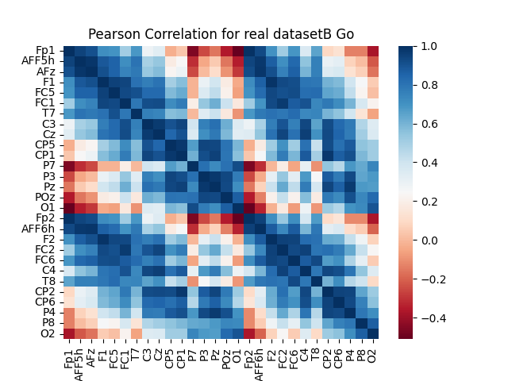
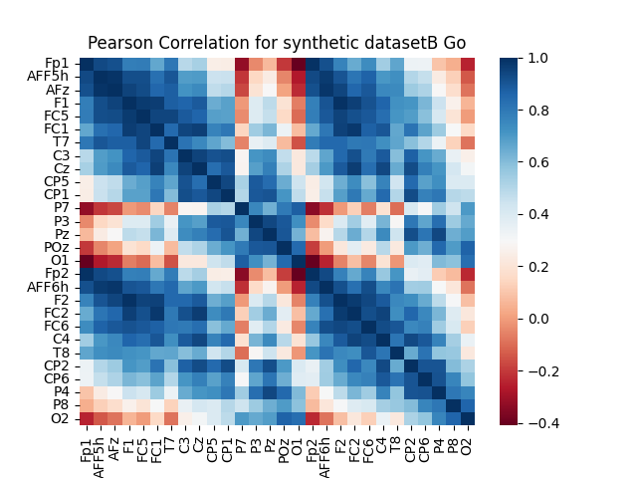
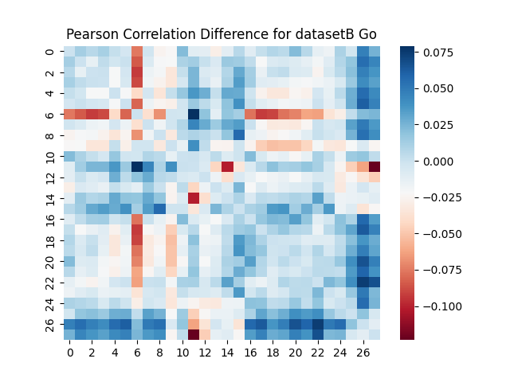
PoC results – Functional connectivity
Pearson r, trial-wise then averaged for all
Synthetic data from ERPs
Zero Difference
Real data
One should expect zero difference between synthetic and real functional connectivity as a measure of integrity and fidelity.
− =
Synthetic data from Epochs
Zero Difference

Slide 9
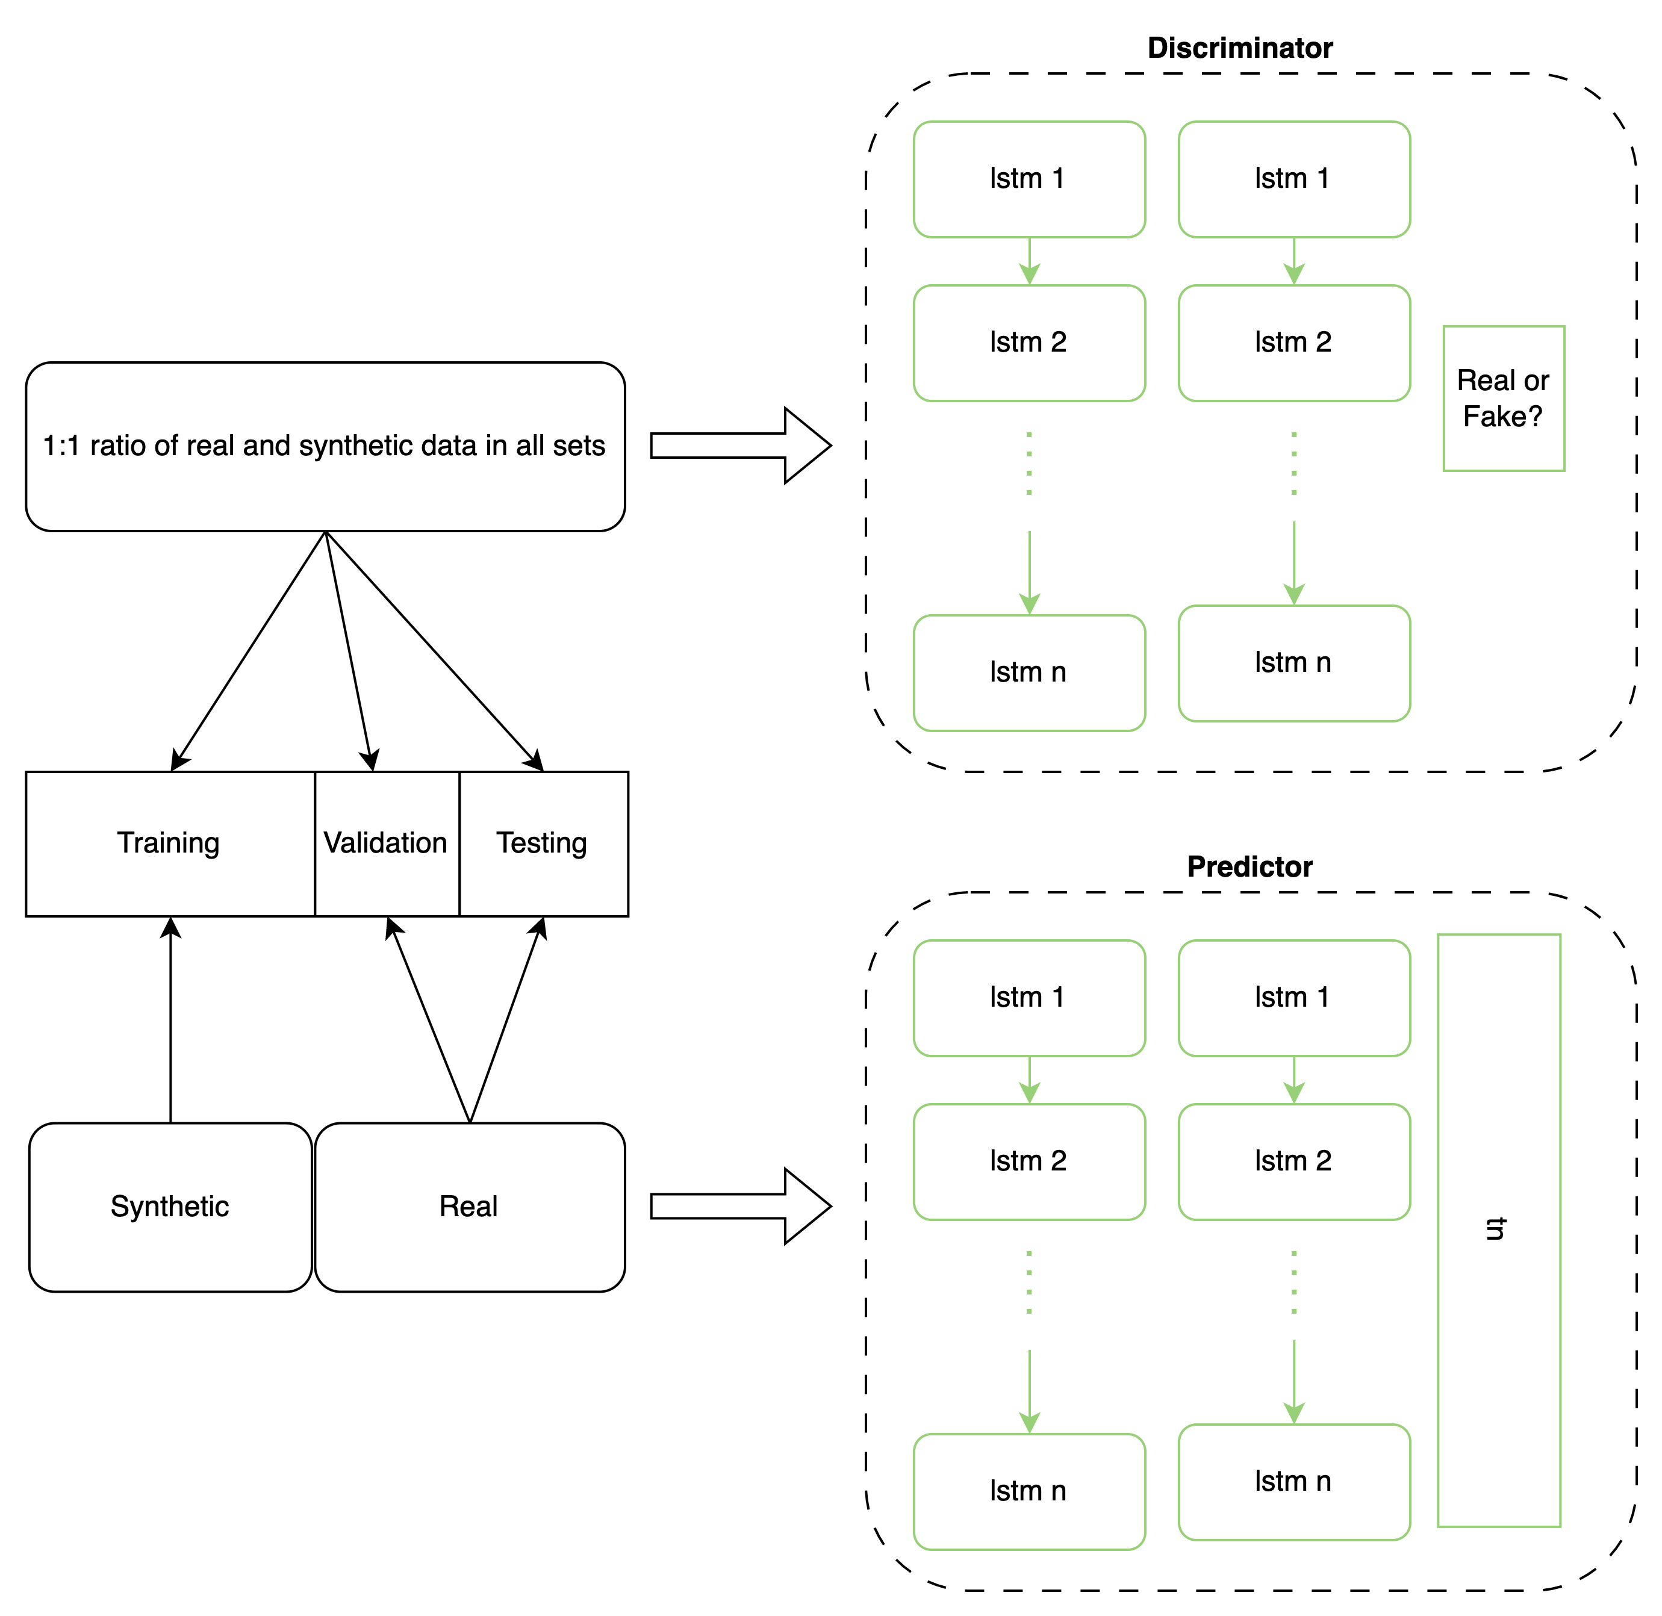
POC Results– Discriminative and predictive Scores⁴
⁴ Yoon, J., Jarrett, D., & Van der Schaar, M. (2019). Time-series generative adversarial networks. Advances in neural information processing systems, 32.
Start by balancing the data: n_real = n_synthetic
Discriminative score = $\left|0.5−accuracy\right|$
Predictive Score = $MAE$
The lower, the better!
 | Discriminative Score |0.5-acc| | Predictive Score MAE
Learning from ERPs | 0.436 | 0.9458
Learning from Epochs | 0.498 | 5.8617

Slide 10
conclusion
There remains many more questions to answer, such as:
Did the synthetic EEG data retain integrity and fidelity in the frequency domain?
How do popular time series GANs compare for EEG data?
What is the recommended minimum sample size for training the GAN?
It is evident that one should include a collection of objective metrics for evaluation.
There is high promise for synthetic neuroimaging data in overcoming the restrictions over data sharing. The methods of generative AI are available and ever evolving, the obstacle is establishing trust with generated data.

Slide 11
tHANK YOU FOR LISTENING!
Feel free to contact me at f.abdellatif@fz-juelich.de
This work is funded by the Palestinian German Science Bridge.
Many thanks to everyone involved:
Team Lead at INM-4: Dr. Juergen Dammers
INM-4 Director: Prof. N.J. Shah
Collaborators:
Dr. Ahmad Hasasneh, AAUP Faculty of Graduate Studies
Prof. A. Morrison, FZJ IAS-6, RWTH Computer Science Department

