Slide 1

Machine learning denoising of high-resolution nanotomography data
P05 nanotomography at PETRA III, DESY
Silja Flenner
Institute for Materials Research
Helmholtz AI 2024

Slide 2
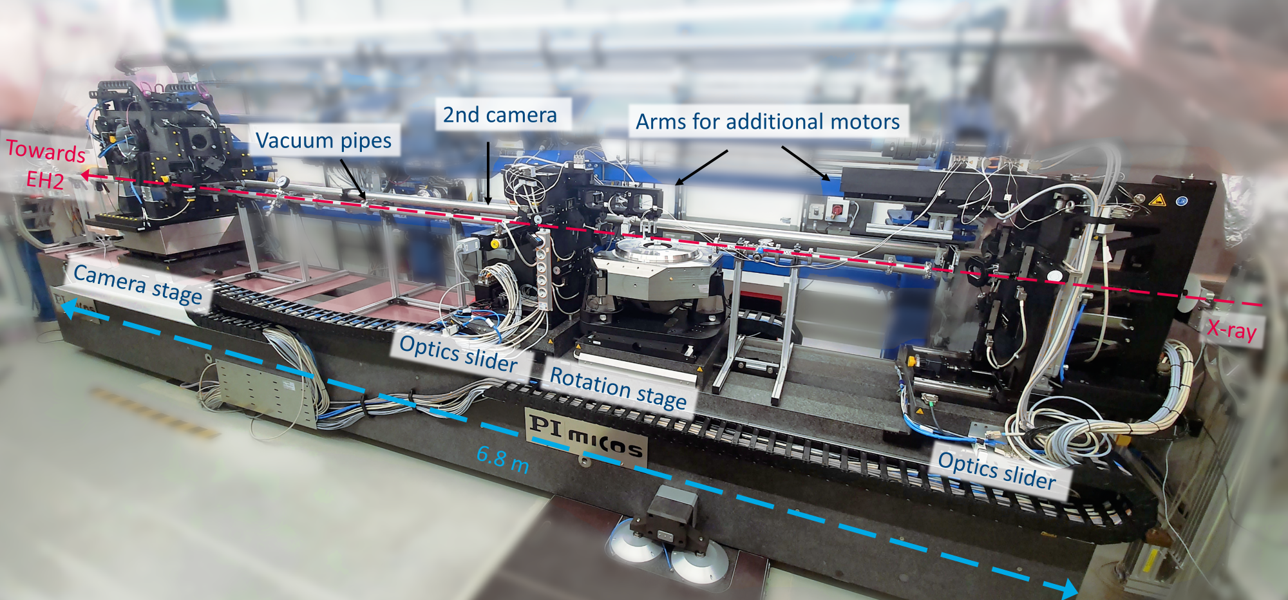

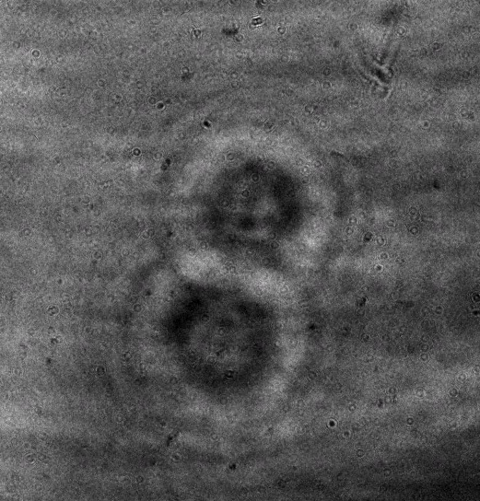

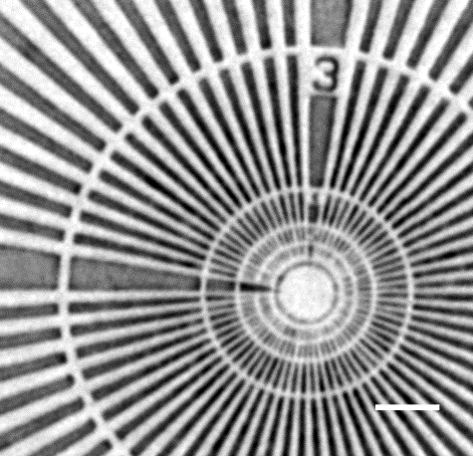
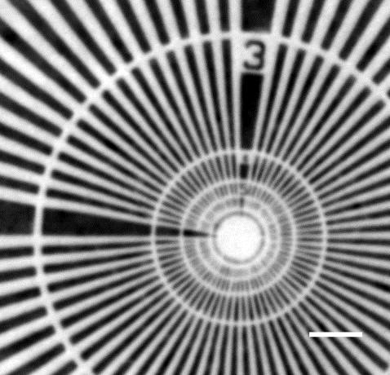
Full-field nanotomography @ P05, PETRA III, DESY
Transmission X-ray Microscopy
Beamstop
Sample
Beamshaper
OSA
FZP
Camera
Holotomography
20 m – 22 m
790 mm
50 mm – 100 mm
Nanotomography:
Resolution < 50 nm
Standard scans 15 min
Fast scanning
In situ applications
Absorption
Zernike Phase contrast
FZP
Beamstop
OSA
Sample
Camera
48 nm - 37 nm lines
f = 133 mm
z₁ = 50 mm – 3000 mm
z₂ = 16 m – 22 m
Flenner et al. Journal of Synchrotron Radiation, (2020)
Flenner et al. Optics Express (2020)
1 µm
1 µm

Slide 3

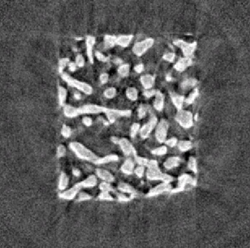
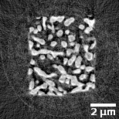
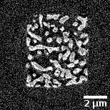
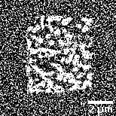

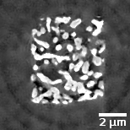
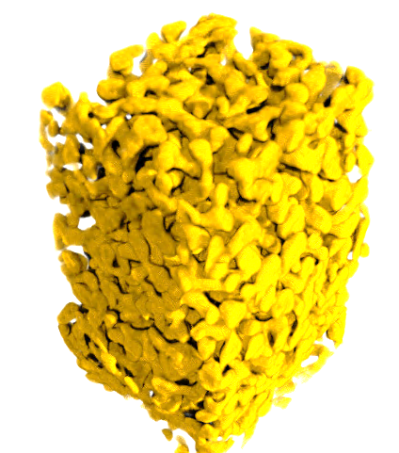
Machine learning for high time resolution
1 h
15 min
3 min
36 s
6 s
Nanoporous gold
3D test pattern for Nanotomography
https://github.com/dmpelt/msdnet
Flenner et al. (2020), Journal of Synchrotron Radiation
Pelt & Sethian (2017), Proc. of the Nat. Ac. of Sc. of the United States of America

Slide 4
Machine learning for high time resolution
1 h
15 min
3 min
36 s
6 s
Reference
Input
6 s + ML
Machine learning (ML) for very short scan times
Train network
Output
https://github.com/dmpelt/msdnet
Flenner et al. (2020), Journal of Synchrotron Radiation
Pelt & Sethian (2017), Proc. of the Nat. Ac. of Sc. of the United States of America

Slide 5

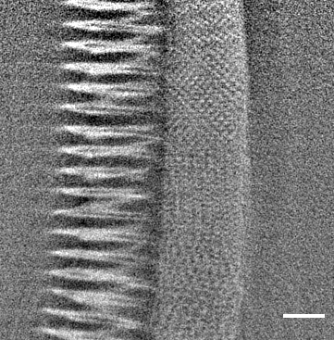
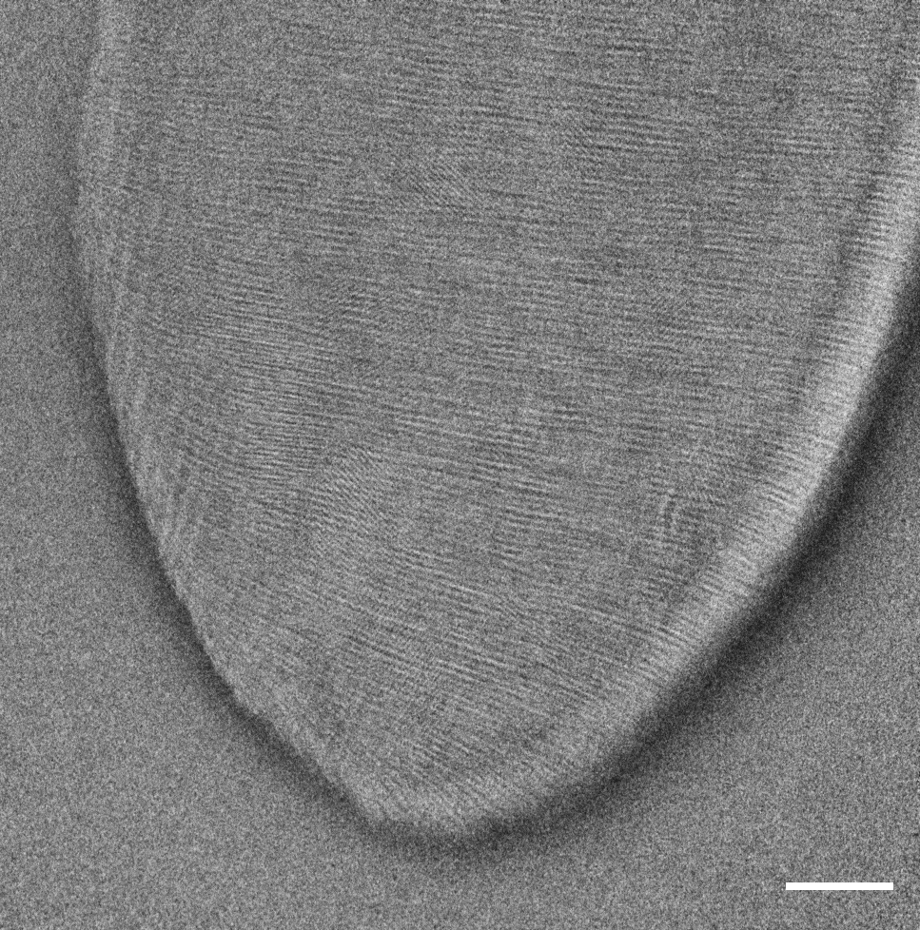
Machine learning denoising: Noise2Inverse
ML
apply
Input
Trained network
split
reconstruct
train
Target
Stack of projections
2 stack with ½ projections
2 reconstructed stacks
Hendriksen et al. (2020). IEEE Transactions on Computational Imaging
Flenner et al. (2022) Journal of Synchrotron Radiation
https://github.com/dmpelt/msdnet

Slide 6
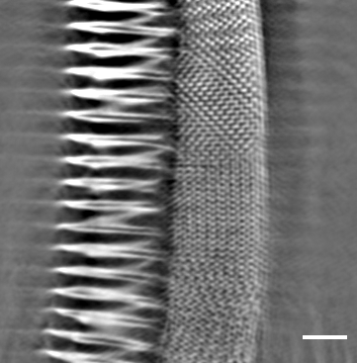

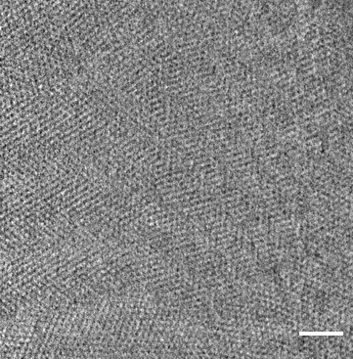
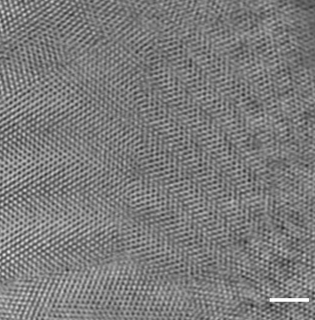


Denoising of standard scans
Unfiltered
ML filter
Applicable on standard scans without reference scan
Multi-scale dense network (msdnet)
5 input channels (5 slices, 2.5D training)
Image size: 1024 x 1024
Training data size: 100 – 300 slices
Test data size: 40 – 80 slices
x-y view
3 µm
3 µm
y-z view
3 µm
3 µm
Flenner et al. (2022) Journal of Synchrotron Radiation
Hendriksen et al. (2020). IEEE Transactions on Computational Imaging
https://github.com/dmpelt/msdnet
Notes:
Recorded 2000 projections

Slide 7
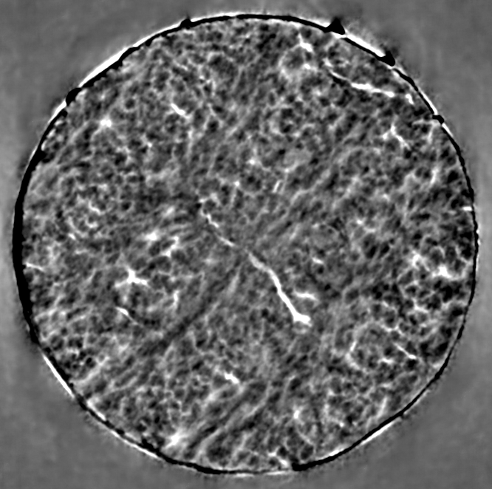
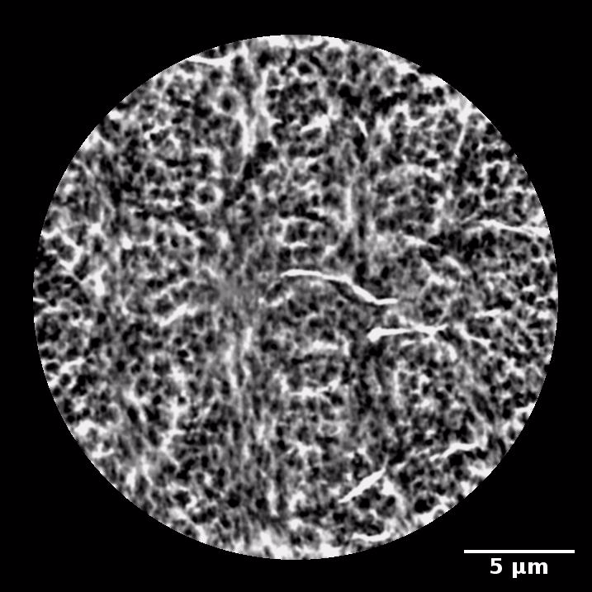
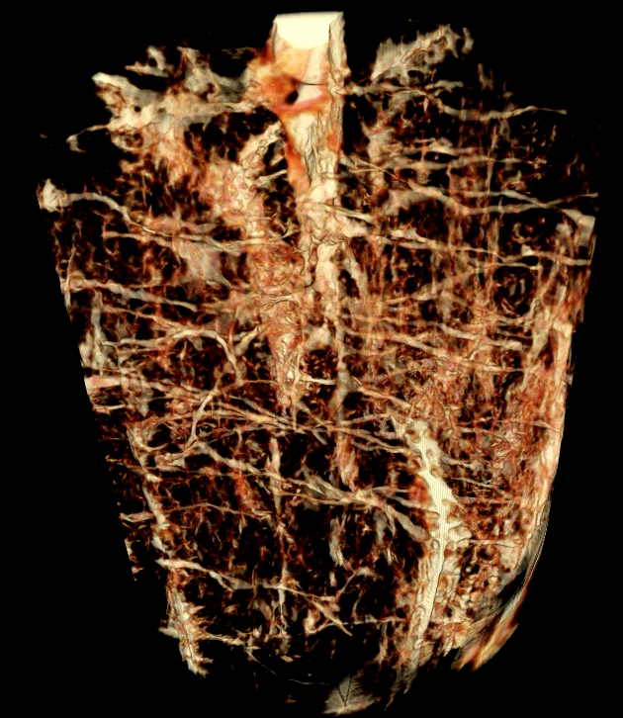
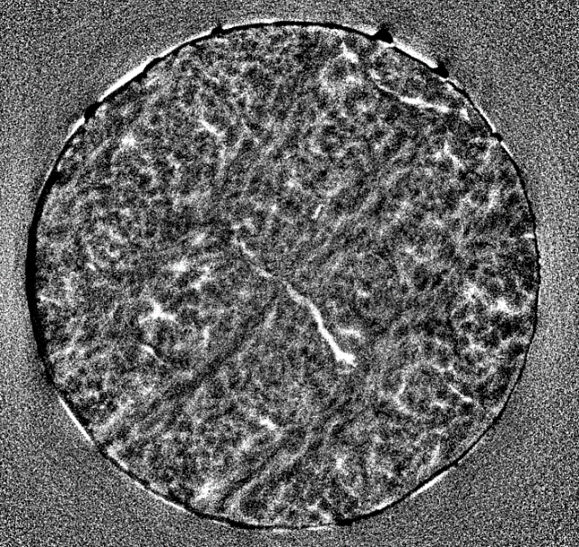
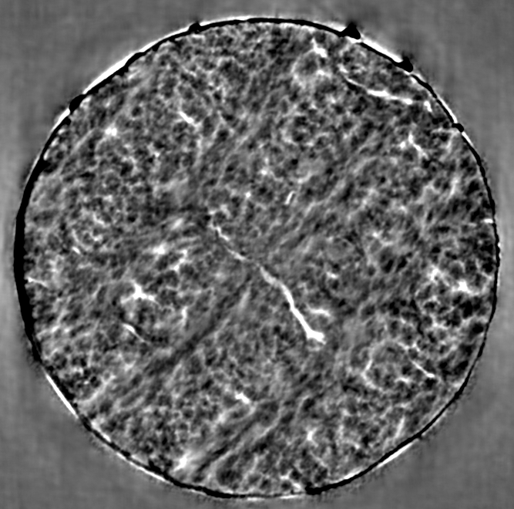
Applicability
3D Human Bone Anatomy
Training is the most time consuming step (up to several hours)
Typical TXM experiment:
Batch of similar samples
Trained on same sample
Trained on similar sample
Original
Stockhausen et al. ACS Nano, 15 (1), 455-467, 2021
In collaboration with Prof. B. Busse (UKE)

Slide 8
Machine learning denoising
ML
apply
Input
Trained network
split
reconstruct
train
Target
Network is trained to be applied on a scan with half the number of projections!
Stack of projections
2 stack with ½ projections
2 recostructed stacks
6 min
3 min

Slide 9
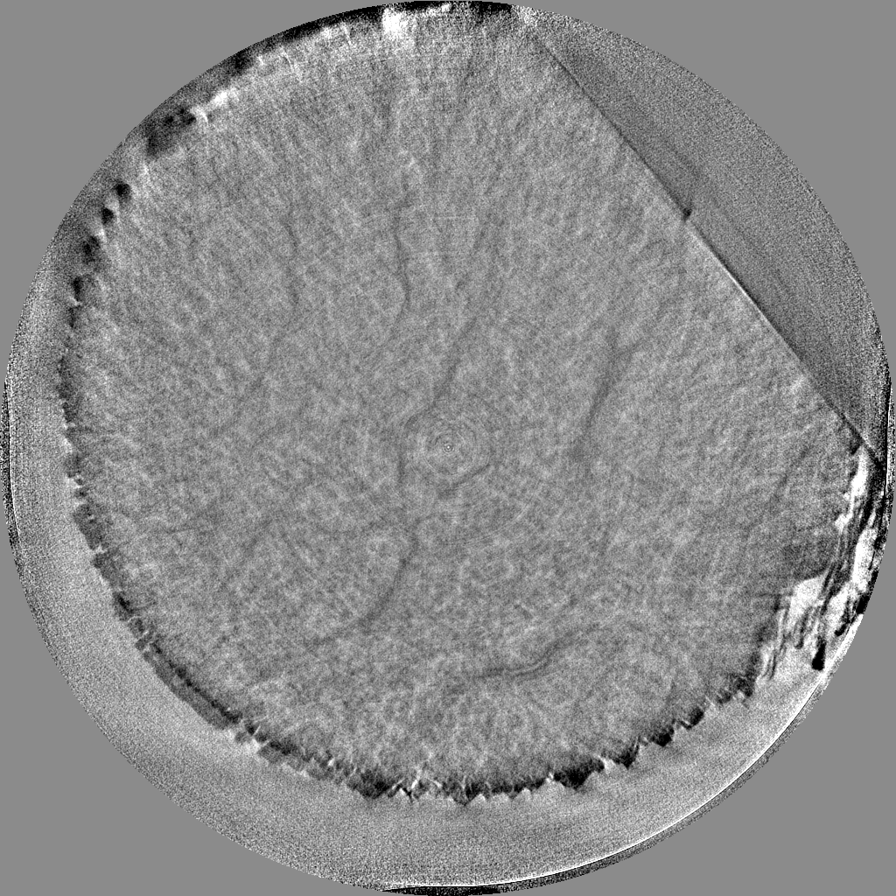
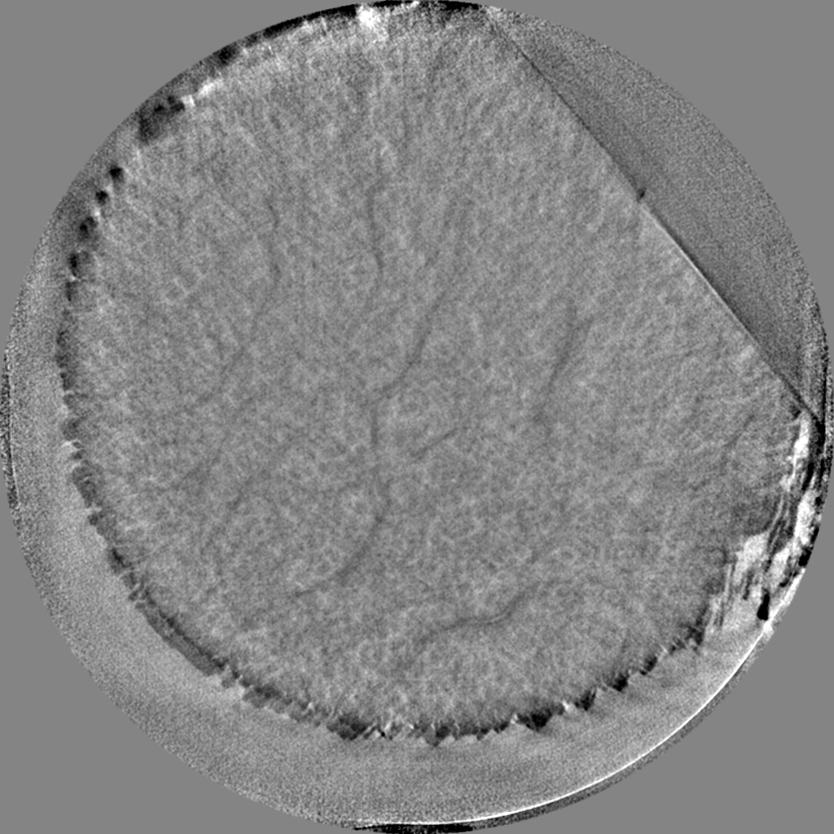
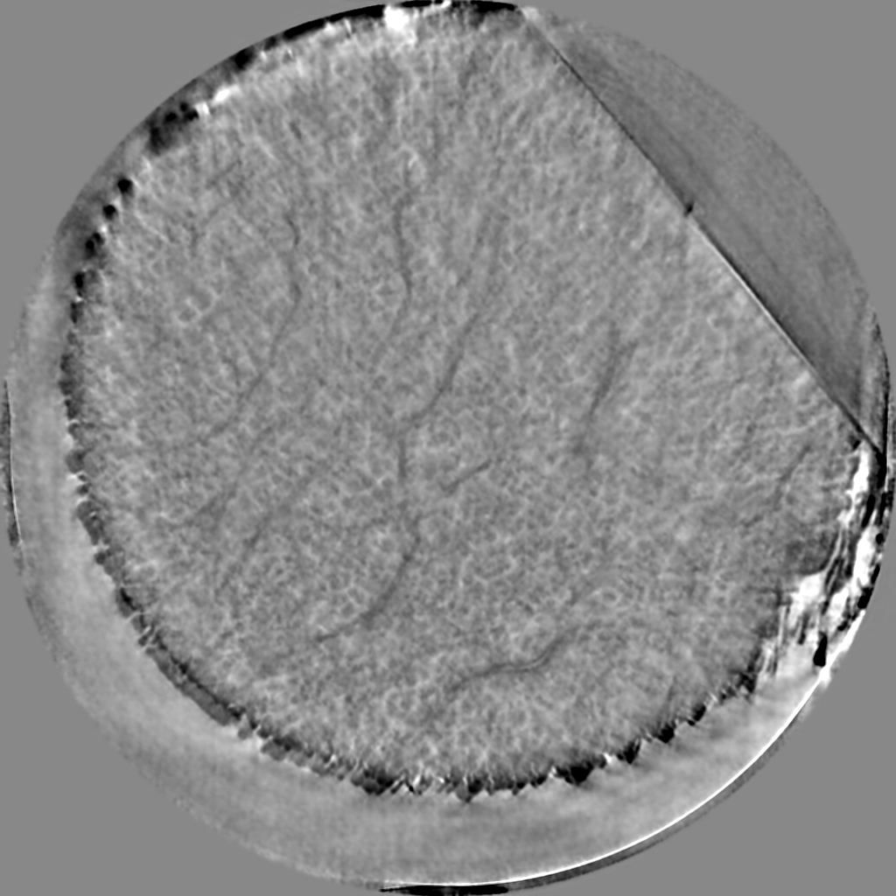
Decreasing scan time for in situ experiments
3D Human Bone Anatomy
6 min
3 min
3 min – ML filtered
training
Trained network

Slide 10
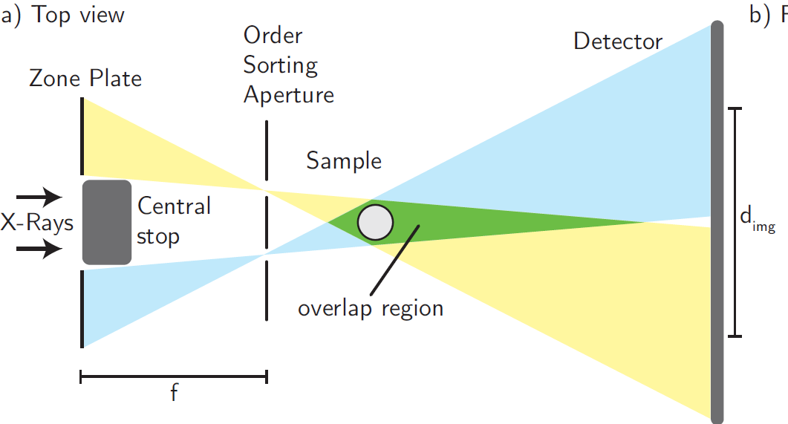
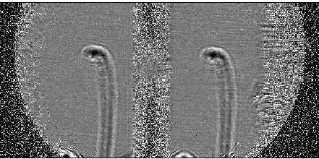
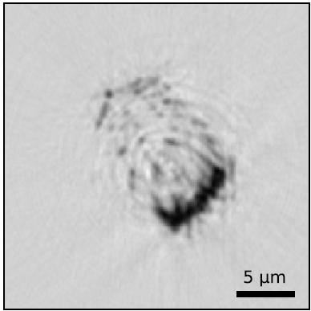
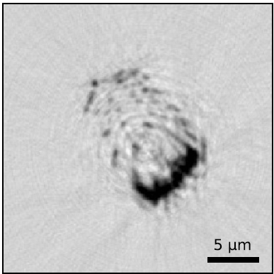
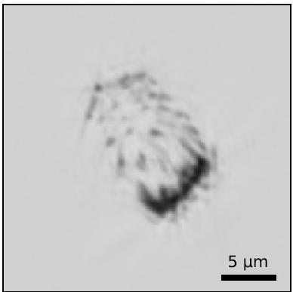
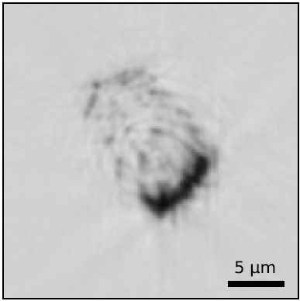
The next step: Dual-beam tomography for ML
left
input
right
target
ML
result
left & right
interlaced
Flenner et al. (2024) Journal of Synchrotron Radiation

Slide 11
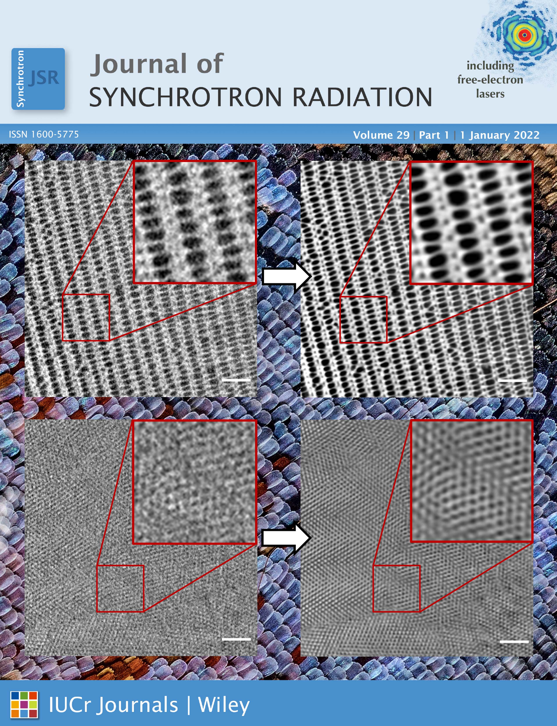
Summary
Machine learning denoising
    Very short scans (with high quality reference scan)
    Standard scans without a reference scan
    Helps to reduce scan time for in situ experiments
    Dual- beam setup for artifact removal
silja.flenner@hereon.de, imke.greving@hereon.de

Slide 12


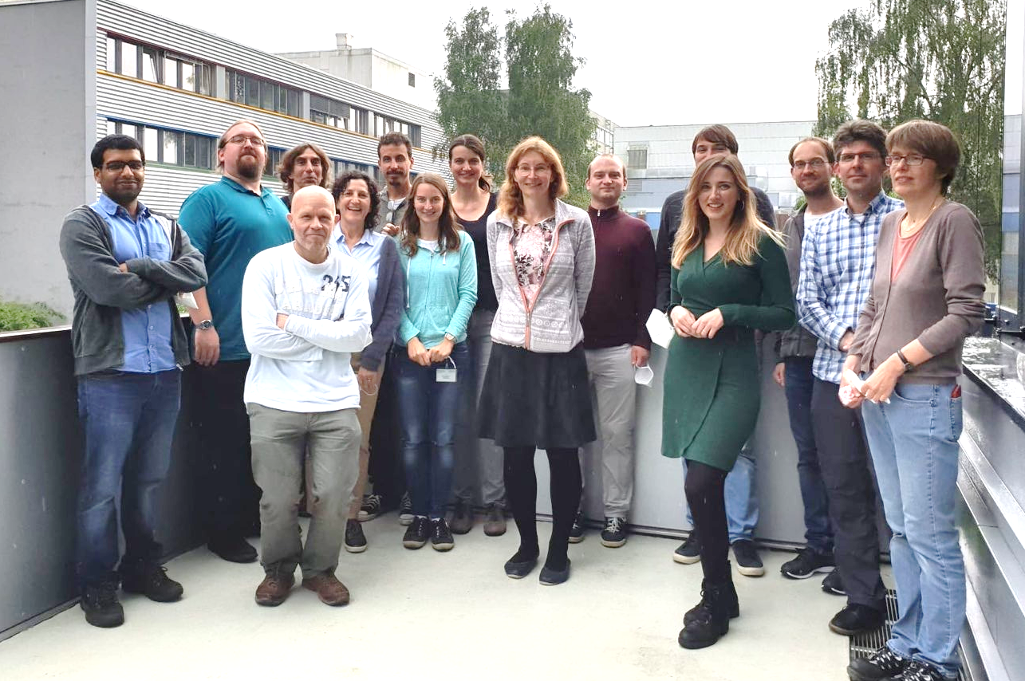
Thank you
Hereon Team
Imke Greving
Stefan Bruns
Elena Longo
Malte Storm
Berit Zeller-Plumhoff
Felix Beckmann
Fabian Wilde
Jörg Hammel
Julian Moosmann
Jens Breling
Hilmar Burmester
Ursula Tietze
Christina Krywka
Martin Müller
Adam Kubec
Peng Qui
Florian Döring
Christian David
Johannes Hagemann
Felix Wittwer
André Rothkirch
Samples
Kilian Stockhausen (UKE)
Björn Busse (UKE)
Andrew J. Parnell
(University of Sheffield)
Erica Lilleodden (hereon)
Silja Flenner
silja.flenner@hereon.de, imke.greving@hereon.de

