Slide 1




A Kernel-based Framework
for Uncertainty in Generative AI
Sebastian G. Gruber
German Cancer Research Center (DKFZ), Germany
German Cancer Consortium (DKTK), Frankfurt, Germany
Goethe University Frankfurt, Germany
sebastian.gruber@dkfz.de

Slide 2
A Kernel-based Framework
for Uncertainty in Generative AI
Sebastian G. Gruber
German Cancer Research Center (DKFZ), Germany
German Cancer Consortium (DKTK), Frankfurt, Germany
Goethe University Frankfurt, Germany
sebastian.gruber@dkfz.de

Slide 3
A Kernel-based Framework
for Uncertainty in Generative AI
Sebastian G. Gruber
German Cancer Research Center (DKFZ), Germany
German Cancer Consortium (DKTK), Frankfurt, Germany
Goethe University Frankfurt, Germany
sebastian.gruber@dkfz.de

Slide 4
A Kernel-based Framework
for Uncertainty in Generative AI
Sebastian G. Gruber
German Cancer Research Center (DKFZ), Germany
German Cancer Consortium (DKTK), Frankfurt, Germany
Goethe University Frankfurt, Germany
sebastian.gruber@dkfz.de

Slide 5
A Kernel-based Framework
for Uncertainty in Generative AI
Sebastian G. Gruber
German Cancer Research Center (DKFZ), Germany
German Cancer Consortium (DKTK), Frankfurt, Germany
Goethe University Frankfurt, Germany
sebastian.gruber@dkfz.de

Slide 6
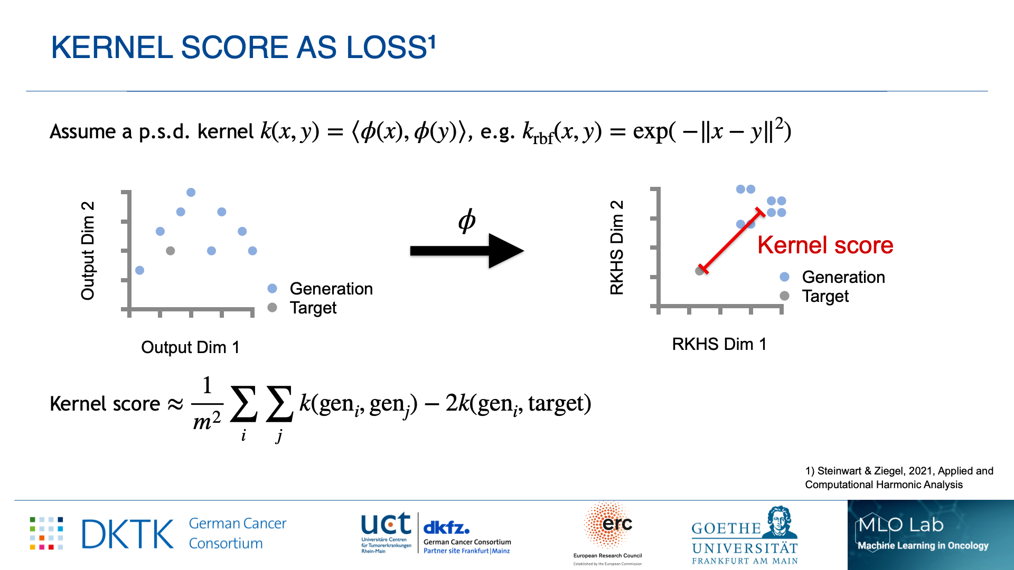


Kernel score as loss¹
Assume a p.s.d. kernel $k(x,y)=⟨φ(x),φ(y)⟩$, e.g. $k_{rbf}(x,y)=exp(−∥x−y∥^{2})$
Kernel score $≈$ $\frac{1}{m^{2}}\underset{i}{∑}\underset{j}{∑}k({gen}_{i},{gen}_{j})−2k({gen}_{i},target)$
$$φ$$
Kernel score
1) Steinwart & Ziegel, 2021, Applied and
Computational Harmonic Analysis

Slide 7
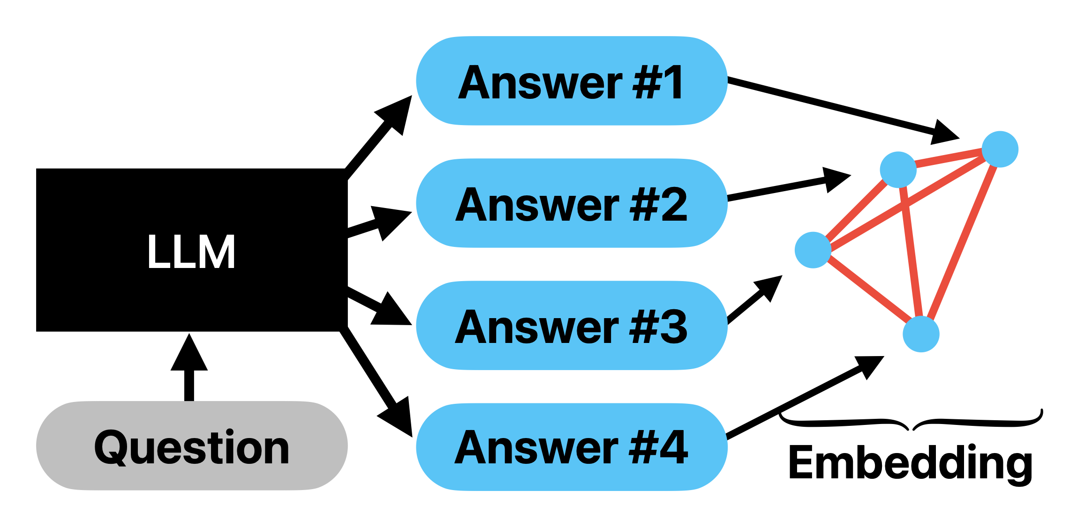

Kernel-based uncertainties²
$𝔼$[Kernel score] = Noise + Bias + Variance
  Each quantity has a ‘nice’ kernel-based estimator
  Noise is kernel entropy
Predictive
kernel entropy
2) Gruber & Buettner, 2024, ICML

Slide 8
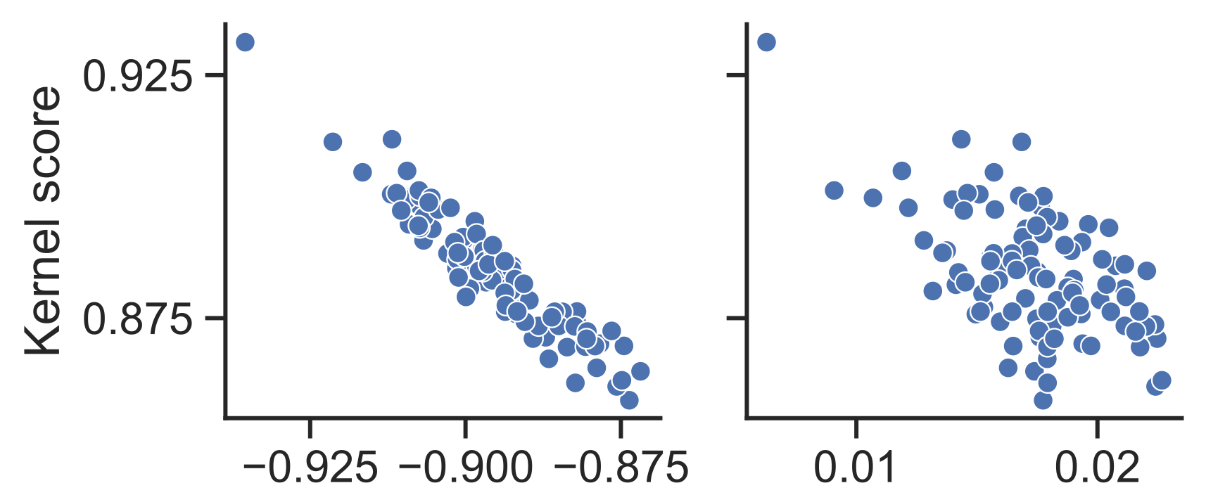
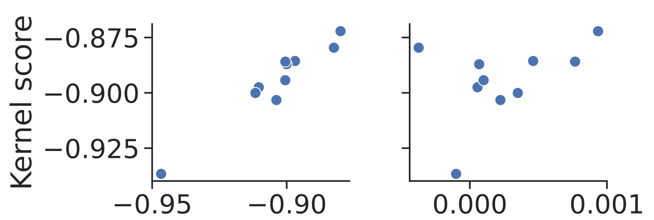
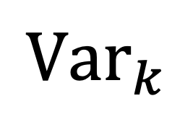
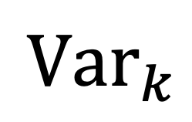
IMAGE and audio Evaluation²
MNIST Generation
LJSpeech Audio Generation
Kernel entropy
$${Var}_{k}$$
Kernel entropy
$${Var}_{k}$$
2) Gruber & Buettner, 2024, ICML

Slide 9
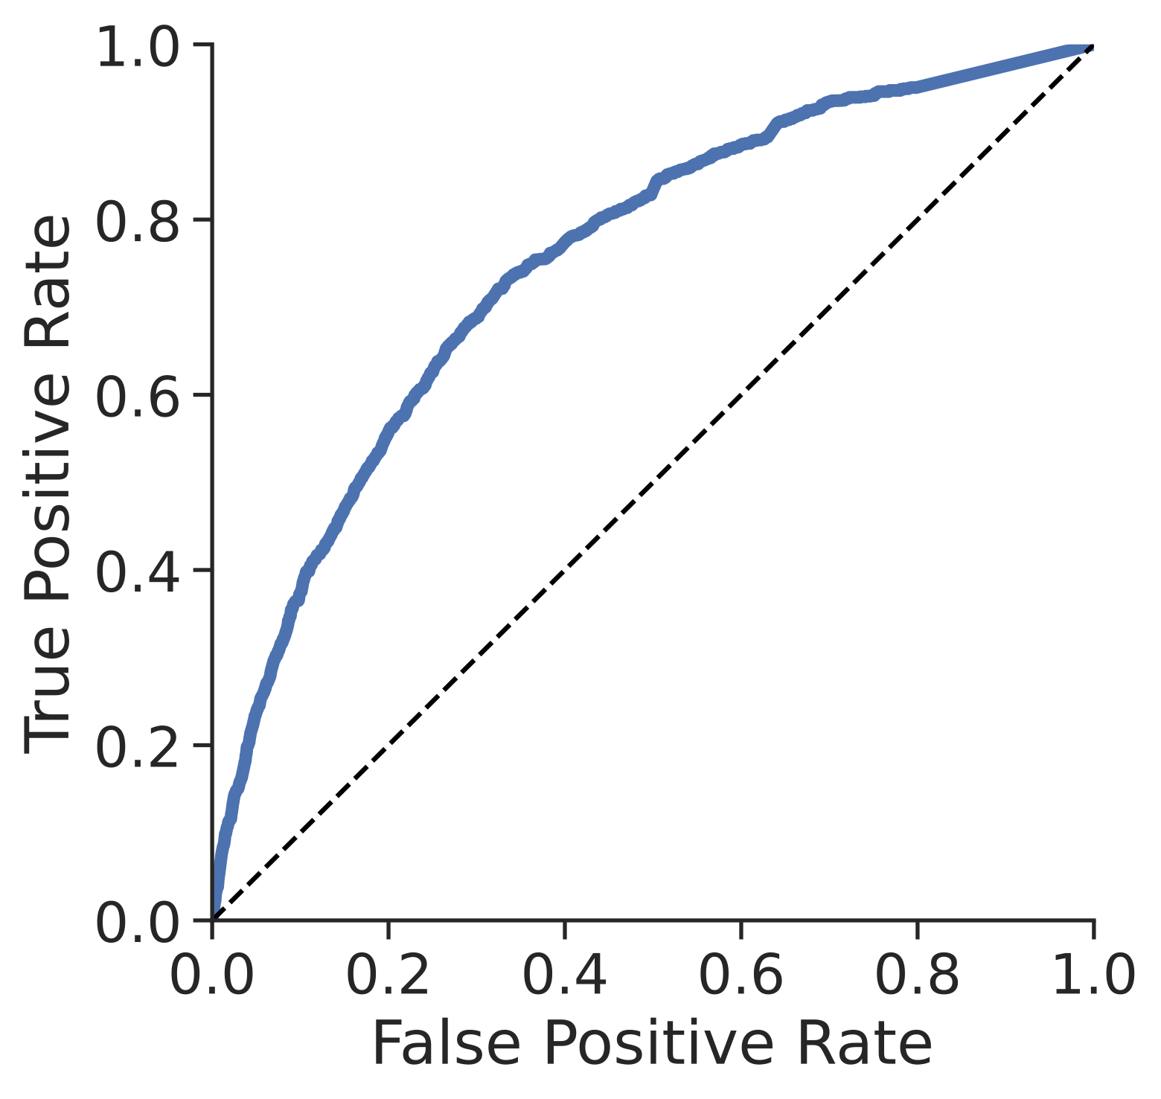
Language Evaluation
ROC of kernel entropy
Datasets: TriviaQA and CoQA
Models: 125m … 13b LLMs
Uncertainty as predictor for answer correctness
Compute Area-Under-ROC (AUROC) as uncertainty performance measure

Slide 10
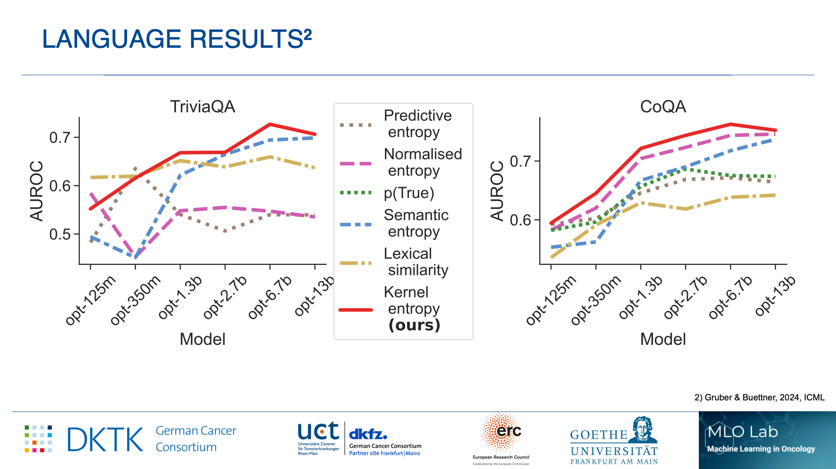
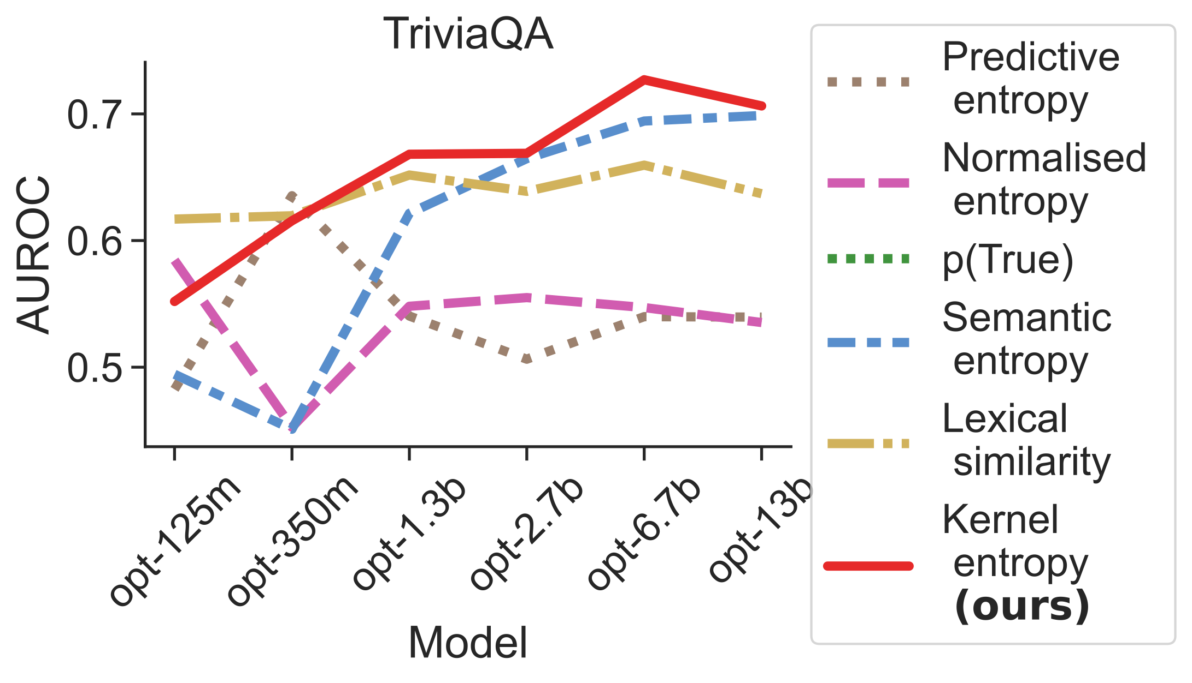
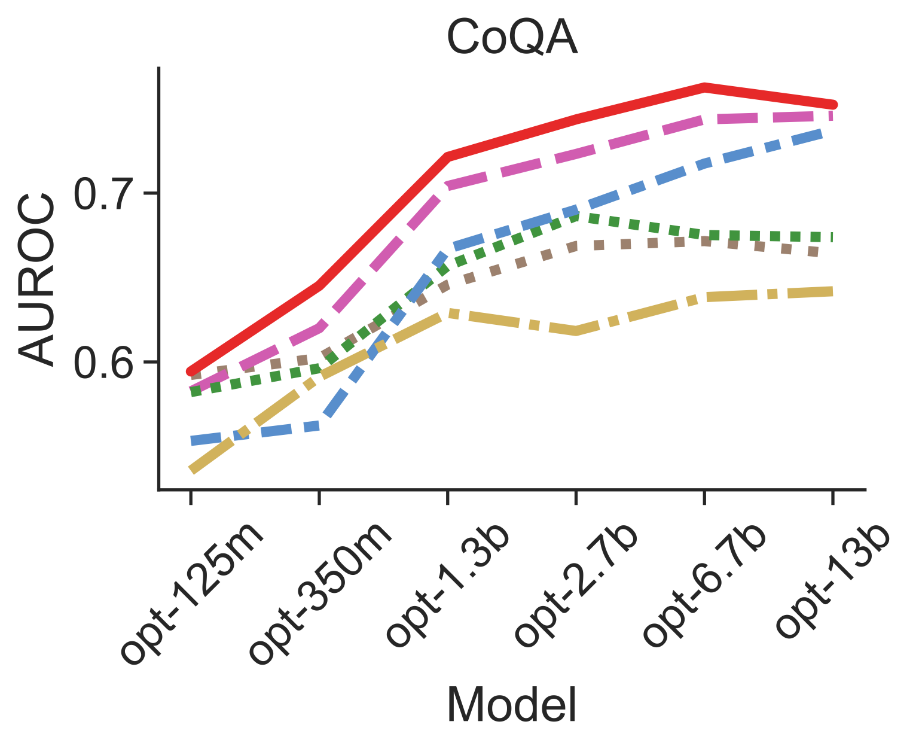
Language results²
2) Gruber & Buettner, 2024, ICML

Slide 11
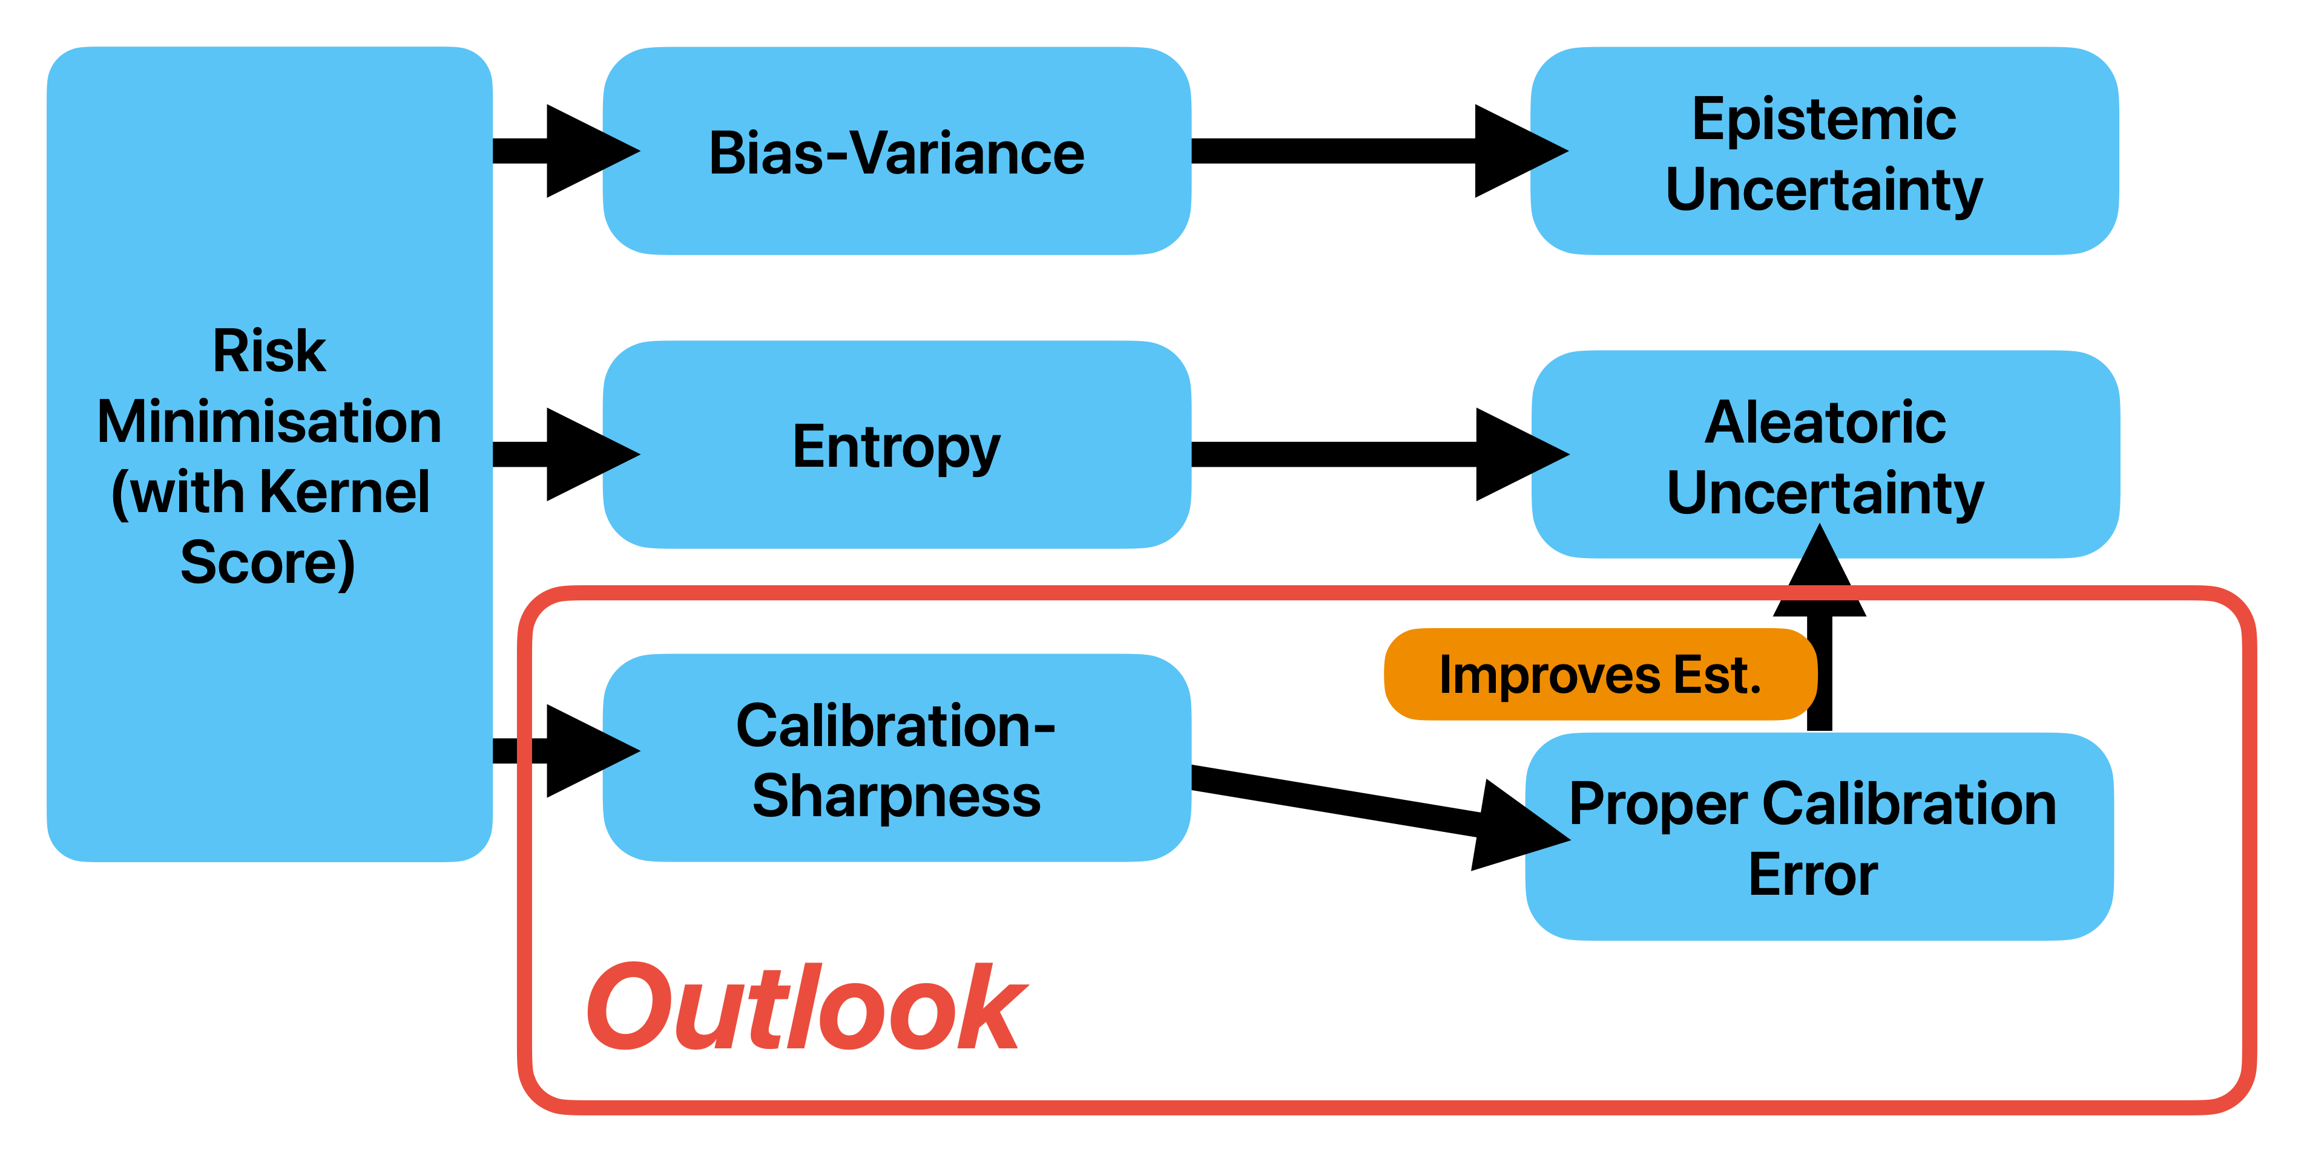
Summary
Mail: sebastian.gruber@dkfz.de
Coauthors: Florian Buettner, Francis Bach

