Slide 1
Near-field Holographic Image Denoising Using Dilated Convolutional Neural Networks
1,*
1
1,2,3
Vahid Rahmani , Johannes Hagemann , Christian Schroer
${}^{1}$ Center for X-ray and Nano Science CXNS, Deutsches Elektronen-Synchrotron DESY, Hamburg, Germany ${}^{2}$ Department Physik, Universit ̈at Hamburg UHH, Luruper Chaussee 149, 22761 Hamburg, Germany ${}^{3}$ HELMHOLTZ IMAGING, Deutsches Elektronen-Synchrotron DESY, Hamburg, Germany
* Vahid.rahmani@desy.de

Slide 2
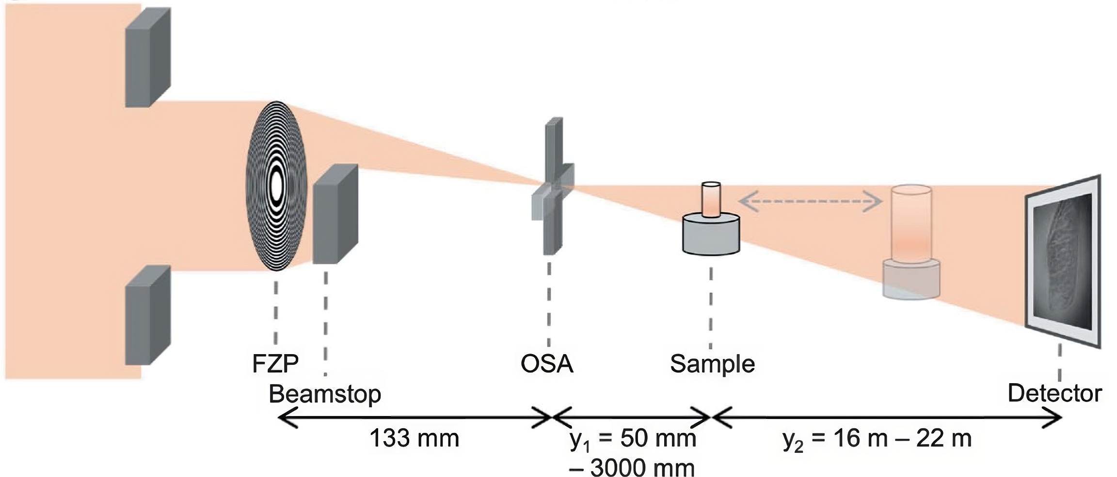
| Near-field Holography image Denoising using Dilated Convolutional Neural Networks | Vahid Rahmani |
Near-Field Holography
14 June 2024 Helmholtz AI Conference 24 - AI for Science Slide 2/12

Slide 3
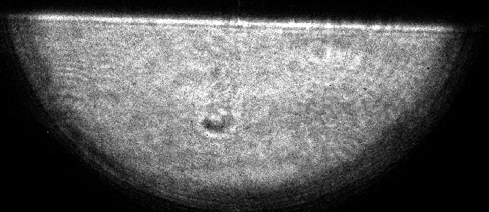
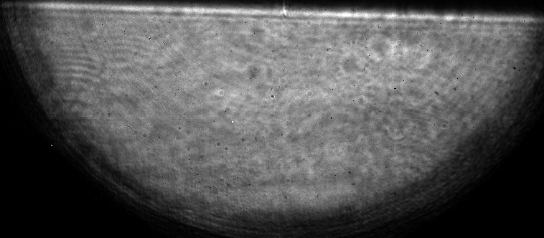
| Near-field Holography image Denoising using Dilated Convolutional Neural Networks | Vahid Rahmani |
Near-Field Holography Experiment
Image with object (spider hair)
Hologram images (without object) Flat-fields
Flat-field corrected image
Remove
outliers
Flat-field correction using PCA
Reconstruction
Bad pixel
$$5μm$$
Reconstructed image
14 June 2024 Helmholtz AI Conference 24 - AI for Science Slide 3/12

Slide 4
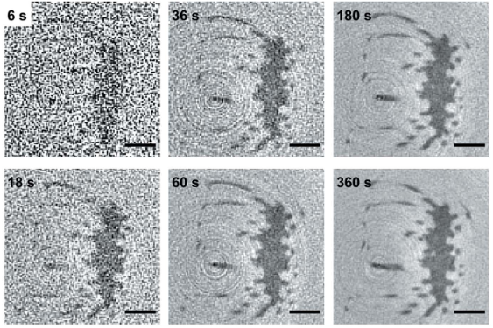
| Near-field Holography image Denoising using Dilated Convolutional Neural Networks | Vahid Rahmani |
Noise in Near-field Holography
High Frequency Noise
Near-field holographic data often contains high-frequency noise that is difficult to remove without losing important details.
Photon Counts
Fewer photons are collected with lower exposure times, reducing the interference pattern's contrast and clarity in holography.
Shot Noise
Shot noise, arising from the discrete nature of photons, becomes more pronounced with fewer photons. Lower exposure times make statistical fluctuations in detected photons significant, increasing the hologram's overall noise level.
Reconstructed slices of a spider attachment hair withdifferent scan times. Silja Flenner et al, (2023)
Producing clean image is always a trade-off because higher exposure time can damage the sample
14 June 2024 Helmholtz AI Conference 24 - AI for Science Slide 4/12

Slide 5
| Near-field Holography image Denoising using Dilated Convolutional Neural Networks | Vahid Rahmani |
High Frequency Noise
100% light
4 Photon/pixel
1 Photon/pixel
Ideal
100% light
50% light
4 Photon/pixel
1 Photon/pixel
50% light
25% light
4 Photon/pixel
1 Photon/pixel
25% light
14 June 2024 Helmholtz AI Conference 24 - AI for Science Slide 5/12

Slide 6
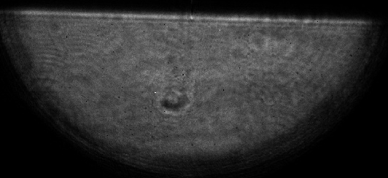
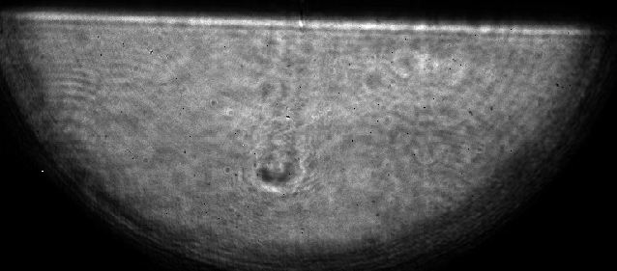
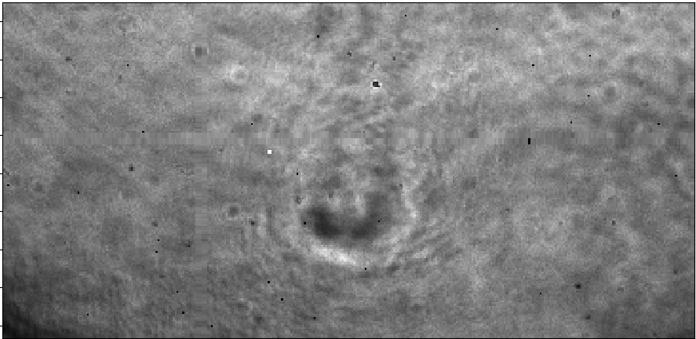
| Near-field Holography image Denoising using Dilated Convolutional Neural Networks | Vahid Rahmani |
Near-field Holography images in different exposure time
1ms 10ms 3000ms 8000ms
14 June 2024 Helmholtz AI Conference 24 - AI for Science Slide 6/12

Slide 7
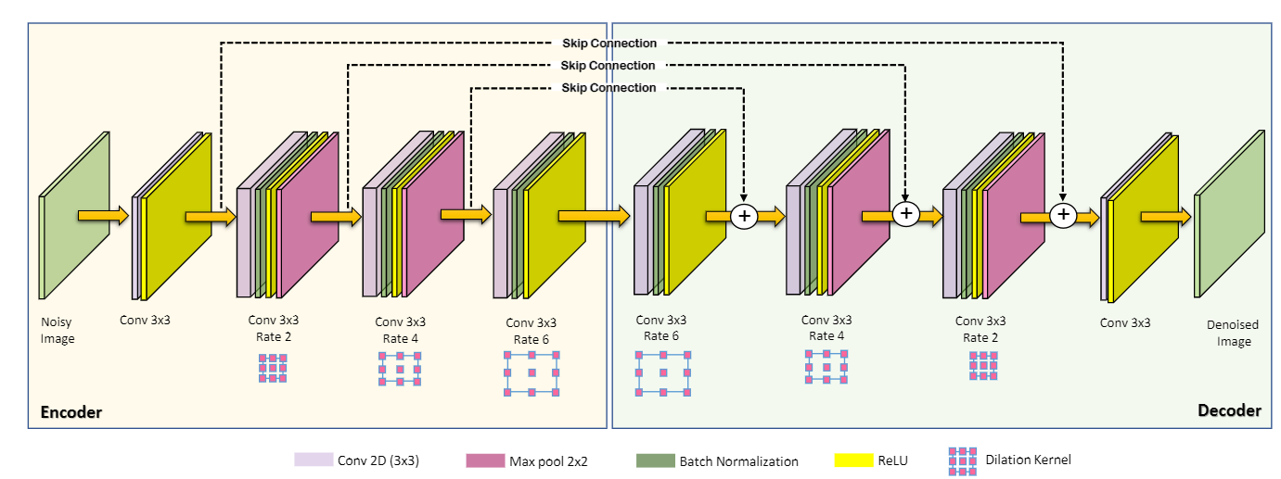
| Near-field Holography image Denoising using Dilated Convolutional Neural Networks | Vahid Rahmani |
Dilated Convolutional Deep Neural Networks
Dilated Convolutional Deep Neural Networks (DnCNN)
14 June 2024 Helmholtz AI Conference 24 - AI for Science Slide 7/12

Slide 8
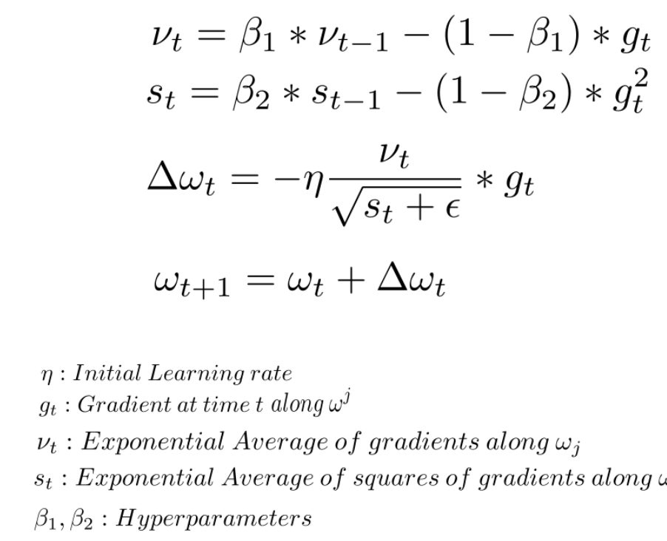
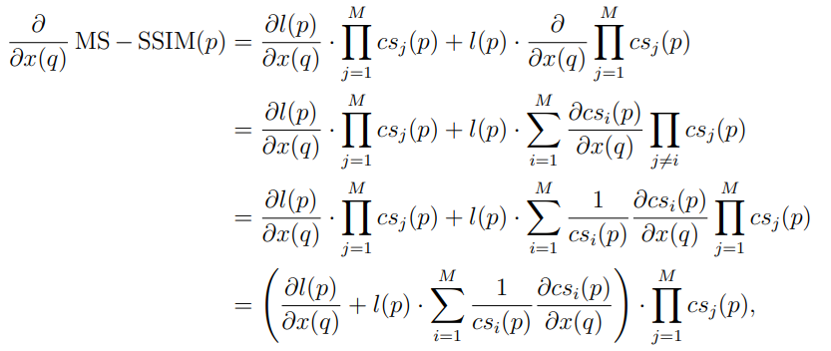
| Near-field Holography image Denoising using Dilated Convolutional Neural Networks | Vahid Rahmani |
Training and Optimization of the Dilated CNN Model
Data Augmentation
Loss Functions
Optimization Strategies
Adding Poisson noise to input image
$E\{X\} = const$
$n → ∞$
14 June 2024 Helmholtz AI Conference 24 - AI for Science Slide 8/12

Slide 9
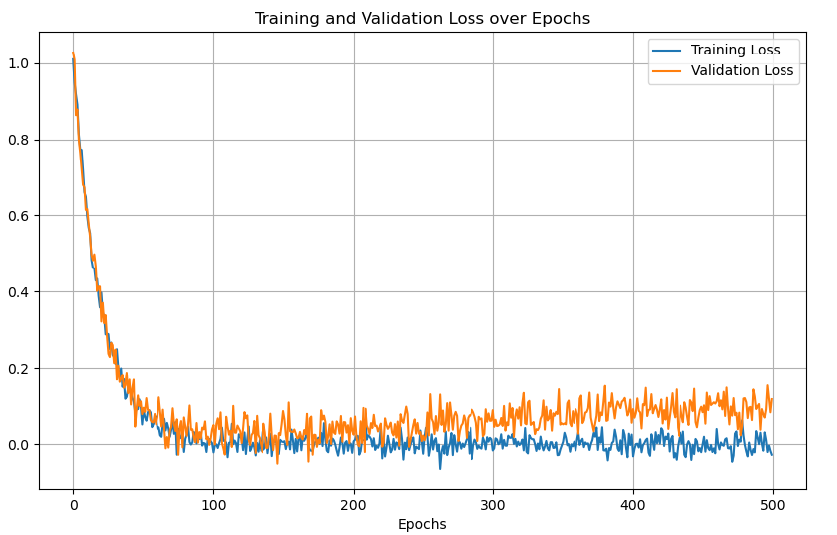
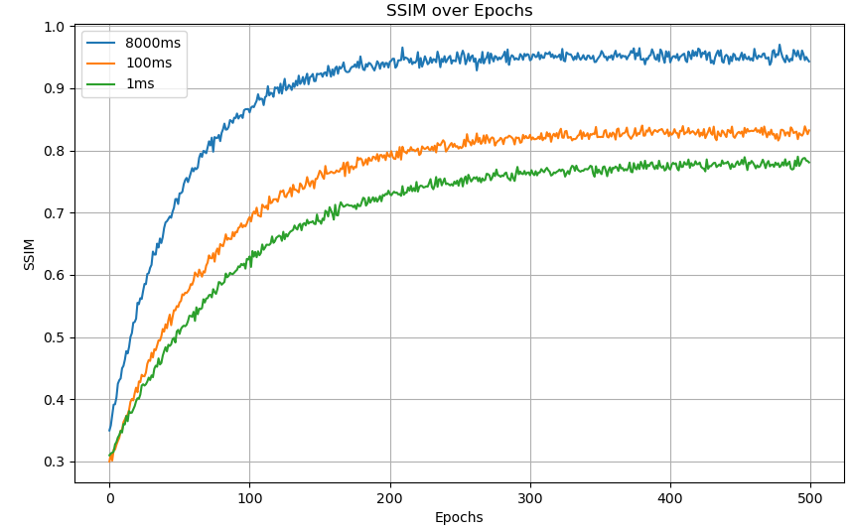
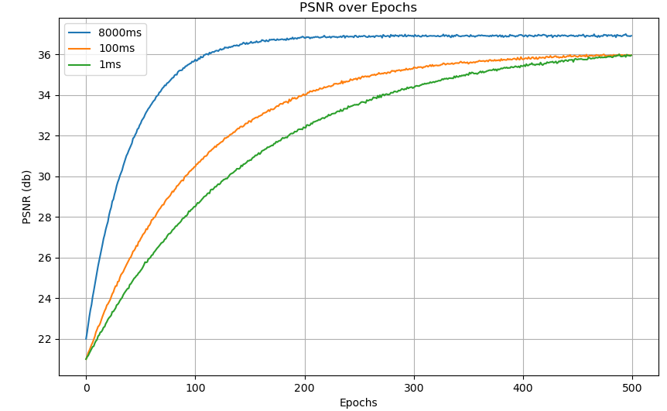
| Near-field Holography image Denoising using Dilated Convolutional Neural Networks | Vahid Rahmani |
Experimental Results and Evaluation
Training and Validation Loss over Epochs
SSIM over Epochs
PSNR over Epochs
Epochs
Epochs
Epochs
14 June 2024 Helmholtz AI Conference 24 - AI for Science Slide 9/12

Slide 10
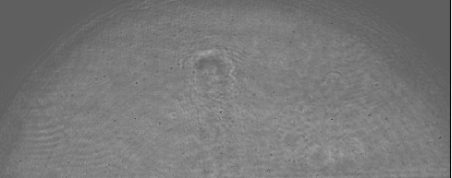
| Near-field Holography image Denoising using Dilated Convolutional Neural Networks | Vahid Rahmani |
Reconstructing results
Raw Image
Flat-field Corrected
$$5μm$$
Denoised Image
Reconstructed
$$5μm$$
14 June 2024 Helmholtz AI Conference 24 - AI for Science Slide 10/12

Slide 11
| Near-field Holography image Denoising using Dilated Convolutional Neural Networks | Vahid Rahmani |
Comparing ML based and non-ML based reconstruction
ML-based reconstructed Image
Non-ML based reconstructed Image
$$5μm$$
$$5μm$$
14 June 2024 Helmholtz AI Conference 24 - AI for Science Slide 11/12

Slide 12
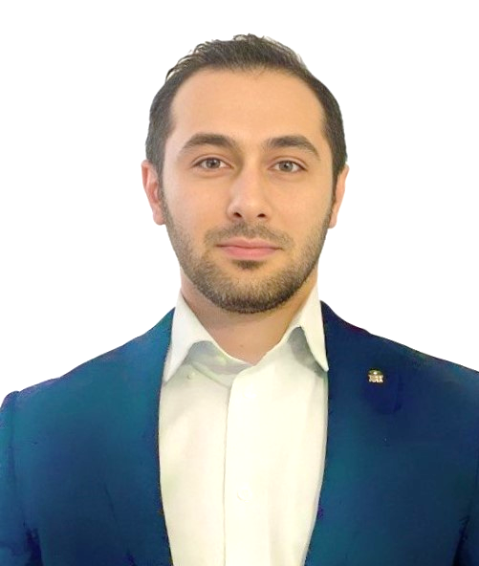
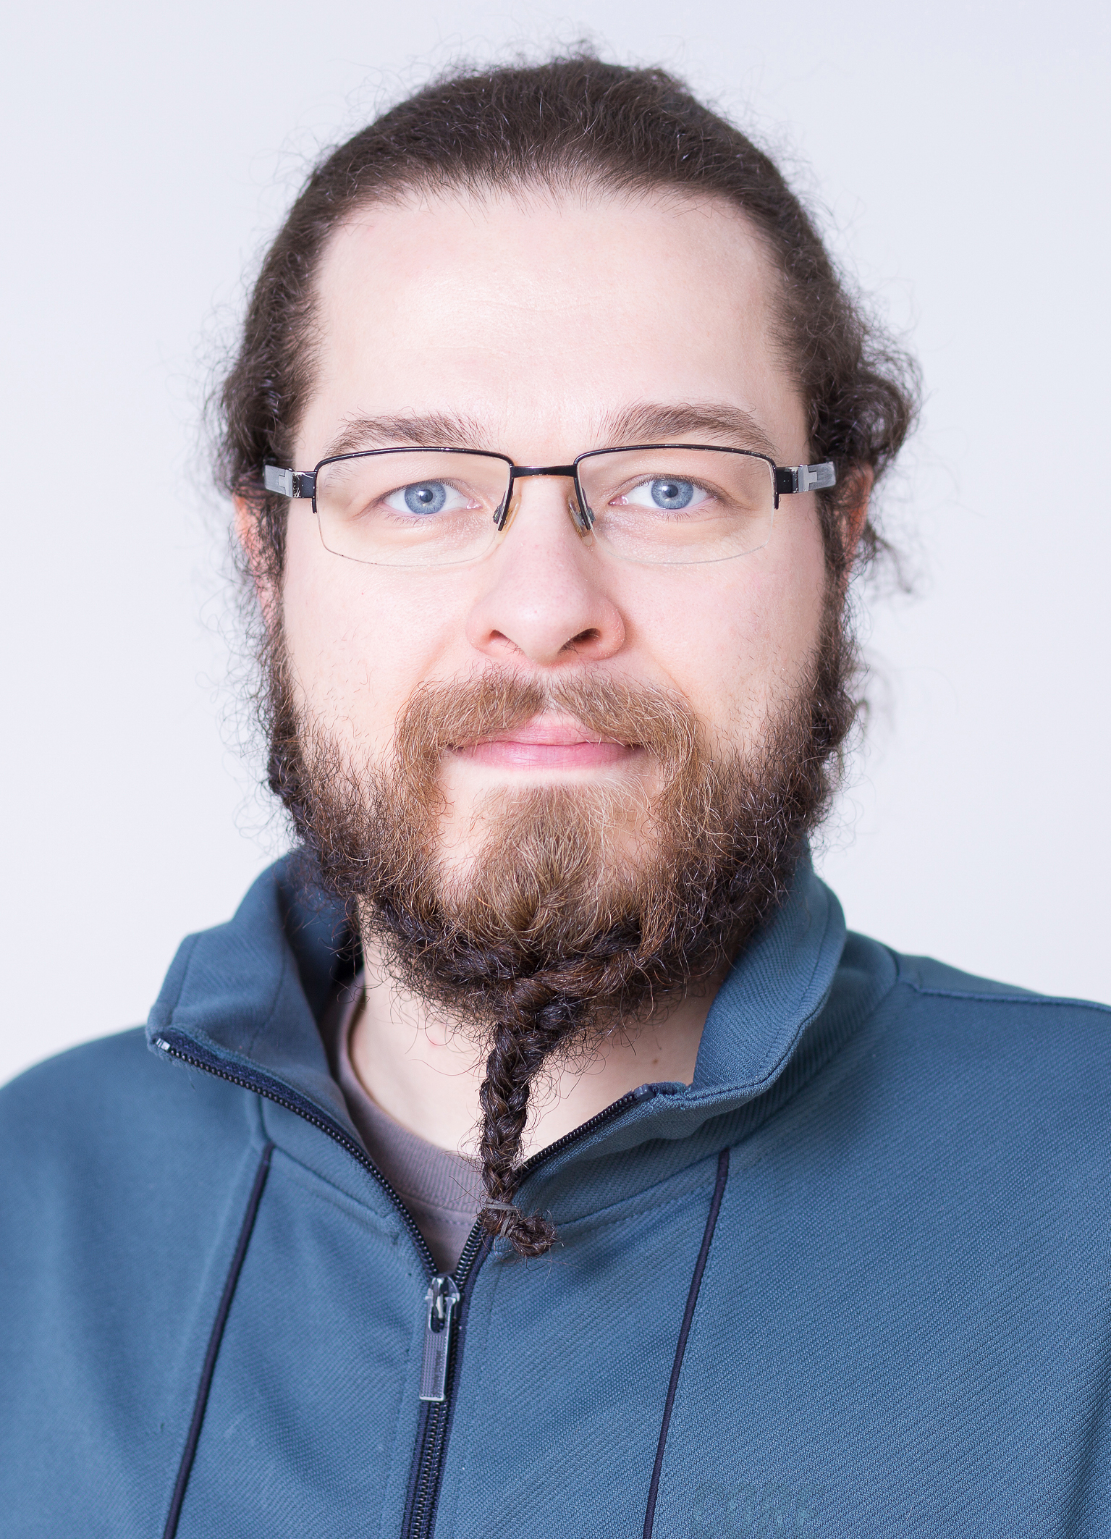
| Near-field Holography image Denoising using Dilated Convolutional Neural Networks | Vahid Rahmani |
Thank you for your attention.
Vahid Rahmani
Vahid.Rahmani@desy.de
Johannes Hagemann
Johannes.hagemann@desy.de
Christian Schroer
Christian.schroer@desy.de
14 June 2024 Helmholtz AI Conference 24 - AI for Science Slide 12/12

