Slide 1
Enhancing clinical immunology through global Swarm Learning
A pioneering approach for ML-based clinical diagnostics
Thursday, 13.06.2024
Stefanie Warnat-Herresthal
Notes:
Good aftenoon everyone,
First of all, thanks a lot to the organizers for the opportunity to present my work at this conference today! My name is Stefanie Warnat-Herresthal and I am from the Systems Medicine department at DZNE in Bonn.
I would like to introduce a project which I find really exciting because I think contributes to the idea of making AI more democtratic, which is also the theme of this conference

Slide 2
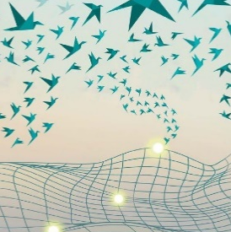
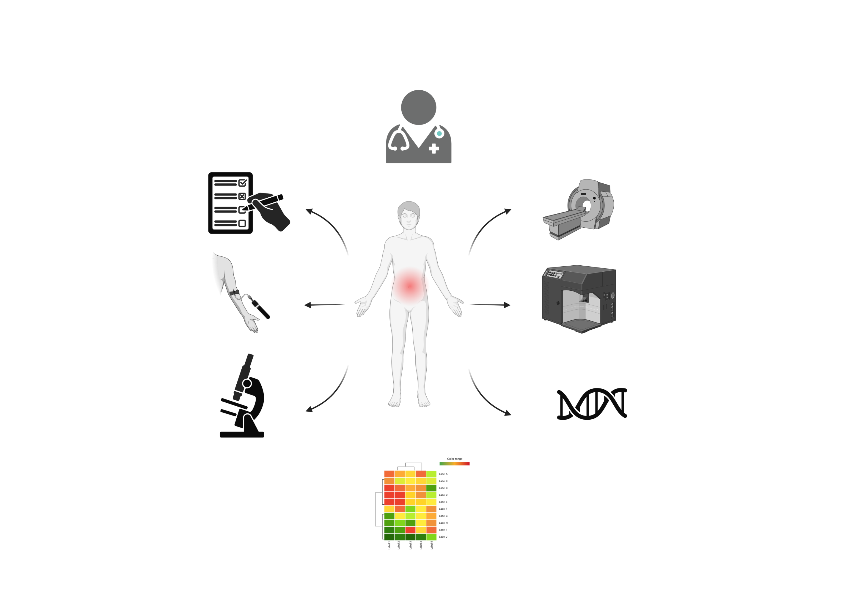

What information can we use to enhance clinical diagnosis?
Notes:
First, I would like to start off with a patient. Imagine you are sick and you are going to the doctor.

Slide 3
What information can we use to enhance clinical diagnosis?
Notes:
The doctor will perform all kinds of tests, such as interviews and also diagnostic tests, to understand what is wrong.
It is like a puzzle to understand your health condition.
Now this puzzle is in the end a data analysis and interpretation task.
However, the question is which data are taken into account to solve this task. It is clear, that with the possibilities of modern molecular biology much more data could be taken into account than what is currently the case
This can lead to better diagnostics, but we need AI tools to help is analyze and interpret these data.

Slide 4
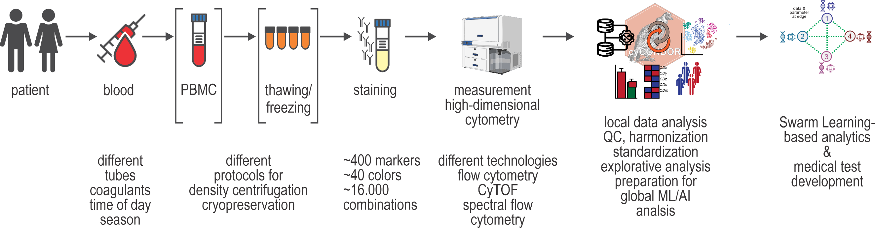
The complexity of global high-dimensional cytometry (HDC)
Many parameters can be varied throughout the entire pipeline
Valuable clinical data is available
Not straightforward to use for machine learning applications
Schultze et al., Nat Rev Immunol, 2022
Notes:
One example of such a data type is High dimensional Cytometry Data. Flow Cytometry and Mass Cytometry are technologies that can characterize cells by measuring a particular set of cellular proteins either by fluoresence coupled antibodies or metal-conjugated antibodies.
The technology is a standard technology in immunological research. However, it is not being used for machine learning applications.
Reason:
Data processing is not standardized (many parameters cann be varied)
Data sharing is not allowed
Data is too big

Slide 5
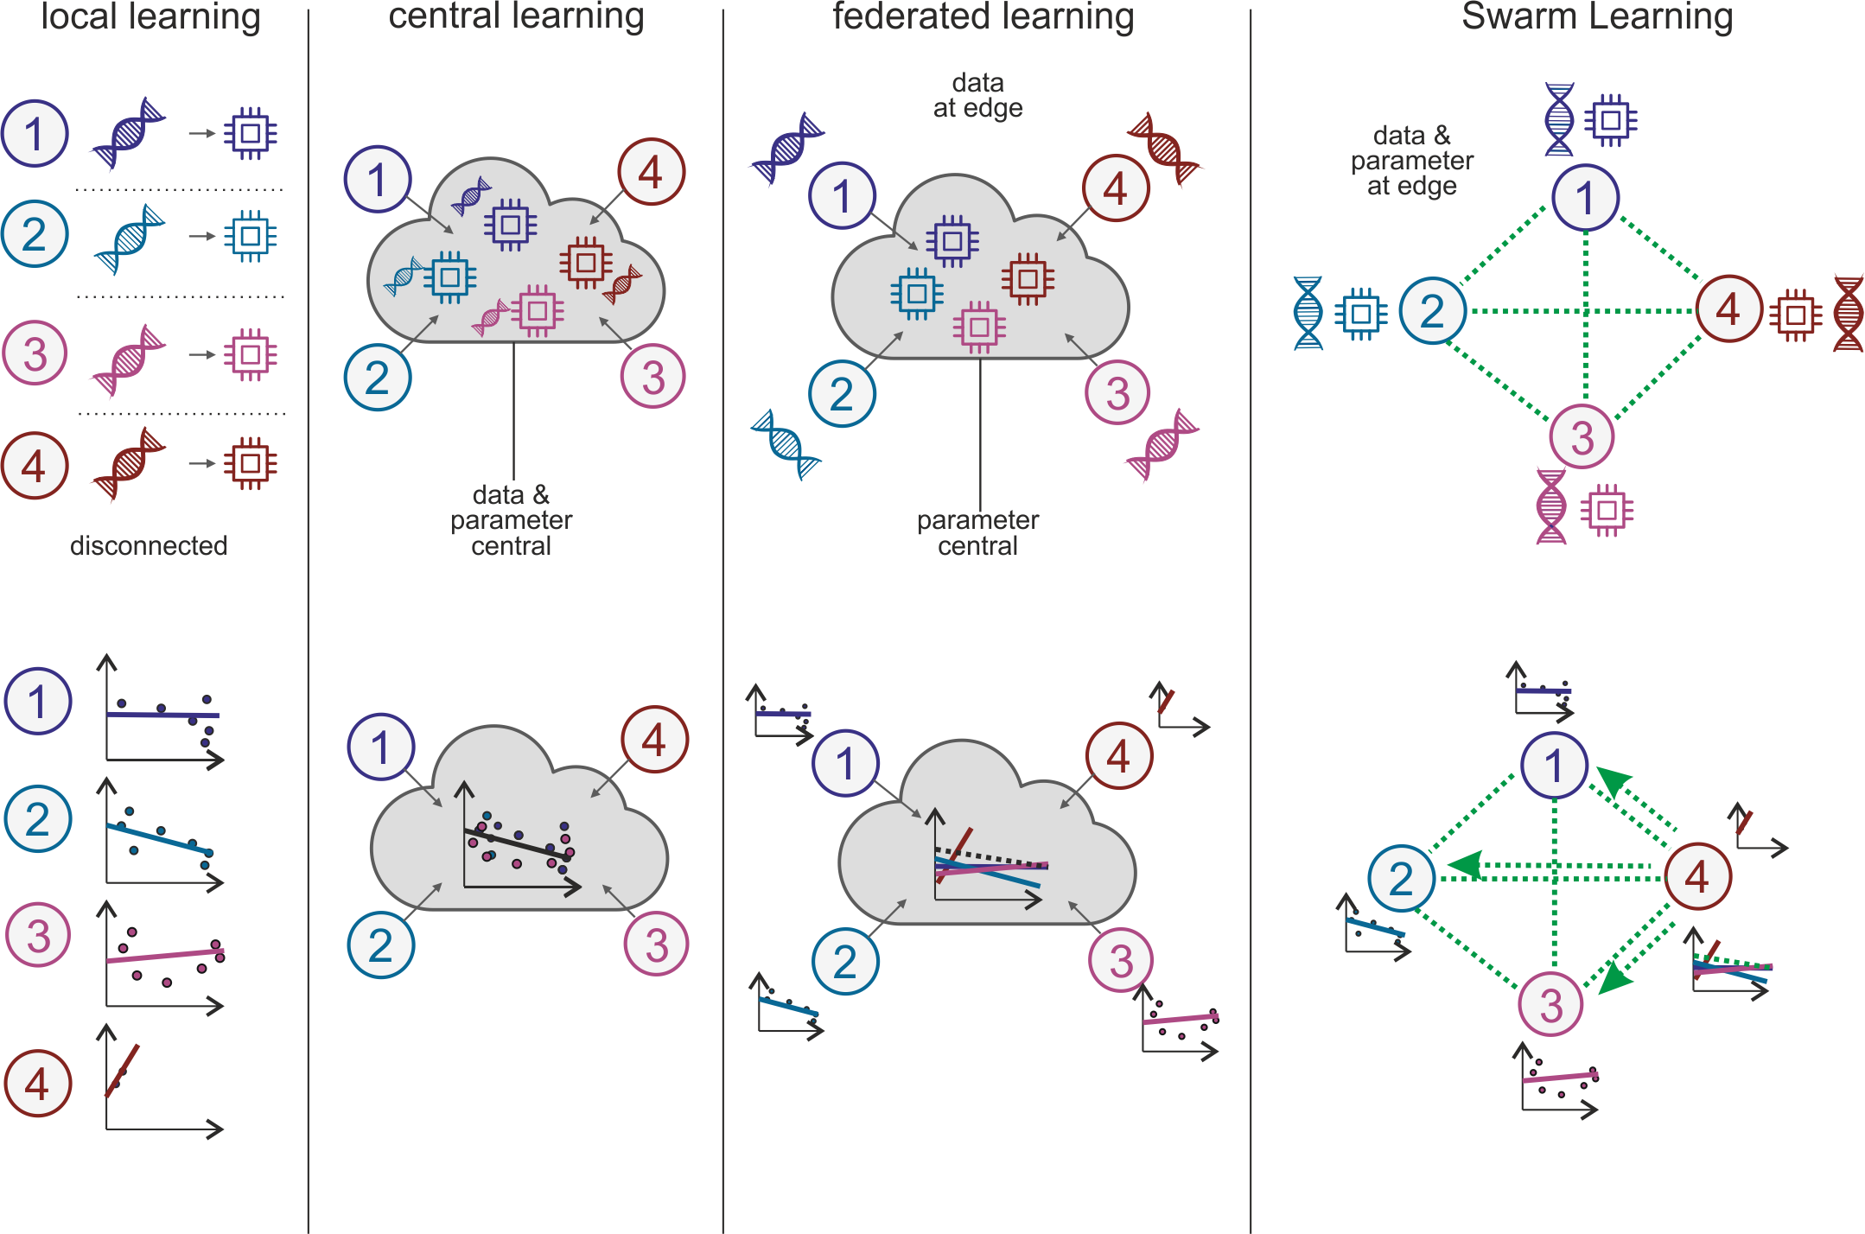
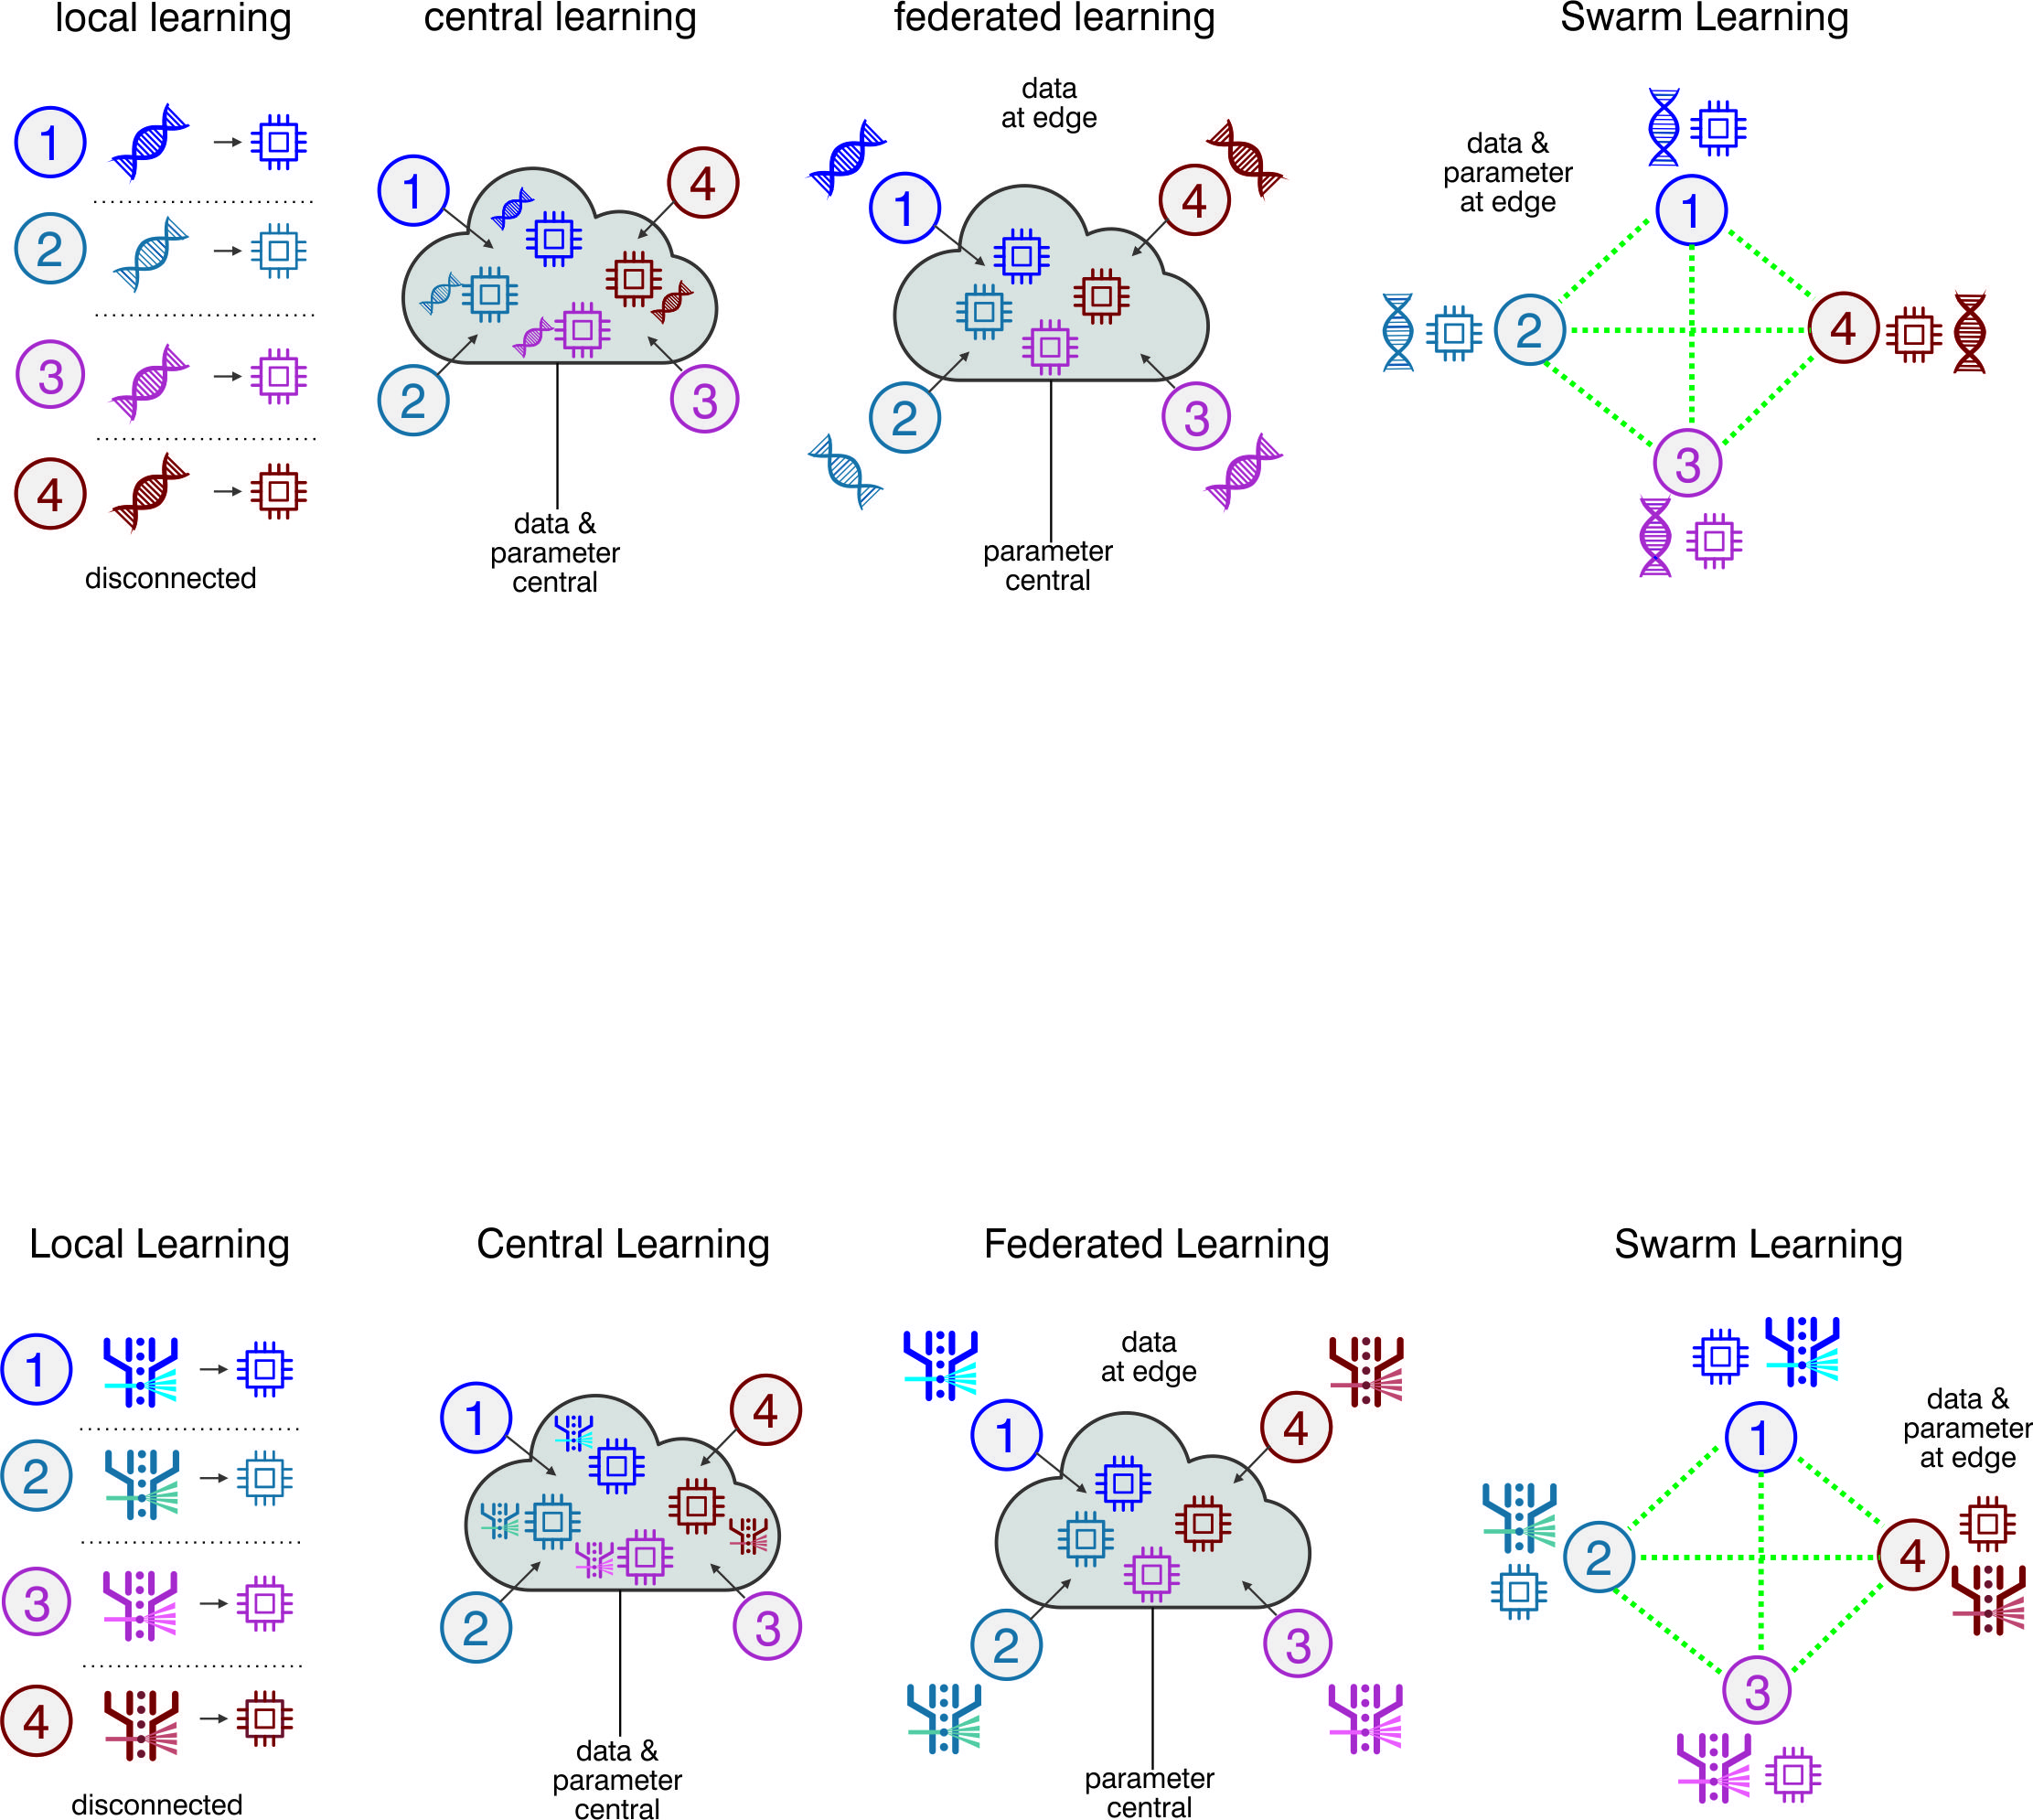


Local learning
Model generalization
Privacy
Decentralization
Warnat-Herresthal et al., Nature 2021
Schultze et al., Nat Rev Immunol, 2022
Schultze, J CME, 2023
Notes:
To briefly give you some background, imagine you have four centers and each train a model on their local data.
Now imagine you are site 4, you simply don‘t have enough data to train a good model which is generalizable.

Slide 6
Central learning
Model generalization
Privacy
Decentralization
Warnat-Herresthal et al., Nature 2021
Schultze et al., Nat Rev Immunol, 2022
Schultze, J CME, 2023
Notes:
One anwer to this is a cloud solution, where data is transferred to the cloud and the model is calculated centrally on all data.
In this case, the central model achieves a good generalization
However, for medical data such as Flow Cytometry data, this is oftentimes not possible. Medical data is highly sensitive and cannot be shipped around.
Furthermore, medical data is inherently decentral, since it is collected across different healthcare institutions that also come with different legislations and data protection rules.
We heared it also in the panel discussion this morning: Data sharing is simply not the way forwars

Slide 7
Federated learning
Model generalization
Privacy
Decentralization
McMahan et al. arXiv 2016
Warnat-Herresthal et al., Nature 2021
Schultze et al., Nat Rev Immunol, 2022
Schultze, J CME, 2023
Notes:
As an alternative to central learning, federated learning has been introduced as a concept by Google in 2016.
It consists of a federation of clients (eg mobile phones), that collectively train a model under the orchestration of a central parameter server.
This means, the partners don‘t need to share their data, but the models are trained locally, and then only the model parameters are shared. The parameters are then merged by a central server, and the updated model is then sent back to the local clients.
This can be problem for two reasons:
The participants have to trust the central instance
The central instance is a likely target for an attack, because all parameters are sent there.which makes it a single point of failure

Slide 8

Swarm learning
Model generalization
Privacy
Decentralization
Warnat-Herresthal et al., Nature 2021
Schultze et al., Nat Rev Immunol, 2022
Schultze, J CME, 2023
Also NVIDIA adopted SL as a way of doing AI
Notes:
Swarm Learning is a framework that overcomes these limitations by being entirely decentralized and we have introduced the concept together with HPE in 2021.
In SL, the participants or „nodes“ are not sending their parameters to a cental instance, but all nodes are connected within a blockchain network.
Swarm Learning is based on equal rights for all members of the swarm. For medicine this is a very critical point in terms of how in the end has control over trained models and their deployment.
- Swarm Learning enhances the security, transparency, and trustworthiness, because a blockchain network comes with so-called „smart contracts“:
Smart contracts are pieces of code that are executed automatically when certain conditions apply.
For a Swarm Network, it can define rules, incentives, and penalties for participants based on their contributions to the model training. This helps automate and enforce the protocol without the need for a central authority and it makes the whole structure more democratic and more independent from monopolies.

Slide 9
Swarm Learning for high-dimensional immunology
Swarm Learning analytics
Experimental Pipeline
Data pre-processing
CyCONDOR
Kroeger et al., Nat Commun, in revision
Schultze et al., Nat Rev Immunol, 2022
Notes:
Now, what we are doing is we are integrating Swarm Learning into a standardized pre-processing pipeline which consists first of a QC pipeline and exporatory analysis, and then train a disease classifier based of Swarm Learning.

Slide 10

A global Swarm Learning Network
Global Swarm Network
DZNE, Bonn, Germany
Charite, Berlin, Germany
MHH Hannover, Germany
HUS, Helsinki, Finland
University Zurich, Switzerland
Cambridge University, UK
Stanford, CA, USA
Mt. Sinai, NY, USA
Broad Institute, Harvard/MIT, MA, USA
IFReC, University of Osaka, Japan
Doherty Institute, Melbourne, Australia
University of Auckland, New Zealand
UKE Hamburg, Germany
UK Giessen, Germany
UK Köln, Germany
UK Saarland, Germany
TUM, Munich, Germany
Helmholtz Munich, Germany
Hamburg
Berlin
Giessen
Saarland
München
Hannover
Helsinki
Cambridge
Boston
Bonn
Stanford
Zurich
New York
Osaka
Melbourne
Auckland
Use Case: Prediction of COVID-19
Notes:
To do this, we are in the process of establishing a global swarm learning network.
Currently, we have already 14 institutions around the globe involved, and the network is growing.

Slide 11

Data harmonization aka
“How to apply ML to data that you don’t see?”
The Swarm Hub
laminDB
metadata
metadata
Local database
Local database
Local .fcs files
Local .fcs files
Synonym matching of marker names
Matching of metadata information to public databases
Notes:
Technically, we are working with local databases, in which the sites ingest their data to.
These are so-called lamin databases. Lamindb is an open source database infrastucture which is really tailored to biology and if you also have biological data, I can recommend to check them out.
What happens is basically a data curation step where synonyms are matched and metadata is curated.

Slide 12
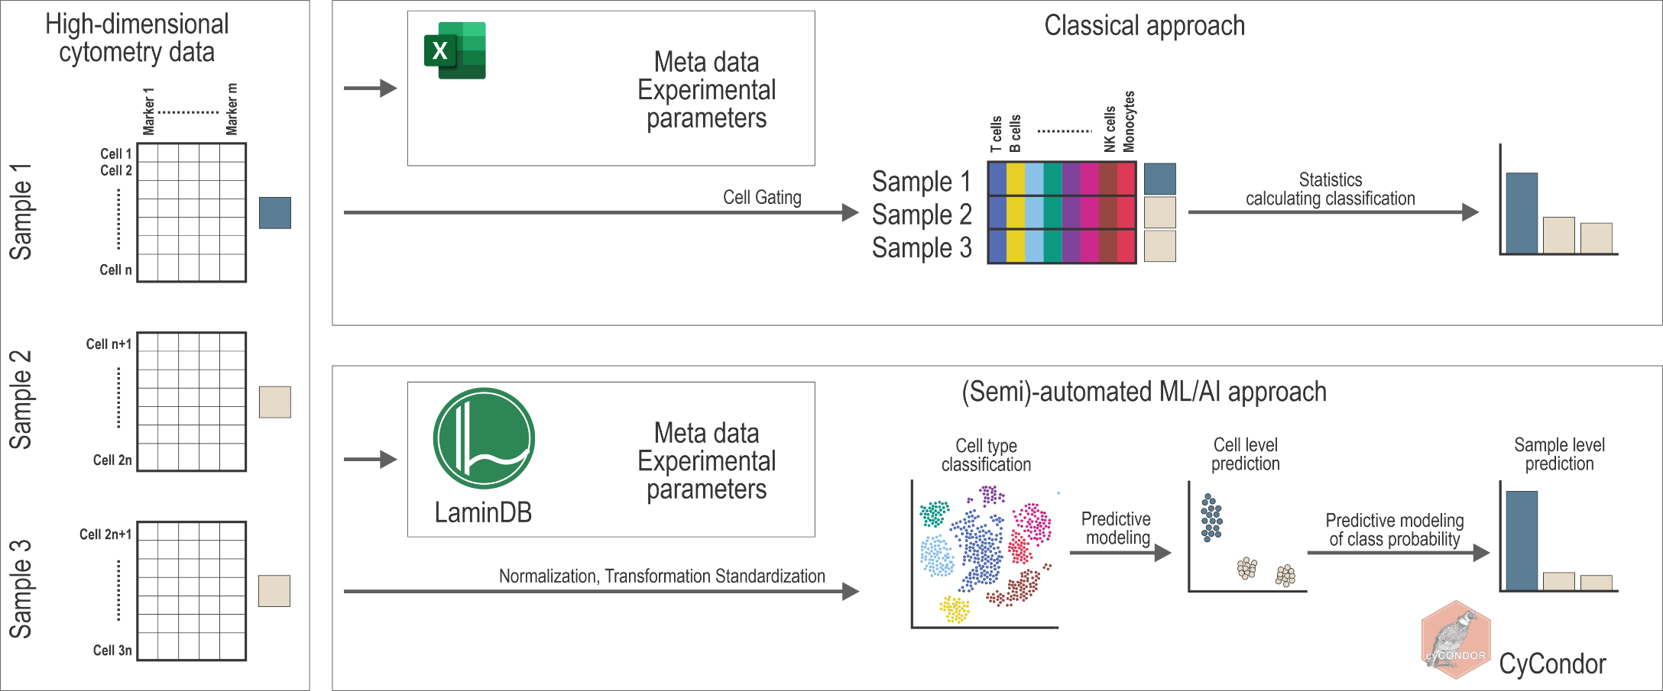

Next generation HDC application
From manual gating and complex group comparisons to fully automated local machine learning for disease detection
Schultze et al., Nat Rev Immunol, 2022
Notes:
So, instead of doing manual metadata annotation, gating and prediction based on celltype frequency, we are aiming for a more automated approach where cell-level prediction is diectly done based on the paramters that are shared within the network.

Slide 13
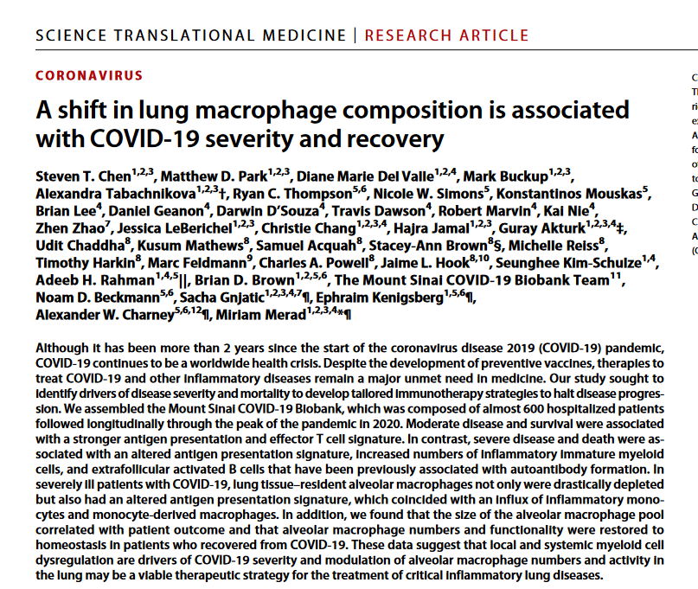
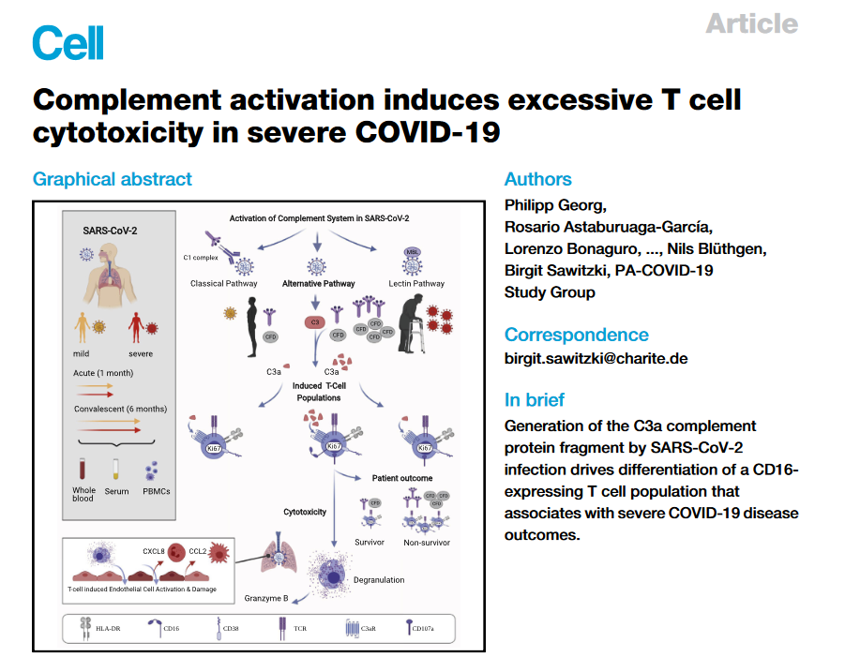
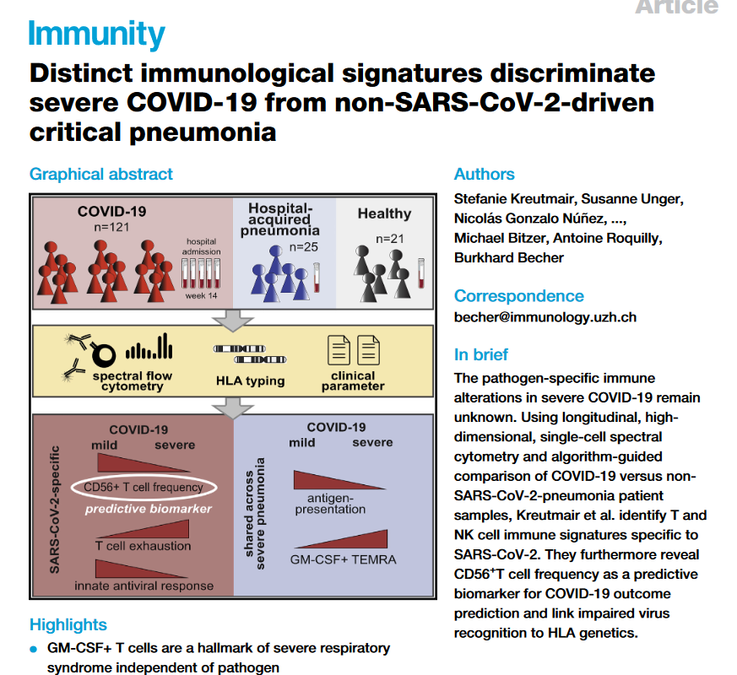
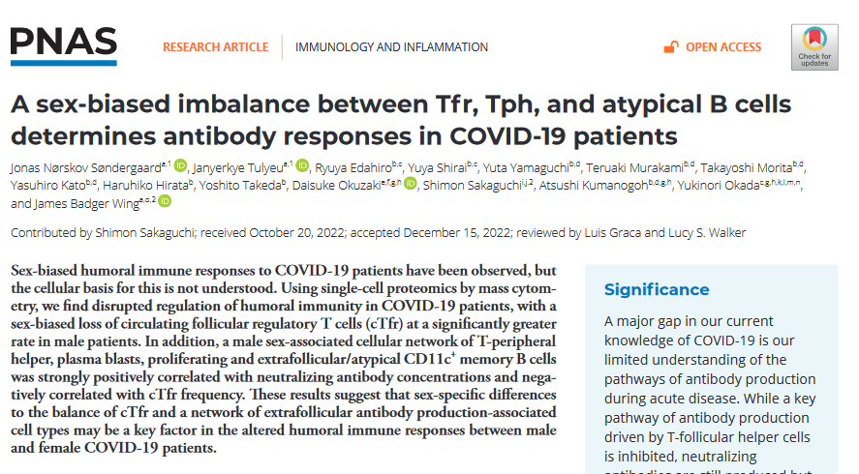
Use case: Prediction of (severe) COVID-19
Can a meaningful clinical prediction be done across hospitals, cities, continents, technologies, panels?
Notes:
As a use case we are predicting COVID-19.
The pandemic has led to the situation that data on the same disease has been collected and analyzed throughout the world in different labs and this serves as a unique opportunity for us to understand whether we can make a clinically meaningful prediction across hospitals, cities, technologes and panels.

Slide 14





The Global Swarm is diverse
Type of
Samples
Technologies
& Instruments
Panels
Disease
conditions
Sample
Numbers per
nide
Notes:
Now, what is the data situation in terms ogf sample types, technologies, panels, diesease conditions and sample numbers?

Slide 15
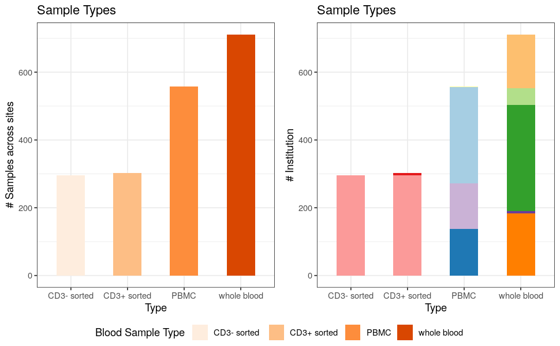
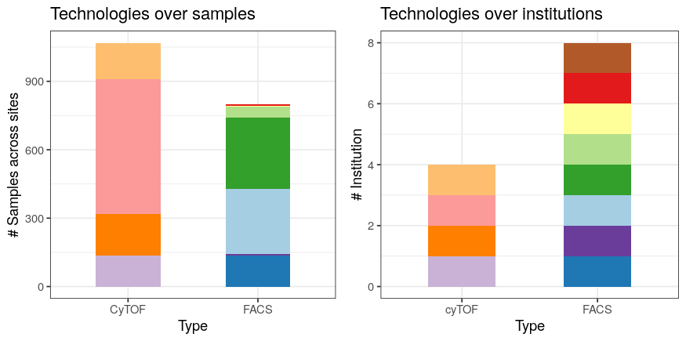
The Global Swarm is diverse
Technologies
& Instruments
Type of
Samples
Notes:
We are having diverse set of samle types and technologies.
ON left hand site you can see we have different kinds of blood sampling protiocols, and on the right hand side different kinds of high-dimensional cytometry technologies being used.

Slide 16

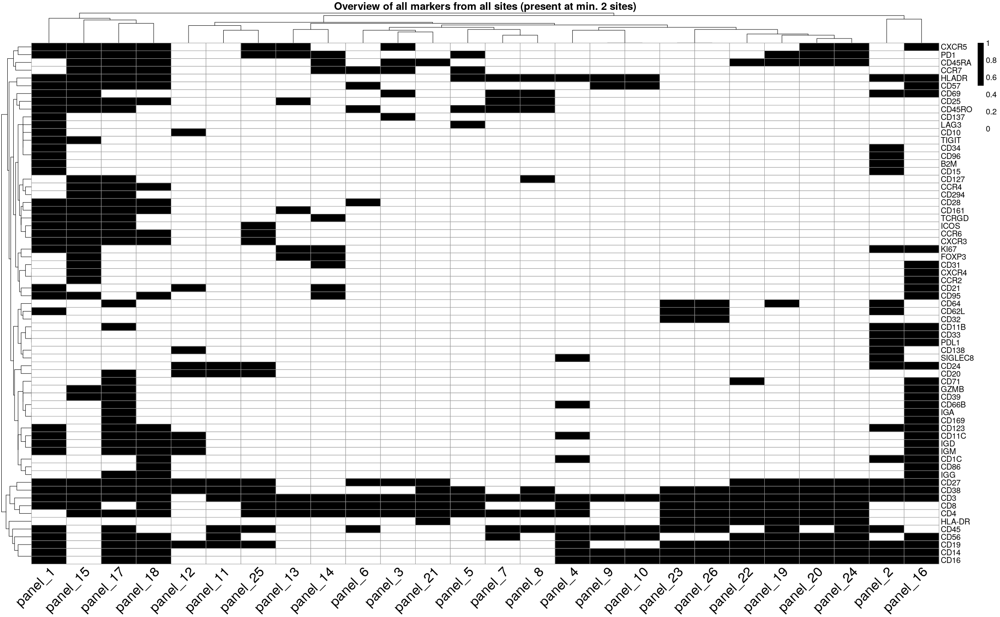
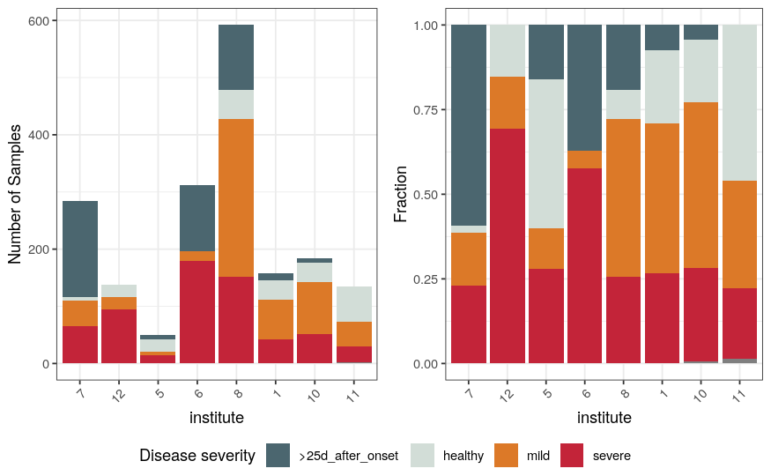
Diversity of panels, sample numbers and disease conditions
Panels
Sample
Numbers
Disease
conditions
Notes:
In terms of features, we have really little overlap. The black splots are overlapping markers across sites.
Also sample numbers are quite diverse between sites.
We therefore are starting at the moment with nodes that have a large overlap in features

Slide 17
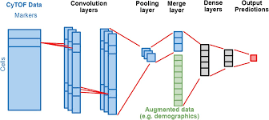
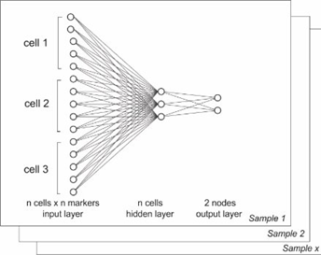

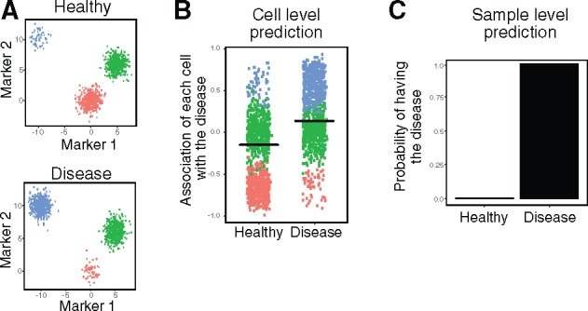
More details on the models used
Convolutional Neural Network
Feedforward Neural Network
Hu et al. 2020
Linear Models
Poster 02 - 47
Ivan Savchuk
Hu et al. 2019
Notes:
If you want to learn more about the models and first experiment runs, you can go and visit the poster of Ivan Savchuk.

Slide 18

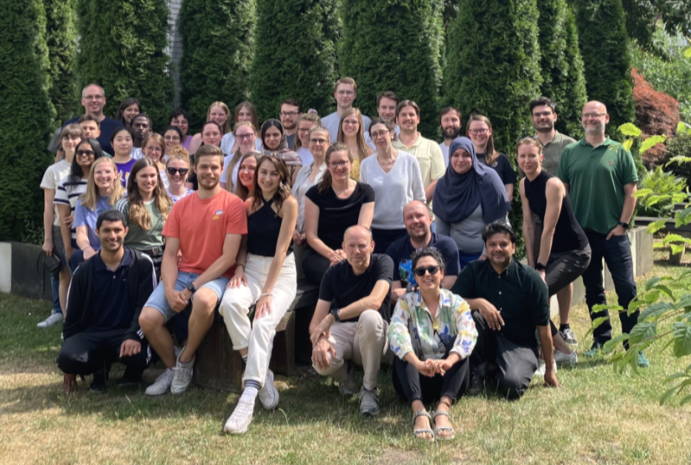




Thank you!
The Global Swarm Learning Network
University of Helsinki
Kimmo Porkka
Eliisa Kekäläinen
Universität Zurich
Burkhard Becher
Stefanie Kreutmair
MIT / Broad Institute
Alex K. Shalek
Jose Ordovas-Montanes
Kyle Kimler
Ying Tang (Tia)
MHH Hannover
Christine Falk
Evgeny Chichelnitskiy
IFReC Osaka
Daron Standley
James Wing
Charité I
Leif Eric Sander
William Hirst
David Hillus
Charité II
Birgit Sawitzki
Lev Petrov
University of Melbourne
Katherine Kedzierska
Hayley McQuilten
University of Stanford
Bali Pulendran
Zhuoqing Fang
Dmitri Kazmin
University of Cambridge
Ken Smith
Paul Lyons
University of Auckland
Anna Brooks
Universität des Saarlandes
Martina Sester
Lamin Labs
Alex Wolf
Sunny Sun
DZNE Bonn Swarm Learning Team
Stefanie Warnat-Herresthal
Lorenzo Bonaguro
Hartmut Schultze
Ivan Savchuk
Maren Büttner
Anna Aschenbrenner
Jonas Schulte-Schrepping
Luisa Schäfer
Martina van Uelft
Matthias Becker
Omid Shirvani
Tal Pecht
Thomas Ulas
Arnab Bandyopadhyay
Lucas Secchim Ribiero
Joachim Schultze
Notes:
This work is being done by a large Swarm Learning Team in Bonn
And I would like to thank all cooperation partners around the globe

