Slide 1
FastGPR: divide-and-conquer technique in neuroimaging data shortens training time and improves accuracy
13.06.2024 | Federico raimondo

Slide 2
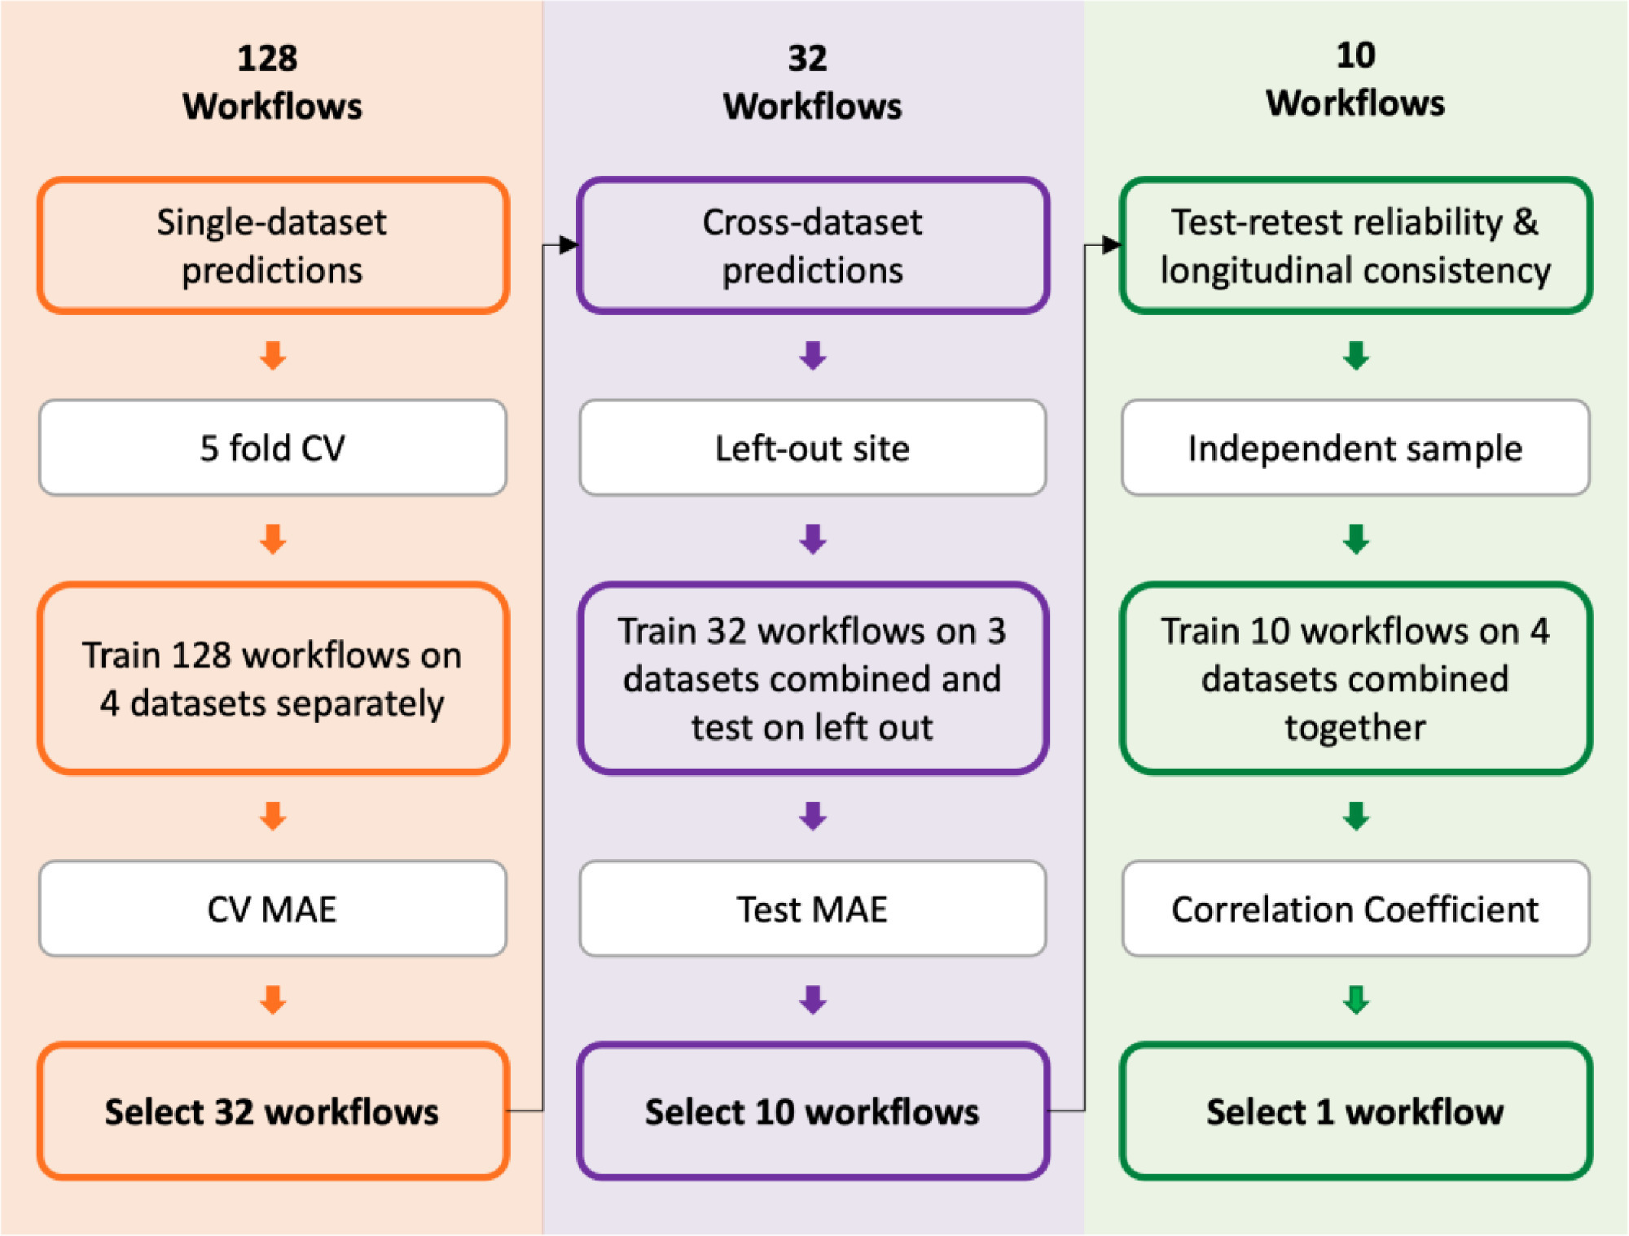
Ex: Brain-age prediction: A systematic comparison of machine learning workflows
More et al., Neuroimage 2023.
Experimental Setup
Brain-age prediction:
ML to predict age from brain imaging
Accuracy: ~5 to 8 years
Delta between brain-age and age -> proxy for atypical aging
Missing:
Test-retest evaluation
Cross-dataset evaluation
How choices affect results
128 Workflows:
8 different ML algorithms
16 Feature Spaces
f.raimondo@fz-juelich.de

Slide 3
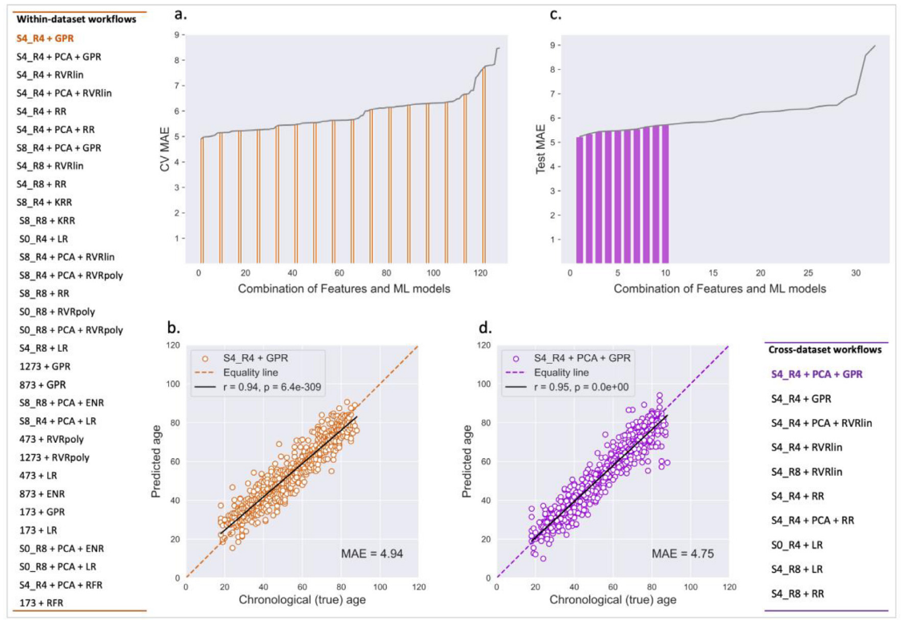
Ex: Brain-age prediction: A systematic comparison of machine learning workflows
More et al., Neuroimage 2023.
Experimental Setup
# Samples (4 datasets) = 2.953
# Features:
R4: 29.852
R8: 3.747
f.raimondo@fz-juelich.de

Slide 4
GPR: Gaussian process regression
Flexible framework for modelling complex non-linear relationships
Interpolates observations
Shape of the function is defined by a kernel
Which defines “similarity” between samples (similar samples -> similar target values)
Training a GP model requires to:
Compute all the parwise “similarities”.
Invert a covariance matrix: $𝒪(n^{3}$) where $n$ is the number of samples
$𝒪(n^{3}$) is a scalability issue!
More et al: 2.953
UKBiobank: ~40.000

Slide 5
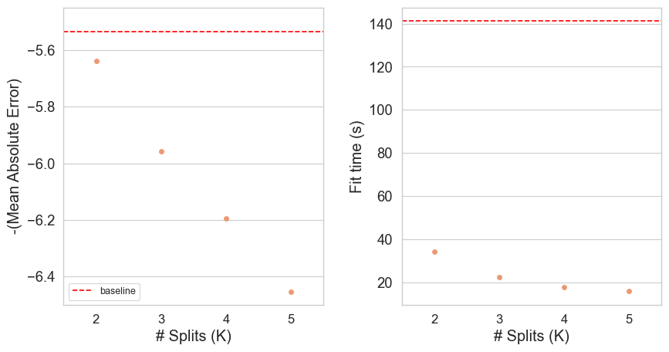
FastGPR: divide and conquer
Prediction Performance
Computational Cost
Algorithm:
Split the data into K partitions
Train K GPR models
Average the K predictions
Training data
No-split
2-splits
3-splits
4-splits
5-splits

Slide 6
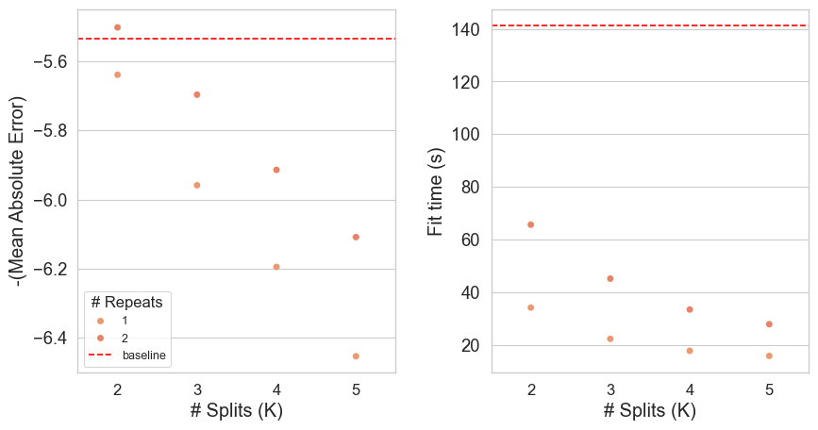
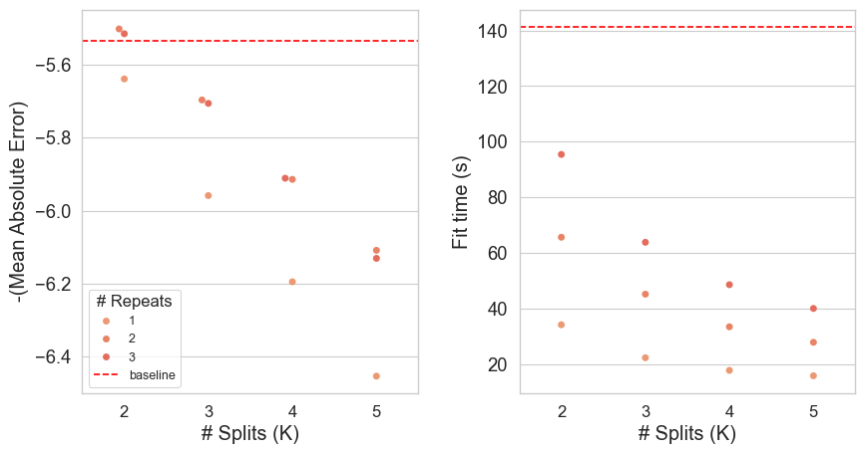
FastGPR: divide and conquer
Prediction Performance
Computational Cost
Algorithm:
Split the data into K partitions
Train K GPR models
Average the KxR predictions
Shuffle and repeat
Training data
No-split
2-splits
3-splits
4-splits
5-splits

Slide 7
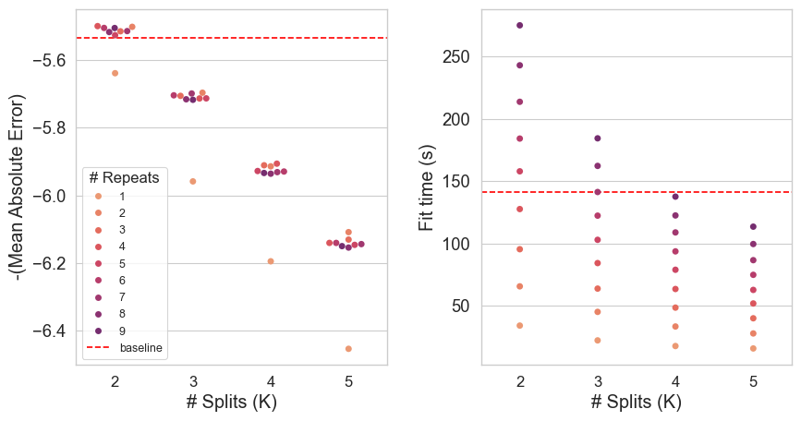
FastGPR: divide and conquer
Prediction Performance
Computational Cost
Algorithm:
Split the data into K partitions
Train K GPR models
Average the KxR predictions
Shuffle and repeat
Training data
No-split
2-splits
3-splits
4-splits
5-splits
Best-case: 2x2 splits

Slide 8
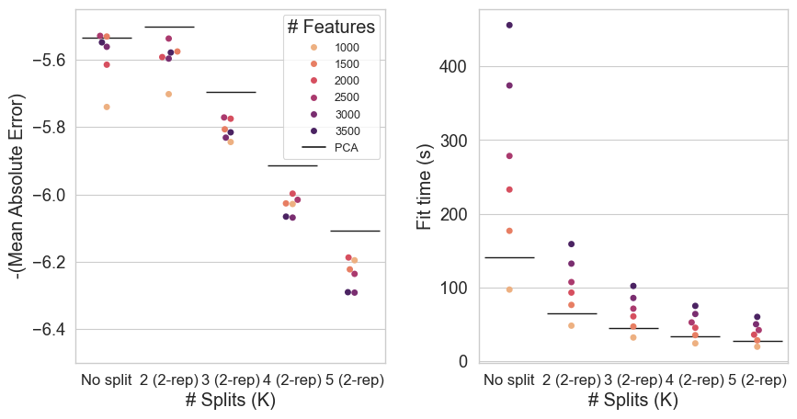
FastGPR: Effect of #Features
Prediction Performance
Computational Cost
But:
# Features is constant
PCA on 3.747 -> ~2.350
With splitting, the # Samples vs # Features ratio changes!
Training data
No-split
2-splits
3-splits
4-splits
5-splits
Best-case for our scenario: 2x2 splits

Slide 9
FASTGPR: Conlusions
Divide-and-conquer approach works
Reduces signficantly the computation time
Enables use of GPR in large datasets (>10.000 samples)
Best-case depends on the application (# Features, Samples)
Need to be evaluated
Based on the computing capacity
Code: https://github.com/juaml/gp_train_opt
Publication: waiting for the publisher
G. Antonopoulos
S. Eickhoff
K. R. Patil
https://juaml.github.io/julearn

