Slide 1
Federated Continual Learning Goes Online
HAICON2024 – Social and Ethical Dimensions of AI
Poster Spotlight Talk
Giuseppe Serra – Postdoc @ MLO Lab (Goethe Uni)
Florian Buettner – Principal Investigator @ MLO Lab (Goethe Uni, DKFZ)
June 12, 2024

Slide 3
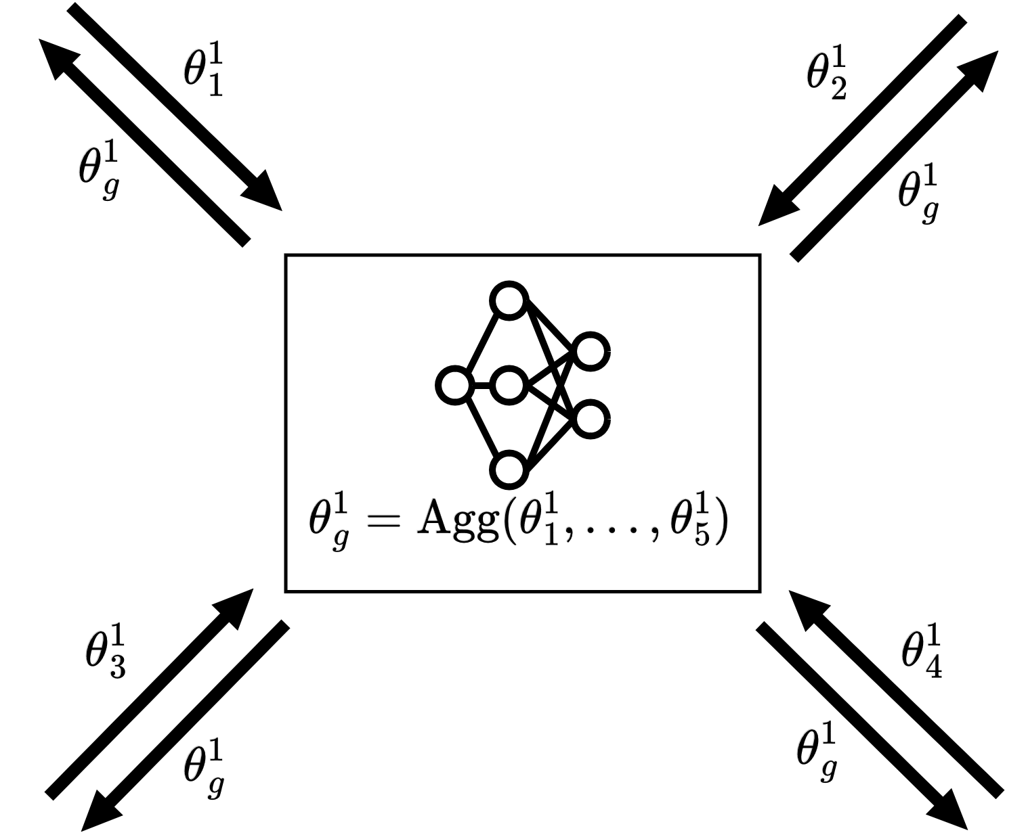
Federated Learning (FL) enables decentralised clients to learn a global model via data-private collaborative training in a static single-task scenario.

Slide 4
In reality, new tasks/classes (e.g., new virus variants) may arise over time in a collaborative framework with sensitive data.
→ Federated Continual Learning to model more realistic and dynamic scenarios.
Catastrophic forgetting (CF): predictive model is prone to suffer from significant performance degradation on older tasks.

Slide 5
General research trend in the literature
Generative-based solutions (computationally expensive, abundance of data required).
Task datasets stored locally and used multiple times (static datasets, large data storage needed).
Architectures specifically tailored for vision tasks.

Slide 6
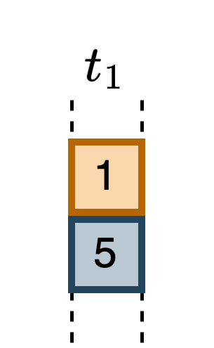
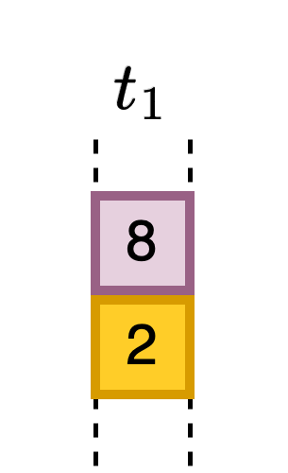
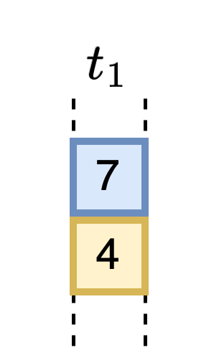
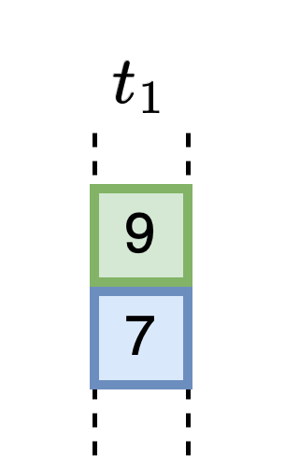
Online: data arrive gradually as a stream of mini-batches that can be processed only once (beneficial on edge devices).
Modality-agnostic: input data can be different than images.
Privacy-preserving: only model parameters are shared.

Slide 7
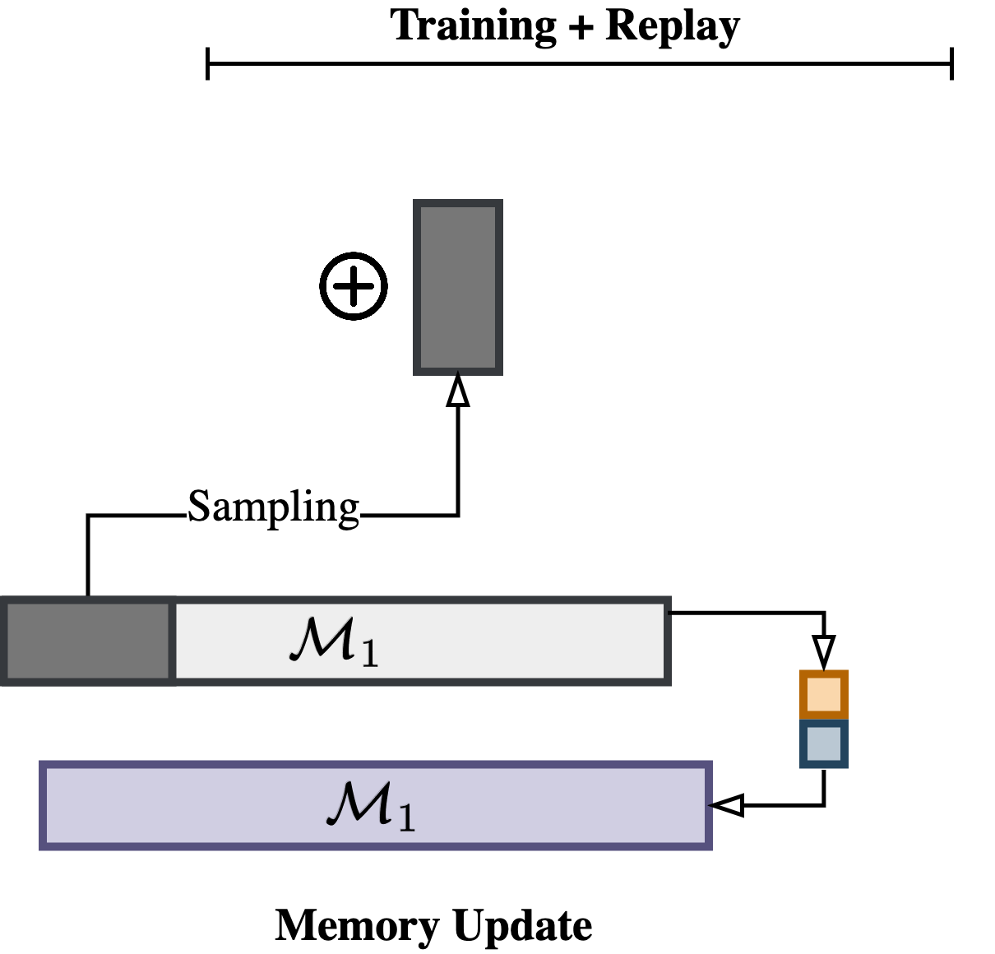
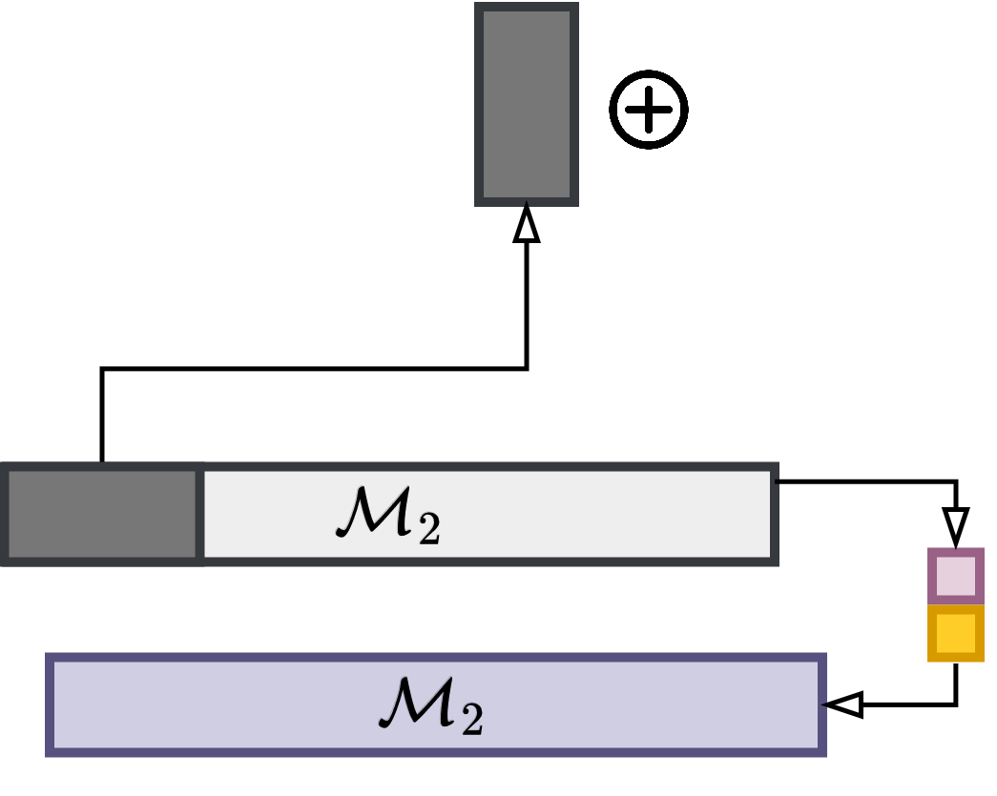
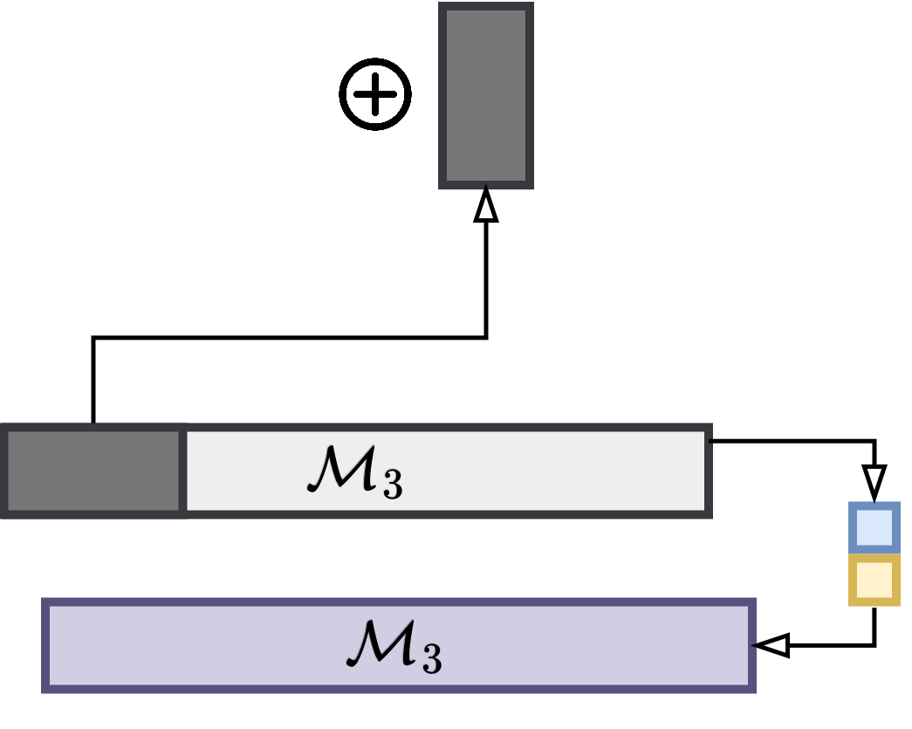
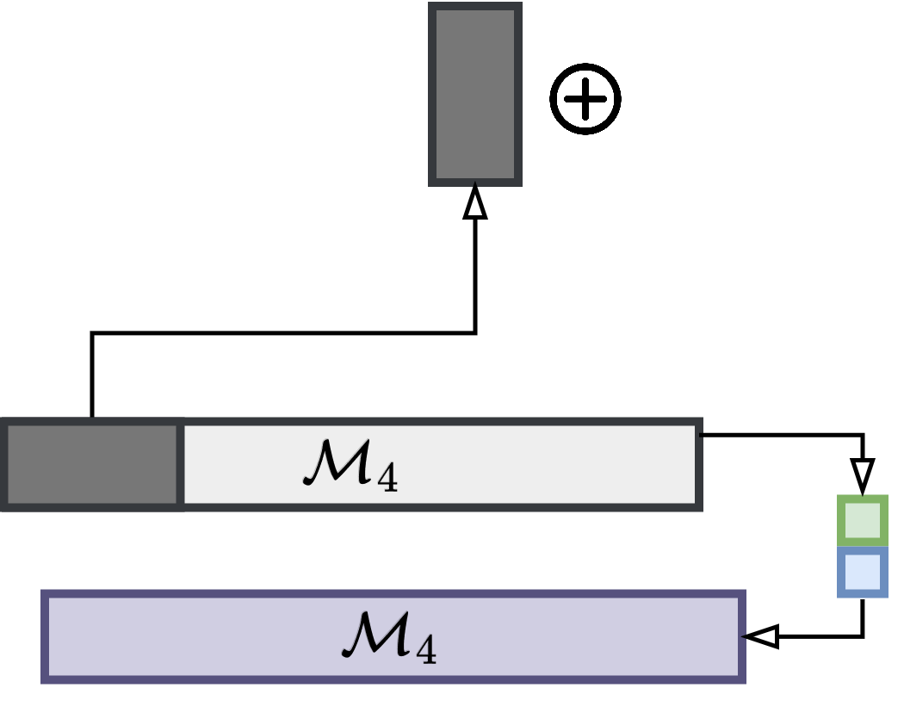
Two main ingredients for the episodic memory:
Limited fixed-size memory buffer to save seen data instances.
Small replay dataset sampled from the memory for retraining.
RQ1: How to populate the memory with meaningful samples?

Slide 8
→ Predictive uncertainty provides an idea of the samples’ location in the decision space.
RQ2: Are samples with high uncertainty or low uncertainty more effective in
combating catastrophic forgetting?

